Slide 1
Mechanics of Materials Engr 350 - Lecture 14 - Stress Transformation
"Do not forget what you have learned of our past, Rodimus. From its lessons the future is forged."
Optimus Prime
Correction: Rodimus is not the brother of Optimus. Rodimus was former leader of autobots.
Similarly, President Trump is not the brother of President Obama.

Slide 2
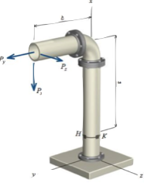
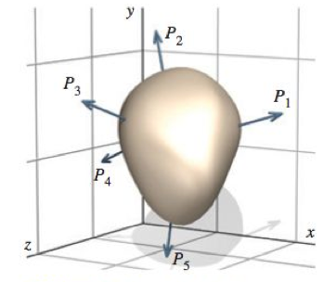
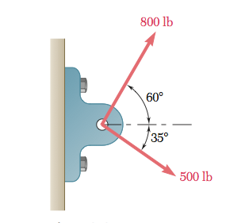
Stresses in an arbitrarily loaded body
It is easy to define stress in simple body/loading
In members/components with complex shape, internal force distribution will not be simple
Consider a body with a general shape and general loading
We can cut this member and represent the multiple loads as a shear force and a normal force (single force with three components - See next slide

Slide 3
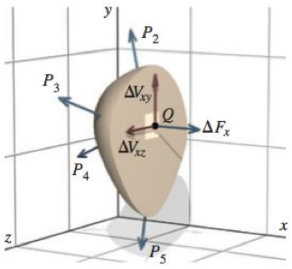
Resultant force
The components of the resultant force are a normal force and the two components of the shear force.
The first and second subscripts describe the face and direction of the applied stress respectively.

Slide 4
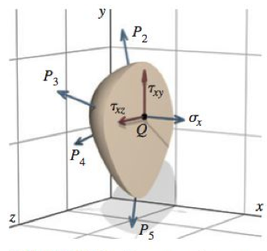
Stresses
We will analyze the forces on a very small area of the cut face, 𝛥A.
If we divide the force by this area, then in the limit as the area goes to zero, we obtain the stress at a point.
Stresses follow the same subscript convention

Slide 5
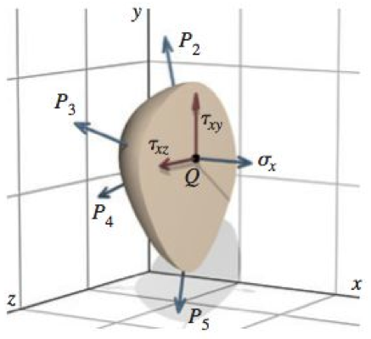
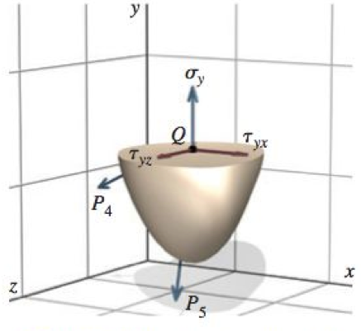
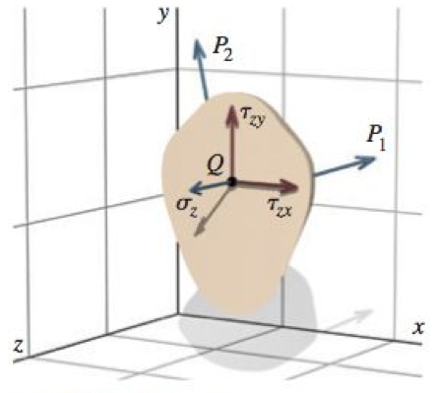
State of stress
Imagine that we cut the arbitrary body on three planes, each parallel to one of the coordinate axes
Now consider the same point (point Q)
We find that each face has three stress components

Slide 6
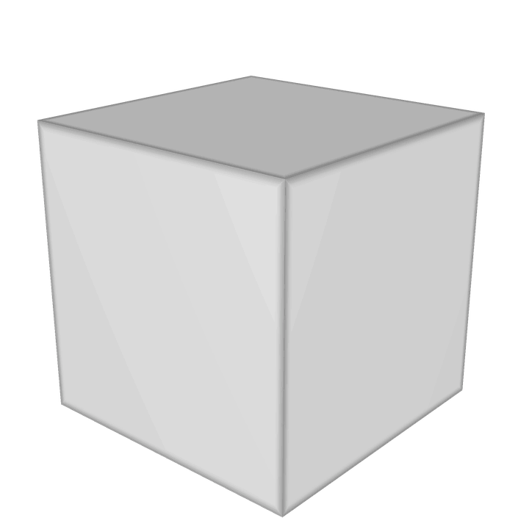
Representing stresses on an element
We use an infinitesimally small element to represent the “state of stress” at the point Q (or any point in the body)

Slide 7
Sign conventions
Normal stresses
Tension
Compression
Shear stresses
Positive if
Acts on positive face in positive direction
Acts on negative face in negative direction
Negative if
Acts on positive face in negative direction
Acts on negative face in positive direction

Slide 8
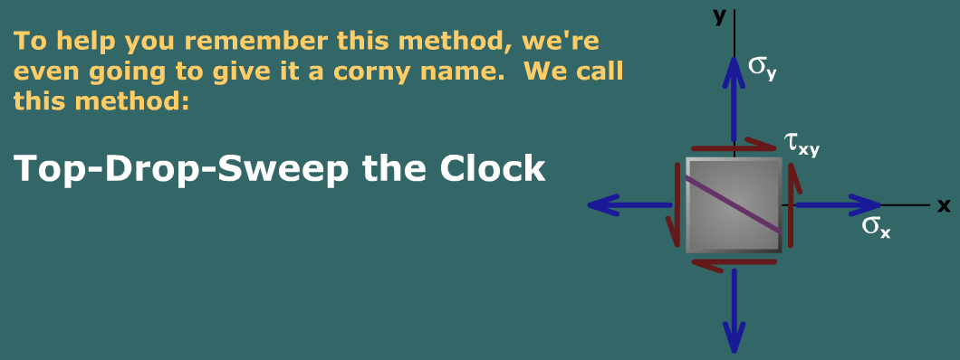
Finding θ on Angled Stress Element Surfaces
MM Module M12.2

Slide 9
Extra Study Materials
Because we just skipped chapters 6-11, there are some things used in textbook examples that you don’t know about yet (bending stresses, torsion, beam theory). There are also some of the homework problems in the textbook you won’t be able to solve. Here are some resources that should be helpful to study with:
MM Module M12.1 – Amazing Stress Camera
M12.2 – Finding correct angle
M12.3 – Finding correct sign
M12,4 – Practice finding Principle Stresses (orientation with no shear stress)

