Slide 1
Mechanics of Materials Engr 350 - Lecture 15 Stress Transformation 2
Transformation does not happen by learning new information. It happens when you change how you view and react to other people, events and things around you.
-Med Jones
Totally False

Slide 2
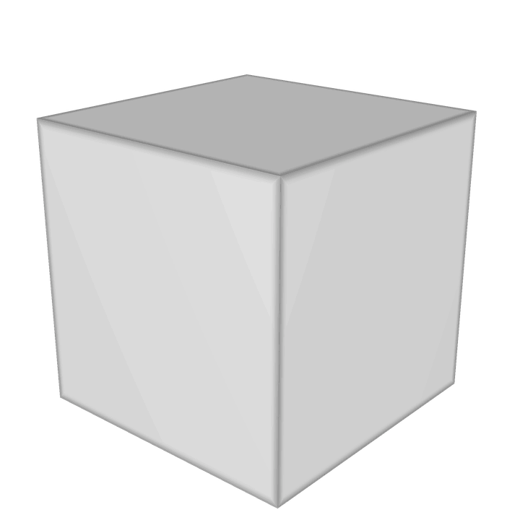
Equilibrium of the stress element
As mentioned before, if a body is in equilibrium, any portion of that body must be in equilibrium
From the preceding discussion we find that if a shear stress exists on any plane, there must also be a shear stress of the same magnitude acting on an orthogonal plane (perpendicular plane).

Slide 3
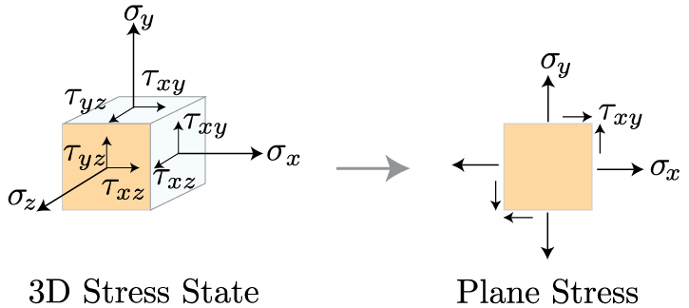
3D Stress Element and Plane Stress
Many loading and geometry combinations will result in stress states in three-dimensions. However, while learning the basics we can simplify a 3D stress state in to one called “Plane Stress”
Consider a stress element where two of the parallel faces are free of stress
σ_{z} = 0, τ_{zx} = 0, and τ_{zy} = 0
This also means that τ_{xz} = 0, and τ_{yz} = 0

Slide 4
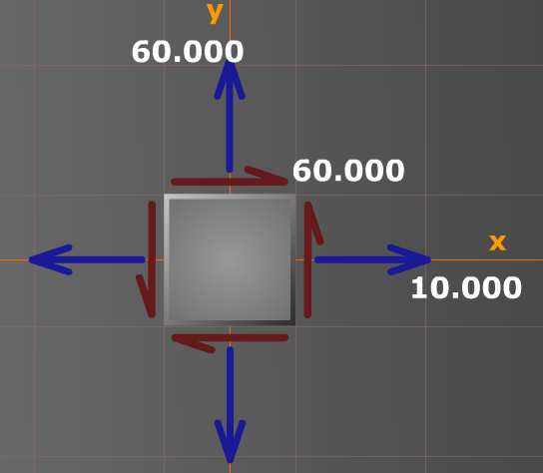
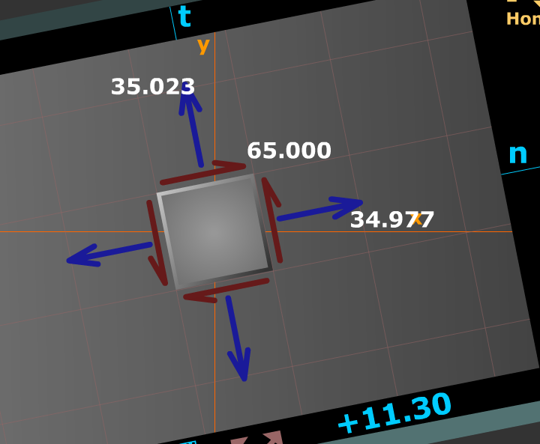
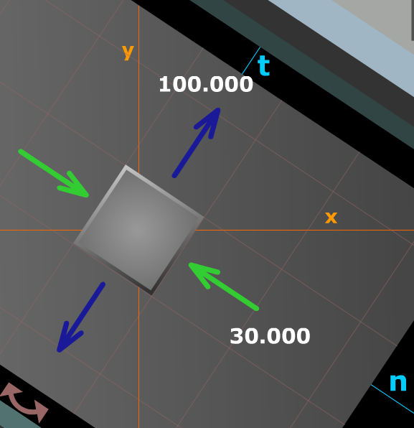
Stress transformation
Recall that stress is not simply a vector, its magnitude depends on the face it acts on (remember stress on inclined plane?)
Similarly, the state of stress at a point is constant, but depending on the coordinate system (axes) we choose, it is represented differently
All three stress states below are the same!

Slide 5
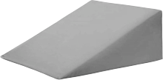
Equilibrium method for plane stress transformations
One technique is to use vector addition
Use equilibrium to determine stresses on inclined faces
We will consider plane stress cases
Must consider magnitude, direction, and area
Example, find stress on inclined plane when
𝜎x=16 and 𝜎x=10
What is θ? (Top, drop, sweep the clock)
What are the forces on each surface?
16 MPa
σ_{n} * dA
(10 MPa) * dA*cos(θ)
10 MPa
τ_{nt} * dA
32.7°
(16 MPa) * dA*sin(θ)

Slide 6
Equilibrium method for plane stress transformations
Example, find stress on inclined plane when
𝜎x=16 and 𝜎x=10
$\sum{F_{n}=σ_{n}dA−}(10MPa)(dA\cos{θ)cosθ−(16MPa)(dA sinθ})sinθ=0$
$σ_{n}=11.75 MPa$
$\sum{F_{t}=τ_{nt}dA+}(10MPa)(dA\sin{θ)cosθ−(16MPa)(dA cosθ})sinθ=0$
$τ_{nt}=2.73 MPa$
σ_{n} * dA
(10 MPa) * dA*cos(θ)
τ_{nt} * dA
(16 MPa) * dA*sin(θ)

Slide 7
General Equations for Plane Stress Transformation
In the previous example of Plane Stress, we actually had a Principle Stress orientation (no shear stress on the x or y faces).
The general equation accommodates shear stress as well.
Orientation: θ must follow the top, drop, sweep the clock
Counter-clockwise: Positive
Clockwise: Negative
Same as any right-hand-rule system (sweep from x to y)
$σ_{n}= σ_{x}\cos^{2}θ+σ_{y}\sin^{2}θ+2τ_{xy}sinθcosθ$
$τ_{nt}= {−(σ}_{x}−σ_{y})sinθcosθ+τ_{xy}(\cos^{2}θ−\sin^{2}θ)$

Slide 8
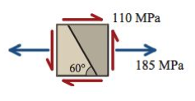
Practice Problem
Using the equilibrium approach, determine the normal and shear stresses on the inclined plane shown
What is θ? (Top, drop, sweep the clock)
What are σ_{x}, σ_{y}, and τ_{xy}?
What are σ_{n} and τ_{nt}?
+ 30°
$$σ_{n}= σ_{x}\cos^{2}θ+σ_{y}\sin^{2}θ+2τ_{xy}sinθcosθ$$
$$τ_{nt}= {−(σ}_{x}−σ_{y})sinθcosθ+τ_{xy}(\cos^{2}θ−\sin^{2}θ)$$
60°
Notes:
Philpot 12.21

