Slide 1
Mechanics of Materials Engr 350 - Lecture 17 - Principal Stresses and Maximum Shear Stress
Totally False

Slide 2
Finding the orientation of principal planes
What are principal planes?
Orientations where normal stresses are maximum and/or minimum.
Orientations where the shear stresses on the surface are zero.
Option 1: How can we find the principal stress orientation?
If you want to find the max and min of a function, take its derivative and set it equal to zero.
$$σ_{n}=\frac{σ_{x}+σ_{y}}{2}+\left[\frac{σ_{x}−σ_{y}}{2}cos2θ\right]+τ_{xy}sin2θ$$
$$\frac{dσ_{n}}{dθ}=−\frac{σ_{x}−σ_{y}}{2}\left(2sin2θ\right)+{2τ}_{xy}cos2θ=0$$
Some algebra gets this to:
$$\tan\left(2θ_{p}\right)= \frac{2τ_{xy}}{σ_{x} − σ_{y}}$$

Slide 3
Finding the orientation of principal planes
What are principal planes?
Orientations where normal stresses are maximum and/or minimum.
Orientations where the shear stresses on the surface are zero.
Option 2: How can we find the principal stress orientation?
Find the angle where shear stress is zero.
$$τ_{nt}=−\left[\frac{σ_{x}−σ_{y}}{2}sin2θ\right]+τ_{xy}cos2θ=0$$
Same algebra gets you to the same result:
$$\tan\left(2θ_{p}\right)= \frac{2τ_{xy}}{σ_{x} − σ_{y}}$$

Slide 4
Finding the orientation of principal planes
What do we get from this equation?
$$\tan\left(2θ_{p}\right)= \frac{2τ_{xy}}{σ_{x} − σ_{y}}$$
$θ_{p}$ is the orientation of the principal stress plane
This equation is satisfied by two (really, four) values of $θ_{p}$
Each correct value of $θ_{p}$ will be 90° apart from the other
Direction of Rotation
When $\tan\left(2θ_{p}\right)$ is positive, $θ_{p}$ is positive (rotate counter clockwise from x-axis)
When $\tan\left(2θ_{p}\right)$ is negative, $θ_{p}$ is negative (rotate clockwise from x-axis)
One value of $θ_{p}$ will always be between -45° and +45°
The other value of $θ_{p}$ will be 90° away

Slide 5
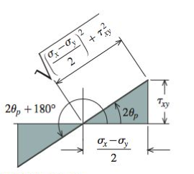
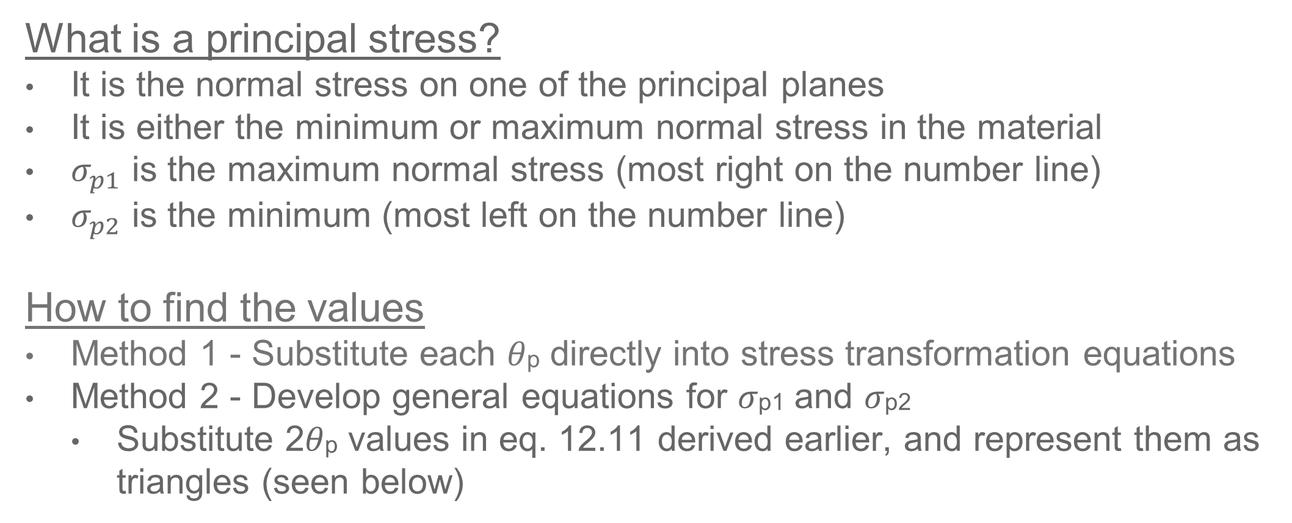
Magnitude of principal stresses
What is a principal stress?
It is the normal stress on one of the principal planes
It is either the minimum or maximum normal stress in the material
$σ_{p1}$ is the maximum normal stress (most right on the number line)
$σ_{p2}$ is the minimum (most left on the number line)
How to find the values
Method 1 - Substitute each 𝜃p directly into stress transformation equations
Method 2 - Develop general equations for 𝜎p1 and 𝜎p2
Substitute 2𝜃p values in eq. 12.11 derived earlier, and represent them as triangles (seen below)

Slide 6
Magnitude of principal stresses
Using SOA and CAH we can define the angle 2𝜃p as:
Substitute these in to →
Some algebra shows we get:
If we substitute a value of 2𝜃 that is 180° away, we get:

Slide 7
Magnitude of principal stresses
We can combine these as one equation
This equation gives you the magnitudes of both principal stresses if you input $σ_{x}$, $σ_{y}$, and $τ_{xy}$
If you don’t need the orientation of principal stresses (only the magnitudes) you can get everything you need in this one equation

Slide 8
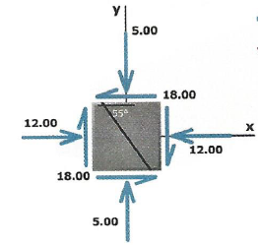
Example Problem
Find the following: (ignore the 55° line)
Orientation of principal stresses
Magnitude of principal stresses
Orientation of maximum shear stress
Magnitude of maximum shear stress
Plan:
Find $θ_{p}$ using: $\tan\left(2θ_{p}\right)= \frac{2τ_{xy}}{σ_{x} − σ_{y}}$
Find σ_{p1} and σ_{p2} using:
Know that max shear is 45° from $θ_{p}$
Use $θ_{τ}=$ $θ_{p}±45 in$ $τ_{nt}=−\left[\frac{σ_{x}−σ_{y}}{2}sin2θ\right]+τ_{xy}cos2θ$

Slide 9
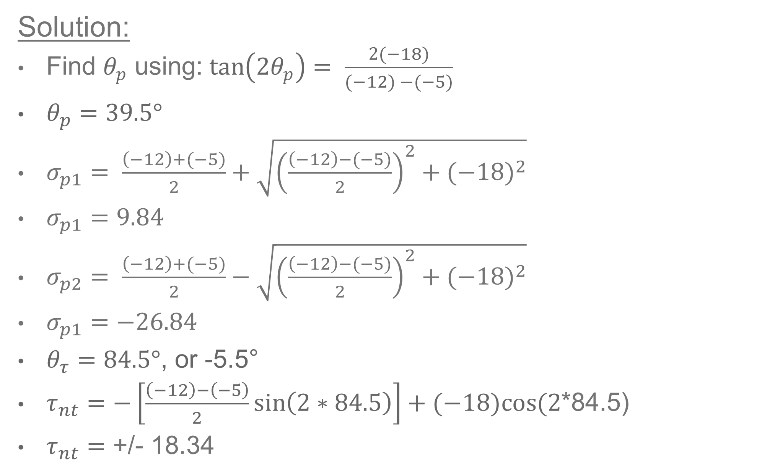
Example Problem
Solution:
Find $θ_{p}$ using: $\tan\left(2θ_{p}\right)= \frac{2(−18)}{(−12) −(−5)}$
$θ_{p}=39.5°$
$σ_{p1}= \frac{\left(−12\right)+(−5)}{2}+\sqrt{{\left(\frac{\left(−12\right)−(−5)}{2}\right)}^{2}+{(−18)}^{2}}$
$σ_{p1}=9.84$
$σ_{p2}= \frac{\left(−12\right)+(−5)}{2}−\sqrt{{\left(\frac{\left(−12\right)−(−5)}{2}\right)}^{2}+{(−18)}^{2}}$
$σ_{p1}=−26.84$
$θ_{τ}=84.5°$, or -5.5°
$τ_{nt}=−\left[\frac{\left(−12\right)−\left(−5\right)}{2}\sin\left(2∗84.5\right)\right]+(−18)cos⁡(2$*84.5)
$τ_{nt}=$ +/- 18.34

