Slide 1
Mechanics of Materials Engr 350 - Lecture 18 - Principal Stresses and Maximum Shear Stress
Totally False

Slide 2
Review L17: Finding the orientation of principal planes
What are principal planes?
Orientations where normal stresses are maximum and/or minimum.
Orientations where the shear stresses on the surface are zero.
Option 1: How can we find the principal stress orientation?
If you want to find the max and min of a function, take its derivative and set it equal to zero.
$$σ_{n}=\frac{σ_{x}+σ_{y}}{2}+\left[\frac{σ_{x}−σ_{y}}{2}cos2θ\right]+τ_{xy}sin2θ$$
$$\frac{dσ_{n}}{dθ}=−\frac{σ_{x}−σ_{y}}{2}\left(2sin2θ\right)+{2τ}_{xy}cos2θ=0$$
Some algebra gets this to:
$$\tan\left(2θ_{p}\right)= \frac{2τ_{xy}}{σ_{x} − σ_{y}}$$

Slide 3
Review L17: Finding the orientation of principal planes
Option 2: How can we find the principal stress orientation?
Find the angle where shear stress is zero.
$$τ_{nt}=−\left[\frac{σ_{x}−σ_{y}}{2}sin2θ\right]+τ_{xy}cos2θ=0$$
Same algebra gets you to the same result:
$$\tan\left(2θ_{p}\right)= \frac{2τ_{xy}}{σ_{x} − σ_{y}}$$

Slide 4
Review L17: Finding the orientation of principal planes
What do we get from this equation?
$$\tan\left(2θ_{p}\right)= \frac{2τ_{xy}}{σ_{x} − σ_{y}}$$
$θ_{p}$ is the orientation of the principal stress plane
This equation is satisfied by two (really, four) values of $θ_{p}$
Each correct value of $θ_{p}$ will be 90° apart from the other
Direction of Rotation
When $\tan\left(2θ_{p}\right)$ is positive, $θ_{p}$ is positive (rotate counter clockwise from x-axis)
When $\tan\left(2θ_{p}\right)$ is negative, $θ_{p}$ is negative (rotate clockwise from x-axis)
One value of $θ_{p}$ will always be between -45° and +45°
The other value of $θ_{p}$ will be 90° away

Slide 5
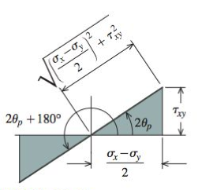
Review L17: Magnitude of principal stresses
What is a principal stress?
It is the normal stress on one of the principal planes
It is either the minimum or maximum normal stress in the material
$σ_{p1}$ is the maximum normal stress (most right on the number line)
$σ_{p2}$ is the minimum (most left on the number line)
How to find the values
Method 1 - Substitute each 𝜃p directly into stress transformation equations
Method 2 - Develop general equations for 𝜎p1 and 𝜎p2
Substitute 2𝜃p values in eq. 12.11 derived earlier, and represent them as triangles (seen below)

Slide 6
Review L17: Magnitude of principal stresses
Using SOA and CAH we can define the angle 2𝜃p as:
Substitute these in to →
Some algebra shows we get:
If we substitute a value of 2𝜃 that is 180° away, we get:

Slide 7
Review L17: Magnitude of principal stresses
We can combine these as one equation
This equation gives you the magnitudes of both principal stresses if you input $σ_{x}$, $σ_{y}$, and $τ_{xy}$
If you don’t need the orientation of principal stresses (only the magnitudes) you can get everything you need in this one equation

Slide 8
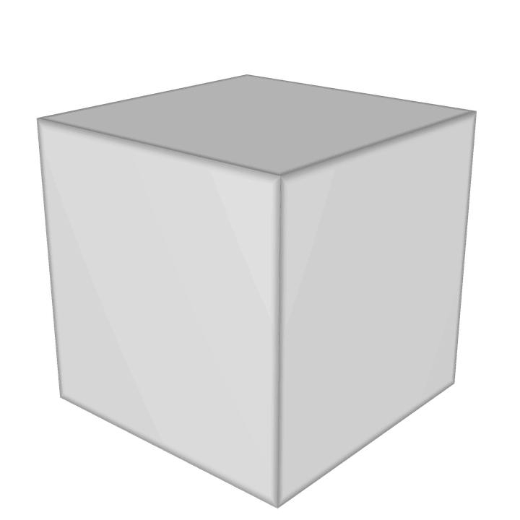
More Shear Stress and Principal Planes
By definition, the shear stress on principal planes must be zero
Inversely, if the shear stress on a plane is zero, then that plane must be a principal plane.
Also, if we are considering plane stress (𝜎z=𝜏zx=𝜏xz=0) then since the shear stress on the z-face is 0, then 𝜎z must be a principal stress (we call this the 3rd principal stress)
Even in 2D stress state, 𝜎z = 0 can be an important piece of information

Slide 9
The Third Principal Stress
We have determined principal stresses and planes for the case of plane stress
These are the in-plane principal stresses
We must not forget about the z-faces!
𝜎z = 0, τ_{zx} = 0, and τ_{zy} = 0
A point in a material subject to plane stress has three principal stress
𝜎p1, 𝜎p2, and 𝜎p3
One of these principal stresses is 𝜎z = 0 (because no shear on the z-surface)
Examples where:
𝜎p1 is positive and 𝜎p2 is negative
𝜎p1, and 𝜎p2 have same sign

Slide 10
Orientation of the maximum in-plane shear stress
(You already know that this is 45° from θ_{p})
Prove it by differentiating Eq 12.6 wrt 𝜃
The solution of this equation is equation 12.14 in text

Slide 11
Comparing Eqn 12.11 and 12.14
Eq. 12.11 Eq. 12.14
One is the negative reciprocal of the other.
The values of 2θ_{p} that satisfy Eq. 12.11 are going to be 90° away from the values of 2θ_{s} that satisfy Eq. 12.14
θ_{p} and θ_{s} are 45° apart
Note:
θ_{p} is orientation of principle stress
θ_{s} is orientation of maximum shear stress

Slide 12
Magnitude of the max in-plane shear stresses
Method 1 - Substitute 𝜃s directly into equation 12.4 or 12.6
$$τ_{max}=−\left[\frac{σ_{x}−σ_{y}}{2}sin{2θ}_{s}\right]+τ_{xy}cos{2θ}_{s}$$
Get 𝜃s by either
adding ±45° to 𝜃p obtained from Eq. 12.11
solving Eq. 12.14 directly
Method 2 – Eq. 12.15 comes from combining eq. 12.6 and 12.14 obtain
Method 2 is useful if you don’t need to know the orientation of θ_{s}

Slide 13
Other useful relationships
on planes where 𝜏 is maximum
The absolute maximum shear stress is given by
Remember that these are the largest and smallest numerically (not abs. value)

Slide 14
Example Stress States
Find σ_{max}, σ_{min}, and τ_{abs max}
σ_{p1} = 5, σ_{p2} = 0, σ_{z} = 0
σ_{p1} = 3, σ_{p2} = -3, σ_{z} = 0
σ_{p1} = -2, σ_{p2} = -5, σ_{z} = 0
𝜎p2, 𝜎z
𝜎p1
𝜎p2
𝜎z
𝜎p1
𝜎p2
𝜎p1
𝜎z
σ_{z} = 0 really matters!

Slide 15
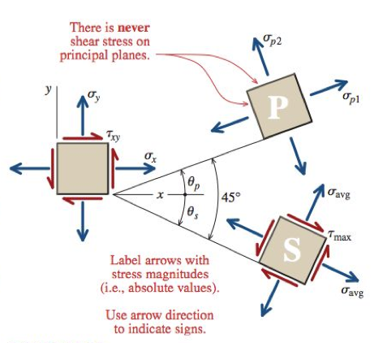
Presenting Planar Stress Transformation Results
Method 1 - Two square stress elements
Section 12.9 for details

Slide 16
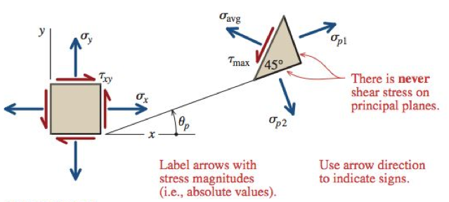
Presenting Planar Stress Transformation Results
Method 2 - wedge stress element
Section 12.9 for details

