Slide 1
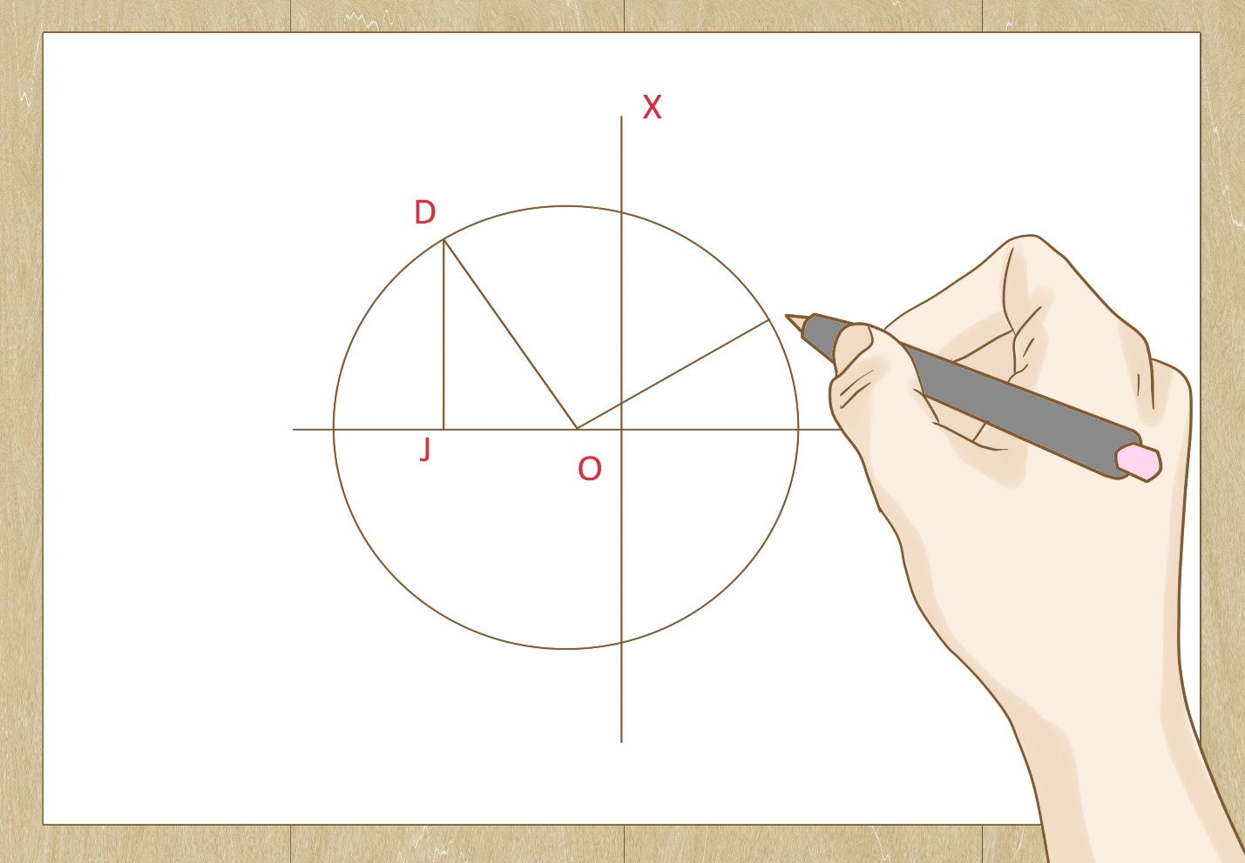
Mechanics of Materials ENGR 350 - Lecture 19 Mohr’s Circle
Circles
are
Awesome
I
Circles

Slide 2
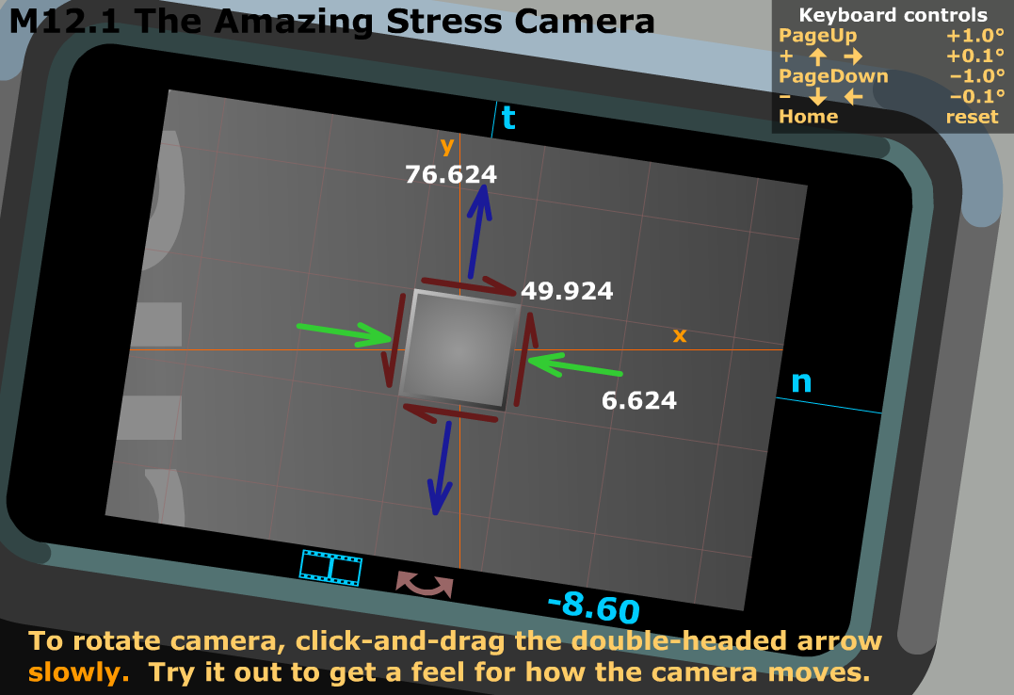
Stress State vs. Orientation
Remember the Amazing Stress Camera?
As we rotate the lens:
The stress state isn’t changing
The numbers used to describe the stress state are changing

Slide 3
What is Mohr’s Circle?
It is a graphical representation of the stress transformation equations
Start with the two stress transformation equations
Algebra Time!
$σ_{n}−\frac{σ_{x}+σ_{y}}{2}=\frac{σ_{x}−σ_{y}}{2}cos2θ+τ_{xy}sin2θ$ $τ_{nt}=−\frac{σ_{x}−σ_{y}}{2}sin2θ+τ_{xy}cos2θ$
Square both equations and add them together (sin² and cos² terms go away)
$${\left(σ_{n}−\frac{σ_{x}+σ_{y}}{2}\right)}^{2}+ {τ_{nt}}^{2}= {\left(\frac{σ_{x}−σ_{y}}{2}\right)}^{2}+{τ_{xy}}^{2}$$
This is just like the equation for a circle in terms of $σ_{n}$ (x-axis) and $τ_{nt}$ (y-axis)!!

Slide 4
What is Mohr’s Circle?
Recall the standard equation of a circle
h is the x-location of the center, and k is the y-location of the center
$${\left(σ_{n}−\frac{σ_{x}+σ_{y}}{2}\right)}^{2}+ {τ_{nt}}^{2}= {\left(\frac{σ_{x}−σ_{y}}{2}\right)}^{2}+{τ_{xy}}^{2}$$
In the above equation
$h= \frac{σ_{x}+σ_{y}}{2}$ , $k=0$
$r^{2}= {\left(\frac{σ_{x}−σ_{y}}{2}\right)}^{2}+{τ_{xy}}^{2}$, so $r= \sqrt{{\left(\frac{σ_{x}−σ_{y}}{2}\right)}^{2}+{τ_{xy}}^{2}}$
Now we have almost all the pieces we need to construct our circles.

Slide 5
Sign conventions for Mohr’s Circle
Normal stresses
Same sign convention as before
Positive (+) Negative (-)
Shear stresses
Special convention required (and it’s backwards from θ sign convention)
Positive (+) Negative (-)
Rotates element clockwise Rotates element counterclockwise

Slide 6
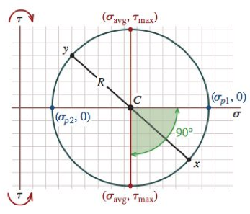
Why Mohr’s circle?
Convenient way to visualize stress transformations
Once construction technique is understood, the equations of transformation aren’t needed (can derive)
Now you have multiple ways to check your stress transformation numbers, principal stresses, and max shear stresses
General Plan:
Plot σ on x-axis
Plot τ on y-axis
Make a circle

Slide 7
Constructing the circle
Identify 𝜎x, 𝜎y, and 𝜏xy (given/known values from the stress state)
Draw 𝜎 and 𝜏 axes. Label the axis for sign conventions. Make a grid.
Plot the stress components from the x-face. Watch sign conventions.
Label the point just plotted as “x”
Plot the stress components from the y-face. Watch sign conventions.
Label the point just plotted as “y”
Connect x and y with a line. The center of the circle is where this line crosses the 𝜎-axis
Draw a circle with center at the radius that connects the x and y points
Label the important points
(𝜎p1, 𝜎p2, 𝜎p3)
𝜏max
Determine the orientation of the principal planes (note: Mohr’s circle is in 2𝜃 space. The element is in 𝜃 space.

Slide 8
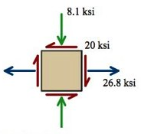
τ
x
σ
Visual Inspection
σ_{p1} = ~36 ksi
σ_{p2} = ~-17 ksi
σ_{ave} = ~9 ksi
Radius = ~26 ksi
τ_{max} = ~26 ksi
y
τ

Slide 9
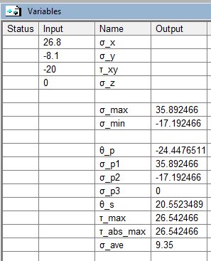
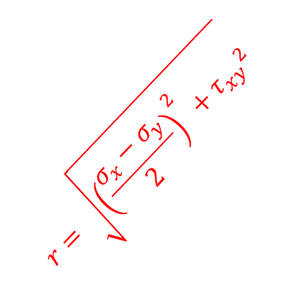


τ
Center = $\frac{σ_{x}+σ_{y}}{2}$
Center = 9.35
$$r= \sqrt{{\left(\frac{σ_{x}−σ_{y}}{2}\right)}^{2}+{τ_{xy}}^{2}}$$
r = 26.54
$$r= \sqrt{{\left(\frac{σ_{x}−σ_{y}}{2}\right)}^{2}+{τ_{xy}}^{2}}$$
$$τ_{xy}$$
$${2θ}_{p}$$
σ
Calculated From Circle
σ_{p1} = 35.89 ksi
σ_{p2} = -17.19 ksi
σ_{ave} = 9.35 ksi
τ_{max} = 26.54 ksi
$$\frac{σ_{x}−σ_{y}}{2}$$
2θ = -tan⁻¹(20/(26.8-9.35)
2θ = -tan⁻¹(20/(17.45)
2θ = -48.89°
θ_{p} = -24.44°
τ

Slide 10
τ
Mohr’s Circle
Showing all three 2D planes
σ
τ

Slide 11
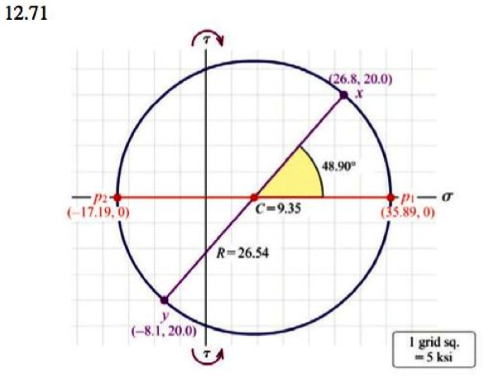
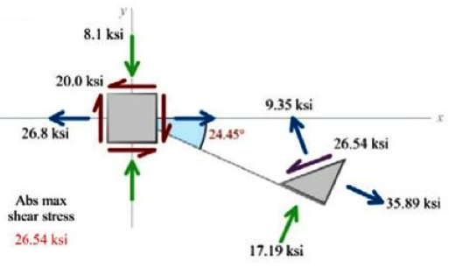
Displaying Mohr’s Circle Results on Wedge Element
Wedge Surface -45° from θ_{p1}

Slide 12
Additional Resources
MM Module 12.10 has three sub-modules
Basic information about Mohr’s Circle
Each step in creating a Mohr’s Circle
Coaching module with 7 topics
MM Module 12.11 is a game
Match the correct circle to the given stress state
MM Module 12.12 is a game
Match the correct stress state from the given circle
MM Module 12.16
Step-by-step for creating Mohr’s Circle
MM Module 12.17
Step-by-step for finding Principal Stresses from Mohr’s Circle
MM Module 12.18
Step-by-step for finding Max Shear Stresses from Mohr’s Circle
MM Module 12.19
Creates Mohr’s Circle using x and y input

Slide 13
τ
σ
τ

