Slide 1
Mechanics of Materials Engr 350 - Lecture 20 More Mohr’s Circles

Slide 2
For each element draw the Mohr’s Circle and use it to calculate the following: a) Principal stresses and the maximum in-plane shear stress b) Angle of maximum principal stresses and angle of maximum in-plane shear stress c) If appropriate, draw a circle to show the absolute maximum shear stress
Center location: ___________________
Radius: __________________________

Slide 3
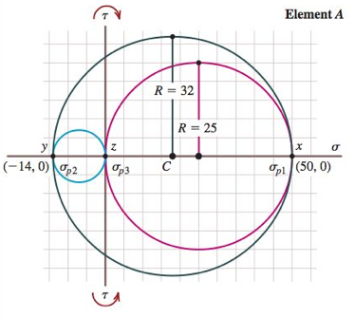
Mohr’s circle when considering out of plane shear stresses
Remember, the absolute maximum shear stress does not occur in the same plane as maximum shear stresses.
The absolute maximum shear stress can be determined by plotting a circle that contains 𝜎max and 𝜎min.

Slide 4
Can also use Mohr’s Circle to describe stress state in any orientation For each element draw the Mohr’s Circle and use it to describe the stress state at orientation: θ = ____________________________
Center location: ___________________
Radius: __________________________

