Slide 1
Mechanics of Materials Engr 350 - Lecture 21
Hooke’s Law for Isotropic Materials
“As adjectives the difference between isentropic and isotropic is that:
Isentropic is (thermodynamics. of process) having a constant entropy while isotropic is (physics) having properties that are identical in all directions; exhibiting isotropy.”
-Wikidiff

Slide 2
Hooke’s Law (pronounce like ‘hook’)
The initial portion of the stress-strain curve is linear
𝜎
Hooke’s Law gives us the relationship of stress and strain ONLY in the elastic region of the curve
$σ=E∗ε$
where E is the modulus of elasticity
Hooke’s Law also applies to shear stress and shear strain
$τ=G∗γ$
where G is the modulus of rigidity (also known as the shear modulus)
Hooke’s Law
Hooke’s Law
𝜀

Slide 3
Poisson’s ratio (rhymes with ‘boy-john’)
If a solid body is subjected to an axial tension, it contracts in lateral directions
If a solid body is compressed, it expands in lateral directions
$v=−\frac{ε_{lateral}}{ε_{longitudinal}}=−\frac{ε_{lat}}{ε_{long}}=−\frac{ε_{transverse}}{ε_{axial}}$ $=−\frac{ε_{t}}{ε_{a}}$
Only applies to a state of uniaxial stress
Typical values → 1/4 to 1/3
Max value → 0.5 (rubber, etc.)
Demonstration?

Slide 4
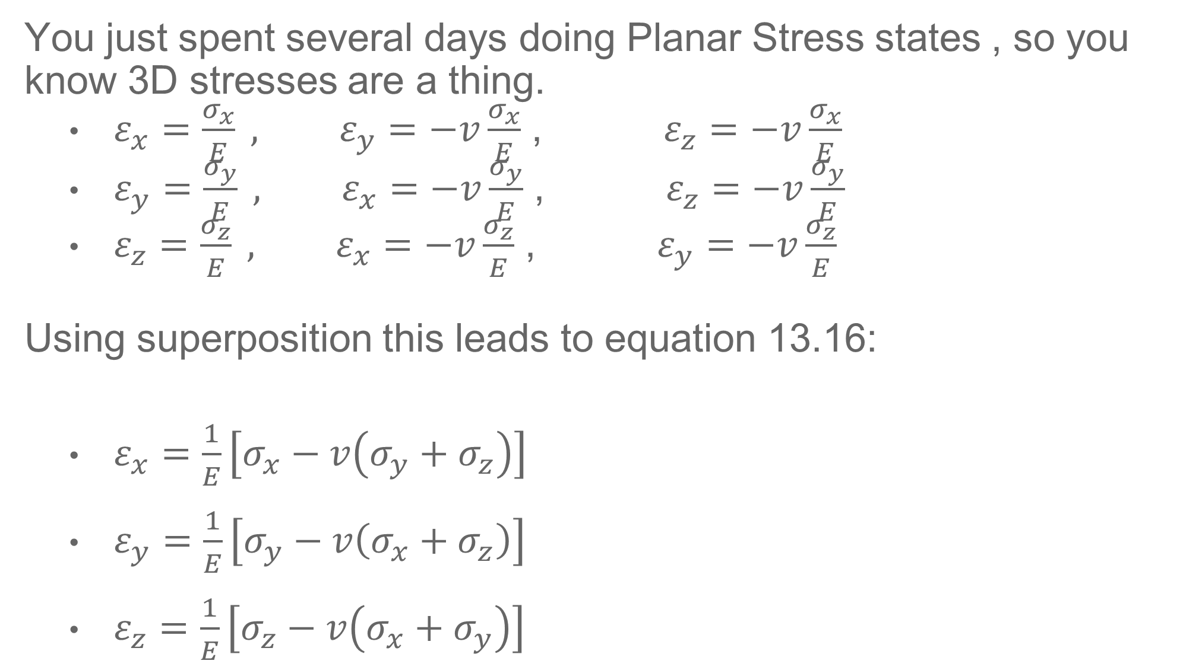
What about 3D Stress State?
You just spent several days doing Planar Stress states , so you know 3D stresses are a thing.
$ε_{x}=\frac{σ_{x}}{E} , ε_{y}=−v\frac{σ_{x}}{E}$ , $ε_{z}=−v\frac{σ_{x}}{E}$
$ε_{y}=\frac{σ_{y}}{E} , ε_{x}=−v\frac{σ_{y}}{E}$ , $ε_{z}=−v\frac{σ_{y}}{E}$
$ε_{z}=\frac{σ_{z}}{E} , ε_{x}=−v\frac{σ_{z}}{E}$ , $ε_{y}=−v\frac{σ_{z}}{E}$
Using superposition this leads to equation 13.16:
$ε_{x}=\frac{1}{E}\left[σ_{x}−v\left(σ_{y}+σ_{z}\right)\right]$
$ε_{y}=\frac{1}{E}\left[σ_{y}−v\left(σ_{x}+σ_{z}\right)\right]$
$ε_{z}=\frac{1}{E}\left[σ_{z}−v\left(σ_{x}+σ_{y}\right)\right]$
If you know $σ_{x},σ_{y}$, and $σ_{z}$ this will tell you the strain in each direction

Slide 5

What about 3D Strain State?
What if you know the strain in each direction, how do you find the stress state?
Solve the last three equations for stress we get equation 13.19:
$σ_{x}=\frac{E}{(1+v)(1−2v)}\left[\left(1−v\right)ε_{x}+v\left(ε_{y}+ε_{z}\right)\right]$
$σ_{y}=\frac{E}{(1+v)(1−2v)}\left[\left(1−v\right)ε_{y}+v\left(ε_{x}+ε_{z}\right)\right]$
$σ_{z}=\frac{E}{(1+v)(1−2v)}\left[\left(1−v\right)ε_{z}+v\left(ε_{x}+ε_{y}\right)\right]$

Slide 6
Special Cases – Volumetric Change
How does the unit volume change (stress element volume change) when stressed?
Volumetric Strain, or Dilatation (e) = change in volume / unit volume
$e=\frac{∆V}{V}=ε_{x}+ε_{y}+ε_{z}$
Using Hooke’s Law relationships dilatation is also:
$e=\frac{∆V}{V}=\frac{1−2v}{E}\left(σ_{x}+σ_{y}+σ_{z}\right)$
Interesting tidbit: Remember $v_{max}=\frac{1}{2}$ ?
Consider a stress element that does not change volume no matter how much stress we put on it (incompressible!)
For volume strain or dilatation to be zero, $1−2v$ must equal zero
This tells us something incompressible has $v=\frac{1}{2}$

Slide 7
Special Cases – Hydrostatic Pressure
What about when a volume is subject to uniform pressure (same pressure in all directions)? This would be the case of submerging an object in water (the deeper the water, the higher the pressure).
In this case the volumetric Strain, or Dilatation becomes:
$σ_{x}=σ_{y}=σ_{z}=−p$
$e=\frac{∆V}{V}=\frac{3(1−2v)}{E}p$
Can define a new modulus (ratio between stress and strain)
The Bulk Modulus can be defined as:
$K=\frac{−p}{e}=\frac{E}{3(1−2v)}$

Slide 8
Homework 21 and Beyond
This won’t be turned in. But you should do two things as part of your homework.
Look at Examples 13.5 and 13.6
Practice stress transformation problems (L14 – L20) in preparation for Exam 3 (Friday during class time)
Midterm Grades posted during Spring Break
Exam 2 will not be part of your grade
Quizzes 1-3, Homework, and Exam 1 will determine midterm
Midterm grades are not part of your transcript, just to help you see how you are doing in classes
Have a fun, relaxing, energizing break
Come back ready to tackle the rest of the semester.

