Slide 1
Mechanics of Materials ENGR 350 - Lecture 22 Torsion 1
I am strong because I’ve overcome weakness
I am fearless because I’ve overcome fear
I have a twisted sense of humor because I’ve overcome torsion
-Dr. Dan

Slide 2
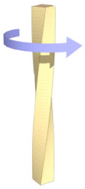
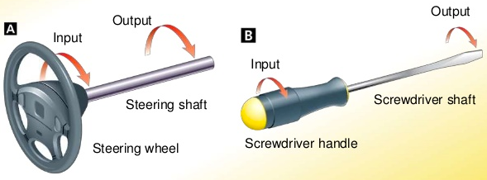
Torsion and torque
Torsion - a state of being twisted
Torque - a moment that tends to twist a member about it’s longitudinal axis
A shaft is the simplest member that transmits a torque
What are other things that experience torsion?

Slide 3
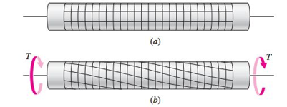
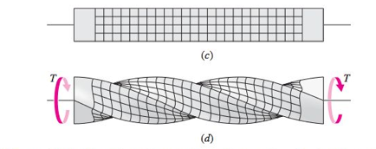
Torsion and Assumptions
For solid and hollow circular cross-sections we make the following assumptions:
Cross-sectional planes remain planar
Radial lines on these planes remain straight
Cross-sections rotate about the longitudinal axis, and remain perpendicular to that axis
No axial strain present due to torsion
These assumptions are not valid for anything other than a shaft with a circular cross-section! (solid or hollow)

Slide 4
Torsional Shear Strain
Pure torsion All portions of the shaft are subjected to the same torque
Side angle γ, - Constant throughout length of member
Angle of twist 𝜙 - varies throughout length of member
γ
𝜙
γ
𝜙₁
γ
𝜙₂

Slide 5
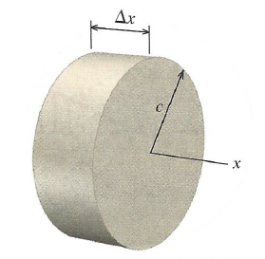
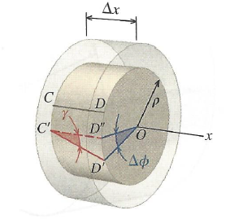
Developing the Shear Strain Equation
Consider a small disk-shaped section of the shaft
c – distance to from centerline to outside of shaft (shaft radius)
Δx – small segment of shaft length
ρ – radial distance from centerline
Δϕ – change in twist over Δx

Slide 6
Developing the Shear Strain Equation
Consider a small disk-shaped section of the shaft
Defining γ:
$$\tan\left(γ\right)= \frac{D^{′}D′′}{∆x}$$
But can express D’D’’ using arc length
$$\tan\left(γ\right)= \frac{ρ∆∅}{∆x}$$

Slide 7
Developing the Shear Strain Equation
Consider a small disk-shaped section of the shaft
Small Angle Approximation:
$$\tan\left(γ\right)= γ= \frac{ρ∆∅}{∆x}$$
Or, written as:
$$γ= ρ\frac{∆∅}{∆x}$$
Eqn. 6.1

Slide 8
Developing the shear strain equation
Consider a small disk-shaped section of the shaft
Max shear strain when ρ = c
$$γ_{max}=c\frac{∆∅}{∆x}$$
Since linear, can express strain at a given distance from centerline as a ratio of the maximum shear strain:
$$γ_{ρ}=\frac{ρ}{c}γ_{max}$$
Eqn. 6.2
Eqn. 6.3

Slide 9
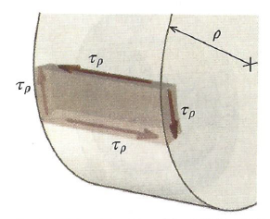
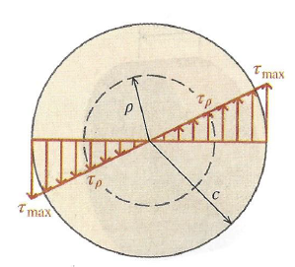
Torsional Shear Stress
Recall Hooke’s law for shear $τ=Gγ$
Substitute this in to Eqn 6.3 to get:
Shear stress is linear across the radius.
It is zero in the center
It is maximum at the outside
Not just on the surface, but as →
$$τ_{ρ}=\frac{ρ}{c}τ_{max}$$
Eqn. 6.4

Slide 10
Relating Torque and Shear Stress
Consider a torque applied to a shaft. The maximum shear stress resulting from that torque will be:
$$τ_{max}= \frac{Tc}{J}$$
Where:
T = applied torque
c = Outer radius of shaft
J = Polar moment of Inertia
Alternatively, the shear stress any distance from the axis will be:
$$τ_{ρ}= \frac{Tρ}{J}$$
Eqn. 6.5
Eqn. 6.6

Slide 11
Polar moment of inertia (J) for circular sections
Math people also call the PMI
Polar Second Moment of Area
For solid circular cross sections:
For hollow circular cross sections:

Slide 12
Example Problem 1
A shaft is subjected to a torque of T=650 lb-in. Determine the maximum shear stress in the shaft. D=1 in, d=0.75in
$J= \frac{π}{32}\left({(1.0 in)}^{4}−{(0.75 in)}^{4}\right)=0.0671 {in}^{4}$
$τ_{max}= \frac{650 \left(lbf∗in\right)∗{1(in)}/2}{0.0671 {in}^{4}}=4843 \frac{lbf}{{in}^{2}}=4843 psi$
$$τ_{max}= \frac{Tc}{J}$$

Slide 13
Example Problem 2 – Driveshaft on Camaro ZL1
Engine torque is 650 lbf-ft. But first gear of transmission is 4.06 : 1 ratio. The driveshaft is 3.0” diameter with a wall thickness of 0.083”. Determine the maximum shear stress in the driveshaft.
$$τ_{max}= \frac{Tc}{J}$$
$J= \frac{π}{32}\left({(3.0 in)}^{4}−{(2.834 in)}^{4}\right)=1.619 {in}^{4}$
$τ_{driveshaft}=650\left(lbf∗ft\right)∗4.06∗12\frac{in}{ft}=31,668 lbf∗in$
$τ_{max}= \frac{31,668 \left(lbf∗in\right)∗{3.0 (in)}/2}{1.619 {in}^{4}}=29,335 \frac{lbf}{{in}^{2}}=29.3 ksi$

Slide 14
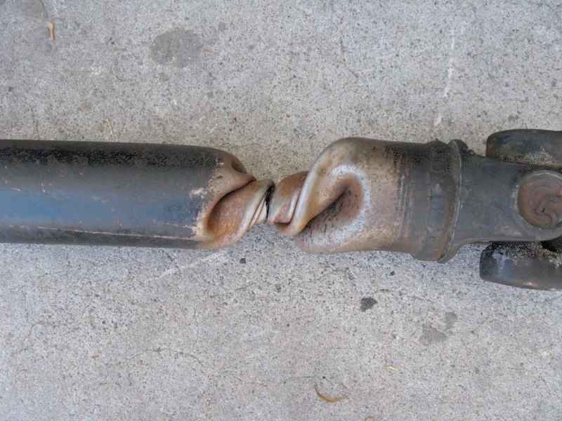
Then why did this happen?

Slide 15
Example Problem 3 – Axle shaft on Camaro ZL1
Engine torque is 650 lbf-ft. First gear is 4.06 : 1 ratio. Rear differential has a 3.73 : 1 reduction. Each half shaft is a solid 1.25” diameter. Determine the maximum shear stress in each half shaft.
$$τ_{max}= \frac{Tc}{J}$$
$$J= \frac{π}{32}\left({(1.25 in)}^{4}−{(0.0 in)}^{4}\right)=0.2397 {in}^{4}$$
$τ_{halfshaft}=31,668\left(lbf∗in\right)∗\frac{3.73}{2}=59,061 lbf∗in$
$$τ_{max}= \frac{59,061 \left(lbf∗in\right)∗{1.25 (in)}/2}{.2397 {in}^{4}}=154,000 \frac{lbf}{{in}^{2}}=154 ksi$$
Note: You’re unlikely to find steel that can sustain 154 ksi of shear stress. So why don’t all the axles on ZL1 Camaros break?

Slide 16
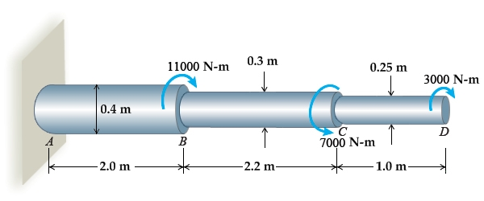
Torsion Problem Tips
How to find torque on
Segment AB?
Segment BC?
Segment CD?
Sometimes you know the torque and allowable shear stress
Need to solve for the diameter.
Equation solver will be your friend. But can do with substitution.

Slide 17
Where else do you see torsion?

Slide 18
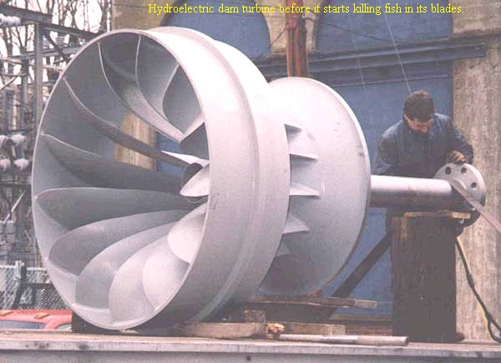

Slide 19
