Slide 1
Mechanics of Materials Engr 350 - Lecture 23 Torsion 2

Slide 2
Where else do you see torsion?

Slide 3
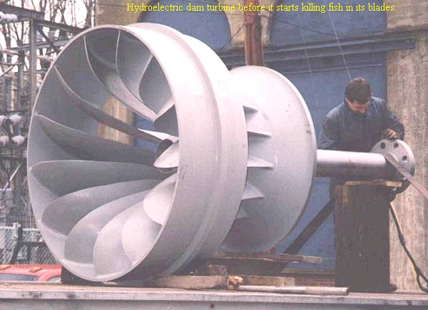

Slide 5
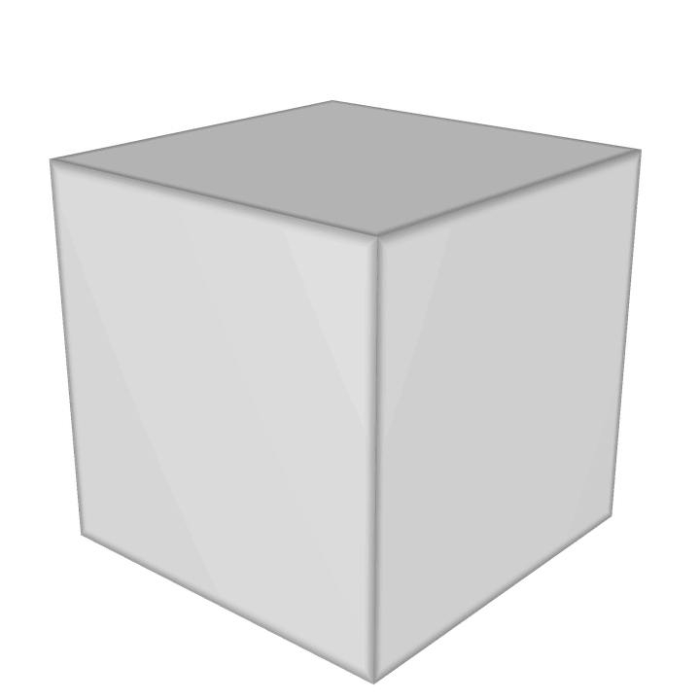
Stresses on Oblique Planes
Recall the result of our equilibrium development of the stress equations
But σ_{x} and σ_{y} = 0 in pure torsion, so for the state of stress of the element in the slice of shaft
$$σ_{n}= τ_{xy}sin⁡(2θ)$$
$$τ_{nt}=τ_{xy}cos⁡(2θ)$$
τ_{nt}
σ_{n}
σ_{x}
𝜃
τ_{xy}
σ_{y}

Slide 6
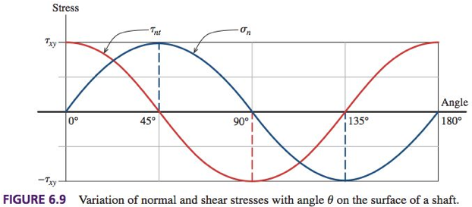
How stress changes with orientation of the element
An Oblique Plane is one that is neither parallel nor perpendicular to the face.
This is why the stress transformation equations become necessary, to find maximum stresses and their orientations.

Slide 7
Stresses on oblique planes influence failure modes
(a) Steel axle shaft
Fails via shear on lateral plane
Crack

Slide 8
Stresses on oblique planes influence failure modes
(b) Aluminum tube
Buckle on 45° plane
Tensile stress causes tearing on other 45° plane
Tear
Buckle

Slide 9
Stresses on oblique planes influence failure modes
(c) Cast iron shaft
Fails in tension (45° break)
Break

Slide 10
Stresses on oblique planes influence failure modes
(d) Low carbon steel
Fails nearly on transverse plane
Note the angle of twist of the piece!
Snap

Slide 11
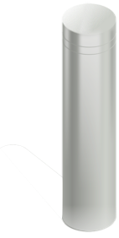
Torsional deformations
Recall Hooke’s law: $τ=Gγ$
Recall relationship between shear stress and position (eq. 6.6): $τ_{ρ}= \frac{Tρ}{J}$
Recall angle of twist equation (eq. 6.1): $γ= ρ\frac{∆∅}{∆x}$
Substitute eq 6.1 and 6.1 in to Hooke’s Law:
Separate and integrate

Slide 12
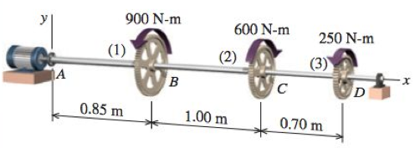
Torsional deformations
This equation can also be expressed as
This is like the FLEA equation, but for torque
These equations are only valid for
homogeneous (means?)
prismatic (means?)
constant torque
For non-prismatic shafts? What about non-constant torque?
Superposition!

Slide 13
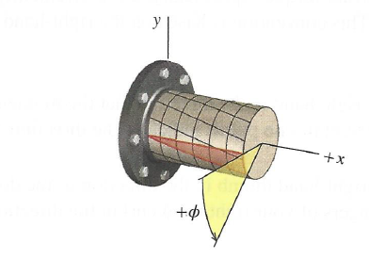
Sign Conventions – Right Hand Rule
Internal torque
Positive
Angle of twist
positive
Rotation angle
positive

Slide 14
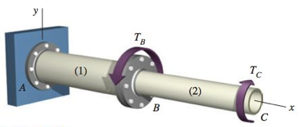
FBDs for composite shafts
Find internal torques in shaft segments (1) and (2)
=1000 N·m
=800 N·m
Torque diagram

Slide 15
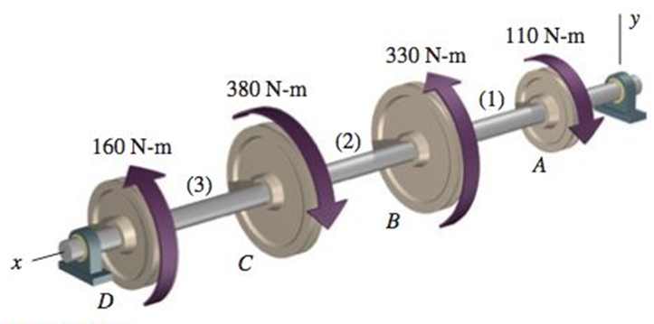
Example problem
A solid 0.75-in. diameter shaft is subjected to the torques shown. The bearings shown allow the shaft to turn freely.
Plot a torque diagram showing the internal torque in segments (1), (2), and (3) of the shaft.
Determine the maximum shear stress magnitude in the shaft.

