Slide 1
Mechanics of Materials Engr 350 - Lecture 24 Beam Equilibrium and VM Diagrams

Slide 2
What is a beam?
Structural member that supports a load
long relative to cross-sectional dimensions
straight
prismatic
support internal shear forces and bending moments

Slide 3
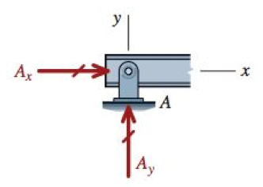
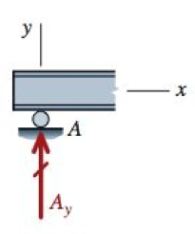
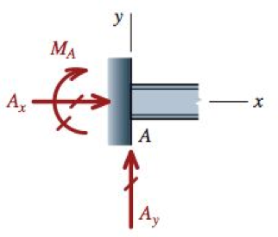
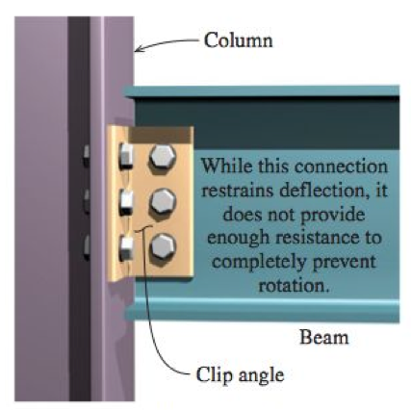
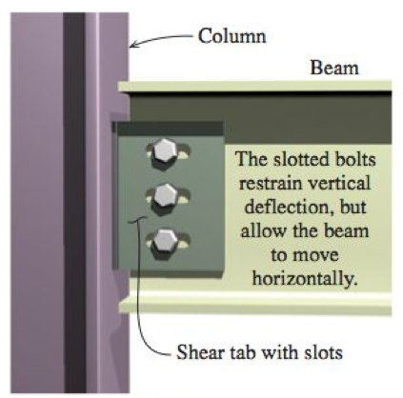
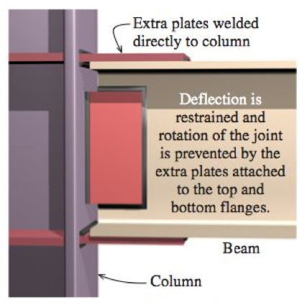
Types of supports
Pinned Connection
Roller Support
Fixed Support

Slide 4
Beam Conditions
Simply Supported
Cantilever
Simply Supported with Overhang
What do the reactions at each end look like for each of these?

Slide 5
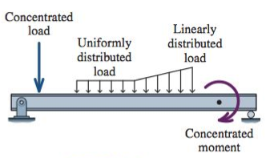
Types of loadings
Concentrated loads and concentrated moments don’t really exist. But many times they are a good approximation.
CW concentrated moment causes upward jump on diagram

Slide 6
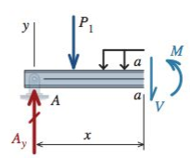
Shear and moment in beams
Before we can determine internal stresses in beams, we must know the internal shear (V) and moment (M)
This is accomplished by “cutting” the beam and analyzing it via equilibrium methods. ie. method of sections

Slide 7
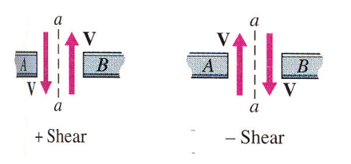
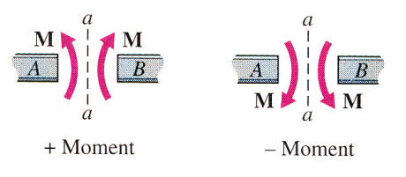
Sign Conventions for Shear and Moment
Positive shear
Makes shear element want to rotate clockwise
Positive moment
Makes beam want to ‘smile’

Slide 8
Rules for Creating VM Diagrams
Shear diagram
Concentrated forces cause a jump in the shear diagram at the location of the force
Change in shear force between any two locations is equal to the area under the distributed load diagram
Slope of any shear diagram at any location is equal to the distributed load value at that location
Moment diagram
Change in moment between any two locations is equal to the area under the shear diagram
Slope of the moment diagram at any location is equal to the shear force at that location
Concentrated moments cause a jump in the internal bending moment at the point of application. CW external moment causes a positive jump

Slide 9
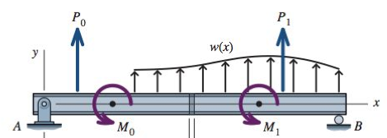
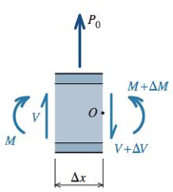
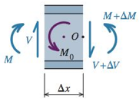
Graphical Method for VM Diagrams
The direct method can become cumbersome when many loads are applied to a beam.
We want to develop a method for creating shear and moment diagrams more quickly
Consider a beam with general loads
Take a section of this beam

Slide 10
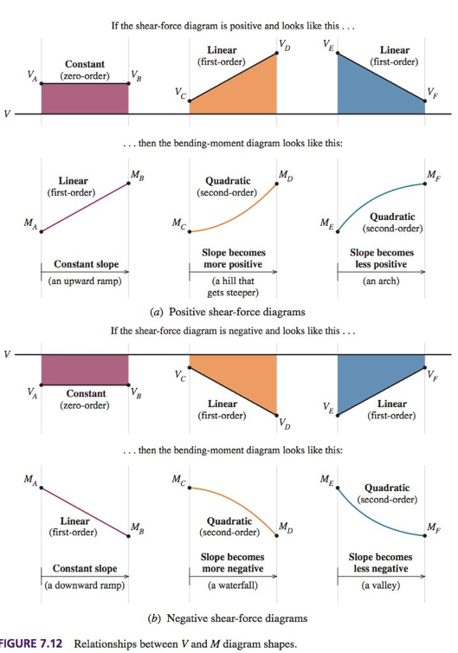
Proper shapes of diagrams

Slide 11
General procedure for graphical construction
Complete the load diagram or FBD
Follow the “rules” to conduct the shear diagram
Locate key points on shear diagram
Follow the “rules” to construct the moment diagram

Slide 12
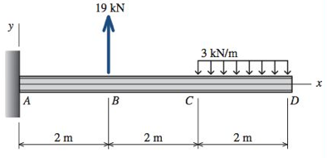
Example - draw the shear force and bending moment diagram for the beam below
V
M

Slide 13
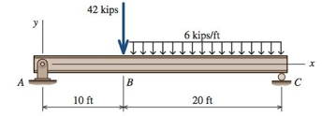
Second Example - draw the shear force and bending moment diagram for the beam below
V
M
Notes:
Philpot 7.11

Slide 14
