Slide 1
Mechanics of Materials Engr 350 - Lecture 25 Bending 1
"Well, that's the trouble with bending the rules—cough—they usually snap right back in your face.“
- Captain Fanzone

Slide 2
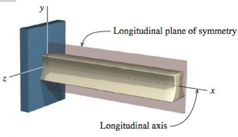
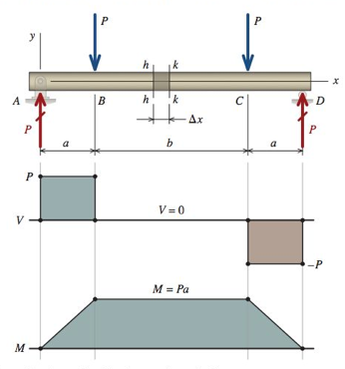
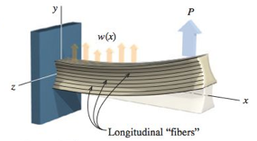
Vocabulary
Transverse - Loads and sections perpendicular to
the longitudinal axis of the member
Bend - What beams do under the action of transverse loads or applied moments (no elongation or twisting)
Coordinate system and “plane of bending”
Longitudinal fibers - imaginary fibers that run along the length of a beam (true for wood, but not for metal or concrete)
Pure bending - Condition where the internal bending moment is constant
Non-uniform bending - Where bending moment changes with position

Slide 3
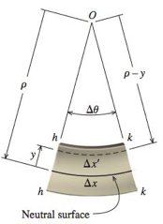
Flexural Strains
Consider a small section of beam in pure bending
Before loading, beam is initially straight
After loading the top fibers experience compressive strain
After loading the bottom fibers experience tensile strain
Somewhere between these extremes, the fibers do not experience any strain (change in length).
This location is the neutral axis.

Slide 4
Flexural Strain Equations
Consider a small section of beam in pure bending
Strain in the x-direction
$ε_{x}=\frac{δ}{L}=\lim_{∆x→0}{\frac{∆x^{′}−∆x}{∆x}=\lim_{∆θ→0}{\frac{(ρ−y)∆θ−ρ∆θ}{ρ∆θ}}}$
$ε_{x}=−\frac{1}{ρ}y$
Radius of curvature (ρ) is from the neutral axis
y is distance upward from neutral axis
Direction matters
Curvature
$kappa=κ=\frac{1}{ρ}$
$ε_{x}=−κy$

Slide 5
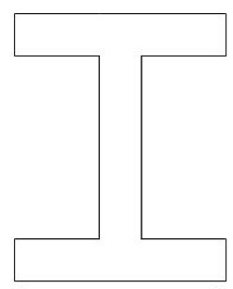
Normal Stresses in Beams
Recall Hooke’s Law:
Substitute the strain developed in the section of beam
side view
y
end view
y
x
z
$$σ_{x}=Eε_{x}=−\frac{E}{ρ}y=−Eκy$$

Slide 6
Moment-Curvature Relationship
side view
y
y
$$M=−\int_{A}^{ }{yσ_{x}dA=}\frac{E}{ρ}\int_{A}^{ }{y^{2}dA}$$
x
z
$\int_{A}^{ }{y^{2}dA}$ is the area moment of inertia around the z-axis
$M=\frac{EI_{z}}{ρ}$ or $κ=\frac{M}{EI_{z}}$

Slide 7
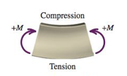
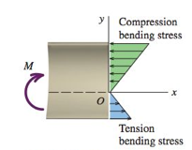
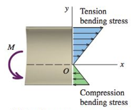
Bending Stress

Slide 8
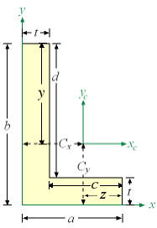
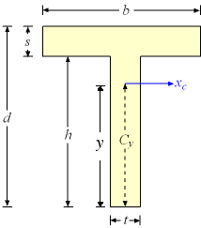
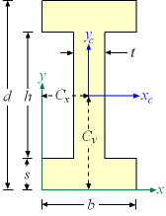
The Centroid
Calculate it
CAD it
Look it up
MecMovies Centroid Game

Slide 9
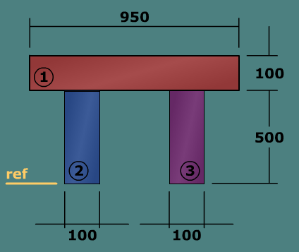
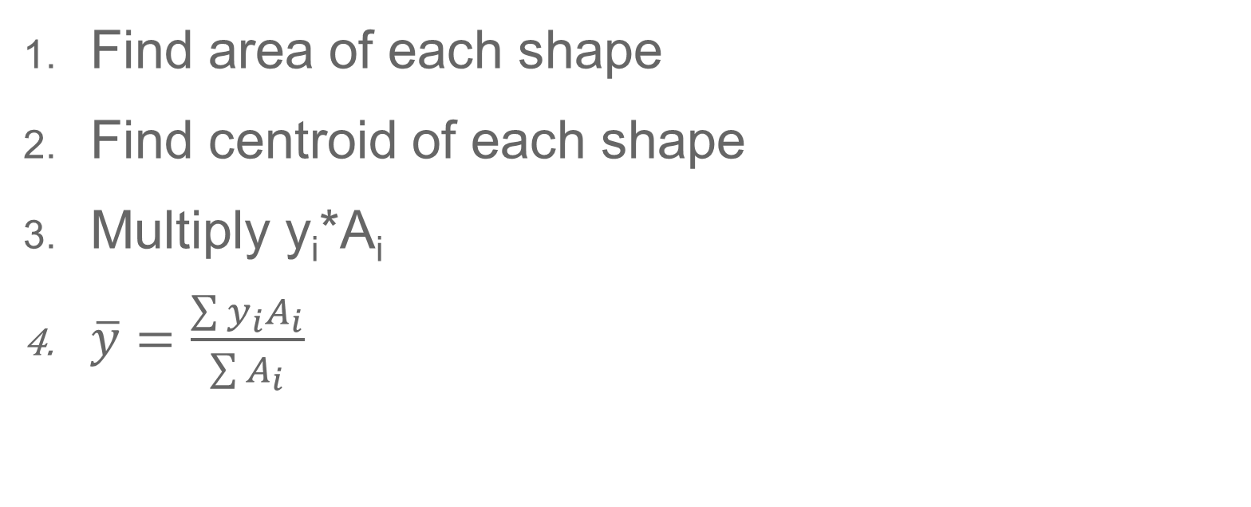
Calculating the Z Centroidal Axis
Find area of each shape
Find centroid of each shape
Multiply y_{i}*A_{i}
$\overline{y}=\frac{\sum{y_{i}A_{i}}}{\sum{A_{i}}}$
 | A_{i} | y_{i} | y_{i}A_{i}
(1)
(2)
(3)
Sum

