Slide 1
Mechanics of Materials Engr 350 - Lecture 26 More Bending

Slide 2
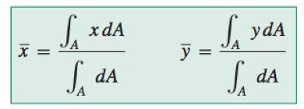
Review centroids
The centroid is the geometric center of an area and can be determined with the following formula
for composite areas use the formula
along with the centroids of common areas, Table A.1
Notes:
from philpot 3rd ed appendix A p820

Slide 3
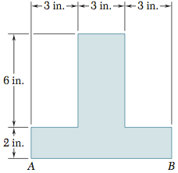
Centroids example
Determine the centroid location y_bar
 | Ai | yi | yi*Ai
1
2
𝛴
Notes:
statics and mechanics beer johnson p7.35

Slide 4
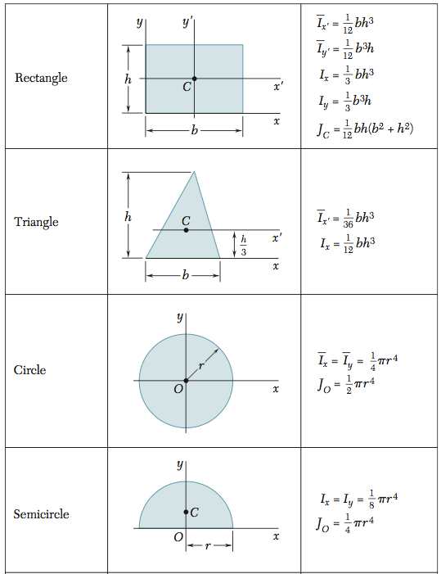
Moment of inertia
Also known as the second moment of an area
Notes:
Philpot 824
statics and machics beer and johnston p289

Slide 5
Parallel axis theorem
States that the moment of inertia for an area about an axis is equal to the area’s moment of inertia about a parallel axis passing through the centroid plus the product of the area and the square of the distance between the two axes.
For composite sections
Notes:
Philpot Appendix A

Slide 6
Moment of inertia for composite sections example
Determine the moment of inertia for the composite section
 | Ici | di | di²Ai | Iz=Ici+di²Ai
1
2
𝛴

Slide 7
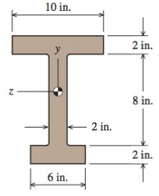
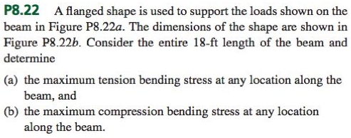
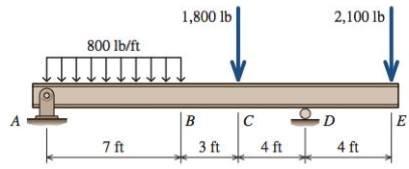
Example
FBD
 | Ai | yi | yi*Ai
1
2
3
𝛴
V
 | Ici | di | di²Ai | Iz=Ici+di²Ai
1
2
3
𝛴
M

Slide 8
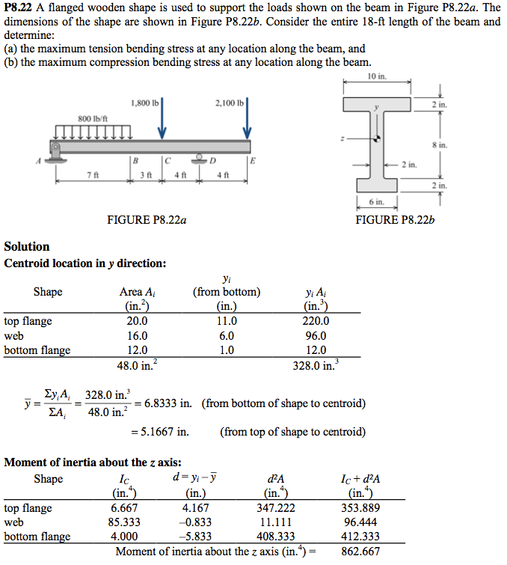
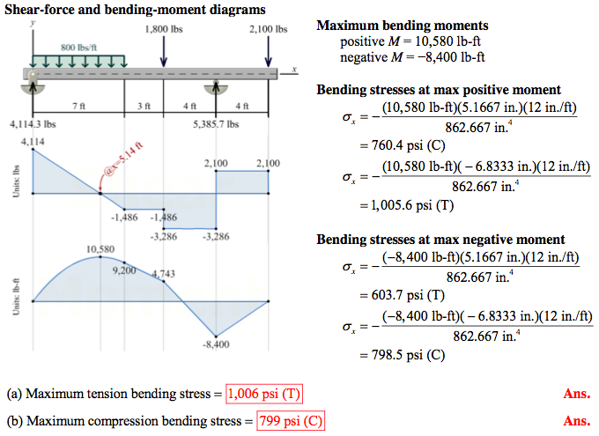

Slide 9
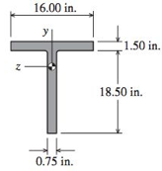
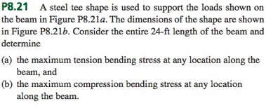
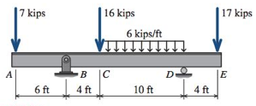
Practice problem
FBD
 | Ai | yi | yi*Ai
1
2
3
𝛴
V
 | Ici | di | di²Ai | Iz=Ici+di²Ai
1
2
3
𝛴
M

Slide 10
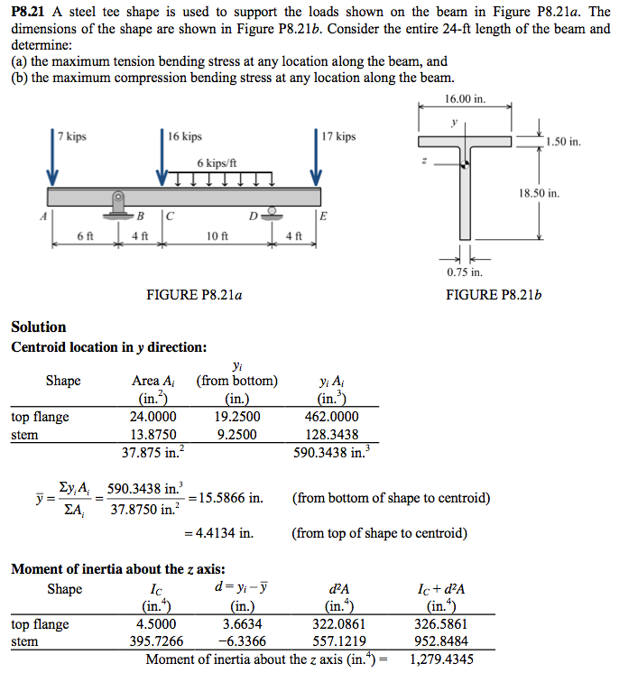
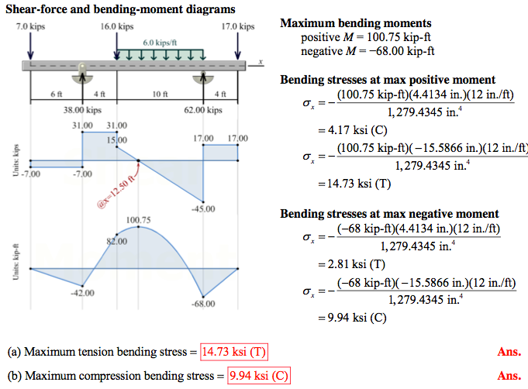

Slide 11
