Slide 1
Mechanics of Materials Engr 350 – Lecture 27
Shear Stress In Beams

Slide 2
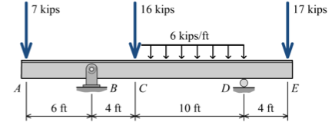
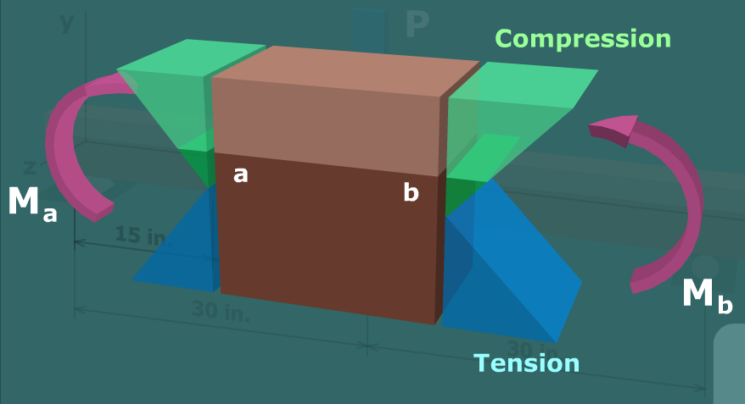
Bending stresses and equilibrium
Consider the segment of beam in textbook problem 8.21 from 2 ft to 4 ft
Bending moment
2ft
4ft
M=
M=ΔM
4in
6in
end view
Bending stress distribution resulting from moment
V
M

Slide 3
Bending stress distribution
Bending stress distribution resulting from moment
(repeated)
Consider the top 2” of the beam
Recall that if a body is in equilibrium
any portion of that body must also
be in equilibrium
Since the axial forces on each side of a segment of a beam that is NOT in pure bending are not equal, another force must be present in order to maintain equilibrium.
This is the transverse shear force

Slide 4
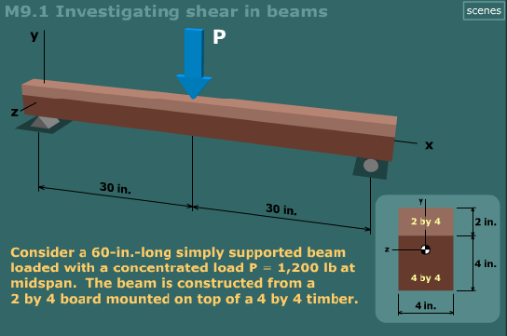
Transverse shear
Transverse shear is also called axial or horizontal shear
The difference in bending moment from the left side of the beam to the right side of the beam is what creates the need for the transverse shear force.
If the bending moment were constant along a beam segment, there would be no horizontal shear force within the material.
Pop out to MM Module 9.1

Slide 5
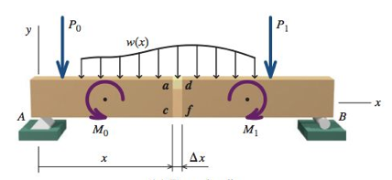
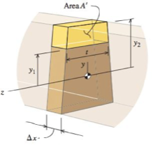
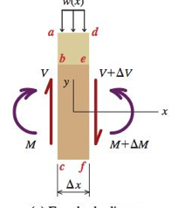
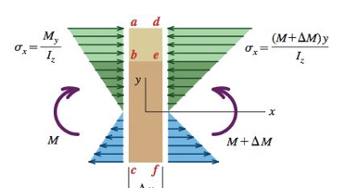
Deriving the shear stress formula
Consider a beam with arbitrary loadings and cross-sectional profile as shown
A section of the beam has internal shear and bending moments, which result in bending stresses.
The area above the point y1 (called A’) has some distribution of bending stresses on it. Recall that the bending stress equation is: $σ_{x}=\frac{My}{I}$

Slide 6
Deriving the shear stress formula
Consider a beam with arbitrary loadings and cross-sectional profile as shown
A section of the beam has internal shear and bending moments, which result in bending stresses.
The area above the point y1 (called A’) has some distribution of bending stresses on it. Recall the stresses are given by __sigma=my/I___.

Slide 7
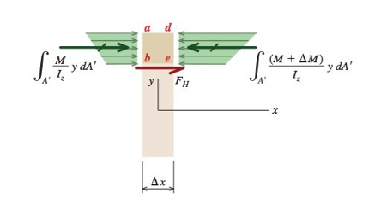
Shear stress formula continued
We can apply equilibrium to the section above y1 (A’)

Slide 8
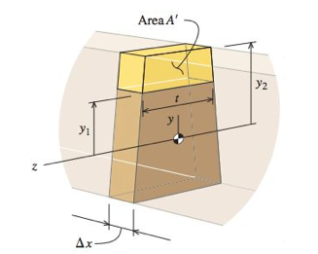
Shear stress formula part III
We have developed an expression for the shear force. Since stress is defined as a force divided by the area over which it acts, the transverse shear stress is found by dividing the shear force by the area (area=t*𝛥x not A’)
Recall from V and M diagrams that $\frac{dM}{dx}=V$

Slide 9
Example Problem
For the cross section at a-a determine the magnitude of the shear stress at point H. The value of Q at point H is 108 in³ The max value of Q is 168.75 in³
Remember, I_{z} for a rectangle is $I_{z}= \frac{bh^{3}}{12}$
V
M

Slide 10
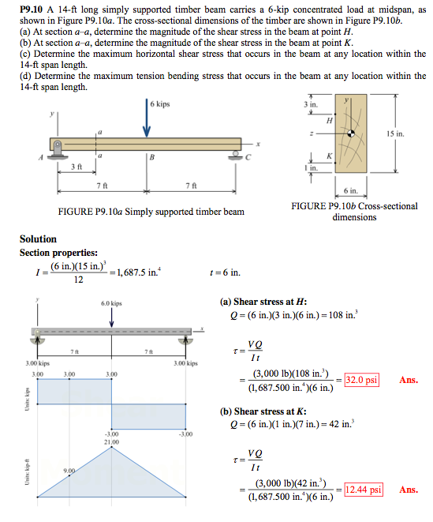
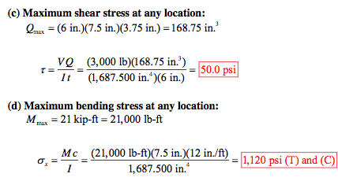
Example Problem

