Slide 1
Mechanics of Materials Engr 350 – Lecture 29 Beam Deflections

Slide 2
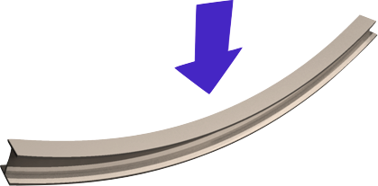
Deflection
Just like axial loadings cause a member to stretch, loads on a beam cause it to deflect
Beam deflections depend on the
The stiffness of the material
Beam cross-sectional dimensions
Loading state
We will first consider the integration method for determining the shape of the deformed beam.

Slide 3
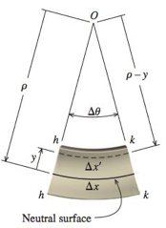
Beam deflections by integration
x coordinate: measures position along the beam (usually start from left end)
y coordinate: measures vertical position within beam (almost always from neutral axis, upward)
v coordinate: measures displacement of the neutral axis (measured from x-axis to neutral surface)
The x and y coordinates are the same as those used in the derivation of the flexure formula
Recall the moment curvature relationship developed before (L21/sect 8.4)

Slide 4
Differentiating the elastic curve
From calculus
substituting the expression for the moment-curvature relationship we reach
Notice that M is a function of x (most of the time it is)

Slide 5
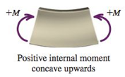

Beam relationships
Moment sign conventions:
Deflection: ν
Slope: $\frac{dν}{dx}=θ$
Moment: $EI\frac{d^{2}ν}{{dx}^{2}}=M$
Shear: $\frac{dM}{dx}=EI\frac{d^{3}ν}{{dx}^{3}}=V$ (if EI is a constant)
Load: $\frac{dV}{dx}=EI\frac{d^{4}ν}{{dx}^{4}}=w$ (if EI is a constant)

Slide 6
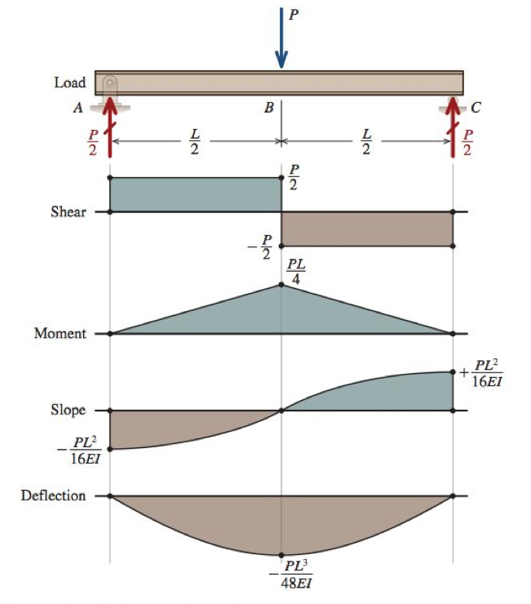
Relationships between beam diagrams

Slide 7
Relationships between beam diagrams
If you know the deflection curve:
Derivative of deflection to get slope
Derivative of slope to get moment
Derivative of moment to get shear
Only one problem: we can’t measure deflection easily ☹
Usually start from shear and INTEGRATE!

Slide 8
Deflections by integration of the moment equation
If the beam meets all of several assumptions, the moment equation can be integrated to give the deflections of the beam
These assumptions are
Beam deflections are small
Planes remain plane
E & I are constant (constant material, prismatic)
Boundary conditions
Specific values of deflection or slope that are known.
When a beam is analyzed in sections, the boundary conditions are known at the ends of the section. (Bounds of section considered, not necessarily the beam)
One BC can be used only once to determine a constant of integration

Slide 9
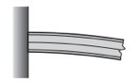
Boundary conditions continued
At a pinned or roller support we know that $ν=0$
At the fixed end of a cantilever beam, we know two things $ν=0, and \frac{dν}{dx}=0$
At the free end of a cantilever beam we know two things
$$V=0, and M=0$$

Slide 10
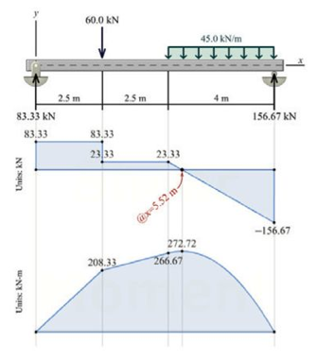
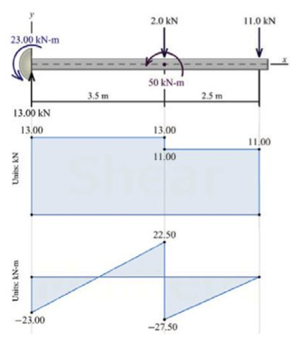
Continuity conditions
In beams, different sections can have different moment and shear equations, so we must write different deflection equations in each section. Since the beam is continuous, there is not an abrupt change in the the deflection or slope of the beam and this fact can be used as a “boundary condition” to solve for constants for the specific section.

Slide 11
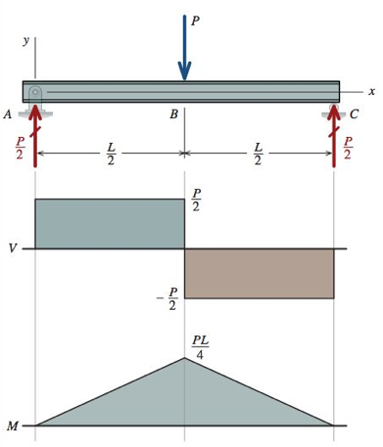
Symmetry conditions
Sometimes symmetry exists in a beam
In this case, the slope at the mid-span must be zero
Remember, only one constant of integration can be determined from each boundary, continuity, or symmetry condition.

Slide 12
Homework for Tonight
All about boundary conditions
MM Module 10.1 has a beam boundary condition game
14-15 beam boundary conditions
Type in name and print result
Tips:
Try printing from the machine before you play the game.
If that doesn’t work, see if you can print/save a PDF, then print that file elsewhere

Slide 13
Procedure for double integration method
1. Sketch: Sketch the beam including supports, loads, and the x–v coordinate system. Sketch the approximate shape of the elastic curve.
2. Support reactions: Determine the beam reactions by considering the equilibrium of the entire beam. Show these reactions in their proper direction on the beam sketch.
3. Equilibrium: For each segment to be considered, draw a FBD that cuts through the beam segment at some distance x from the origin. Show all loads acting on the FBD. From the FBD, derive the bending-moment equation, taking care to note the interval for which it is applicable ____________________
4. Integration: For each segment, set the bending-moment equation equal to ____________ Integrate this differential equation twice, obtaining a slope equation __________, a deflection equation ______, and two constants of integration.
5. Boundary and continuity conditions: List the boundary conditions that are applicable for the bending-moment equation.
6. Evaluate constants: Use the boundary and continuity conditions to evaluate all constants of integration.
7. Elastic curve and slope equations: Replace the constants of integration in step 4 with the values obtained from the boundary and continuity conditions in step 6.
8. Deflections and slopes at specific points: Calculate the deflection at specific points when required.

Slide 14
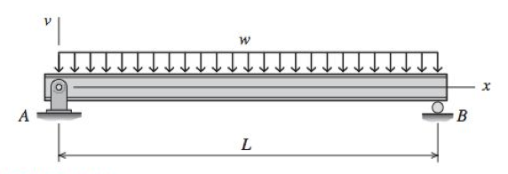
Example problem
For the beam and loading shown, use the double-integration method to determine
(a) the equation of the elastic curve for the beam. (b) the maximum deflection. (c) the slope at A.
Assume that EI is constant for the beam.

