Slide 1
Mechanics of Materials Engr 350 – Lecture 30 Beam Deflection Integration Method

Slide 2
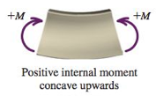
Beam relationships
Moment sign conventions:
Deflection: ν
Slope: $\frac{dν}{dx}=θ$
Moment: $EI\frac{d^{2}ν}{{dx}^{2}}=M$
Shear: $\frac{dM}{dx}=EI\frac{d^{3}ν}{{dx}^{3}}=V$ (if EI is a constant)
Load: $\frac{dV}{dx}=EI\frac{d^{4}ν}{{dx}^{4}}=w$ (if EI is a constant)

Slide 3
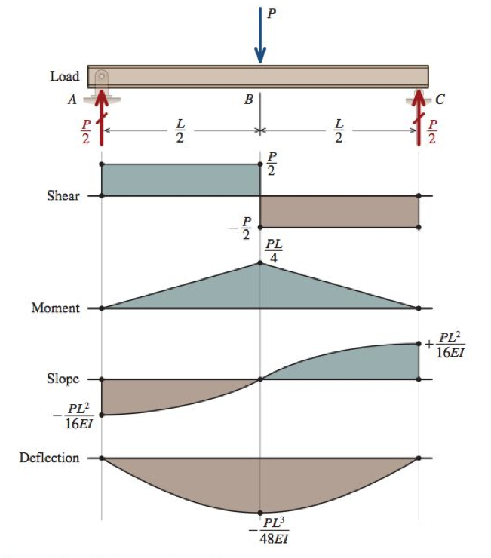
Relationships between beam diagrams
If you know the deflection curve:
Derivative of deflection to get slope
Derivative of slope to get moment
Derivative of moment to get shear
Only one problem: we can’t measure deflection easily ☹
Usually start from moment diagram and INTEGRATE to get deflection!

Slide 4
Deflections by integration of the moment equation
If the beam meets all of several assumptions, the moment equation can be integrated to give the deflections of the beam
These assumptions are
Beam deflections are small
Planes remain plane
E & I are constant (constant material, prismatic)
Boundary conditions
Specific values of deflection or slope that are known.
When a beam is analyzed in sections, the boundary conditions are known at the ends of the section. (Bounds of section considered, not necessarily the beam)
One BC can be used only once to determine a constant of integration

Slide 5
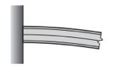
Boundary conditions continued
At a pinned or roller support we know that $ν=0$
At the fixed end of a cantilever beam, we know two things $ν=0, and \frac{dν}{dx}=0$
At the free end of a cantilever beam we know two things
$$V=0, and M=0$$

Slide 6
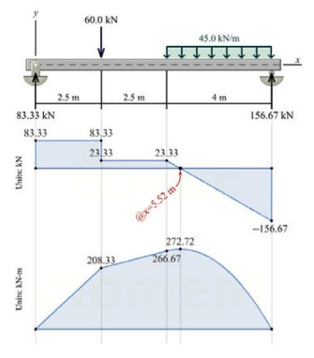
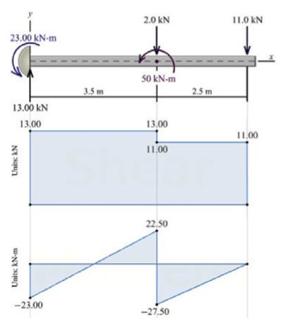
Continuity conditions
In beams, different sections can have different moment and shear equations, so we must write different deflection equations in each section. Since the beam is continuous, there is not an abrupt change in the the deflection or slope of the beam and this fact can be used as a “boundary condition” to solve for constants for the specific section.

Slide 7
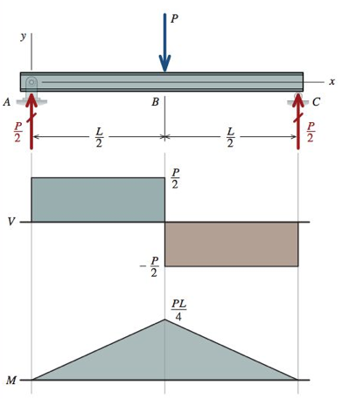
Symmetry conditions
Sometimes symmetry exists in a beam
In this case, the slope at the mid-span must be zero
Remember, only one constant of integration can be determined from each boundary, continuity, or symmetry condition.

Slide 8
Procedure for double integration method
Sketch: Sketch the beam including supports, loads, and the x–v coordinate system. Sketch the approximate shape of the elastic curve.
Support reactions: Determine the beam reactions by considering the equilibrium of the entire beam. Show these reactions in their proper direction on the beam sketch.
Equilibrium: For each segment to be considered, draw a FBD that cuts through the beam segment at some distance x from the origin. Show all loads acting on the FBD. From the FBD, derive the bending-moment equation, taking care to note the interval for which it is applicable.
Integration: For each segment, set the bending-moment equation equal to $M=EI\frac{d^{2}ν}{{dx}^{2}}$ Integrate this differential equation twice, obtaining a slope equation $θ=\frac{dν}{dx}$, a deflection equation ν, and two constants of integration.
Boundary and continuity conditions: List the boundary conditions that are applicable for the bending-moment equation. If the beam is being cut in to segments, list the continuity conditions as well.
Evaluate constants: Use the boundary and continuity conditions to evaluate all constants of integration.
Elastic curve and slope equations: Replace the constants of integration in step 4 with the values obtained from the boundary and continuity conditions in step 6.
Deflections and slopes at specific points: Calculate the deflection at specific points when required.

Slide 9
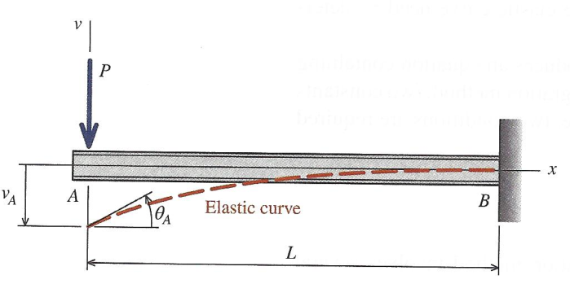
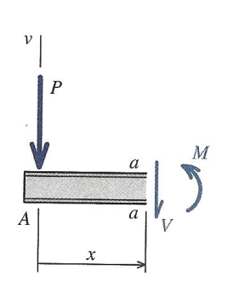
Example Problem 1
For the beam and loading shown, and assuming EI is constant, use the double-integration method to determine:
(a) the equation of the elastic curve for the beam. (b) the deflection and slope at A.
Sketch: Sketch the beam including supports, loads, and the x–v coordinate system. Sketch the approximate shape of the elastic curve.
See above
Support reactions: Determine the beam reactions by considering the equilibrium of the entire beam. Show these reactions in their proper direction on the beam sketch.
There are no support reactions at x = 0, but there are two important reactions at x = L.
R_{B} = P, and M_{B} = PL
Equilibrium: For each segment to be considered, draw a FBD that cuts through the beam segment at some distance x from the origin. Show all loads acting on the FBD. From the FBD, derive the bending-moment equation, taking care to note the interval for which it is applicable.
The bending moment equation is:
M = -Px (sad beam)

Slide 10
Example Problem 1
For the beam and loading shown, and assuming EI is constant, use the double-integration method to determine:
(a) the equation of the elastic curve for the beam. (b) the deflection and slope at A.
Integration: For each segment, set the bending-moment equation equal to $M=EI\frac{d^{2}ν}{{dx}^{2}}$ Integrate this differential equation twice, obtaining a slope equation $θ=\frac{dν}{dx}$, a deflection equation ν, and two constants of integration.
$EI\frac{d^{2}ν}{{dx}^{2}}=−Px$
$EI\frac{dν}{dx}=−\frac{Px^{2}}{2}+C_{1}$
$EIv=−\frac{Px^{3}}{6}+C_{1}x+C_{2}$
Boundary and continuity conditions: List the boundary conditions that are applicable for the bending-moment equation. If the beam is being cut in to segments, list the continuity conditions as well.
At x = 0 we don’t know the slope or the deflection. But at x = L we know both! Additionally, the single moment equation applies over the whole length from $0≤x≤L$
At x = L, $\frac{dν}{dx}=0$, and $v=0$
Evaluate constants: Use the boundary and continuity conditions to evaluate all constants of integration.
$EI(0)=−\frac{P{(L)}^{2}}{2}+C_{1}$, so $C_{1}=\frac{PL^{2}}{2}$
$EI(0)=−\frac{P{\left(L\right)}^{3}}{6}+\frac{PL^{2}}{2}(L)+C_{2}$, so $C_{2}=−\frac{PL^{3}}{3}$

Slide 11
Example Problem 1
For the beam and loading shown, and assuming EI is constant, use the double-integration method to determine:
(a) the equation of the elastic curve for the beam. (b) the deflection and slope at A.
Elastic curve and slope equations: Replace the constants of integration in step 4 with the values obtained from the boundary and continuity conditions in step 6.
Elastic curve equation: $EIv=−\frac{Px^{3}}{6}+\frac{PL^{2}}{2}x−\frac{PL^{3}}{3}$, which becomes $v=\frac{P}{6EI}(−x^{3}+3L^{2}x−2L^{3})$
Beam slope equation: $EI\frac{dν}{dx}=−\frac{Px^{2}}{2}+\frac{PL^{2}}{2}$, which becomes $\frac{dν}{dx}=\frac{P}{2EI}(L^{2}−x^{2})$
Deflections and slopes at specific points: Calculate the deflection at specific points when required.
We want to find the specific values at point A, where x = 0. Substitute this in to the above equations to get:
$v_{A}=\frac{P}{6EI}(−{\left(0\right)}^{3} +3L^{2}(0)−2L^{3})$, which becomes $v_{A}=\frac{PL^{3}}{3EI}$
${\frac{dν}{dx}}_{A}=\frac{P}{2EI}(L^{2}−{(0)}^{2})$, which becomes ${\frac{dν}{dx}}_{A}=\frac{PL^{2}}{2EI}$

Slide 12
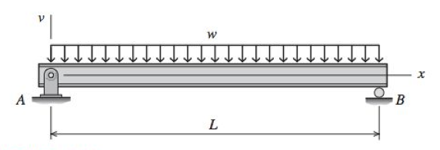
Example Problem 2
For the beam and loading shown, use the double-integration method to determine
(a) the equation of the elastic curve for the beam. (b) the maximum deflection. (c) the slope at A.
Assume that EI is constant for the beam.

