Slide 1
Mechanics of Materials Engr 350 – Lecture 31 Cheating by using Superposition

Slide 2
Superposition
The Principle of Superposition allows you to break hard problems up in to multiple easy problems, then add up all the answers
System must be linear (most mechanics systems are, as are DC electric circuits)
Deflection must have a linear relationship with the loading.
Hooke’s Law must apply to the material.
Loading must not significantly change the original geometry of the beam.
Boundary conditions resulting from the sum of individual cases must be the same as in the original beam configuration. Boundary conditions used should be slope or deflection values.

Slide 3
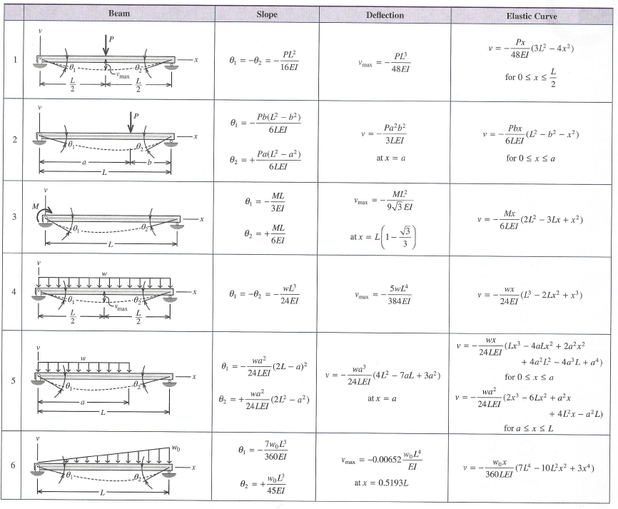

Slide 4
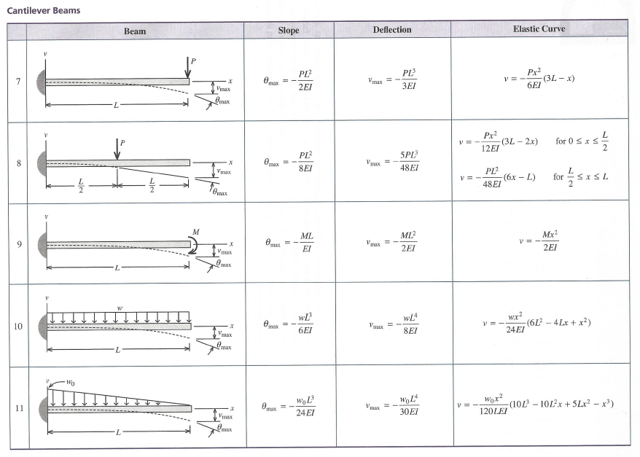

Slide 5
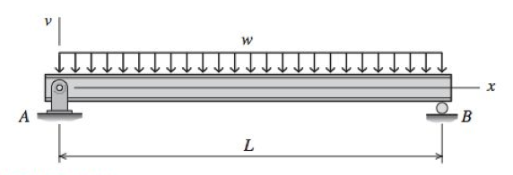
Example problem 1
For the beam and loading shown, use the double-integration method to determine
(a) the equation of the elastic curve for the beam. (b) the maximum deflection. (c) the slope at A.
Assume that EI is constant for the beam.

Slide 6
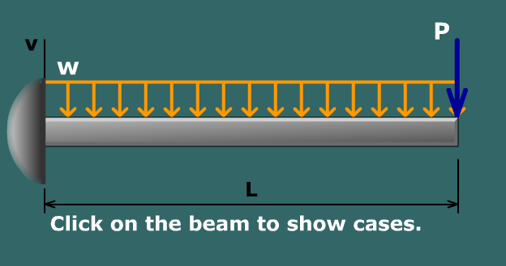
Example 2 - Superposition

Slide 7
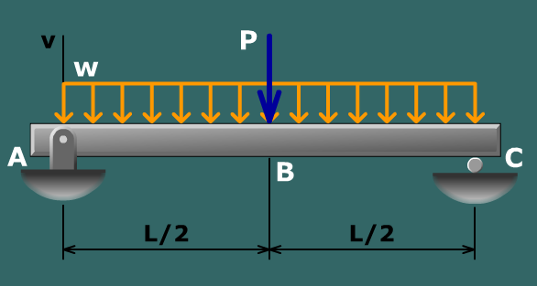
Example 3 - Superposition

