Slide 1
Mechanics of Materials Engr 350 – Lecture 31 What’s going to be on Exam 3?

Slide 2
Topics Since Exam 2
Shear and Moment Diagrams
Torsion
Bending
Transverse Shear

Slide 3
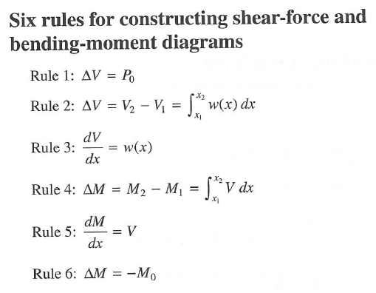
Shear and Moment Diagrams
If provided a FBD, can you create a correct shear diagram?
If provided a FBD, can you create a correct moment diagram?
If provided a shear diagram, can you create a moment diagram
If provided a moment diagram, can you create a shear diagram?

Slide 4
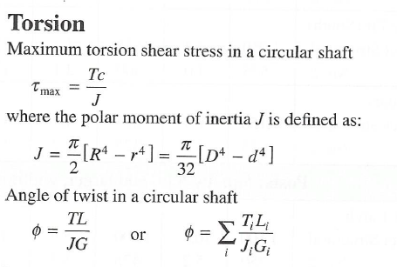
Torsion
If you are given a picture of a shaft with multiple torque inputs, can you determine the torque in any given segment of that shaft?
Can you solve for the angle of twist of any segment of a shaft?
Do you know how to calculate J for solid and hollow shafts?
What does the variable c represent in the equation below?
Where is the location of highest shear?

Slide 5
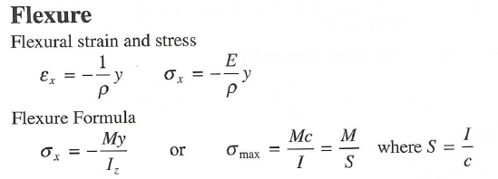
Bending
Can you solve for the bending stress at any location in a beam by knowing the radius of curvature and the beam cross section?
Can you solve for the bending stress at any location in a beam by knowing the moment and beam cross section?
Can you calculate I_{z} for a beam cross section?

Slide 6
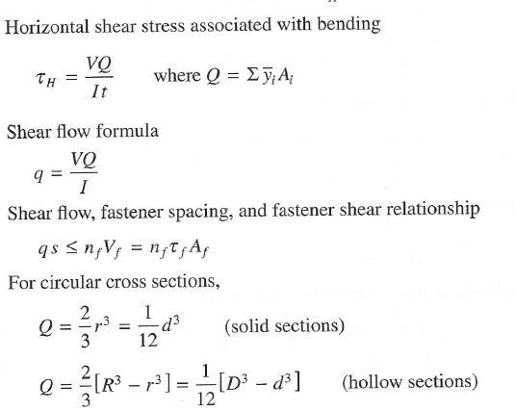
Horizontal Shear
Can you solve for the horizontal shear stress at any location in a beam?
Can you solve for Q at any point in a beam?
What is the variable t in the equation for shear stress below?

