Slide 1
Mechanics of Materials Engr 350 - Lecture 32 Thin Walled Pressure Vessels

Slide 2
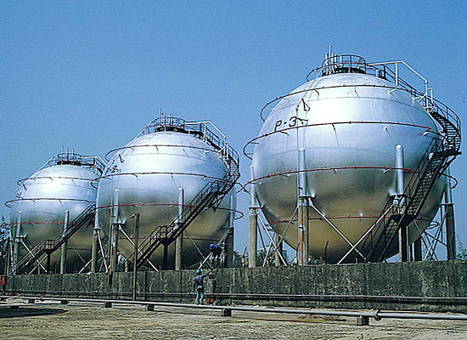
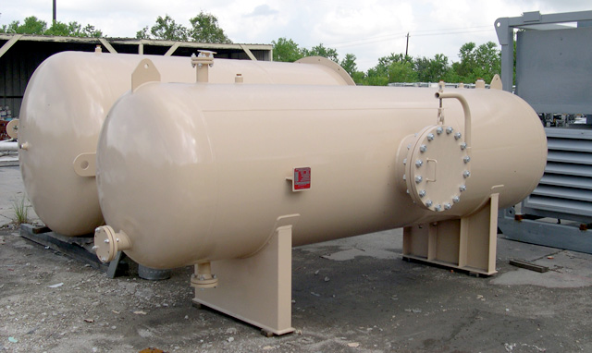
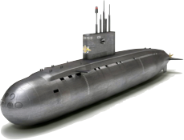
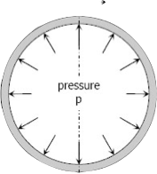
Pressure vessels
Structures that hold pressurized fluid
Examples:
Compressed tanks
Airplanes
Pipelines
Water tower
Inflatable boat
Balloon
In pressure vessels the stress varies across the thickness of the wall
Normal stress actually varies from a maximum value at the inside surface to a minimum value at the outside surface of the vessel wall.
Thin walled if:
Ratio of the inside radius to the wall thickness is greater than 10:1, it can be shown that the maximum normal stress is no more than 5 percent greater than the average normal stress. Therefore, a vessel can be classified as thin walled if the ratio of the inside radius to the wall thickness is greater than about 10:1

Slide 3
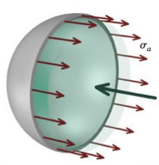
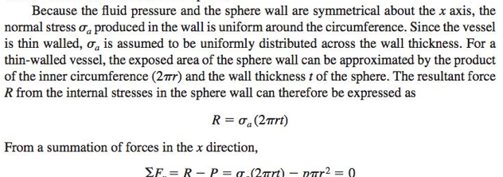
Analysis of spherical pressure vessels
Assumptions
Thin walled, as defined earlier
The weight of the fluid can be neglected , common
Cut sphere down the center and apply equilibrium

Slide 4
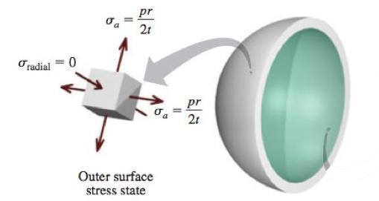
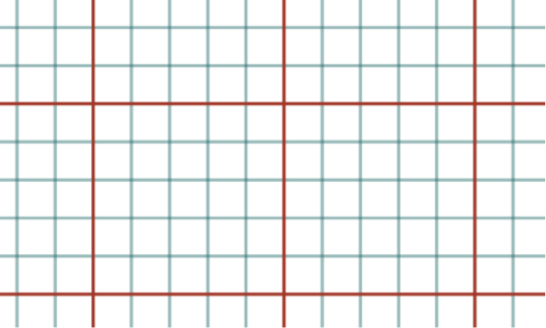
Stresses on the
outer surface
Draw Mohr’s circle
Maximum shear stress (out-of-plane):

Slide 5
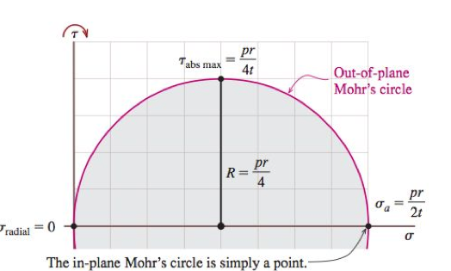
Stresses on the
outer surface
Draw Mohr’s circle
Maximum out of plane shear stress:

Slide 6
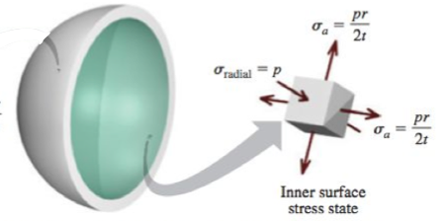
Stresses on the
inner surface
Draw Mohr’s circle
Maximum shear stress (out-of-plane):

Slide 7
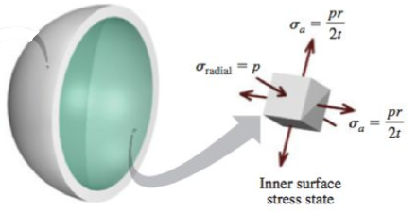
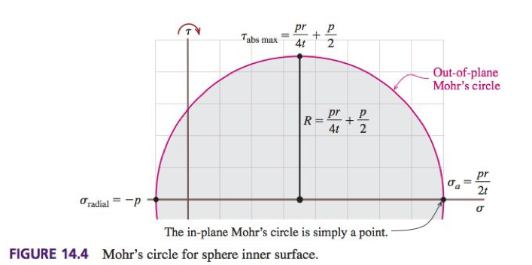
Stresses on the
inner surface
Draw Mohr’s circle
Maximum out of plane shear stress:
Note!: This is a triaxial state of stress

Slide 8
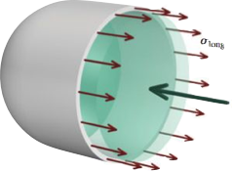
Analysis of cylindrical pressure vessels
Due to geometry, cylindrical PVs have two different types of stresses
S_long (longitudinal)
S_hoop (hoop)
Spherical PVs only have S_long
FBD for longitudinal stresses

Slide 9
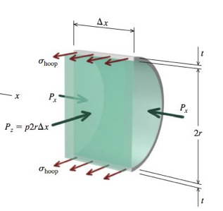
Hoop stresses
Cut and apply equilibrium
Note!: In a cylindrical pressure vessel, the hoop stresses are twice as large as the longitudinal stresses

Slide 10
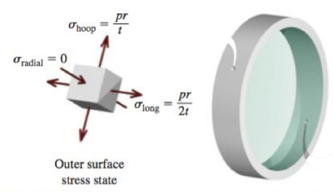
Stresses on the
outer surface
Draw Mohr’s circle
Maximum shear stress (out-of-plane):

Slide 11
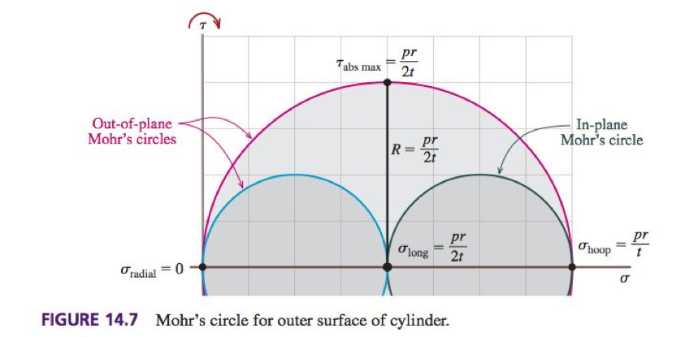
Stresses on the
outer surface
Draw Mohr’s circle
Maximum shear stress (out-of-plane):

Slide 12
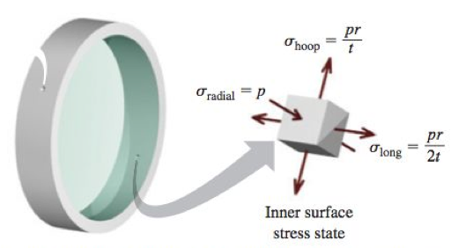
Stresses on the
inner surface
Draw Mohr’s circle
Maximum shear stress (out-of-plane):

Slide 13
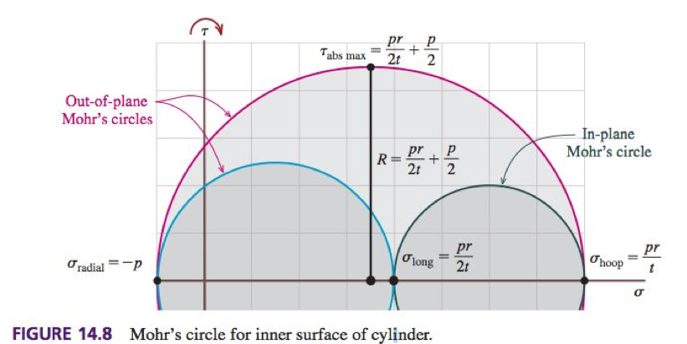
Stresses on the
inner surface
Draw Mohr’s circle
Maximum shear stress (out-of-plane):

Slide 14
Practice Problem 1

Slide 15
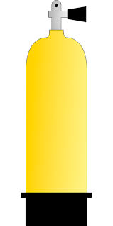
Practice Problem 2
A typical aluminum-alloy scuba diving tank is shown in the figure. The outside diameter of the tank is 6.5 in, and the wall thickness is 0.5 in. If the air in the tank is pressurized to 2500 PSI, determine the longitudinal and hoop stresses in the wall of the tank.

