Slide 1
Mechanics of Materials ENGR 350 - Lecture 33 Thin Walled Pressure Vessels 2

Slide 2
Key Equations – Thin-Walled Pressure Vessels
Spherical:
$σ_{t}=\frac{pr}{2t}=\frac{pd}{4t}$, and $ε_{t}=\frac{pr}{2tE}(1−v)$
Cylindrical:
$σ_{long}=\frac{pr}{2t}=\frac{pd}{4t}$, and $ε_{long}=\frac{pr}{2tE}\left(1−2v\right)$
$σ_{hoop}=\frac{pr}{t}=\frac{pd}{2t}$ , and $ε_{hoop}=\frac{pr}{2tE}(2−v)$
where:
p is pressure
d is diameter (where pressure is acting)
t is wall thickness
E is elastic modulus
$v$ is Poisson’s ratio

Slide 3
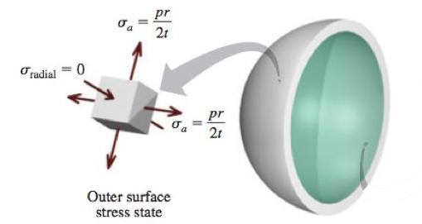
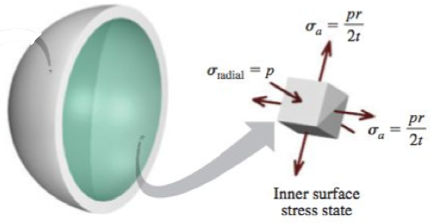
Key Equations – Thin-Walled Pressure Vessels
Spherical, Outer Surface:
$τ_{abs max}=\frac{1}{2}\left(σ_{t}−σ_{radial}\right) = \frac{1}{2}\left(\frac{pr}{2t}−0\right) = \frac{pr}{4t}=\frac{pd}{8t}$
Spherical, Inner Surface:
$τ_{abs max}=\frac{1}{2}\left(σ_{t}−σ_{radial}\right) = \frac{1}{2}\left(\frac{pr}{2t}−(−p)\right) = \frac{pr}{4t}+\frac{p}{2}=\frac{pd}{8t}+\frac{p}{2}$

Slide 4
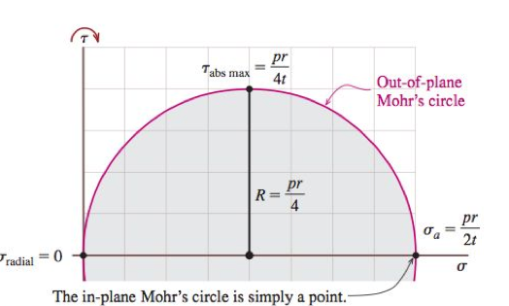
Stresses on the
outer surface
Draw Mohr’s circle

Slide 5
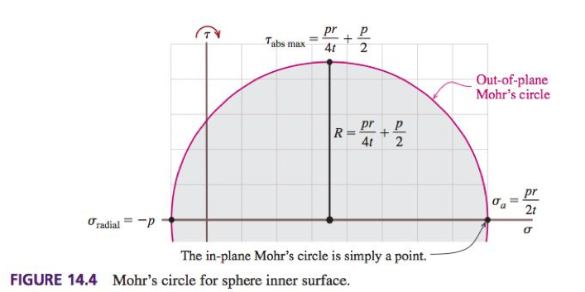
Stresses on the
inner surface
Draw Mohr’s circle
Note!: This is a triaxial state of stress

Slide 6
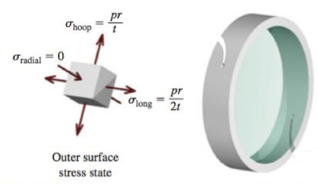
Key Equations – Thin-Walled Pressure Vessels
Cylindrical, Outer Surface, in-plane:
$τ_{max}=\frac{1}{2}\left(σ_{hoop}−σ_{long}\right) = \frac{1}{2}\left(\frac{pr}{t}−\frac{pr}{2t}\right) = \frac{pr}{4t}=\frac{pd}{8t}$
Cylindrical, Outer Surface, out-of-plane:
$τ_{abs max}=\frac{1}{2}\left(σ_{hoop}−σ_{radial}\right) = \frac{1}{2}\left(\frac{pr}{t}−0\right) = \frac{pr}{2t}=\frac{pd}{4t}$

Slide 7
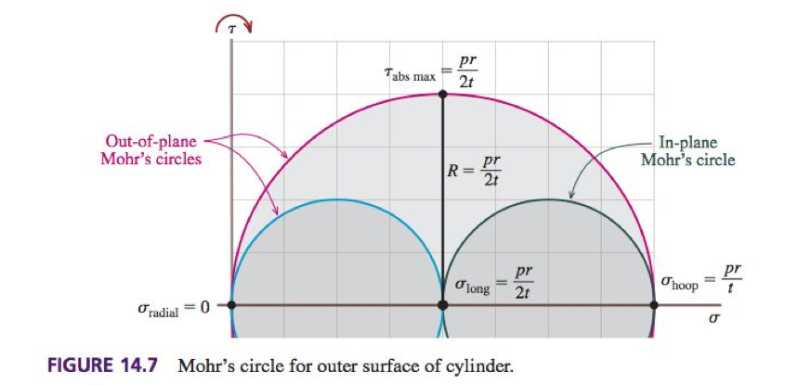
Stresses on the
outer surface
Draw Mohr’s circle

Slide 8
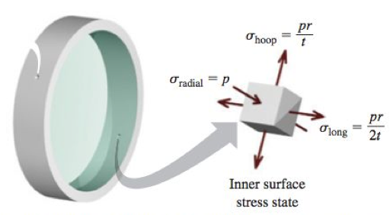
Key Equations – Thin-Walled Pressure Vessels
Cylindrical, Inner Surface, in-plane:
$τ_{max}=\frac{1}{2}\left(σ_{hoop}−σ_{long}\right) = \frac{1}{2}\left(\frac{pr}{t}−\frac{pr}{2t}\right) = \frac{pr}{4t}=\frac{pd}{8t}$ (Same as before)
Cylindrical, Inner Surface, out-of-plane:
$τ_{abs max}=\frac{1}{2}\left(σ_{hoop}−σ_{radial}\right) = \frac{1}{2}\left(\frac{pr}{t}−(−p)\right) = \frac{pr}{2t}+\frac{p}{2}=\frac{pd}{4t}+\frac{p}{2}$

Slide 9
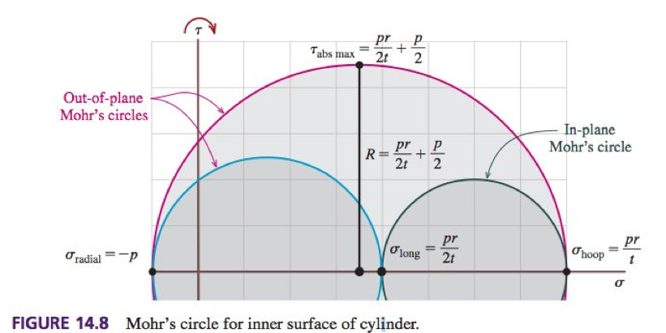
Stresses on the
inner surface
Draw Mohr’s circle
Maximum shear stress (out-of-plane):

Slide 10
Practice Problem 1
Cylindrical boiler has an outside diameter of 2.75 m, a wall thickness of 32 mm, and a yield strength of 340 MPa. Calculate the following:
If internal pressure is 2.3 MPa, find maximum normal stress
If internal pressure is 2.3 MPa, find maximum shear stress
If a factor of safety of 2.5 with respect to yielding must be maintained, find the maximum allowable pressure inside the tank

Slide 11
Practice Problem 2
In thermodynamics class we have boilers with internal pressure of 1600 psia (and temperature of 1100 °F). Those boilers have an outside diameter of 12 ft, a yield strength (at high temperature) of 35 ksi, and require a factor of safety with respect to yielding of 2.5. Calculate the minimum wall thickness.

Slide 12
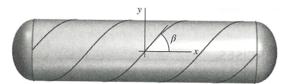
Practice Problem 3
Pressure tank shown above is fabricated from spirally wrapped metal plates with an orientation of β = 40°. The ID of the tank is 720 mm, and wall thickness is 8 mm. If the gage pressure inside the tank is 2.15 MPa, calculate (in-plane):
Normal stress perpendicular to the weld
Shear stress parallel to the weld

Slide 13
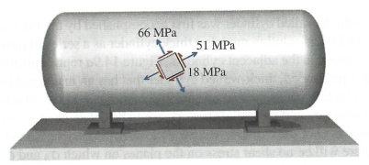
Practice Problem 4
Pressure tank shown above is has stress state as shown. The ID of the tank is 830 mm, and wall thickness is 10 mm. Calculate the gage pressure inside the tank.

Slide 14
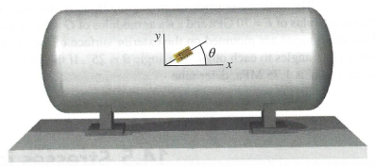
Practice Problem 5
A strain gage mounted at an angle of 25° measures a normal strain of 885 με. The ID of the tank is 1.6 m, and wall thickness is 8 mm. The aluminum tank has an elastic modulus of 73 GPA, and Poisson’s Ratio of 0.33. Calculate the gage pressure inside the tank.

