Slide 1
Mechanics of Materials Engr 350 – Lecture 35 Combined Loading AKA: SuperPosition is Still Awesome

Slide 2
Stress toolbox
We’ve investigated the following
Axial $σ=\frac{P}{A}$
Torsional $τ= \frac{Tc}{J}$
Bending $σ= \frac{My}{I}$
Shear $σ= \frac{VQ}{It}$
Many components are subjected to multiple types of loading we need to determine what the resulting loading is at the critical points
May use Superposition as long as the combination of stresses are still in the elastic (linear) region

Slide 3
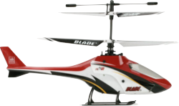
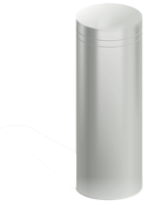
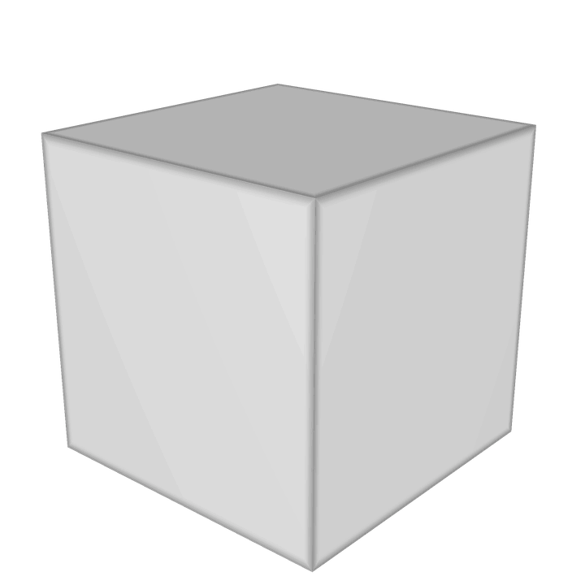
Combined axial and torsional loads
Consider the stress on the rotor shaft of a helicopter
Both axial and torsional loading
Where is axial stress highest?
Where is torsional stress highest?

Slide 4
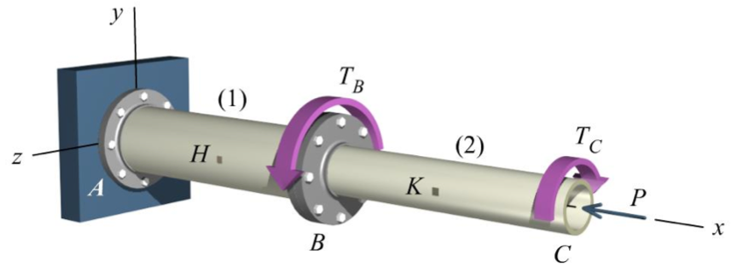
Example Problem 1
= 8 kN-m
= 12 kN-m
= 100 kN
A compound shaft consists of two pipe segments. Segment (1) has an outside diameter of 220 mm and a wall thickness of 10 mm.
- Determine the magnitude of the stresses on element at H.

Slide 5
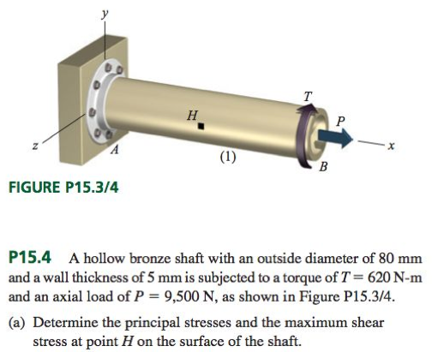
Example Problem 2

Slide 6
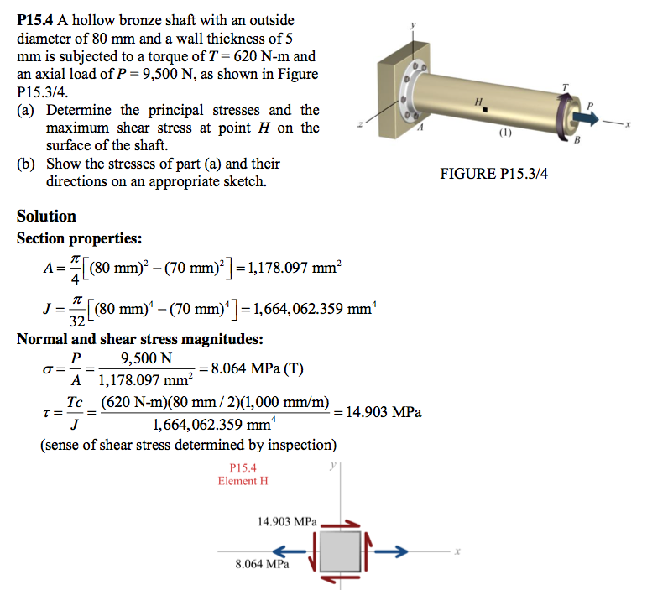
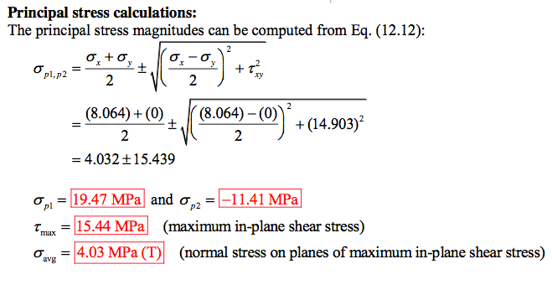
Try-it problem

Slide 7
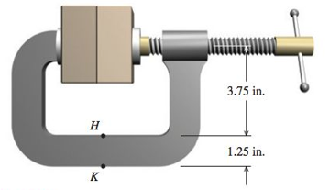
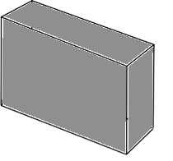
Example Problem 3
Consider the clamp

