Slide 1
Mechanics of Materials Engr 350 – Lecture 39 What’s On the Final Exam?

Slide 2
Statics
$\sum{F_{x}=0}$
$\sum{F_{y}=0}$
$\sum{M=0}$
Two-force members
Breaking force in to x and y components

Slide 3
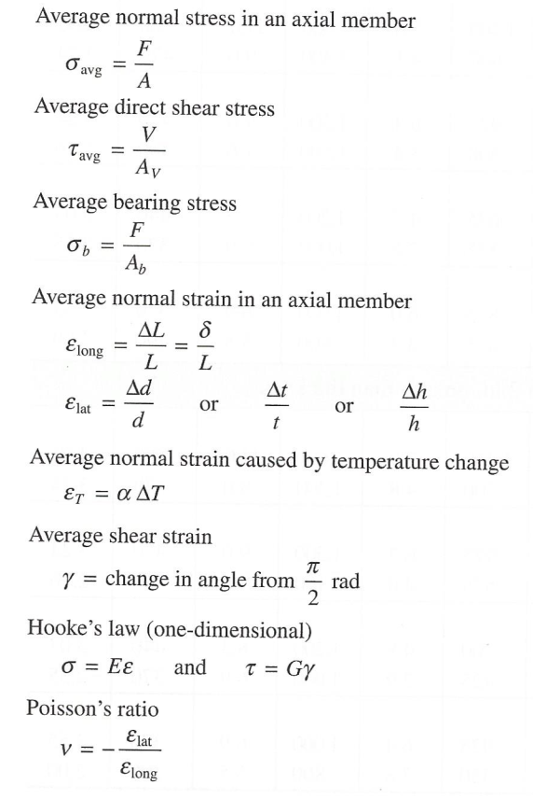
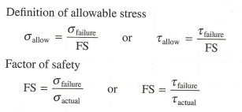
Average Stress, Temperature Change, FS

Slide 4
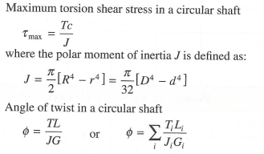
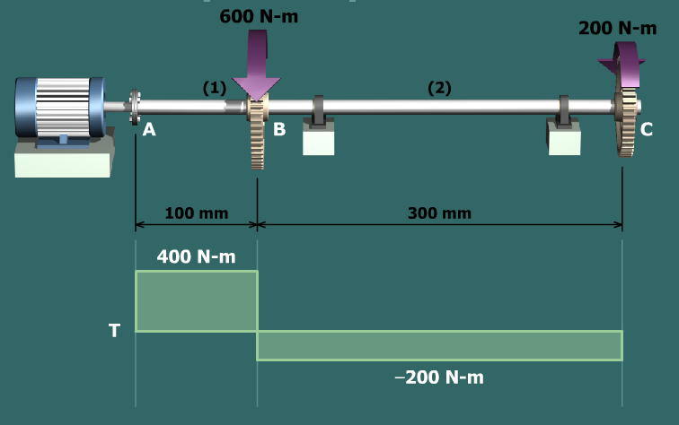
Torsion and Torque Diagram

Slide 5
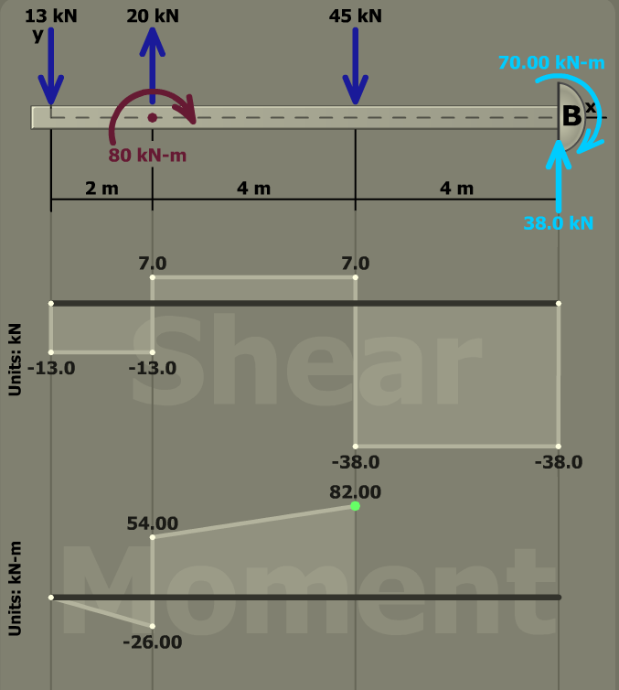
Flexure (Bending) and Shear-Moment Diagrams

Slide 6
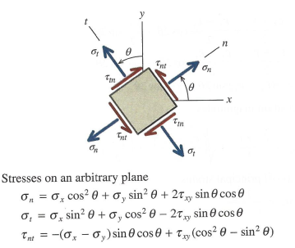
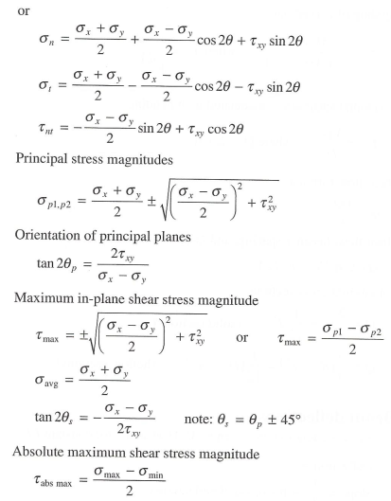
Stress Transformations and Mohr’s Circle

Slide 7
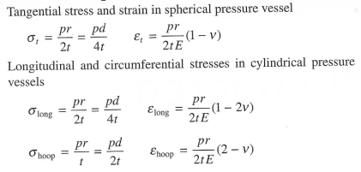
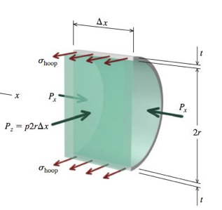
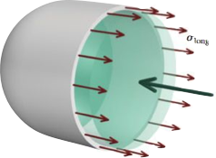
Thin-Walled Pressure Vessels

Slide 8
Types of Problems
Combined Loading
How to separate the problem in to multiple simple problems
How to select appropriate equation(s) for the stress state
How to draw the stress state on a stress element
How to compute the principle stresses and maximum shear stress
Background Calculations
Calculate location of centroid
Calculate area moment of inertia (and use of parallel axis theorem)
Calculate Q
Shear and moment diagrams
Torque diagrams
Relationships from static equilibrium
General Understanding
Location of max torsion
Location of max horizontal shear
Which is larger, hoop or longitudinal stress?

