Slide 1
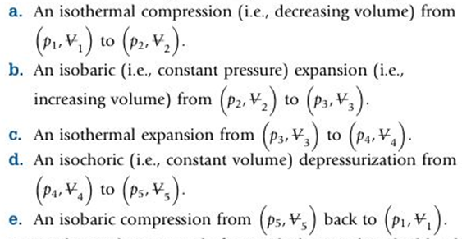
PROBLEM 2.28
GIVEN: An ideal gas that obeys the equation of state undergoing the following thermodynamic processes that make up a thermodynamic cycle,
FIND: Sketch the cycle described above on a p-V diagram
What does ‘iso’ mean?
Isothermal →
Isobaric →
Isochoric →
Isenthalpic→
Isentropic →

Slide 2
Where should we start on the plot?
p
2
3
4
5
1
V

Slide 3
Why is isothermal process curved on a p-V diagram?
$p∗V=m∗R∗T$ but… m = constant, R = constant, and T = constant
So $p∗V=constant$
If V gets very small, p must get very large
If V gets large, p must get small
Should behave like a hyperbolic function
https://www.youtube.com/watch?v=SyJgwYXzz2I
Reflection
• A thermodynamic cycle starts and ends at the exact same state.
• Some new terminology ‘iso____” that will be used throughout the course.
Reflection from Future Me
Work associated with each process can be determined from the area under curve.
• Net work for the entire cycle is the enclosed area by the cycle.

