Slide 1
Lecture 3
Thermodynamic Concepts

Slide 2
Terminology
System
Whatever is being studied
System boundary
Imaginary boundary that separates the system from its surroundings
A control volume is one example (non-moving)
Three Classifications:
Open system
Mass and/or energy can be transferred across the system boundary
Closed system
No transfer of mass across the system boundary
Energy can cross the system boundary
Isolated system
No transfer of mass or energy across the system boundary

Slide 3
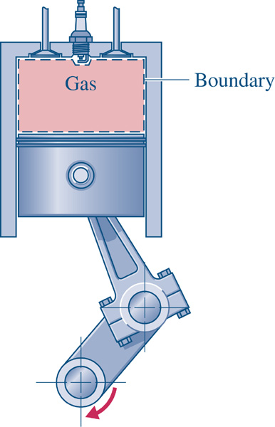
Engine Example #1
Piston-cylinder assembly in an internal combustion engine
Spark plug
System
Gas in the cylinder
System boundary
Changes volume as the piston moves up and down
Closed system
Only energy crosses the boundary during compression, combustion, and expansion
Open system
Both mass and energy cross the boundary (during intake and exhaust processes)
Valve
Valve

Slide 4
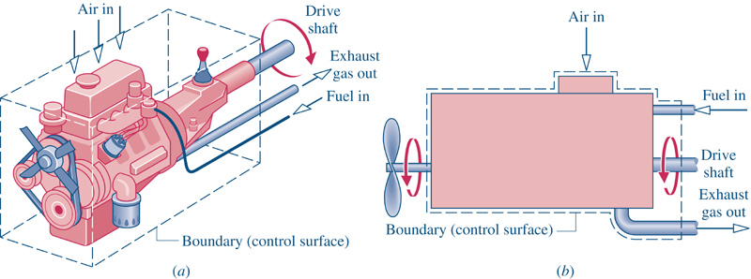
Engine Example #2
An internal combustion engine
System
What is the system being studied?
System boundary
Is it fixed or moveable?
System type
Is the system isolated, open, or closed?

Slide 5
System Descriptions
Microscopic view
Considers atomic and molecular contributions to properties of substances
Important when dealing on micro and nano scales
Macroscopic view (continuum thermodynamics)
Considers only bulk behavior of a substance
Molecular size and time scales much smaller than problem being analyzed
Point of view used in ME 322!

Slide 6
Properties
A property is a characteristic of a system
Intensive Properties
Independent of mass
Examples: pressure, temperature
Extensive Properties
Dependent on mass
Examples: Mass, total volume
Intensive/Extensive Cut-Test
Cut a volume of substance in half
If the property of the half is the same as the whole, then the property is intensive

Slide 7
Notation
Intensive properties – signified with a lower case letter. Intensive properties are usually preceded with the word ‘specific’. Exception: T (temperature)
Extensive properties – signified with a upper case letter. Exceptions: m (mass), n (moles)
Table 2.1 lists specific kinetic and specific potential energy. Are these properties?

Slide 8
Thermodynamic State
This is known as the State Postulate for simple systems
What is a pure substance? (more details on next slide)
What is a work mode?
What is a homogeneous substance? (more details on next slide)
When are intensive properties independent?
When are intensive properties dependent?

Slide 9
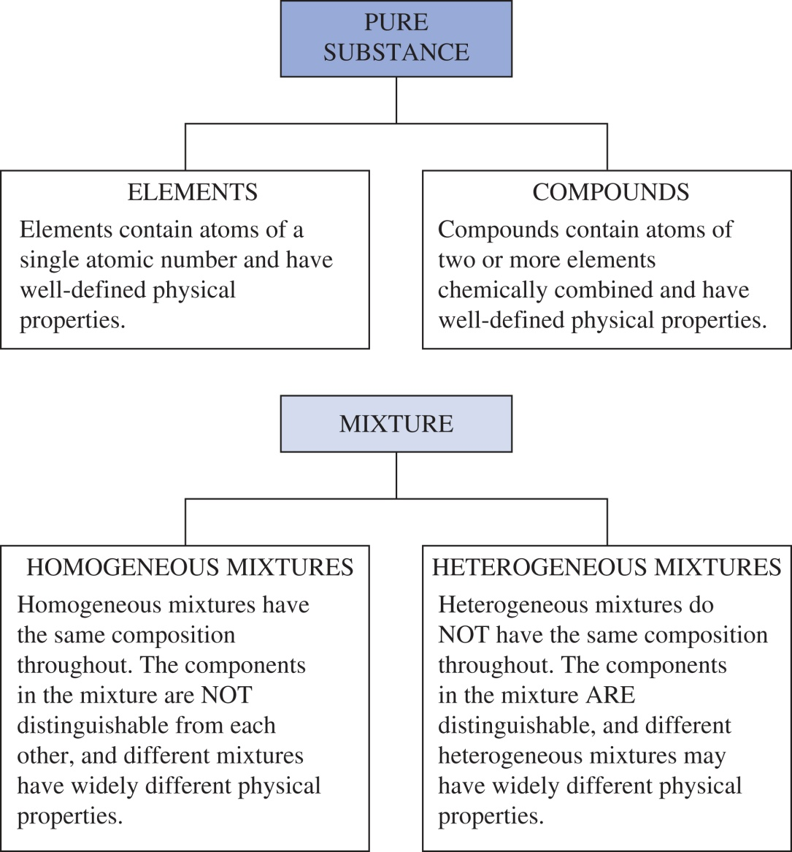
Pure Substances vs. Mixtures

Slide 10
Properties, States, and Processes
Consider a single phase pure substance (simple substance)
Pressure
(property)
(State 1)
Process – a series of states that occur as a system’s state is changed from state 1 to state 2
(State 2)
Temperature
(property)

Slide 11
Equilibrium
From mechanics
Equilibrium is defined as a condition of balanced forces
Thermodynamic equilibrium
Balance of several influences simultaneously
Forces and pressure (mechanical)
Temperature (thermal)
Chemical composition (chemical)
Others (phase, magnetic, etc.)

Slide 12
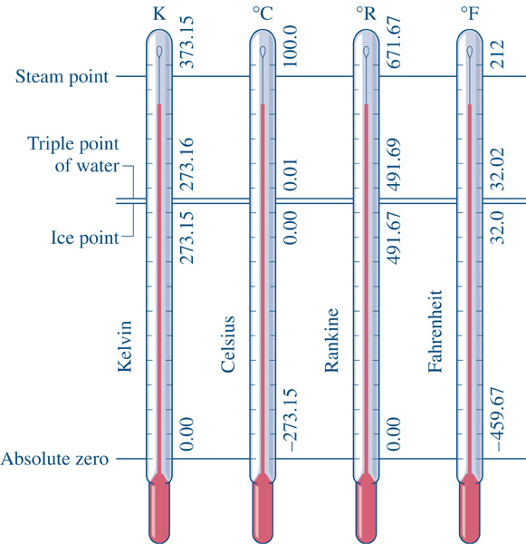
Pressure and Temperature
Pressure = force per unit area
Common units = lbf/in² (psi) or N/m² (Pa)
Temperature = a measure of molecular activity in a substance
Conversions
Notice …

Slide 13
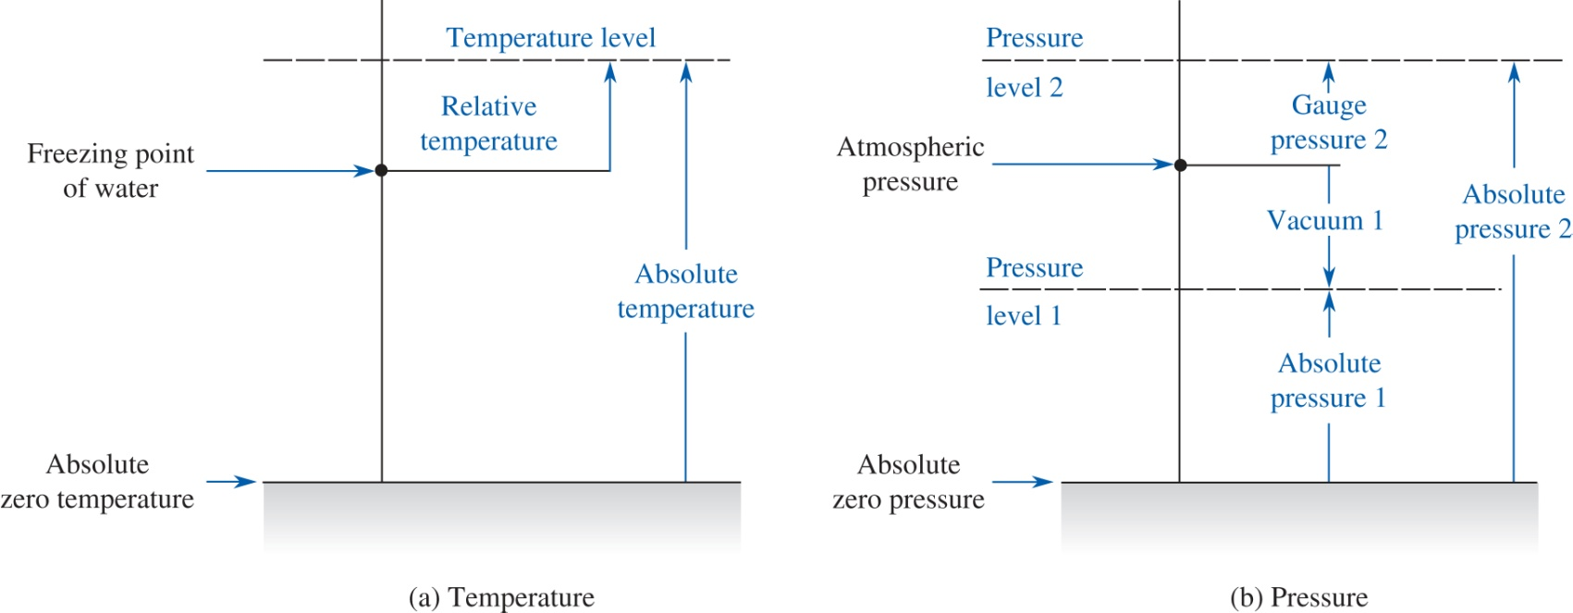
Absolute and Relative Values
In ME 322 pressure is most often expressed on the absolute scale. Temperature can be either relative or absolute. Recall that 1 atm = 14.696 psi = 101325 Pa (or 101.325 kPa).

Slide 14
When to use Absolute Values?
If pressure or temperature stands by itself, or is raised to some power in an equation, then the values assigned to it must be in an absolute scale of units!
For example, in the ideal gas equation p = mRT, both the pressure and temperature stand alone, so they both must be in absolute units. However, for the case of a constant volume and constant mass system, we can write this equation as:
(p₂ – p₁)V = mR(T₂ – T₁)
and since this equation has pressure and temperature differences, then they can both be in either absolute or relative units.

Slide 15
The Zeroth Law of Thermodynamics
If T_{A} = T_{B} and T_{B} = T_{C}, then T_{A} = T_{C}
T_{B}
T_{B}
Calibration using the Standard
Fixed Points
(e.g., freezing point of zinc)
692.677 K 419.527°C
T_{C}
T_{A}
Standard Thermometer
Calibrated Thermometer

Slide 16
Transitive Laws
T_{A} = T_{B} and T_{B} = T_{C} → then T_{A} = T_{C}
The above is an example of a transitive law. Many (but not all) properties have this relationship. For instance, here is an example of something that doesn’t obey the transitive law
Sandy loves Kevin S = K
Kevin loves his mom, Gertrud K = G
Sandy does *not* love Gertrud S ≠ G

