Slide 1
Lecture 27
Gas Power Generation
The Brayton Cycle

Slide 2
Gas Power Cycles
Much higher power output to weight ratio compared to vapor power cycles
Well suited for mobile power plants
Smaller stationary power plants
Commonly known as the gas turbine
Closed cycle
Open cycle

Slide 3
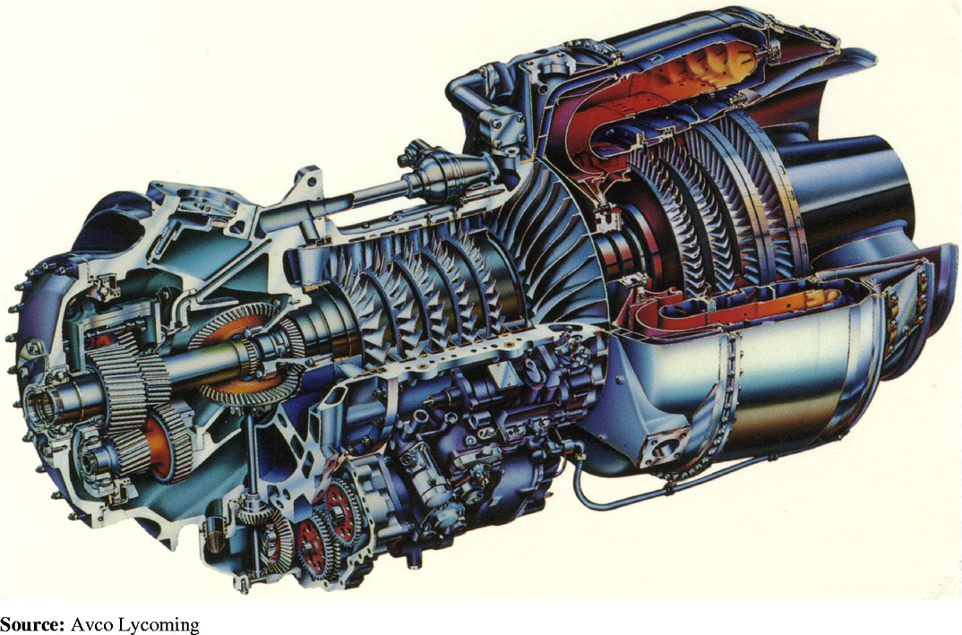
The Gas Turbine
Comparison of the schematic to the ‘real thing’

Slide 4
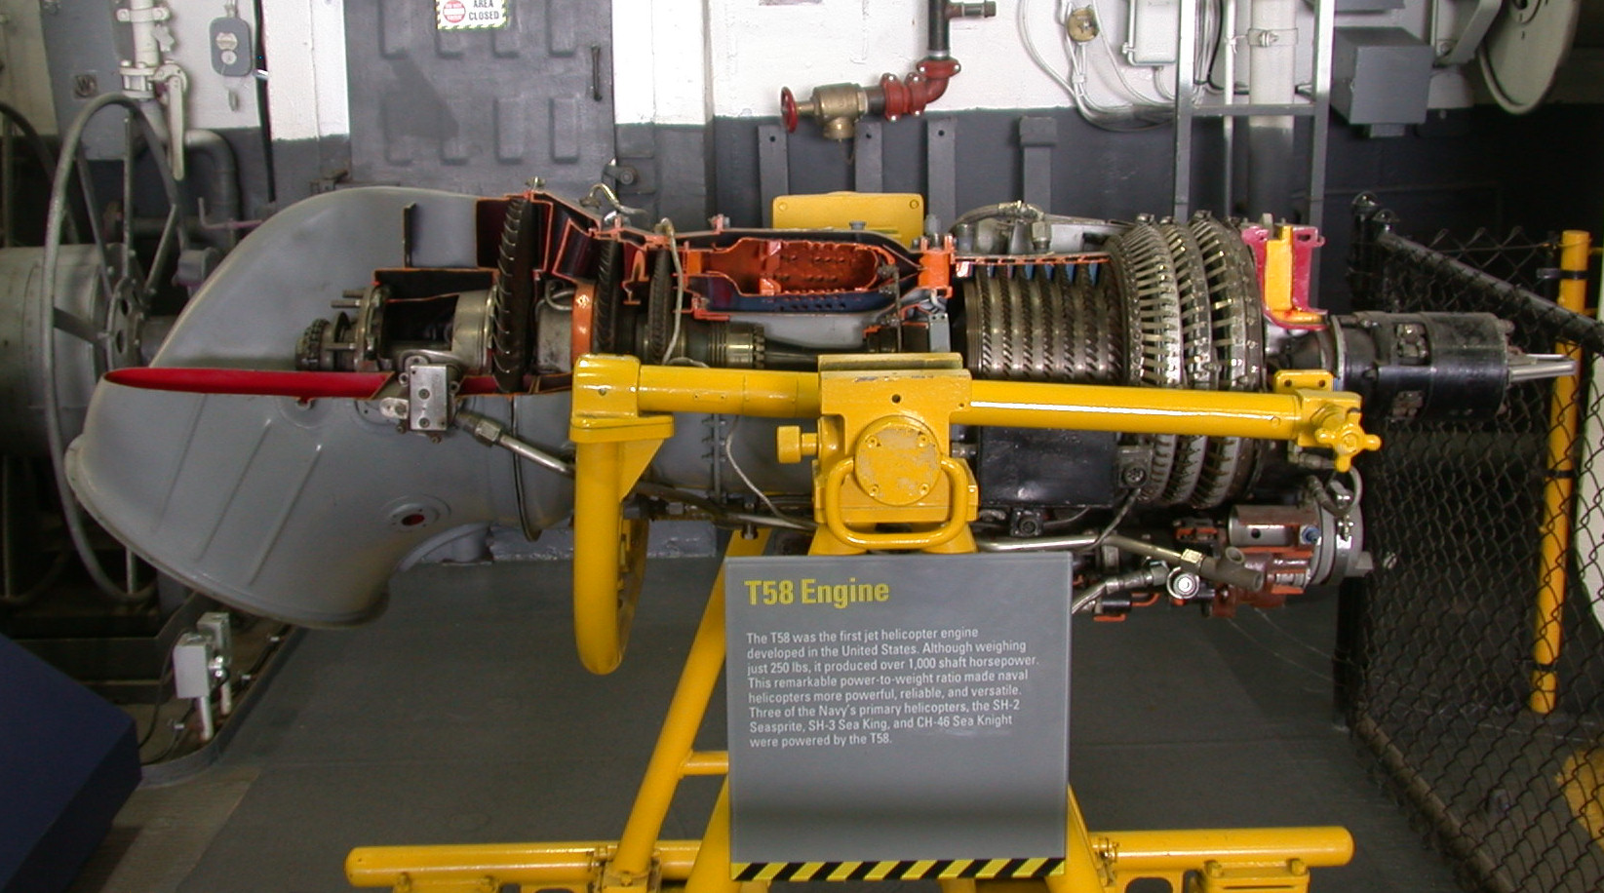
The Gas Turbine – T58 Engine
Helicopter turbine, 1000 hp, ~300 lb (Jet Boat)

Slide 5
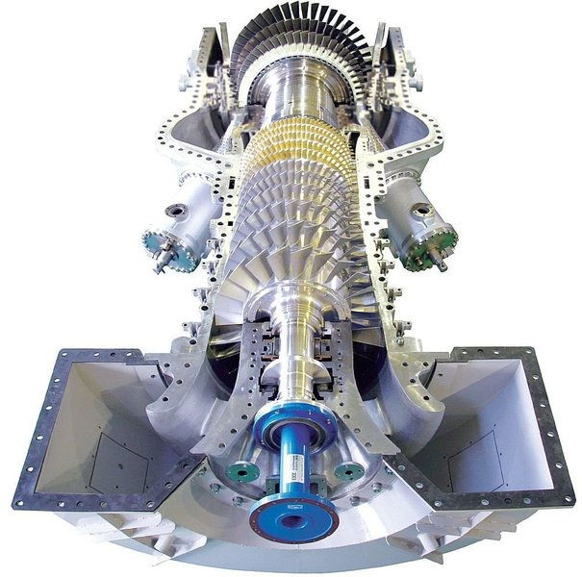
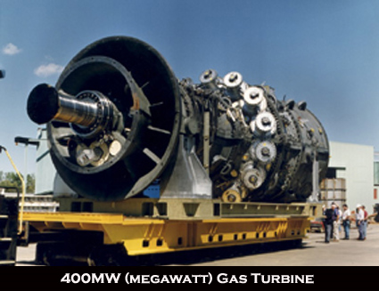
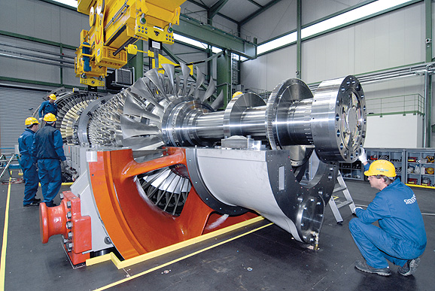
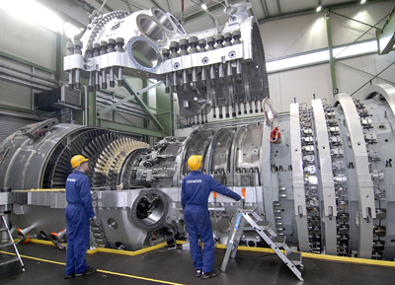
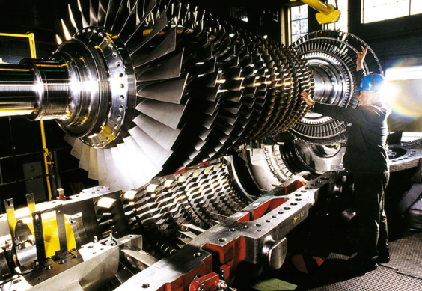
Gas Turbine Examples

Slide 6
The Air Standard Cycle (ASC) Analysis
A fixed amount of air modeled as an ideal gas is the working fluid
The combustion process is replaced by a heat transfer from an external source
All processes are internally reversible
The Cold Air Standard Cycle Analysis
All of the above plus … the heat capacity of the air is assumed to be constant

Slide 7
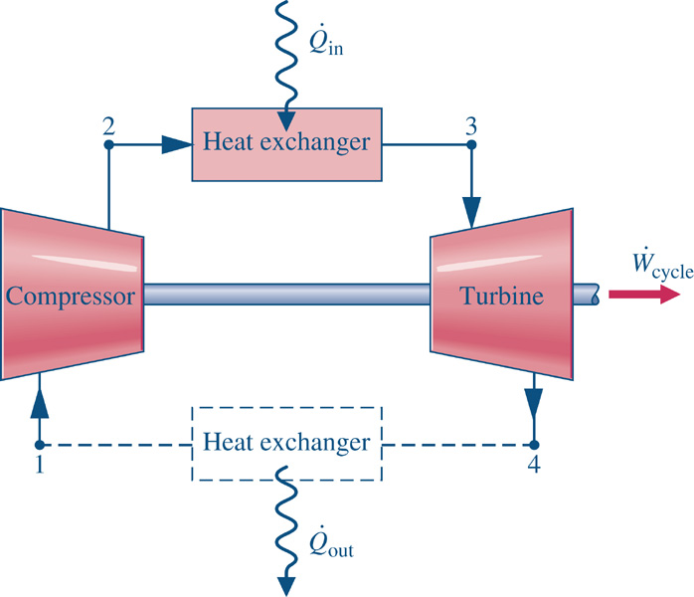
The Brayton Cycle
1-2: Reversible and adiabatic compression
2-3: Constant pressure heat addition
3-4: Reversible and adiabatic expansion
4-1 Constant pressure heat rejection

Slide 8
Brayton Cycle Analysis

Slide 9
Brayton Cycle Performance
Thermal Efficiency

Slide 10
Cold Brayton Cycle Performance
Cold Air Standard Thermal Efficiency
Processes 3-4 and 1-2 are isentropic

Slide 11
Cold Brayton Cycle Performance
Substituting ...
Since process 1-2 is isentropic,

Slide 12
Cold Brayton Cycle Performance
Define ...
Finally ... we have several ways to write the cold ASC thermal efficiency,

Slide 13
Gas Turbine Irreversibilities
Isentropic efficiencies in the turbine and compressor
Isentropic efficiencies in the turbine and compressor and pressure drops in the heat exchangers

