Slide 1
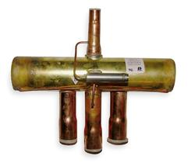
Reversing (4-way) Valve
Expansion Valve
Q_{out}
Q_{in}
Condenser
Evaporator
Condenser
Evaporator
Q_{in}
Compressor
Q_{out}
Refrigeration (Air-Conditioning) Mode
Heat Pump Mode

