Slide 1


Slide 2
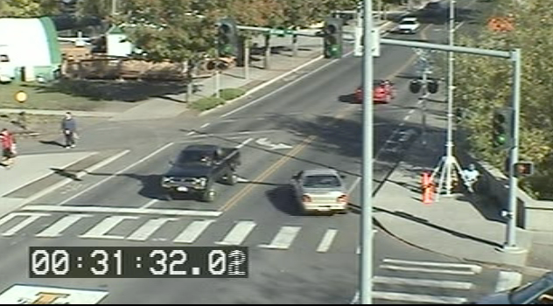

Slide 3
Some questions – queuing systems
What is a queuing system?
Which elements of a traffic control system are included in the queuing system?
Which elements of traffic flow can you represent in a time space diagram
What is a queue accumulation polygon and what information does it show about intersection operation and performance?

