Slide 2
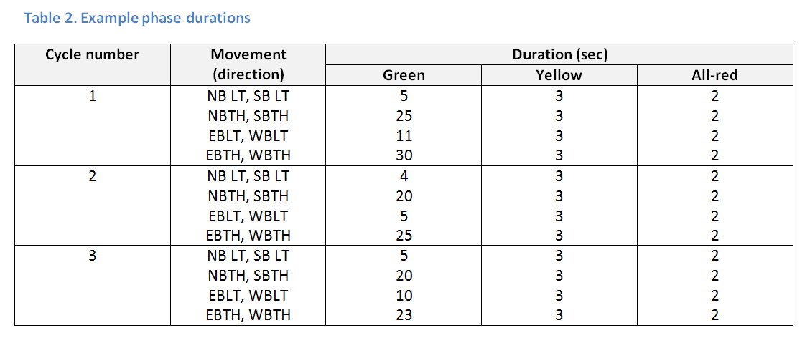
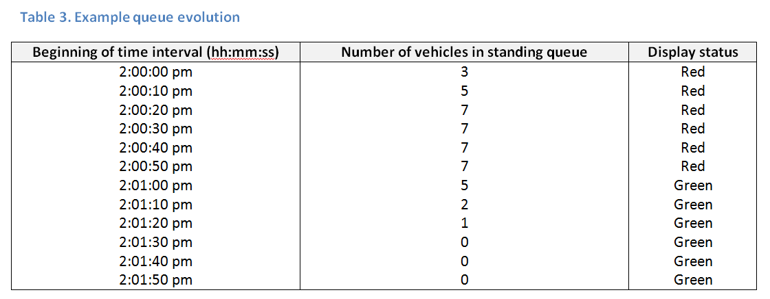
•Title page with activity number and title, authors, and date completed.
•Summary of your general observations and sketch.
•Description of the sequence of movements that you observed and the duration.
•Discussion of the queue pattern that you observed.
•Description of the efficiency of the intersection timing for the lane that you observed.
•Discussion of the pedestrian.
•Summary of traffic flow problems that you observed.

Slide 3
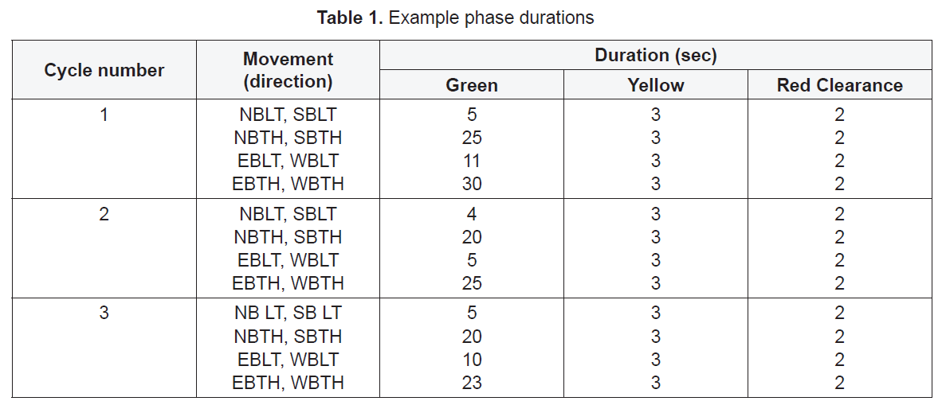

Slide 4
