Slide 1


Slide 3
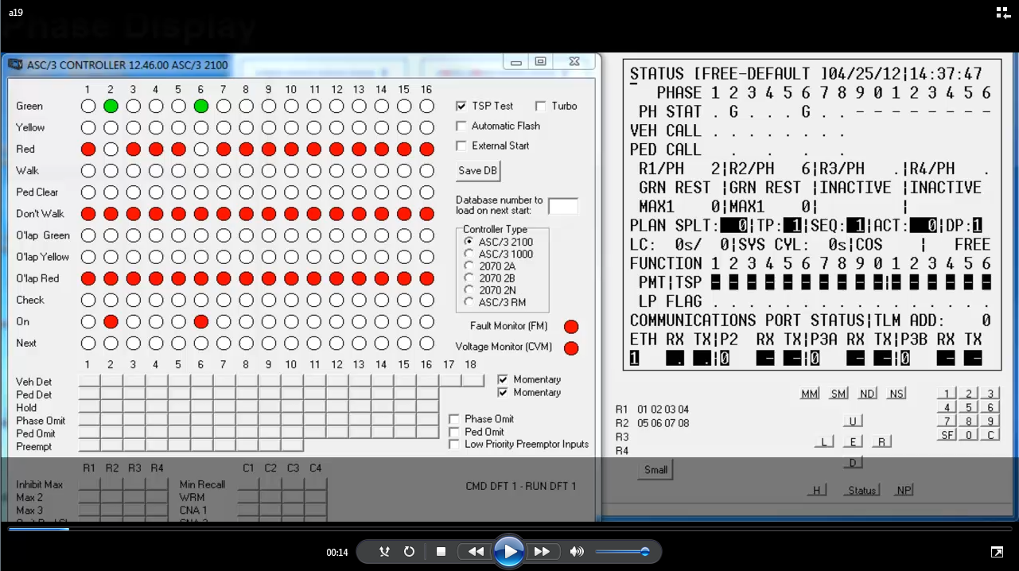

Slide 4
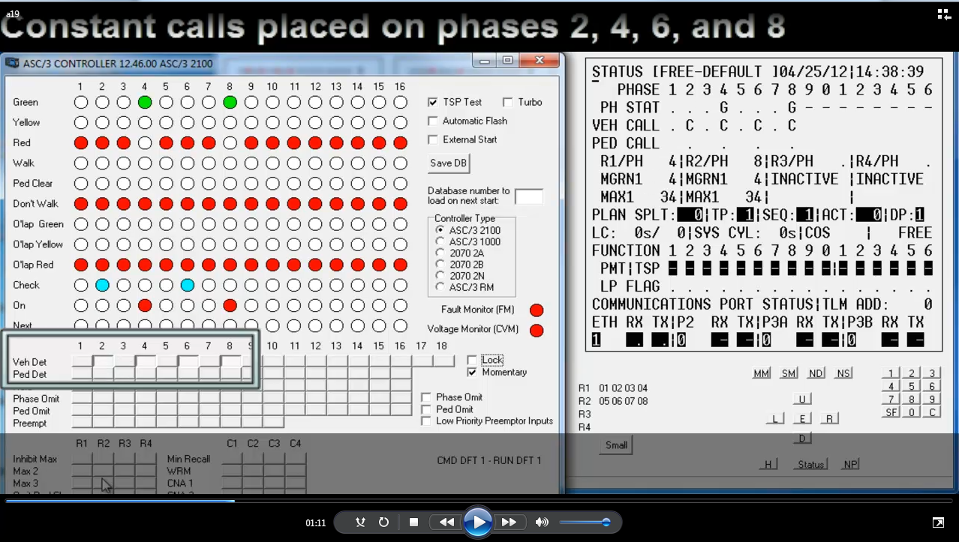

Slide 5
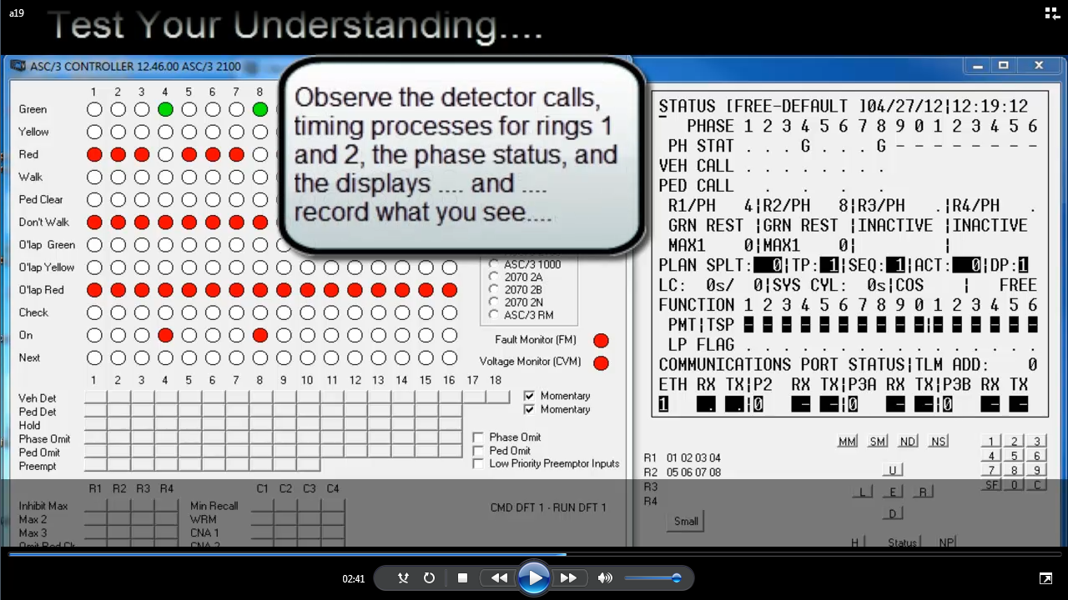

Slide 7
Conflicting call (on phase 4) spawns maximum green timer for phase 2

