Slide 1


Slide 2
Question 1
When is detector active; when is it inactive?

Slide 3
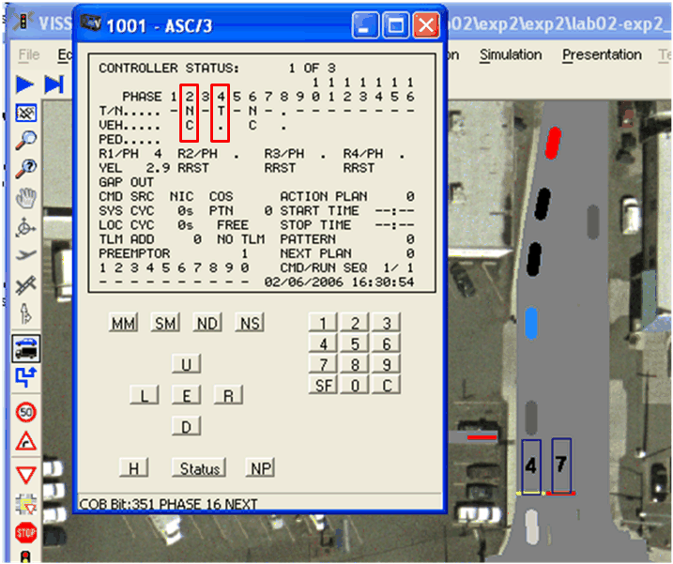
Question 1
When is detector active; when is it inactive?

Slide 4
Question 2
When does the phase terminate?

Slide 5
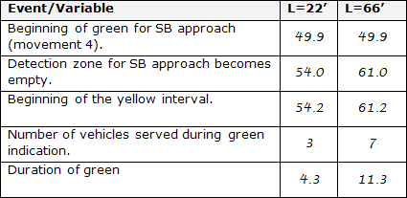
Question 2
When does the phase terminate?

Slide 6
Question 3
Why does the phase terminate?

Slide 7
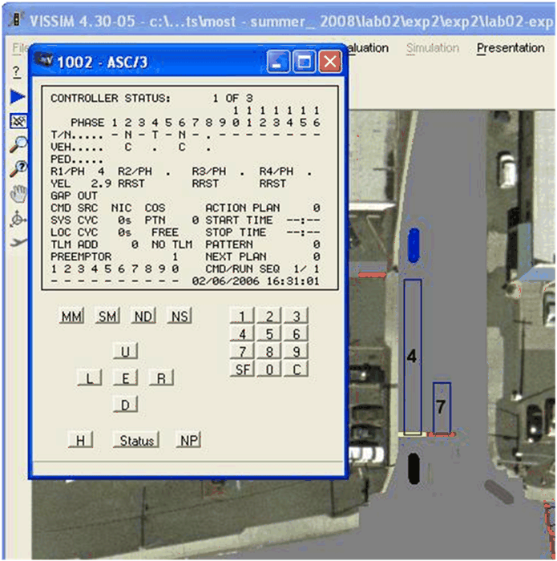
Question 3
Why does the phase terminate?

Slide 8
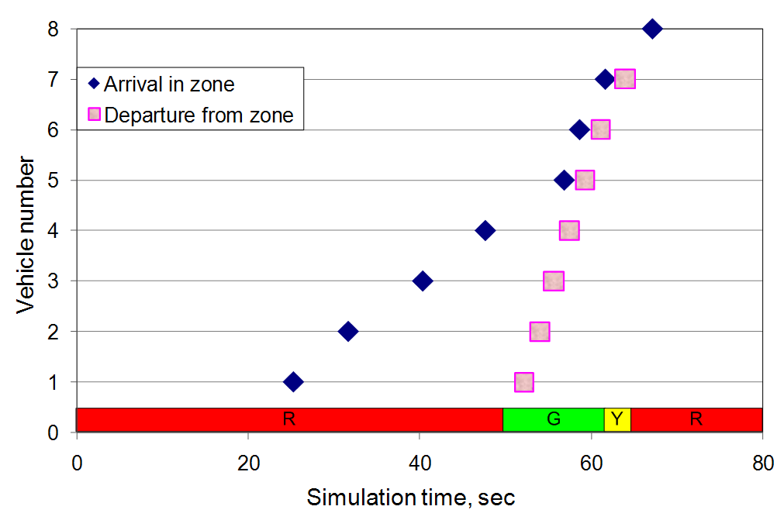
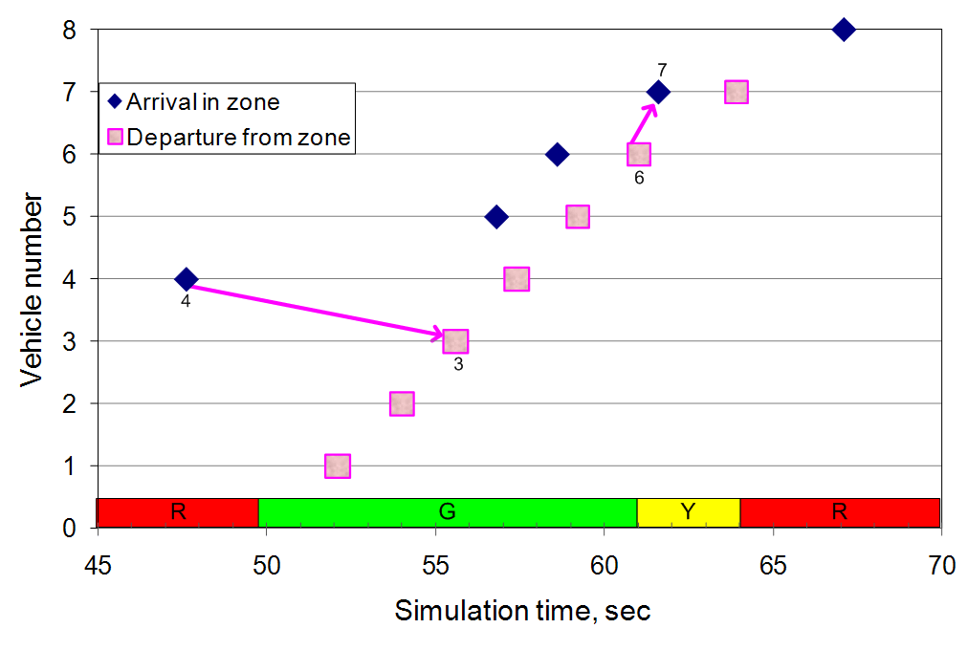
Question 3
Why does the phase terminate?

Slide 9
Question 4
Is the phase operating efficiently or not?

Slide 10
Question 5
Is quality of service good or not?

Slide 11
Question 6
If phase terminates too early or extends too long, what solutions should be considered?

Slide 12
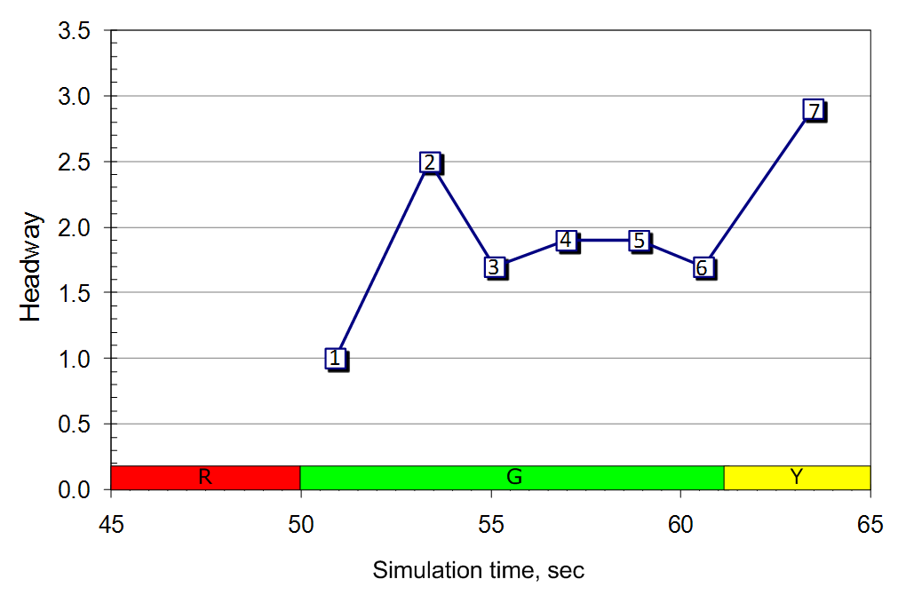
Question 6
If phase terminates too early or extends too long, what solutions should be considered?

