Slide 1
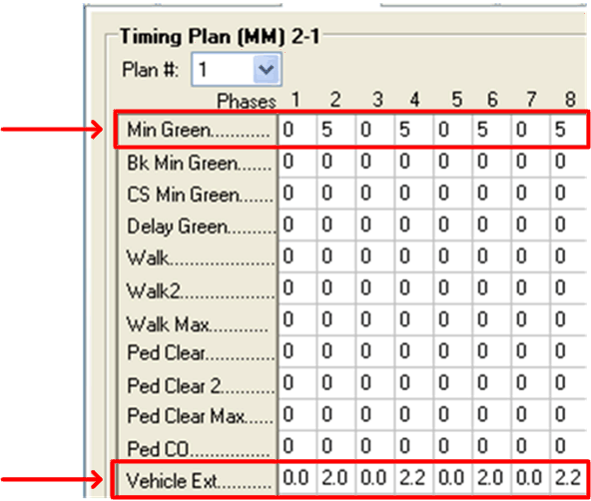

Slide 2
Critical Thinking Questions
When is Minimum Green time too long?
How long should Minimum Green time be in order to get vehicles moving during early portion of green?
What are respective roles of Minimum Green time and Vehicle Extension time in producing efficient operations?

Slide 3
Question 1
When is Minimum Green time too long?

Slide 4
Question 1
When is Minimum Green time too long?

Slide 5
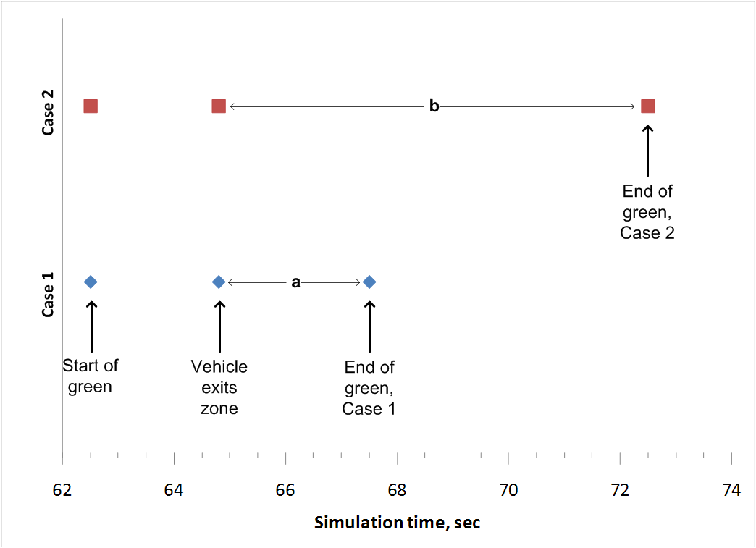
Question 1
When is Minimum Green time too long?

Slide 6
Question 2
How long should Minimum Green time be in order to get vehicles moving during early portion of green?

Slide 7
Question 2
How long should Minimum Green time be in order to get vehicles moving during early portion of green?

Slide 8
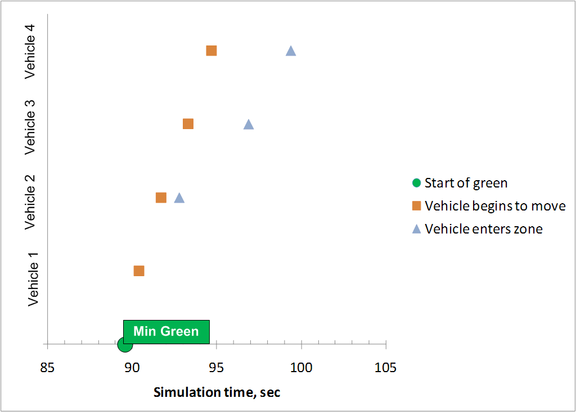
Question 2
How long should Minimum Green time be in order to get vehicles moving during early portion of green?

Slide 9
Question 2
How long should Minimum Green time be in order to get vehicles moving during early portion of green?

Slide 10
Question 3
What are respective roles of Minimum Green time and Vehicle Extension time in producing efficient operations?

