Slide 2
Question 1
How much variation is there in headways between vehicles in departing queue?

Slide 3
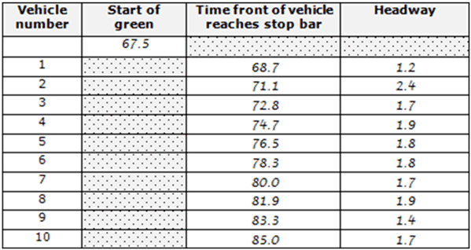
Question 1
How much variation is there in headways between vehicles in departing queue?

Slide 4
Question 2
Based on headways that you observed in departing queue, what is your recommendation for desired maximum headway?

Slide 5
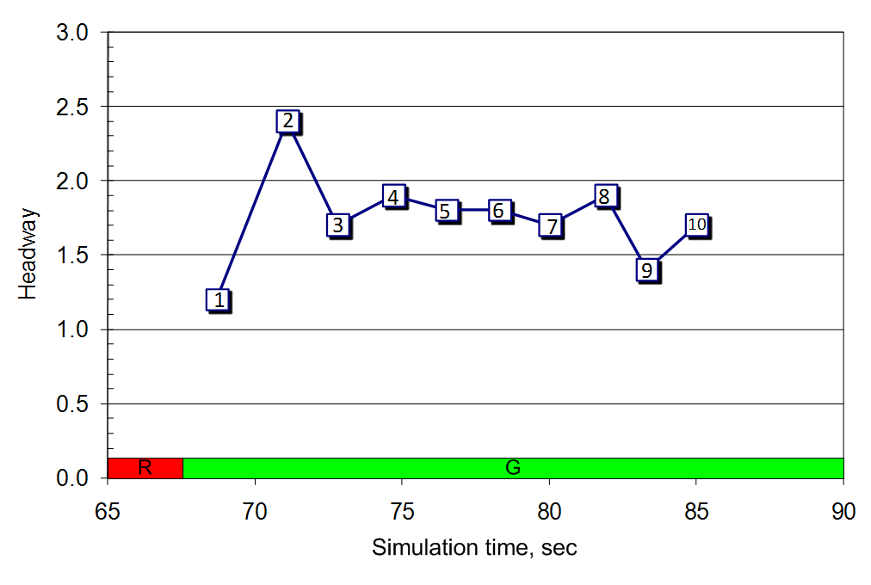
Question 2
Based on headways that you observed in departing queue, what is your recommendation for desired maximum headway?

Slide 6
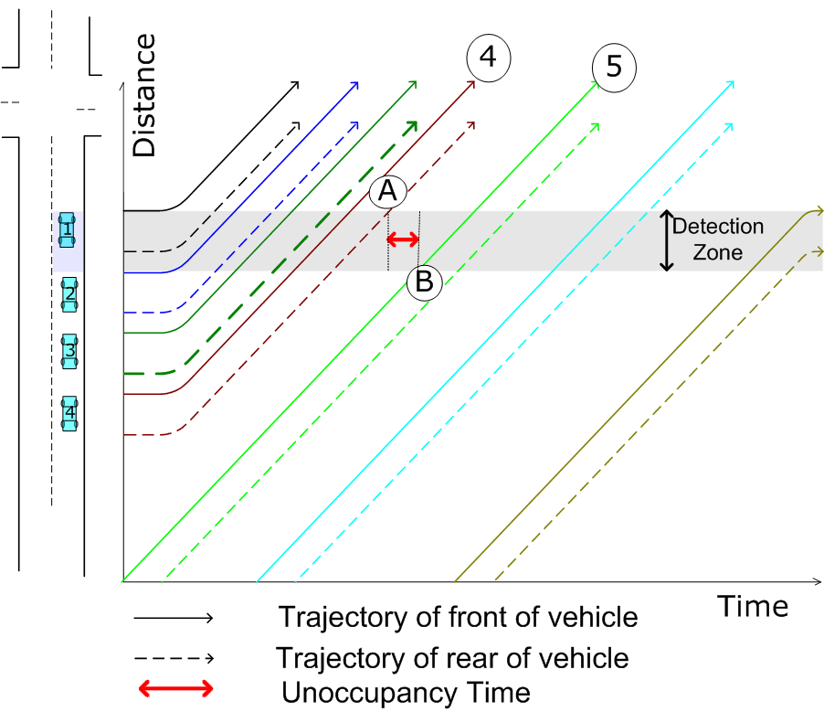
Relationship between Unoccupancy time and Vehicle Extension
Short detection zone

Slide 7
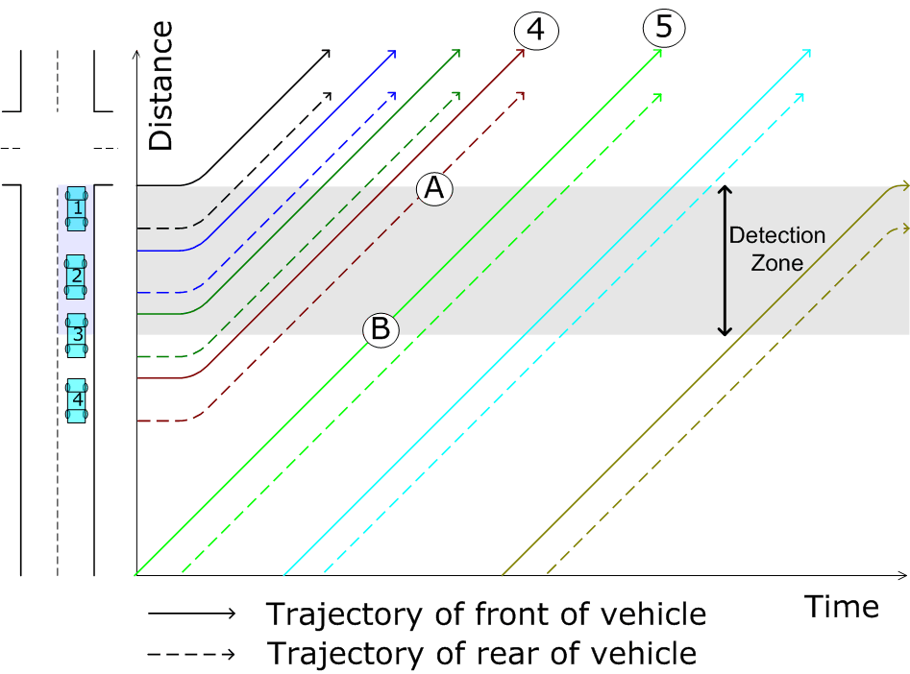
Relationship between Unoccupancy time and Vehicle Extension
Long detection zone

