Slide 2
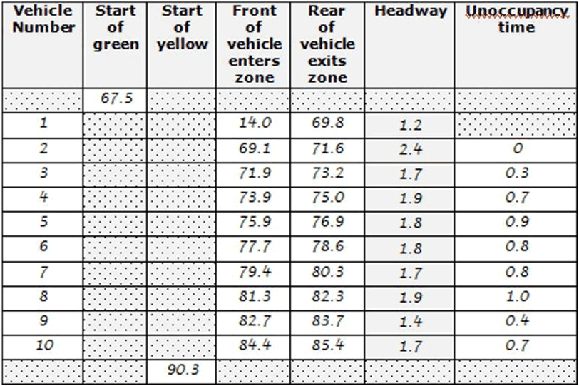
Relationship between Headway and Unoccupancy time
Data collection Table

Slide 3
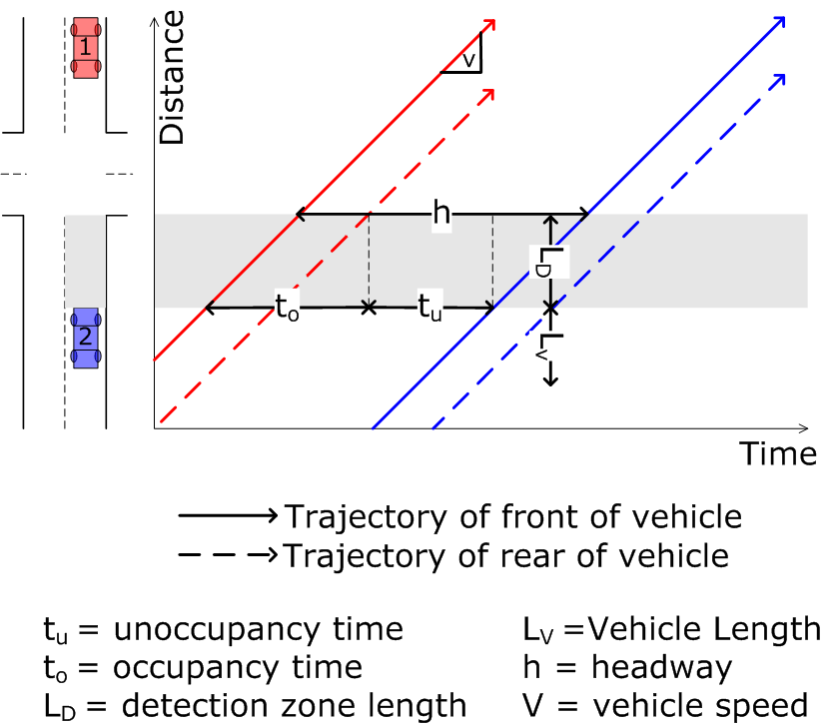
Relationship between Headway and Unoccupancy time

Slide 4
Question 1
What is your recommendation for Vehicle Extension time, based on your recommended desired maximum headway?

Slide 5
Question 2
If detection zone length was longer than 22 feet, would your recommended Vehicle Extension time value be higher or lower?

