Slide 2
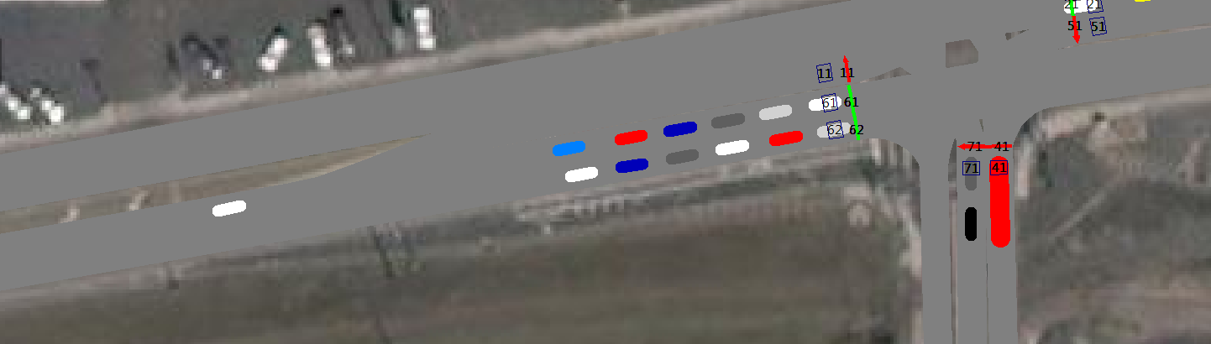
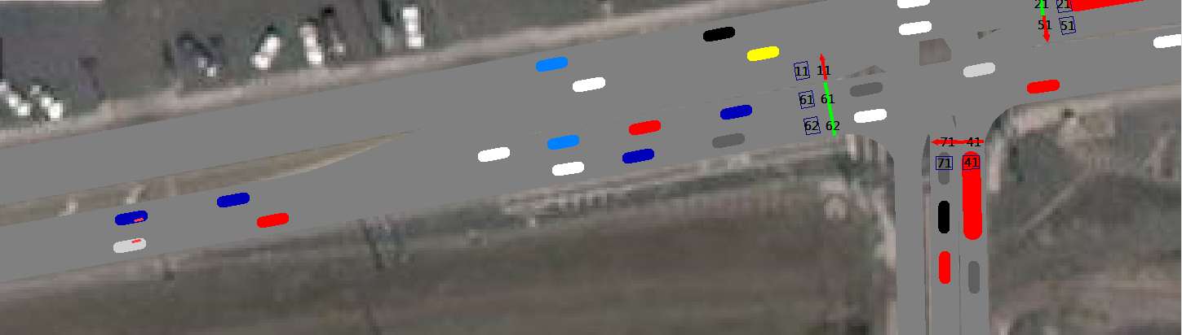
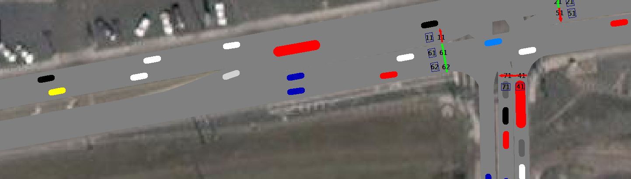
1. Overview

Slide 3
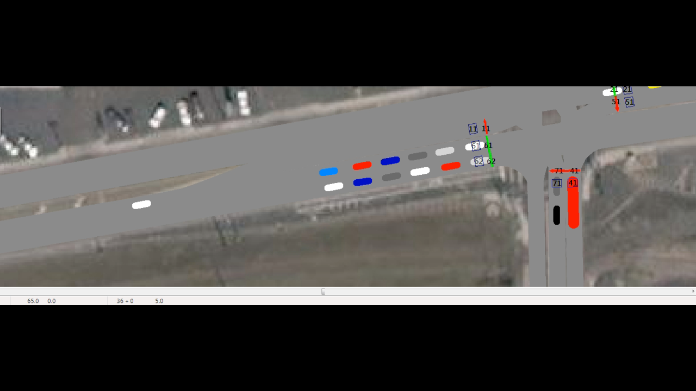
1. Overview

Slide 4
1. Overview

Slide 5
1. Overview

Slide 6
1. Overview

Slide 7

Activity #28
Activity #36
Activity #37
Create new folder
2. Initial Steps

Slide 8
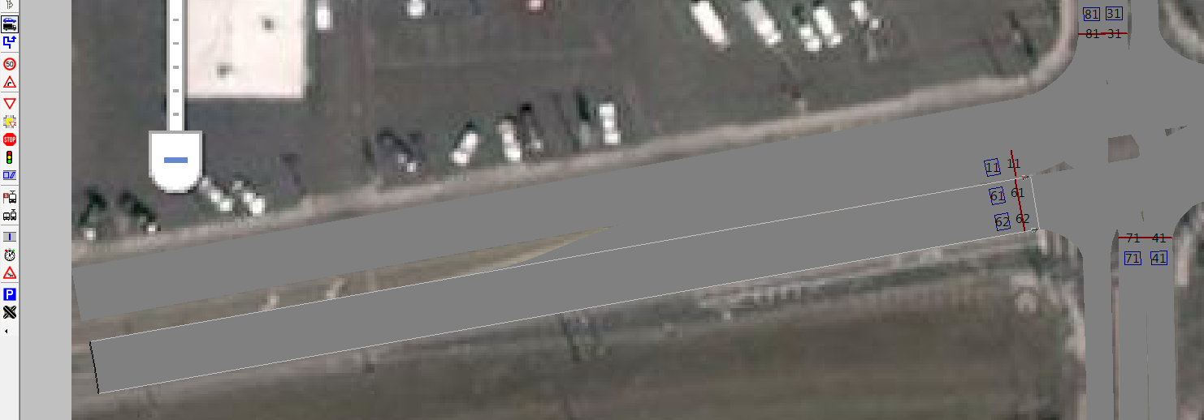
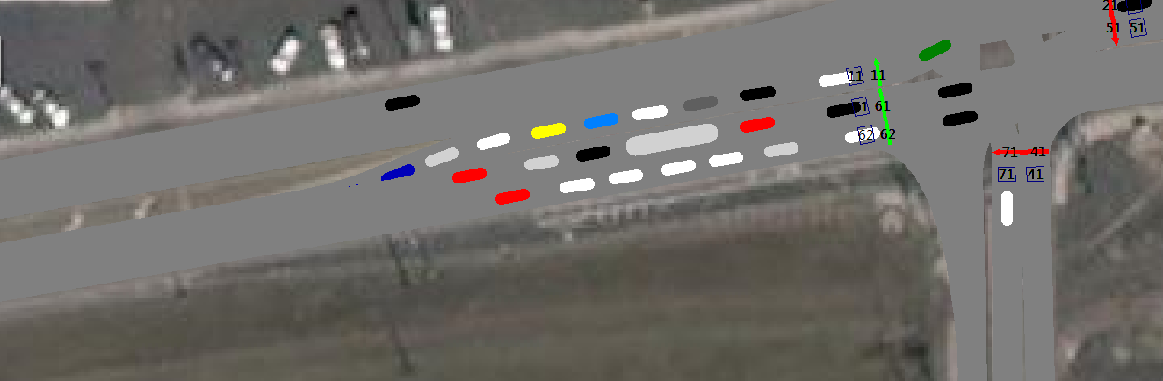
2. Initial Steps

Slide 9
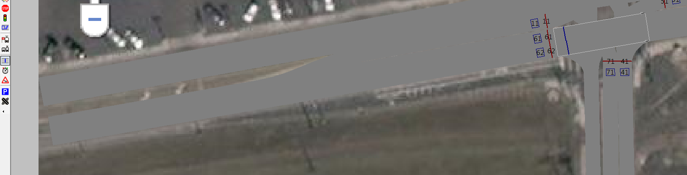
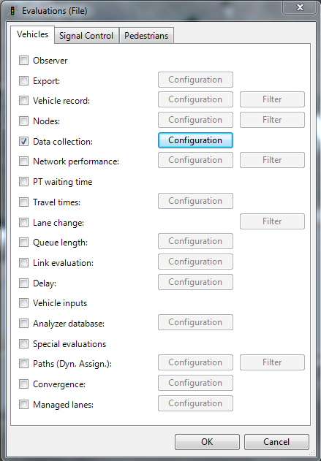
2. Initial Steps

Slide 10
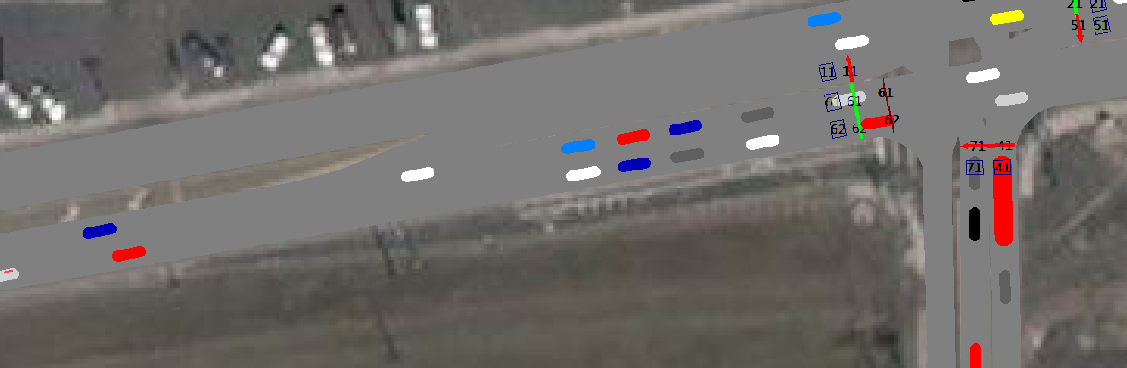
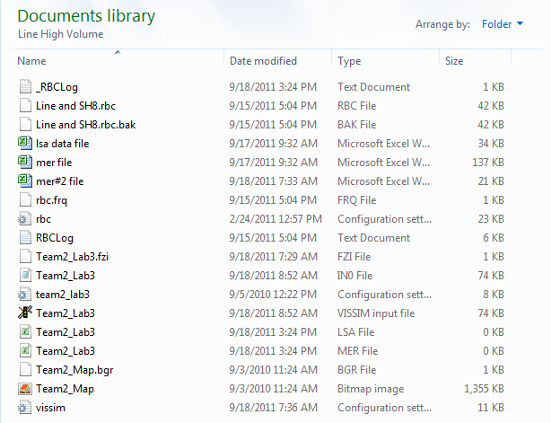
3. Collect data

Slide 11
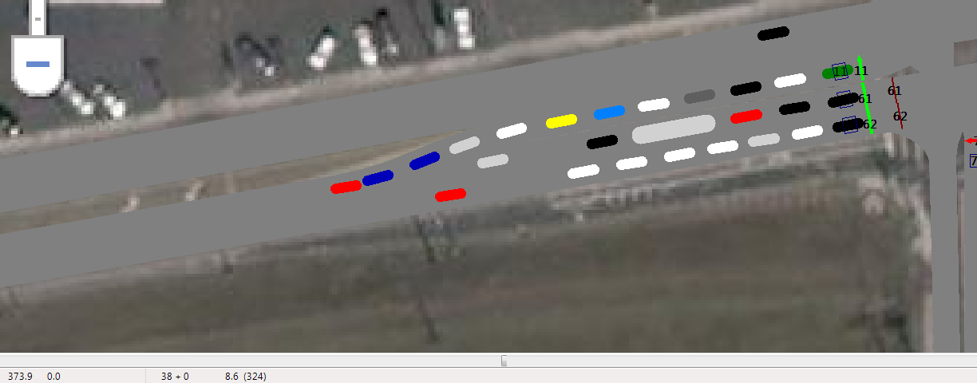
6. MER file – identify Queued and Non-Queued vehicles

Slide 12
7. Headway distribution analysis

Slide 13
7. Headway distribution analysis

Slide 14
7. Headway distribution analysis

Slide 15
7. Headway distribution analysis

Slide 16
8. Phase termination analysis

Slide 17
8. Phase termination analysis

Slide 18
Headway, sec
Time

Slide 19
Headway, sec
Time

Slide 20
7. Headway distribution analysis

Slide 21
7. Headway distribution analysis

Slide 22
8. Phase termination analysis

Slide 23
8. Phase termination analysis

Slide 24
Headway, sec
Time

Slide 25
Headway, sec
Time

Slide 26

Type 2: Green extends too long
Headway, sec
Time

Slide 27

Type 1: Green ends too early
Headway, sec
Time

Slide 28
Type 1: Green ends too early
Type 2: Green extends too long
Headway, sec
Time

Slide 29
Example correction to instructions

Slide 30
7. Headway distribution analysis

Slide 31
7. Headway distribution analysis

Slide 32
8. Phase termination analysis

Slide 33
8. Phase termination analysis

Slide 34
Headway, sec
Time

Slide 35
Headway, sec
Time

Slide 36
Type 2: Green extends too long
Headway, sec
Time

Slide 37
Type 1: Green ends too early
Headway, sec
Time

Slide 38
Type 1: Green ends too early
Type 2: Green extends too long
Headway, sec
Time

Slide 39
Example correction to instructions

Slide 40
Example correction to instructions

Slide 41
Example correction to instructions

