Slide 2
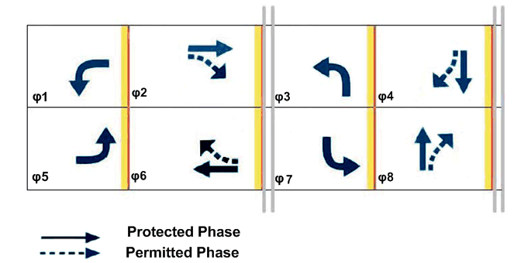
Comparing Permitted And Protected Left Turn Phasing
Learning outcomes
Overview
Questions to consider
Steps

Slide 3
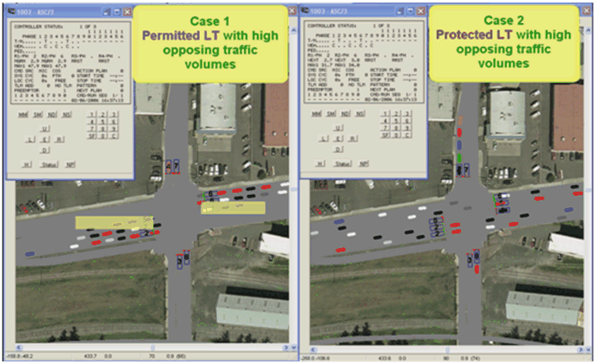
Running the Experiment
Step 1. Open the movie file.
Step2. Observe the operation of the two cases.

Slide 4
Considering the Questions
How does changing from permitted to protected left turn phasing affect the LT operation and the operation of the entire intersection?

Slide 5
Question 1
How does changing from permitted to protected left turn phasing affect the LT operation and the operation of the entire intersection?

Slide 6
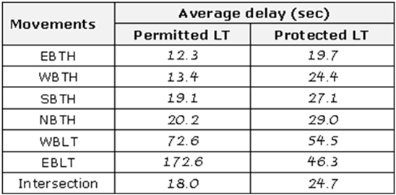
Question 1
Table 2 Average delay for each movement.

