Slide 1
Silage Fermentation
101
Wesley W. Kezar Ph.D.
Boise, Idaho
Retired
University of Idaho
March 11, 2020

Slide 2
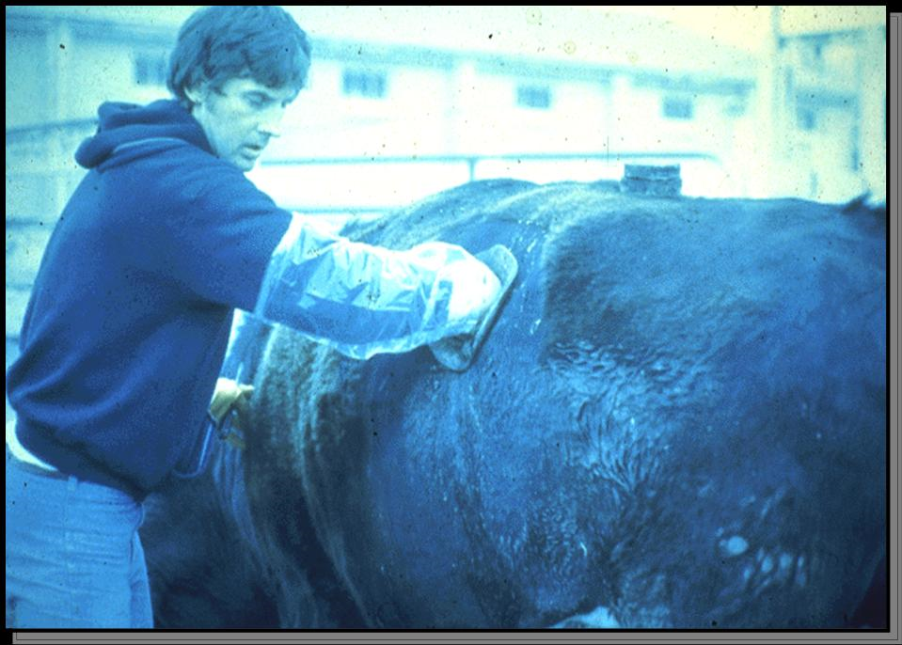
Me

Slide 3








Slide 4


Slide 5
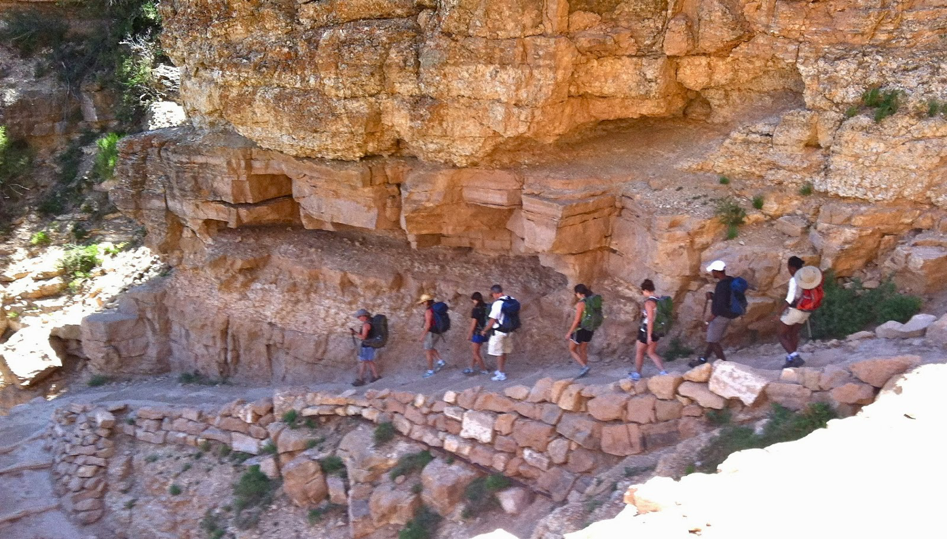

Slide 6
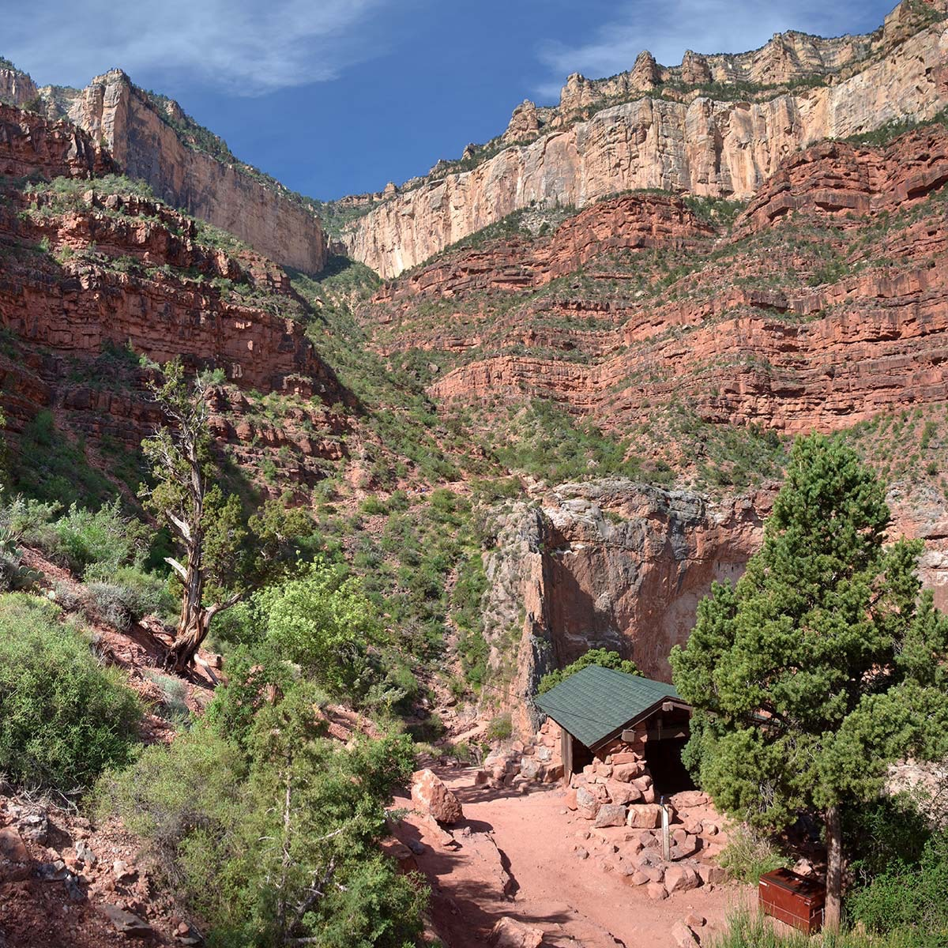

Slide 7
Silage is a Fermented Feed
Acid is produced by micro-organisms
utilizing sugars in the feed to the point most biological activity ceases. Why do we make silage?
How long can silage be stored?
What crops may be used to make silage?

Slide 8
Silage is a Fermented Feed
Acid is produced by micro-organisms
utilizing sugars in the feed to the point most biological activity ceases.
Why do we make silage?
Feed is stable due to a low pH as long as it is not exposed to oxygen
How long can silage be stored?
What crops may be used to make silage?

Slide 9



Slide 10
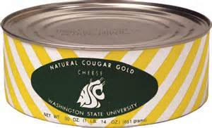
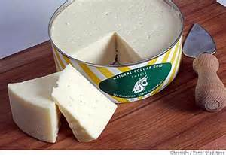
Claimed to be the best cheese in the world!
Source: W.W. Kezar

Slide 11
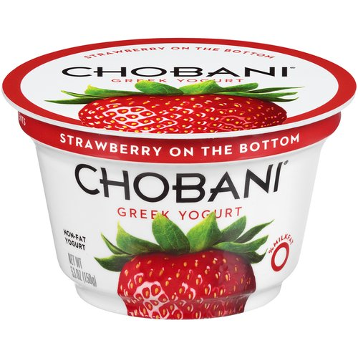

Slide 12
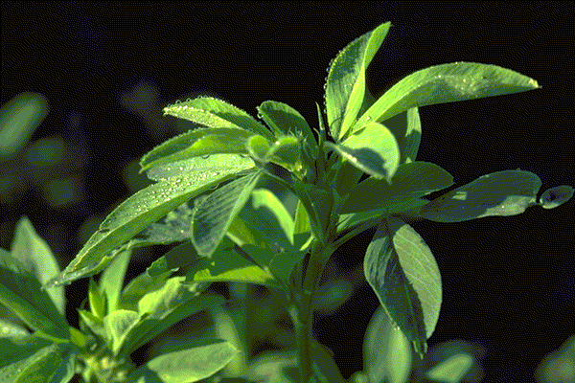
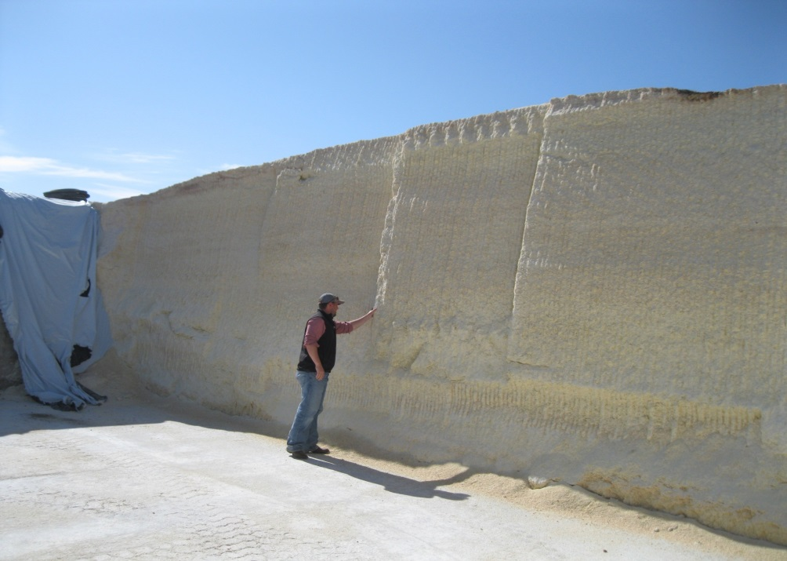
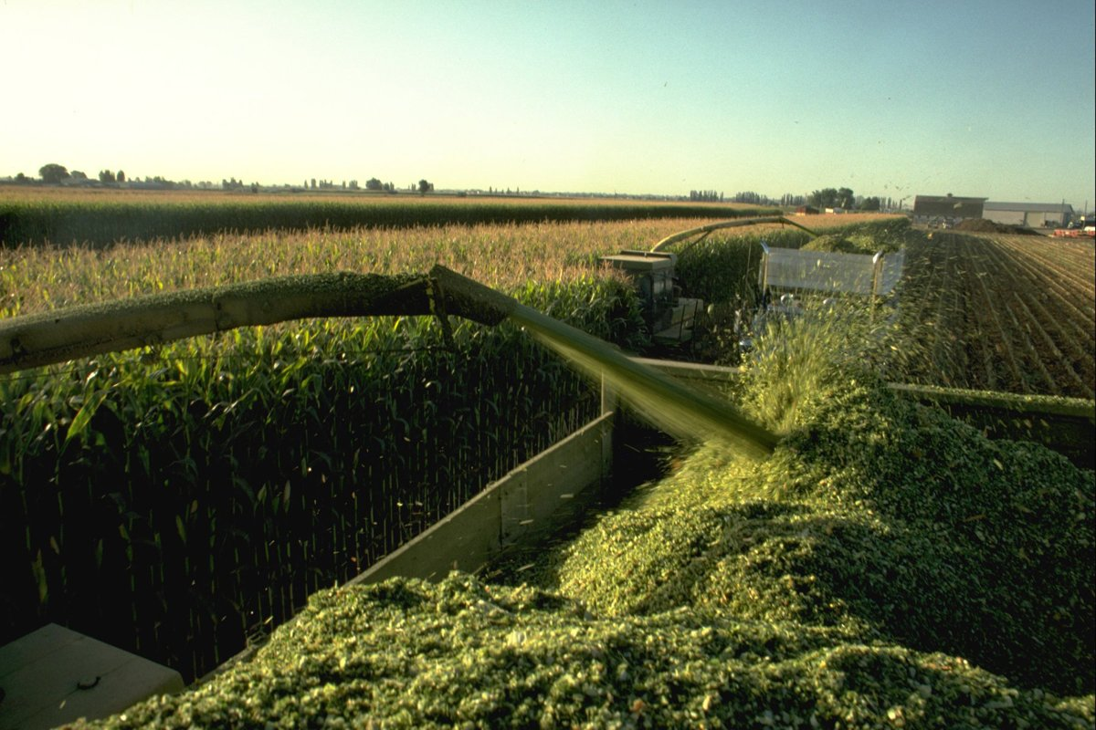
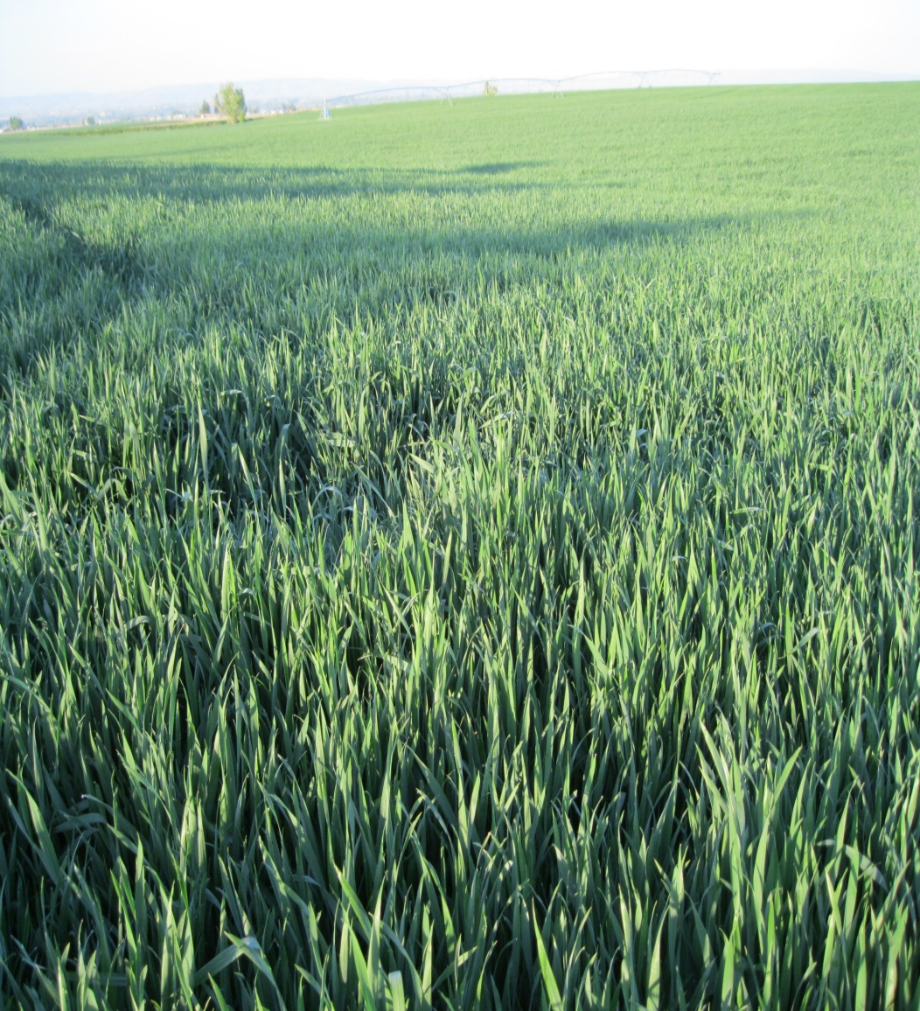
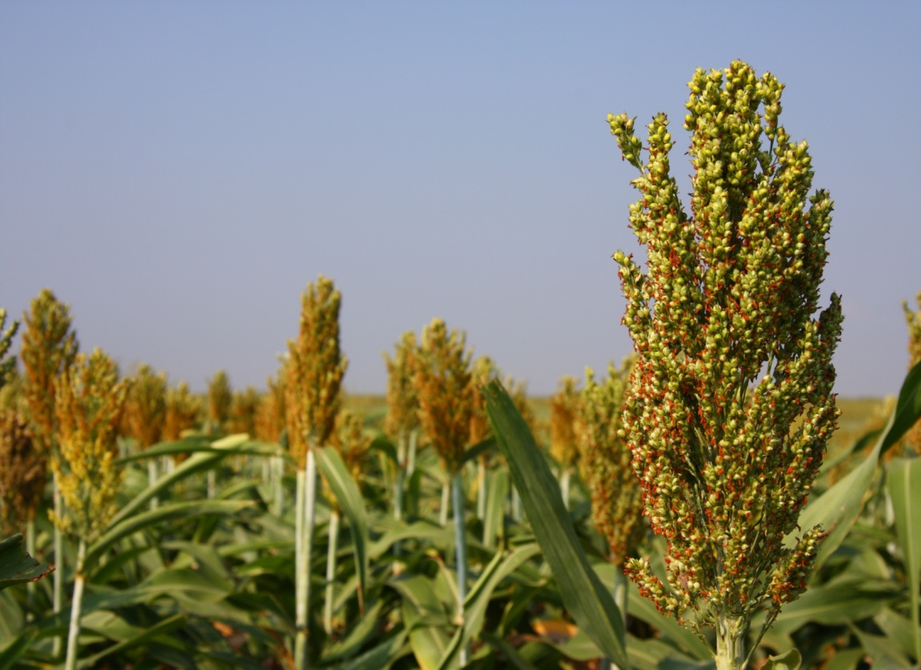
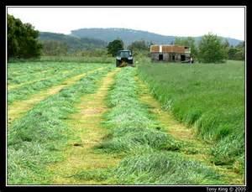
Corn Silage
High Moisture Corn
Alfalfa Small Grain
Sorghum
U.S. Production /year
6.2 million acres
Grass Silage

Slide 13
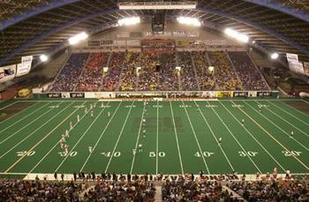
Hay!
How big is an acre?
A football field, not including end zones, minus 27.75 feet

Slide 14
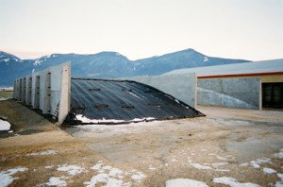
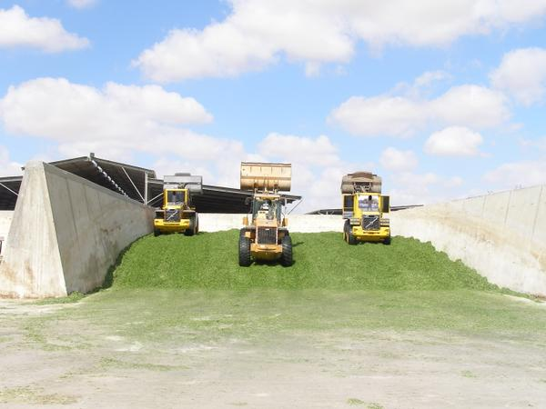
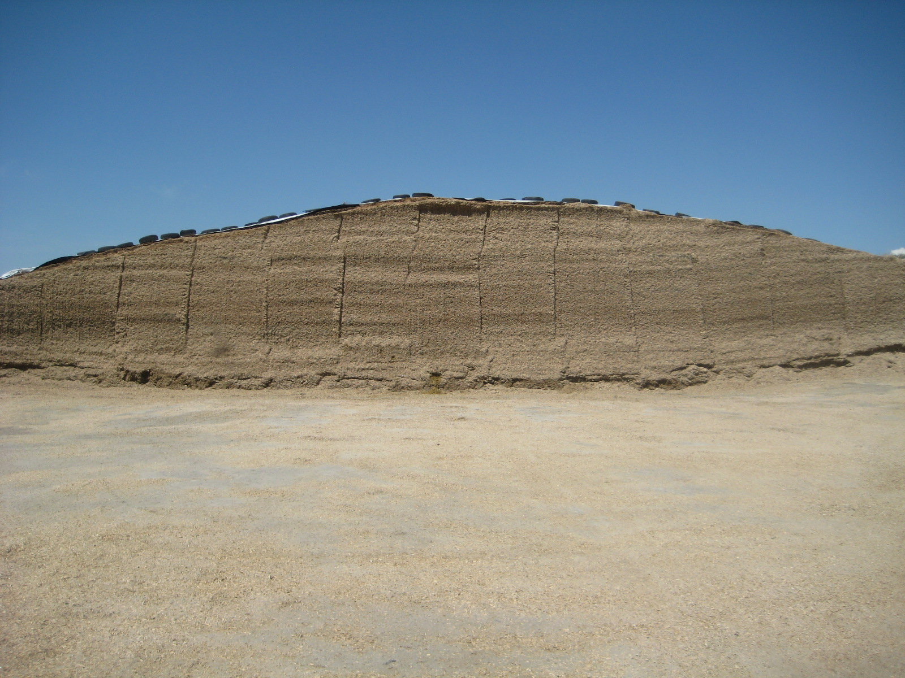

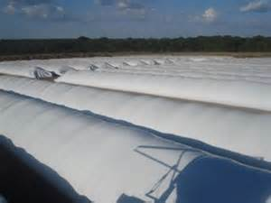
Most Common Silage Storage - Western U.S.
Bunkers
DANGER!
Silage Bags

Slide 15
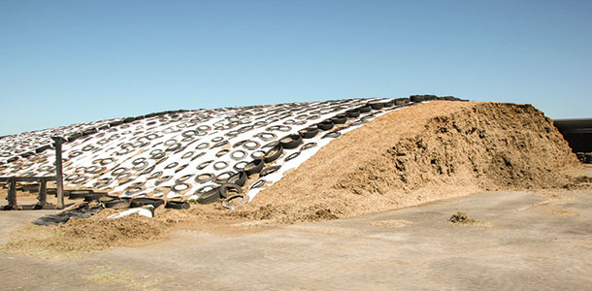
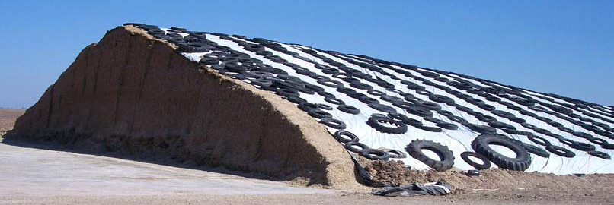
Newest Trend in Silage Storage
Drive Over Silage Piles

Slide 16
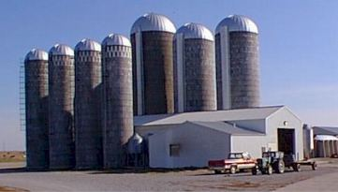
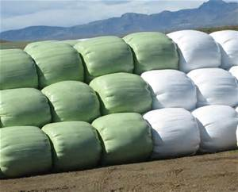
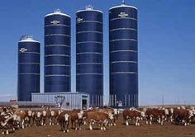
Less Common Silage Storage Options
Stave Silos
Oxygen Limiting Silos
Bale Silage

Slide 17
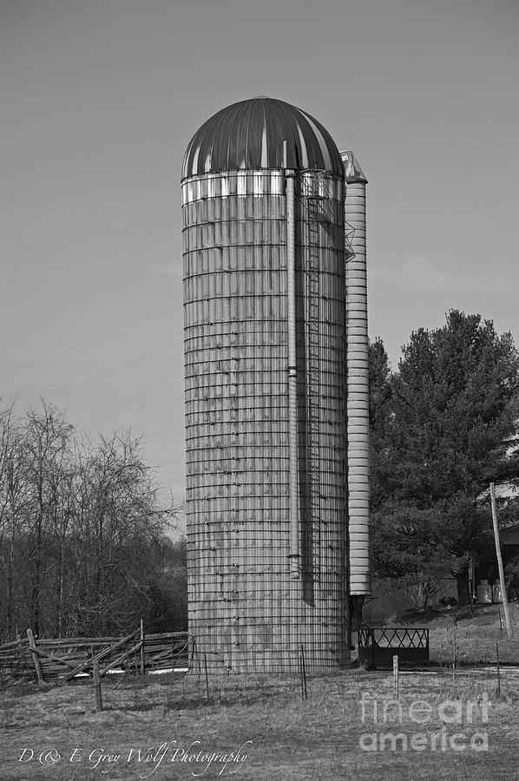

Slide 18
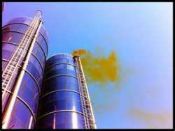
Silo Gas – Nitrogen Dioxide - NO2
Usually forms in first 72 hours after silage starts fermenting
THIS GAS IS VERY LETHAL!

Slide 19
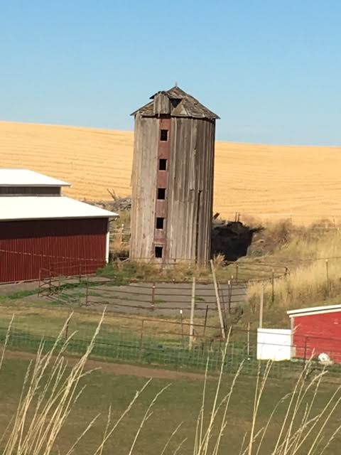

Slide 20

Microbiology Made Simple
Anaerobic (no O2) Aerobic (with O2)
A Few:
Facultative

Slide 21

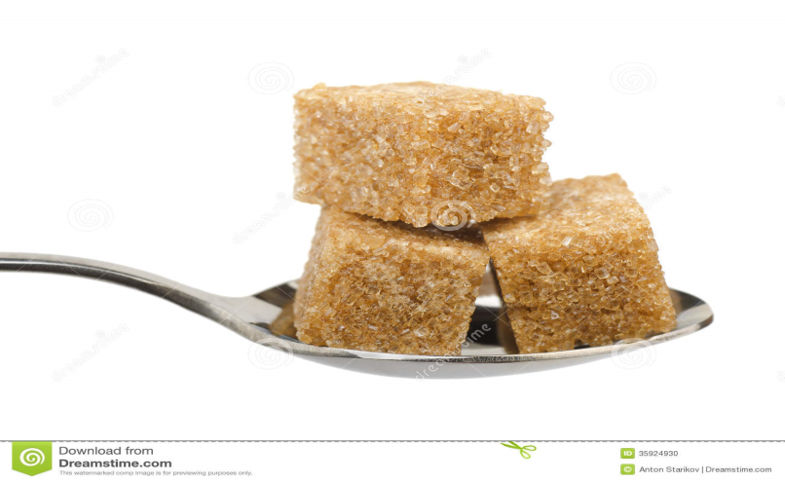
Aerobic Bacteria
In Silage, we are ALWAYS BAD!
Co2
Heat
H2o

Slide 22


Anaerobic Bacteria
In Silage
Good Guys
Acids
Acetic
Lactic

Slide 23
Aerobic Bacteria
In silage making and storage, oxygen is very bad. Management goal is to limit exposure to oxygen!
In Silage, we are
ALWAYS BAD!
Co2
Heat
H2o

Slide 24
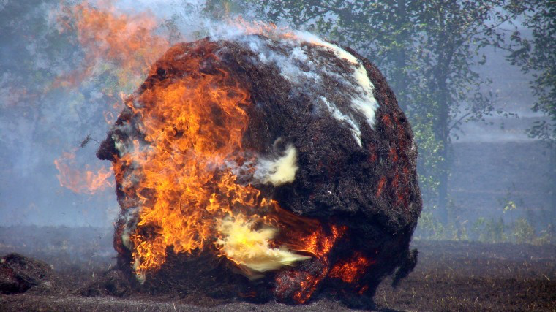
Spontaneous Combustion

Slide 25
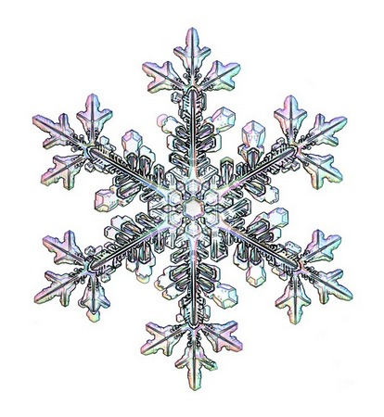



No Two Snow Flakes Are Ever The Same
Variables?
Humidity and Temperature

Slide 26
No Two Silages Are EVER The Same
10,000 Tons of Silage at 28 tons/A planted at 32,000 PPA = 11.43 Million Plants!

Slide 27
EACH PLANT will have its own microflora (epiphytes) at the time of chopping. These populations will change, day to day, hour by hour based on the temperature, humidity and sunlight. There will be multiple genus and species of bacteria on the plants at the time of chopping.
Each genus and species has a different growth rate and pH tolerance. Within each species, growth rates vary based on:
Starting counts of each strain
Temperature
Moisture
Packing density (amount of oxygen present)
Nutrient composition of the crop
pH sensitivity
Since each plant has a different starting microflora and a silo will be filled
with a very large number of different plants, combined with the fact that no two silos will ever be ensiled with the same counts, temperature, moisture, packing density-
SO…..
“No Two Silages Are The Same!”
Scott Dennis, Ph.D.
Microbiologist

Slide 28
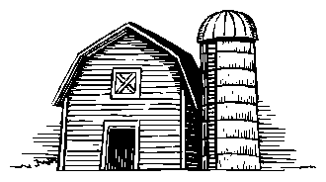
Six Phases of Silage Fermentation and Storage
Un-inoculated
Phase I
Phase II
Phase III
Phase IV
Phase V
Phase VI
Cell
Respiration
Production
of CO₂
Heat and
Water
Production
of
Acetic Acid
Lactic Acid
Ethanol
Lactic Acid
Formation
Lactic Acid
Formation
Material
Storage
Aerobic
Decomposition
on
Re-exposure to
Oxygen
115°F
69°F*
95°F
84°F
Temp
Change
Mold and
Yeast activity
6.0-6.5
7.0
5.0
4.0
pH Change
Aerobic
Activity
Acetic Acid
and
Lactic Acid
Bacteria
Lactic Acid
Bacteria
Lactic Acid
Bacteria
Aerobic
Activity
Anaerobic Activity
2 3 4 21
Age of Silage (Days)

Slide 29
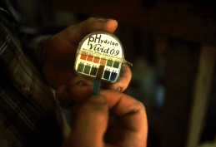
Stable Silage has a Low pH
pH = 4.0 - 4.5 legume silages
pH = 3.8 - 4.2 corn, cereals and grass silages
Crop Buffering Capacity
Corn Silage 200 MEQ
Orchardgrass 300 MEQ
Perennial Ryegrass 350 MEQ
Alfalfa 480 MEQ
Red Clover 560 MEQ
Notes:
Organic acid salts in forages
Resist pH drop
Requires extra W.S.C.
Wilt time concentrates W.S.C.
Alfalfa
Grasses
Not a problem with corn forage

Slide 30
Lactic Acid
Corn silage usually > 3%, alfalfa > 2%
Strongest of all silage acids, will drop pH most effectively
High levels
  Imply efficient fermentation minimal shrink
Do not associate with “rumen lactic acidosis”

Slide 31
Acetic Acid
Usually seen at < 3% level,
Possess aerobic stability properties
Levels found in silages not high enough to cause dry matter intake reductions
Sheperd, A.C., Combs, D.K. 1998

Slide 32
Butyric Acid
Highly undesirable, should be <0.1%
Clostridial fermentation end-product harvested too wet! > 70% Moisture
Smells like rancid butter ??????
Primarily an alfalfa and grass silage problem, seldom see high levels in corn silage.
May reduce forage palatability, especially if present with elevated ammonia nitrogen.
Reduces energy levels of forages.

Slide 33
Stable Silage - Proper
Acid Spectrum
Silage Acid | Ideal * Fermentation | Average * Fermentation
Lactic | >3% | 2-3%
Acetic | <2% | 2-3%
Propionic | <1% | <1%
Butyric | 0% | <.1%
* % Dry Matter Basis

Slide 34
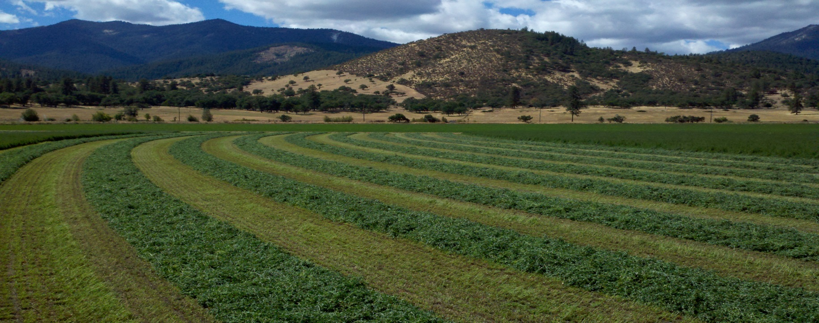

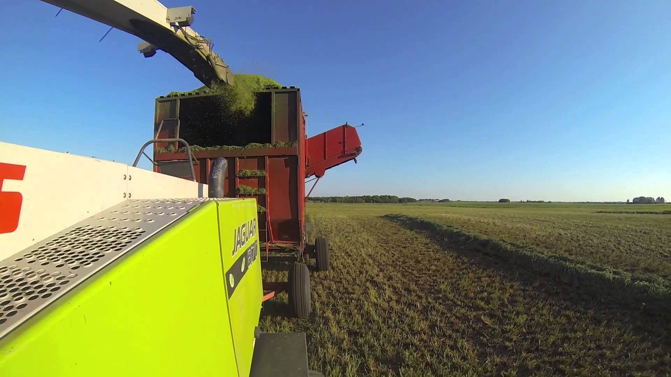
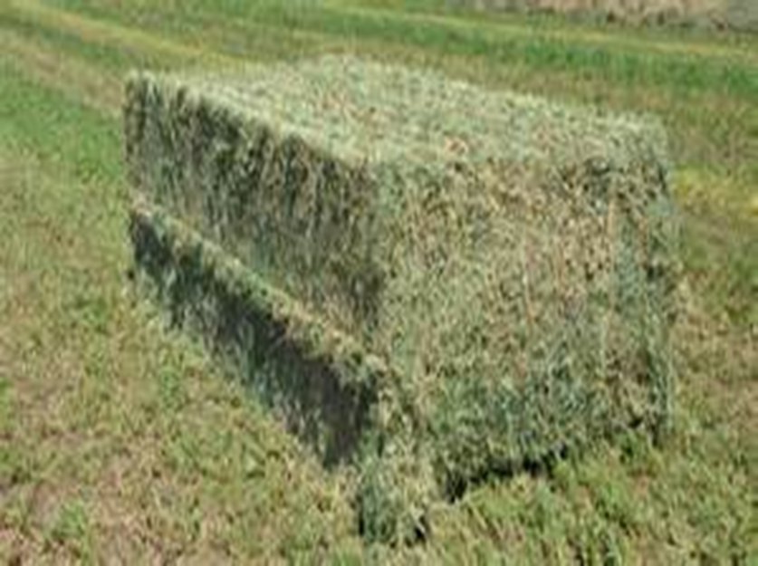

Slide 35
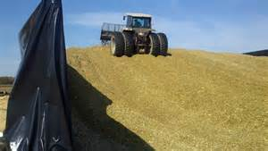
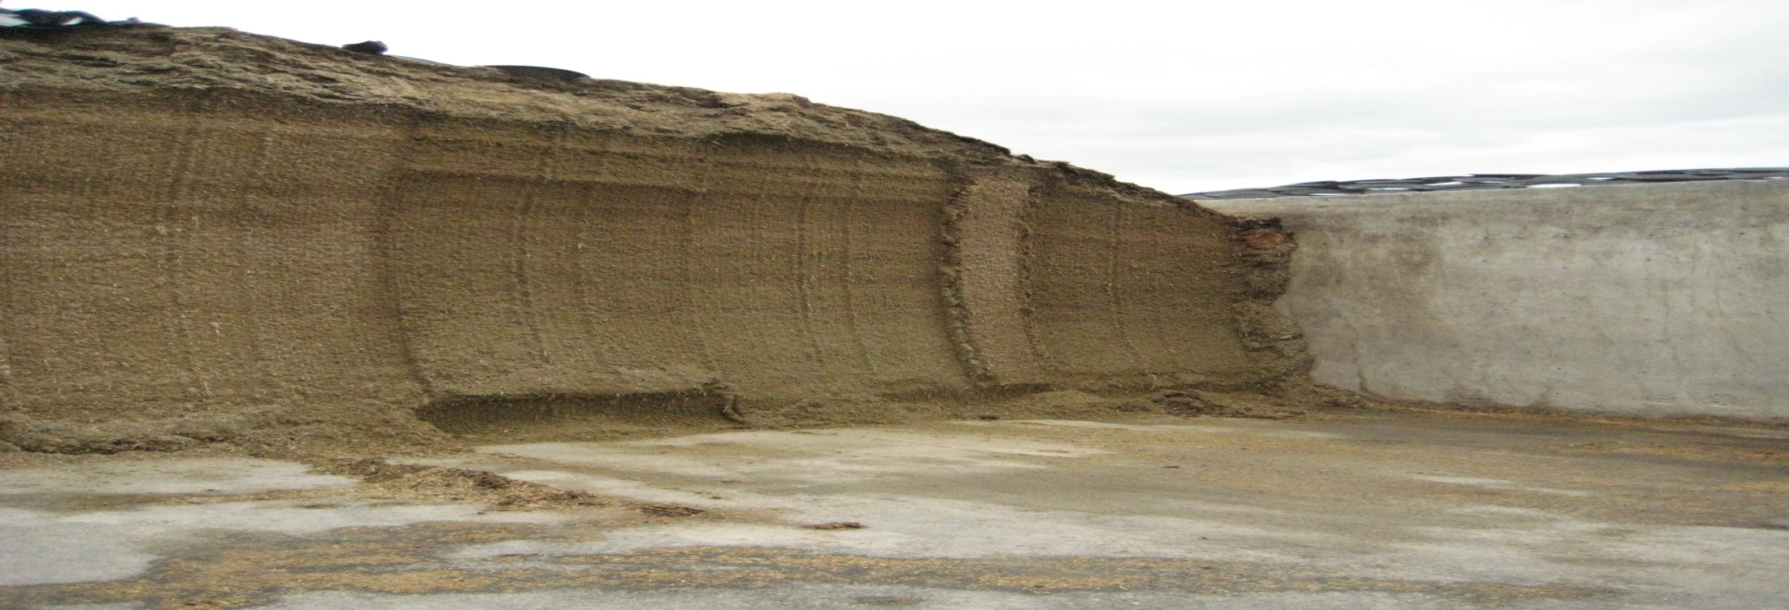
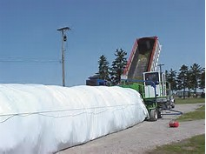
Losses In Making Silage (% DM)
Bunkers: 10-25%
Poor management = >25%
Silage Bags: 5-10%
Danger

Slide 36
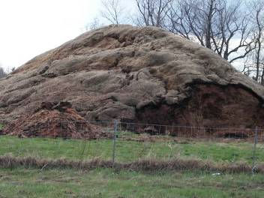
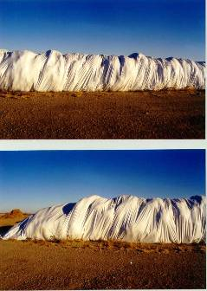
Not so good!!

Slide 37
Where Do The Losses Occur?
Phase I
Phase II
Phase III
Phase IV
Phase V
Phase VI
Cell
Respiration
Production
of CO₂
Heat and
Water
Production
of
Acetic Acid
and
Lactic Acid
Ethanol
Lactic Acid
Formation
Lactic Acid
Formation
Material
Storage
Aerobic
Decomposition
on
Re-exposure to
Oxygen
115°F
69°F*
95°F
84°F
% lost in the two phases
Temp
Change
Mold and
Yeast activity
6.0-6.5
7.0
5.0
4.0
pH Change
Aerobic
Activity
Acetic Acid
and
Lactic Acid
Bacteria
Lactic Acid
Bacteria
Lactic Acid
Bacteria
Aerobic
Activity
Anaerobic Activity
2 3 4 21
Age of Silage (Days)

Slide 38
Where Do The Losses Occur?
Phase I
Phase II
Phase III
Phase IV
Phase V
Phase VI
Cell
Respiration
Production
of CO₂
Heat and
Water
Production
of
Acetic Acid
and
Lactic Acid
Ethanol
Lactic Acid
Formation
Lactic Acid
Formation
Material
Storage
Aerobic
Decomposition
on
Re-exposure to
Oxygen
115°F
69°F*
95°F
84°F
50% ??? 50%
Temp
Change
Mold and
Yeast activity
6.0-6.5
7.0
5.0
4.0
pH Change
Aerobic
Activity
Acetic Acid
and
Lactic Acid
Bacteria
Lactic Acid
Bacteria
Lactic Acid
Bacteria
Aerobic
Activity
Anaerobic Activity
2 3 4 21
Age of Silage (Days)

Slide 39
What Happens To These Guys When We Hit The Terminal pH?
Anaerobic Bacteria

Slide 40
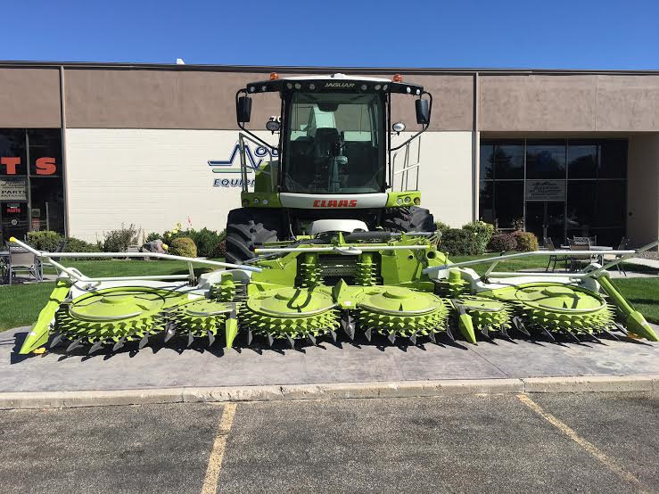
Claas 980 Forage Harvester
DANGER!
Chopping capability?
400 tons per hour

Slide 41
Most Critical Factor in Making Silage?
Reduce oxygen exposure/content as much as possible!
HOW?
Rapid harvest **
Proper moisture content
Proper packing - ASAP
Cover – ASAP
** Not too fast

Slide 42
Most critical factor in making silage?
Reduce oxygen exposure as much as possible!
HOW?
Rapid harvest
Proper moisture content
Proper packing - ASAP
Cover – ASAP

Slide 43
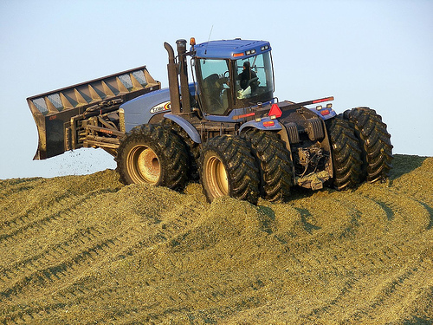
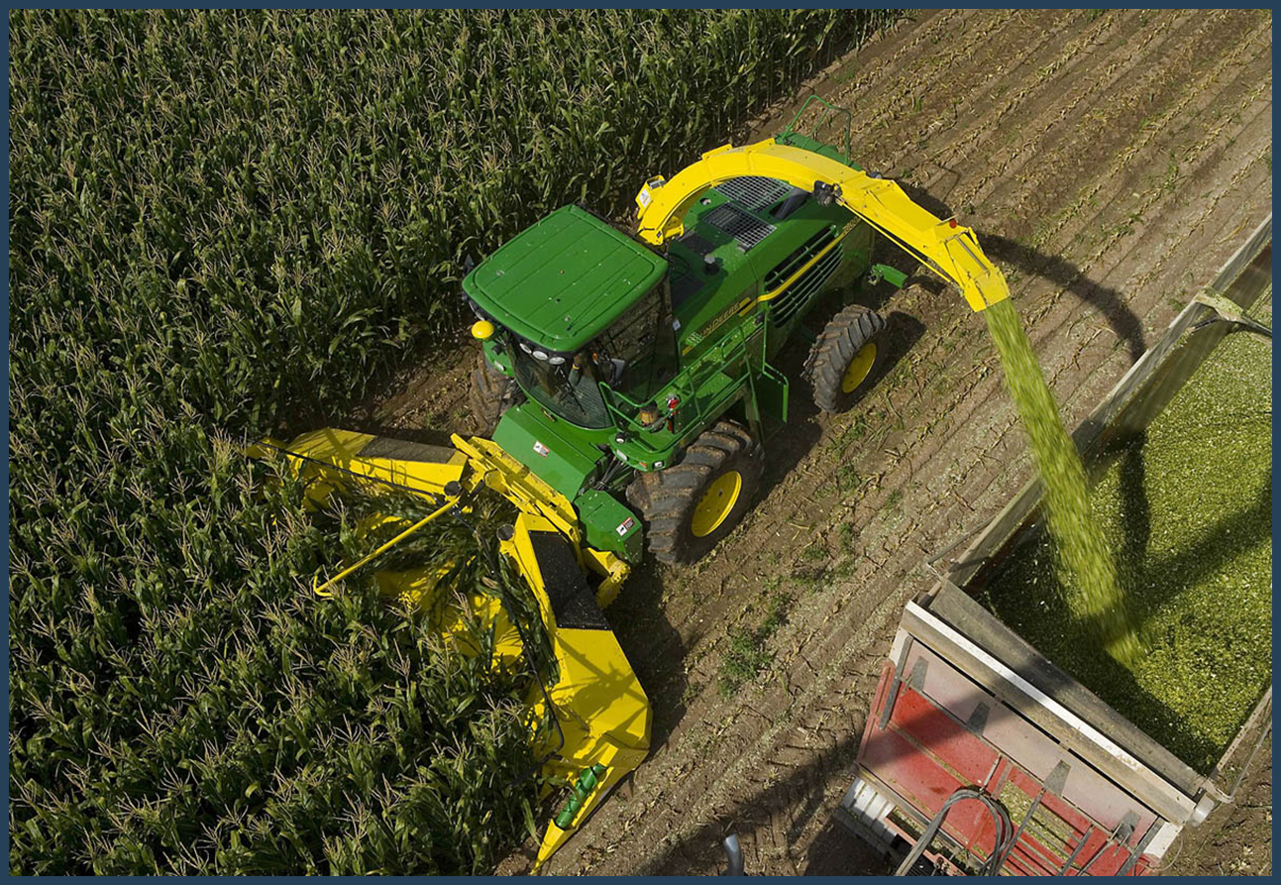
Packing Density Influenced By:
Moisture content of the forage!
63-68% Moisture

Slide 44
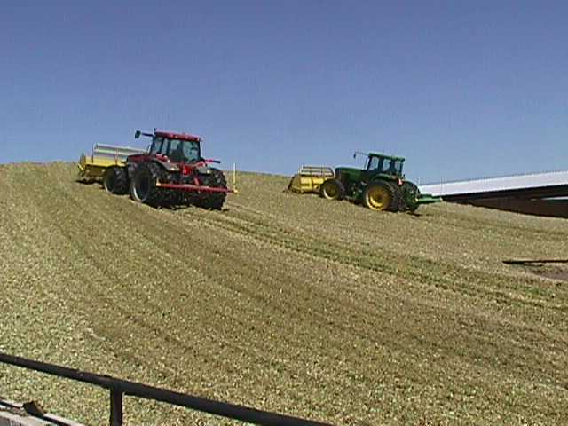
In Making Silage - Oxygen Is Not Your Friend!
Respiration – Occurs In The Presence of QXYGEN
C6H12O6 (Sugars) + 6 O2 (Oxygen) → 6 CO2 + 6 H2O + Heat
Proper moisture leads to better packing density, less oxygen trapped in silage, less respiration!

Slide 45
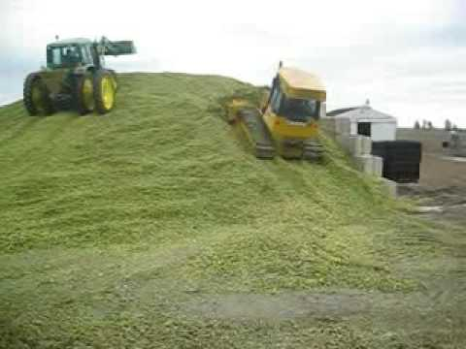
Pounds per square inch!

Slide 46
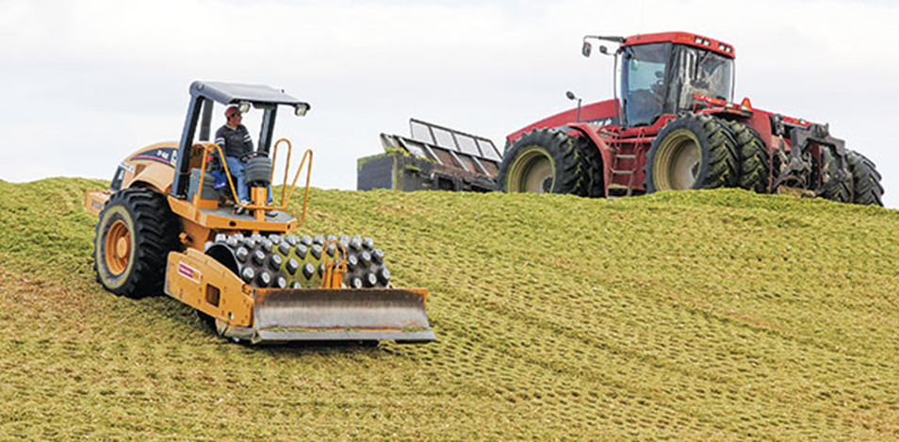

Slide 47
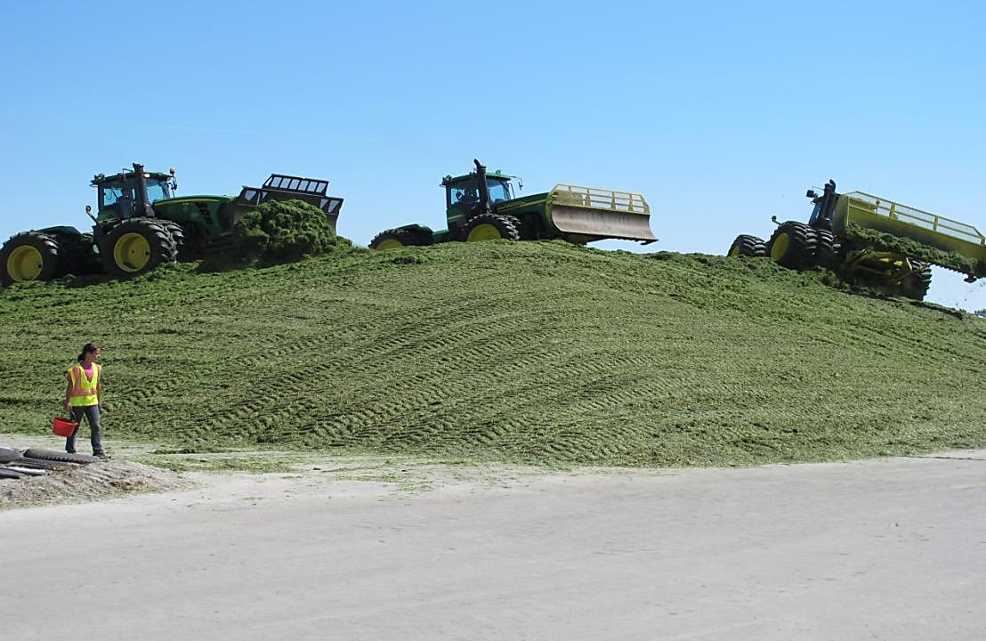
DANGER!

Slide 48
Packing Density Influenced By:
Moisture content of the forage!
Tractor weight-lbs/square inch
Time spent packing
How forage is being distributed
How quickly forage is being delivered

Slide 49
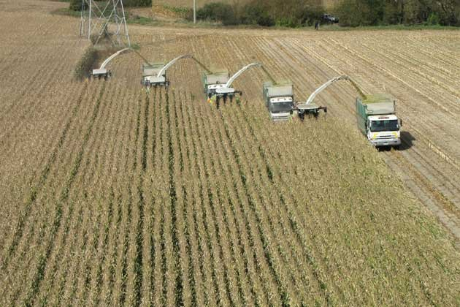
Where are they going with all this silage?

Slide 50
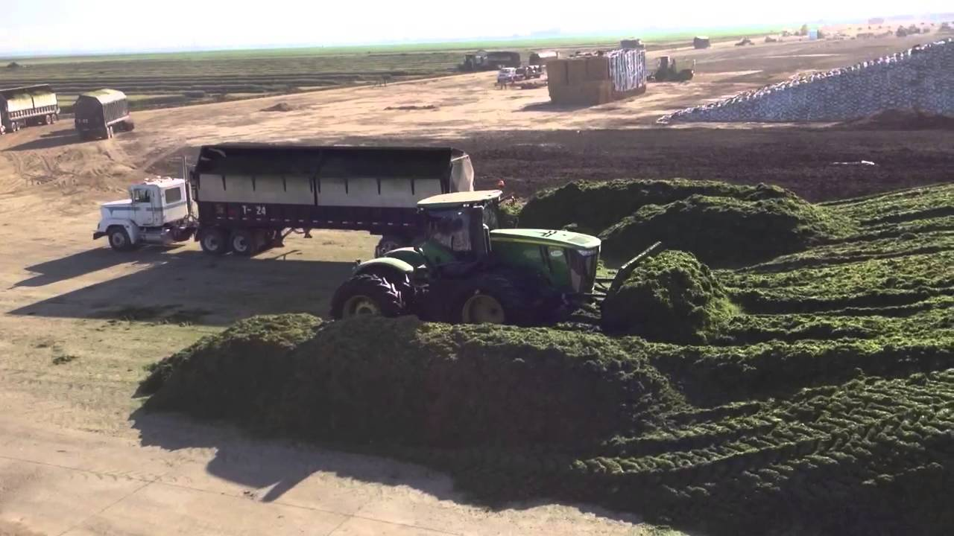
Potential problem?
Harvested crop coming in too fast?

Slide 51
Six Phases of Silage Fermentation and Storage
Un-inoculated
Phase I
Phase II
Phase III
Phase IV
Phase V
Phase VI
Cell
Respiration
Production
of CO₂
Heat and
Water
Production
of
Acetic Acid
Lactic Acid
Ethanol
Lactic Acid
Formation
Lactic Acid
Formation
Material
Storage
Aerobic
Decomposition
on
Re-exposure to
Oxygen
115°F
69°F*
95°F
84°F
Temp
Change
Mold and
Yeast activity
6.0-6.5
7.0
5.0
4.0
pH Change
Aerobic
Activity
Acetic Acid
and
Lactic Acid
Bacteria
Lactic Acid
Bacteria
Lactic Acid
Bacteria
Aerobic
Activity
Anaerobic Activity
2 3 4 21
Age of Silage (Days)

Slide 52

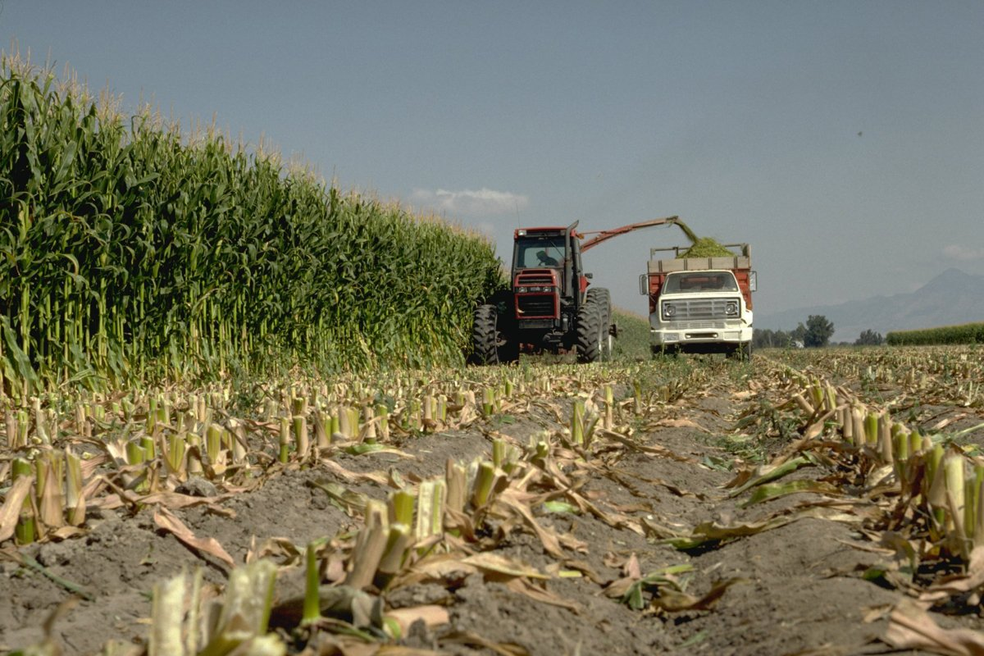
Corn Silage – The King of Forages

Slide 53
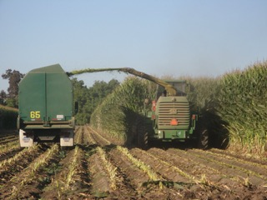
What is the big deal about corn silage?
Direct cut to storage
Quality improves with maturity of the growing crop
If we can produce more high quality corn silage;
Improve animal performance
Improve profitability
Corn silage is a high energy, consistent and palatable feed!

Slide 54
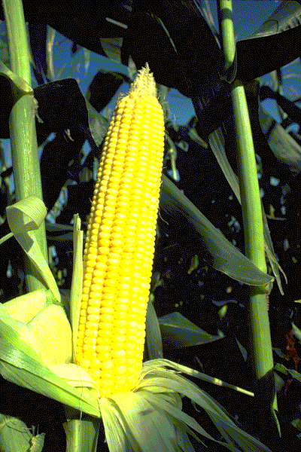
Corn Silage
Digestibility!
Corn is a grass plant
95%
50-60%
With high-moisture corn attached

Slide 55
Questions?
What percent starch is good?
>30%
What percent Grain is that?
Grain in Corn Silage is 70% starch
30 Divided by .7 = 42.85%
“A good silage hybrid needs to be a good grain hybrid”

Slide 56

YOUR JOB: MAXIMIZE QUALITY
Hybrid planted
Grown properly
Harvested at the correct maturity
Processed correctly
Correct moisture content
Correct chop length
Correct additive applied
Packed properly
Covered quickly AND properly
Fed out correctly
BITE
FOR
BITE
VALUE
CONSISTENCY

Slide 57

Starch
Sad story!
95% STARCH
Germ
3/4

Slide 58
YOUR JOB: MAXIMIZE QUALITY
Hybrid planted
Grown properly
Harvested at the correct maturity
Processed correctly
Correct moisture content
Correct chop length
Correct additive applied
Packed properly
Covered quickly AND properly
Fed out correctly
BITE
FOR
BITE
VALUE
CONSISTENCY

Slide 59



Kernel Processing:
Whole plant is processed!
1.5 - 3mm
What Does It Do?
1.35 mm in
thickness
Source: Krone Manufacturing
Improves Starch Digestibility
By Breaking or Cracking Kernels

Slide 60
YOUR JOB: MAXIMIZE QUALITY
Hybrid planted
Grown properly
Harvested at the correct maturity
Processed correctly
Correct moisture content
Correct chop length
Packed properly
Correct additive applied
Covered quickly AND properly
Fed out correctly
BITE
FOR
BITE
VALUE
CONSISTENCY

Slide 61

A Research Proven Cover, Done ASAP, Well Covered, Well Sealed Can Reduce Dry Matter Loss by >2%Units
Black/White plastic
Oxygen barrier film

Slide 62

Covering silage piles
Plastic cover
Oxygen barrier film

Slide 63




Slide 64
YOUR JOB: MAXIMIZE QUALITY
Hybrid planted
Grown properly
Harvested at the correct maturity
Processed correctly
Correct moisture content
Correct chop length
Packed properly
Correct additive applied
Covered quickly AND properly
Fed out correctly
BITE
FOR
BITE
VALUE
CONSISTENCY

Slide 65



Silage Inoculants

Slide 66


Inoculant is usually applied at the time of chopping

Slide 67
Fermentation Dynamics
Follow the Carbon Footprint!
Plant respiration and aerobic bacterial growth
  6-C Glucose → H₂O + CO₂ + heat
  Ceases upon exhaustion of oxygen
Growth of anaerobic bacteria
  Heterofermentation
    6-C Glucose → 2−C acetate + 3-C Lactic Acid 1-C CO₂
    Energy loss from CO₂ gas
  Homofermentation
    Primarily lactic acid (characteristic of Pioneer Inoculants)
    6-C Glucose → 2 3-C Lactic Acid
    No energy loss
C = Carbon. Efficient fermentation involves saving carbon.
CO₂ is a loss of carbon as gas

Slide 68
What Effective Silage Inoculants Do:
Faster, more efficient fermentation.
May improve digestibility of the silage.
A few improve stability on re-exposure to oxygen

Slide 69
Six Phases of Silage Fermentation and Storage
Inoculated
Phase I
Phase II
Phase III
Phase IV
Phase V
Phase VI
Cell
Respiration
Production
of CO₂
Heat and
Water
Production
of
Acetic Acid
Lactic Acid
Ethanol
Lactic Acid
Formation
Lactic Acid
Formation
Material
Storage
Aerobic
Decomposition
on
Re-exposure to
Oxygen
115°F
69°F*
95°F
84°F
Temp
Change
Mold and
Yeast activity
6.0-6.5
7.0
5.0
4.0
pH Change
Aerobic
Activity
Acetic Acid
and
Lactic Acid
Bacteria
Lactic Acid
Bacteria
Lactic Acid
Bacteria
Aerobic
Activity
Anaerobic Activity
3
2 3 4 21
Age of Silage (Days)

Slide 70

A Research Proven Combination Inoculant , Handled and Applied Correctly, Can Save > 3% Units of Dry Matter Loss
L. buchneri

Slide 71
Six Phases of Silage Fermentation and Storage
Inoculated
Phase I
Phase II
Phase III
Phase IV
Phase V
Phase VI
Cell
Respiration
Production
of CO₂
Heat and
Water
Production
of
Acetic Acid
and
Lactic Acid
Ethanol
Material
Storage
Aerobic
Decomposition
on
Re-exposure to
Oxygen
Combination Inoculants
Lactic Acid
Formation
Lactic Acid
Formation
115°F
69°F*
95°F
84°F
Temp
Change
Mold and
Yeast activity
6.0-6.5
7.0
5.0
4.0
pH Change
Aerobic
Activity
Acetic Acid
and
Lactic Acid
Bacteria
Lactic Acid
Bacteria
Lactic Acid
Bacteria
Aerobic
Activity
Anaerobic Activity
2 3 4 21
Age of Silage (Days)

Slide 72
A Research Proven Combination Inoculant , Handled and Applied Correctly, Can Save > 3% Units of Dry Matter Loss
L. buchneri

Slide 73

Excellent Cover
Inoculated with a research proven product!
Extremely well packed> 17 lbs/cubic foot (dry)
Removal procedure: Minimize disturbance to silage mass
Removal rates > 6 inches per day
Keep lose silage cleaned up
Total Dry Matter Loss?
< 10%
Face Management

Slide 74

Dry Matter Loss?
> 50%

Slide 75
Silage Treatments
Control – normal pack
Control – loose pack
Enzyme added
Ground corn and barley added

Slide 76
Food for thought:
What are you ensiling?
Hay has been dried and reconstituted?
WSU: Corn silage cut and frozen?
One solution: Bacterial inoculant?

Slide 77
Six Phases of Silage Fermentation and Storage
Un-inoculated
Phase I
Phase II
Phase III
Phase IV
Phase V
Phase VI
Cell
Respiration
Production
of CO₂
Heat and
Water
Production
of
Acetic Acid
Lactic Acid
Ethanol
Lactic Acid
Formation
Lactic Acid
Formation
Material
Storage
Aerobic
Decomposition
on
Re-exposure to
Oxygen
115°F
69°F*
95°F
84°F
Temp
Change
Mold and
Yeast activity
6.0-6.5
7.0
5.0
4.0
pH Change
Aerobic
Activity
Acetic Acid
and
Lactic Acid
Bacteria
Lactic Acid
Bacteria
Lactic Acid
Bacteria
Aerobic
Activity
Anaerobic Activity
2 3 4 21
Age of Silage (Days)

Slide 78

Money Talk

Slide 79


1 Million Dollars in $100.00 bills
100 Million Dollars in $100.00 Bills

Slide 80



One 18 wheel semi can hold about 5 billion dollars
1 Billion Dollars in $100.00 Dollar Bills
$1,000,000,000.00

Slide 81

1 Trillion Dollars, in $100.00 bills
Jeff Bezos 132 Billion
1 Billion
One trillion is 1,000 billion

Slide 82

Remember: Some days we just make mistakes and have to move on!
?

Slide 83
Please Be Safe!
University of Idaho
Enjoy!
Study! Then enjoy!
Two things to consider doing?
Planks you stand on document
Ask elders: Most important lesson

Slide 84
Please Be Safe!
University of Idaho
Enjoy!
Study! Then enjoy!
Celebrate Diversity!
Have Compassion!
Get a pet!

