Slide 1
Forages

Slide 2
Forages
*** Forages are grown to feed herbivores
Characteristics
  bulky -- low density, fill restricts intake, fewer nutrients consumed per unit of volume
  high fiber -- CF > 18% and NDF > 35%
    less than 70% TDN
  low digestibility - fed to low requirement animals
    high quality (corn silage, alfalfa) = 60 to <68%
    med quality (good grass hay, med alfalfa) = 53 - 59%
    low quality (mature grass hay, crop residue) = < 53%
    by comparison grains > 90% (except oats)
Notes:
Feed that has greater than 18% CF and less than 70% TDN. Forage is the basis of many low cost rations (typically for ruminants that have relatively low nutrient requirements). Forage = roughage =high in structural fiber. There are some feeds that are roughage that is not forage such as cottonseed hulls but most sources of roughage are forage. Structural fiber is an essential diet component so roughage is needed even in high producing ruminant diets such as lactating dairy cows and feedlot rations. Use of effective neutral detergent fiber (eNDF). ENDF is that which is effective in stimulating chewing and salivation (buffering very important), rumination and rumen motility. For feedlot rations 8% eNDF is required. Dairy cows 20 to 22 % eNDF.

Slide 3
Forage Quality
Crude protein content
Cell wall content
  NDF
    Indicative of potential intake
  ADF
    indicative of energy value
  Lignin
    indigestible
    complex cellulose and hemicellulose
    indicates plant maturity
Notes:
Acid detergent insoluble nitrogen (ADIN) is the nitrogen remaining in the acid detergent fiber residue and, while some occurs naturally in all plant material, is generally considered to be an estimate of heat damage occurring during storage or processing. Nitrogen in excessively heated samples is usually unavailable to animals. ADIN is determined as the nitrogen in ADF residue.

Slide 4
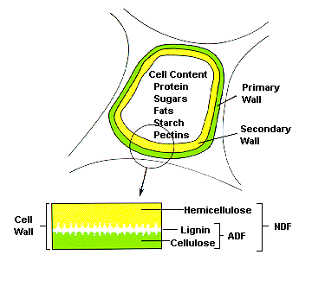
a plant cell wall structure
Cell Content
Protein
Sugar
Fats
Starch
Pectins
Primary Wall
Secondary Wall
Hemicellulose
Cell Wall
NDF
Lignin
ADF
Cellulose

Slide 5
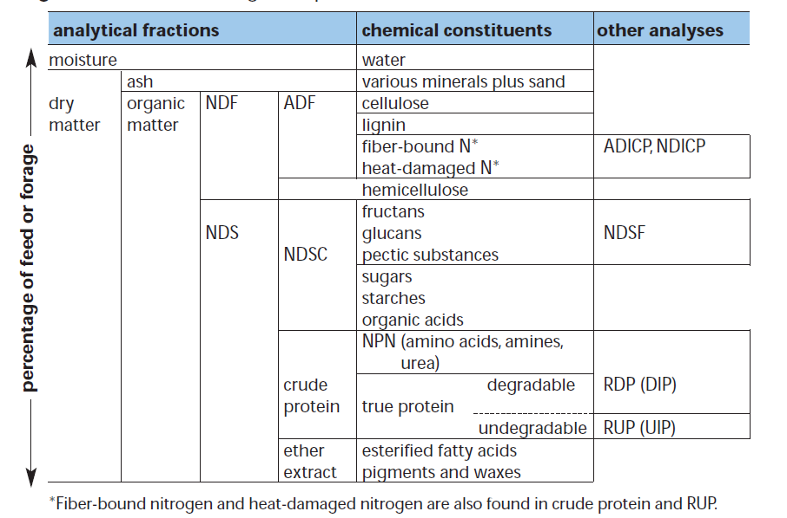
Forage analysis

Slide 6
For ruminants increased NDF means decreased intake
DM intake, % of BW= 120 ÷ NDF%
Notes:
This is for ruminants. Horses are able to pass larger quantities of low quality forage thru their digestive tract to compensate for low quality forages

Slide 7
Intake of forage
4.5
4.0
3.5
3.0
Forage DM intake (%BW)
2.5
2.0
1.5
1.0
30
35
40
45
50
55
60
65
70
75
Forage NDF (% DM)

Slide 8
ADF often used to predict digestibility of forages
Digestible DM % = 88.9 - (ADF% x 0.78)
ADF | DDM
30 | 65%
35 | 61%
40 | 58%
45 | 54%
50 | 50%

Slide 9
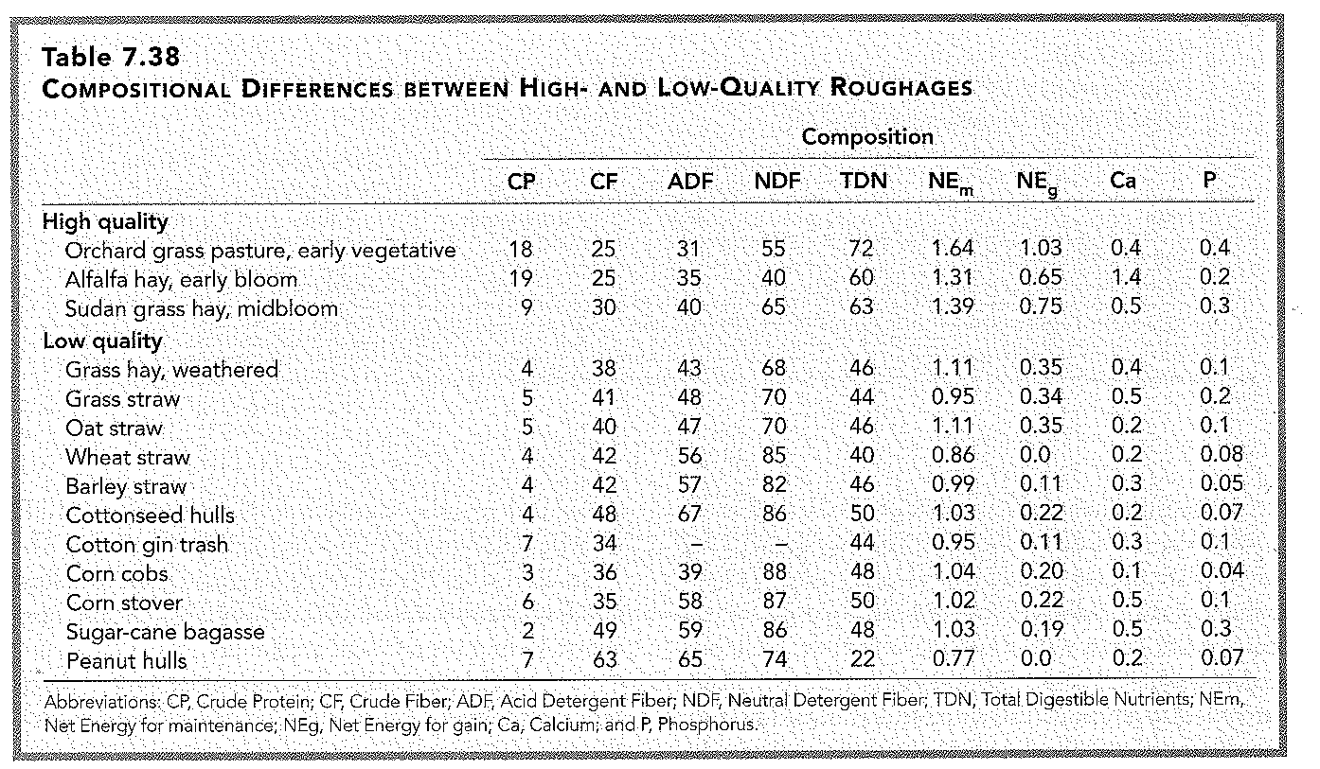

Slide 10
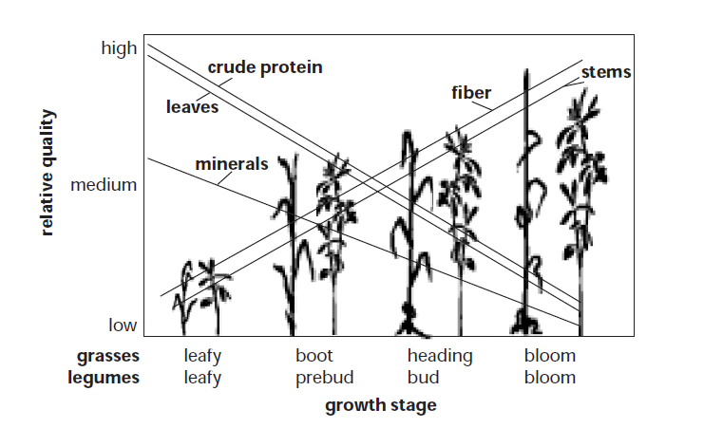
Maturity
Notes:
Maturity has the most impact on quality (within a species)

Slide 11
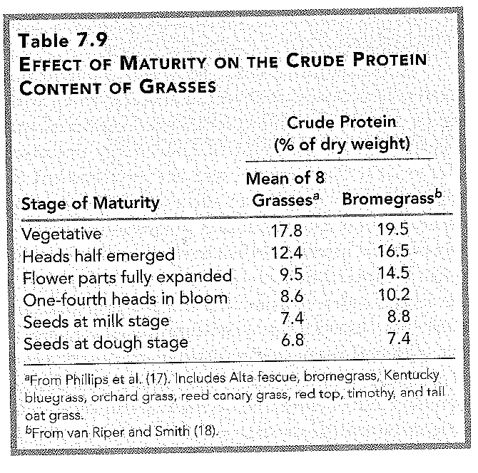

Slide 12
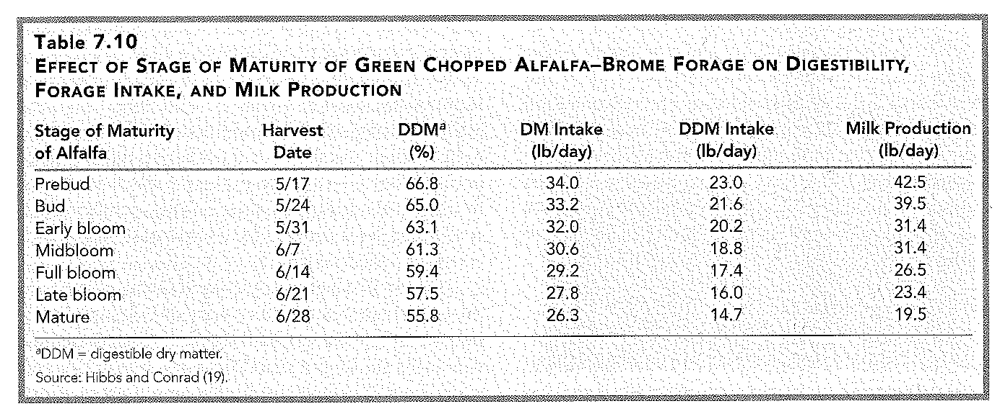
Stage of maturity on digestibility, intake, and production
Notes:
Maturity equated to a 20 lb difference in milk production!! Not all alfalfa/brome mixes are the same. Maturity will have the most influence on quality and value of forage.

Slide 13
Forages - Classification
Legumes: alfalfa, clovers, and many others
  fix atmospheric N with microbes residing in the nodules of the roots
  high crude protein content
  soil fertility
  high yield -- 3 to 4 cuttings
  high in Ca and Mg
  high in vitamin A
  induce bloat
  lower in fiber but higher in lignin
  estrogens
Notes:
Rhizabia organisms. 50% of the hay grown in US is alfalfa. Phytoestrogens= plant and estrogen. When consumed by livestock they exhibit estrogenic activity and may hamper reproductive performance. Clovers such as subterranean clover (Trifolium subterran) and red clover (Trifolium pratense) generally contain isoflavones. Alfalfa (Medicago sativa)contains coumestrans. phytoestrogens have been reported to reduce conception rates in cattle and sheep fed prior to mating. The estrogen content varies among genotypes, but may increase in leaves due to attacks of parasites and fungi. Cattle that are exposed to alfalfa cultivars with high contents of coumestans may experience cystic ovaries and irregular heat cycles. Dairy heifers may exhibit precocious mammary and genital development.

Slide 14
Forages - Classification
Grasses -- non-leguminous, require less management
  cool season: vegetative growth during spring and fall, dormant in the summer
  warm season: productive in long hot days, native grasses
Notes:
Warm season (C4) lower CP and have more structural carbohydrates than Cool season (C3). C3 and C4 plants differ in the leaf anatomies and enzymes used to carry out photosynthesis. These differences are important with respect to their optimal growing conditions, N and water-use efficiency, forage quality, and seasonal production profile. C3 plants have an optimum temperature range of 65-75 degrees F. Growth begins when the soil temperature is 40-45 degrees F. C3 plants become less efficient as the temperature increases.
C4 plants are more efficient at gathering carbon dioxide and utilizing nitrogen from the atmosphere and recycled N in the soil. They also use less water to make dry matter. They grow best at 90-95 degrees F. They begin to grow when the soil temperature is 60-65 degrees F.

Slide 15
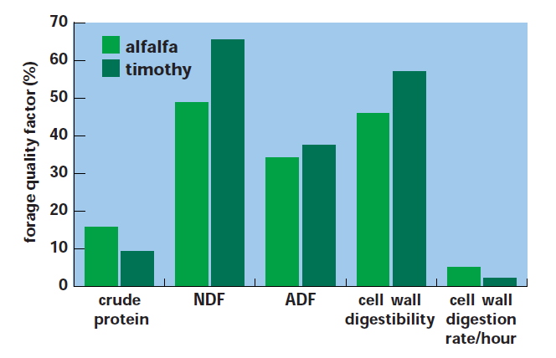
Grasses vs. Legumes

Slide 16
Grasses vs. Legumes
Grass Legume
Crude protein lesser greater
Cell wall % greater lesser
Lignin (response to maturity) lesser greater
Energy --- about the same ---
Bloat none problem!
Minerals Ca, Mg

Slide 17
Grasses – Cool Season: Orchardgrass
shade tolerant -- hence the name "orchard" grass
extremely productive, good regrowth; 50% of total season yield is post-first cutting
much of PNW irrigated pasture
well suited for pasture and hay crop -- especially in a grass-legume mix; problem is that it will mature ahead of legume in the mixture
probably more winter kill, need for re-establishment

Slide 18
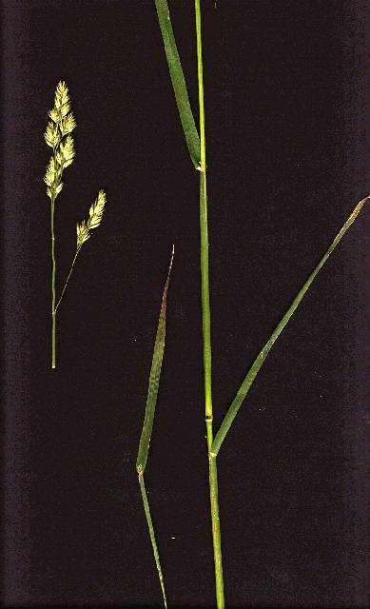
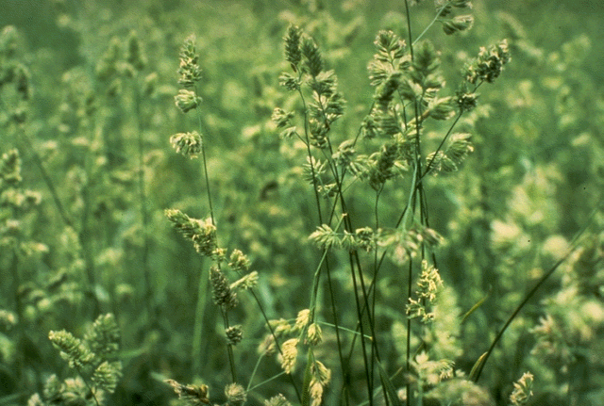

Slide 19
Grasses – Cool Season: Bromegrass
Smooth brome
  very much a cool climate grass
  noted for very high protein content - finer leaf than most grasses
  withstand grazing but not noted for regrowth
  some cultivars now developed for improved regrowth
  also well suited as pasture or a hay grass especially with legume

Slide 20
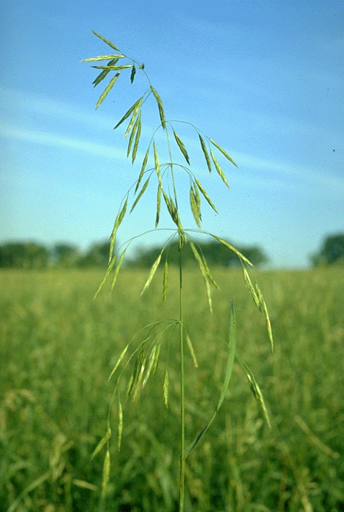
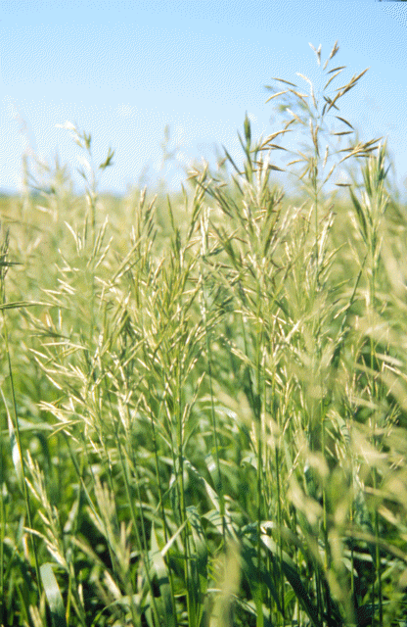

Slide 21
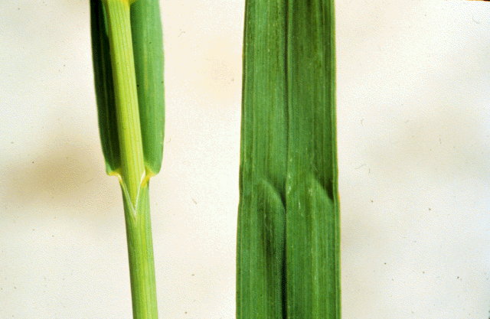

Slide 22
Grasses – Cool Season: Bromegrass
Downy brome – cheatgrass (annual weed!)
  tolerant -- drought and grazing
  negatives:
    not productive
    fast maturing
    fire prone
Notes:
Usually germinating in the autumn, overwintering as a seedling, then flowering in the spring or early summer. If winter rainfall is limiting and spring moisture is adequate, the seeds will germinate in the spring, and the plants will flower that summer. Cheatgrass has increased steadily in acreage and now is the major understory of 19.2 million acres of the Intermountain West. Cheatgrass is a winter annual that competes with other perennial plants by depleting soil moisture, producing prolific amounts of seed, (up to 28.2 million seeds per hectare) and germinating readily in the fall or spring, ensuring that annual recruitment is maintained. Seedheads have awns that may injure eyes and mouth of grazing animals and contaminate fleece. When immature has good forage quality but matures fast so quality drops dramatically. Management of rangeland should be aimed at replacing cheatgrass with a perennial plant cover. This involves releasing grazing pressure during the flower and seed formation stages of the desirable plants. Graze early spring and then after other perennials have went dormant?

Slide 23
Grasses – Cool Season: Tall Fescue
Cool season -- very productive in cool weather
Very tolerant of poor conditions -- fertility, drought, overgrazing
Negatives:
  summer slump -- very unproductive in the summer
  fescue toxicosis, endophyte fungus
    heat stress
    fescue foot
Notes:
Great for stockpiling and grazing in winter. However, if infected with a fungus can cause insufficient blood flow to the extremities results in fescue foot and
generally occurs during winter months.

Slide 24
  Endophyte fungus
The fungus causes the plant to produce ergot alkaloids
  chemical compounds that contain mostly basic nitrogen atoms

Slide 25
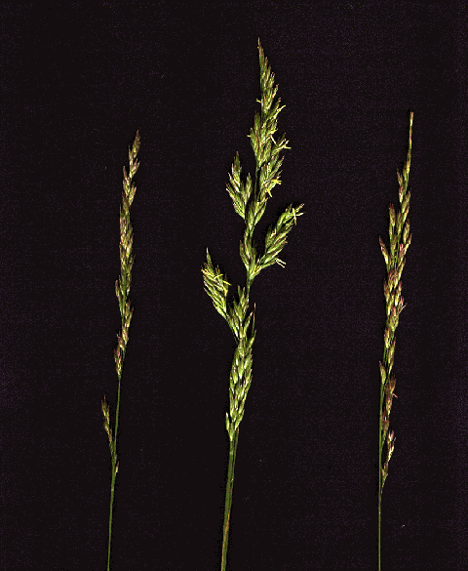
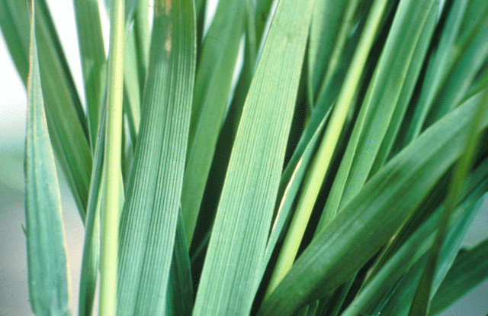

Slide 26
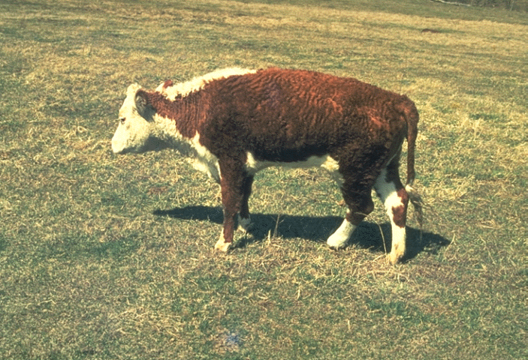

Slide 27
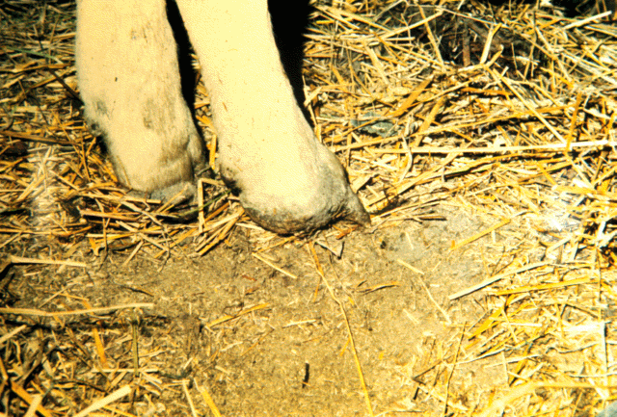
Notes:
Fescue foot is a condition in which cattle become lame with potential sloughing off of the hoof.

Slide 28
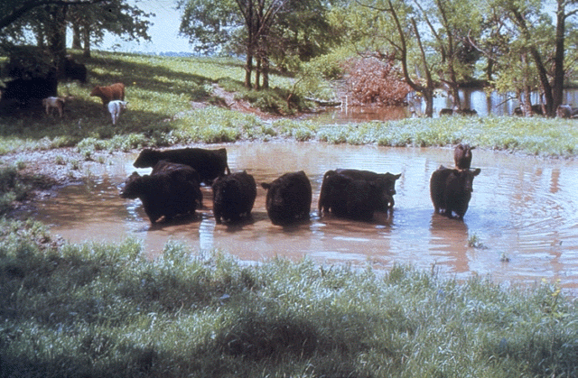
Notes:
Vasoconstriction in the summer = Heat Stress…cattle will try to find alternative cooling methods.
Fescue toxicosis is not a lethal condition and may be subclinical with the only sign being poor growth or low pregnancy rates. Fescue toxicosis
costs the U.S. beef industry an estimated $500 million to $1 billion annually in lost revenue because of reduced reproductive and growth rates in cattle herds.

Slide 29
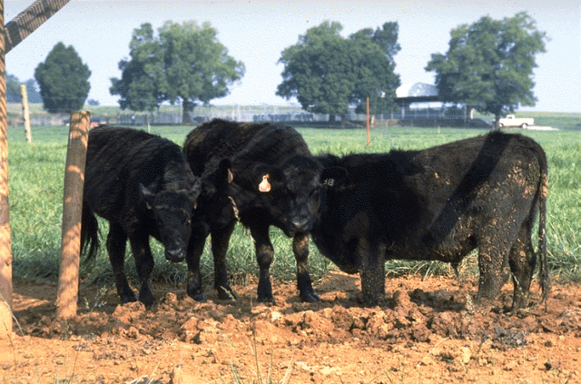

Slide 30
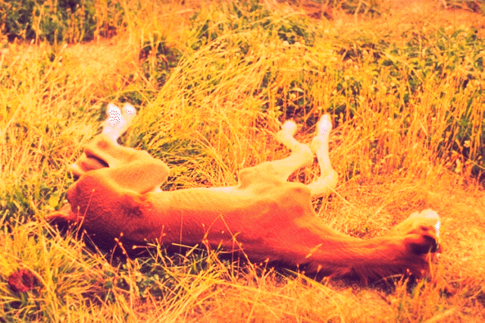
Notes:
Foals from mares grazing endophyte-infected tall fescue are thin and look premature when born, and mares often have little or no milk after foaling. Stillborn foals, dystocias (difficult foalings), foal and mare deaths also occur. Pregnant mares removed no later then 300-days of gestation and given alternative feed (pasture or hay). Early embryonic death has been shown to be higher in broodmares grazing endophyte-infected tall
fescue pasture while being bred, than those on non-endophyte infected pasture.

Slide 31
Grasses – Cool Season: Ryegrass, annual and perennial
Common in New Zealand and Australia; gaining popularity in the US
Generally very productive but often lower quality
  maturity very much a factor
  ideal for wintering cows with low requirements

Slide 32
Grasses – Cool Season:
Bluegrass
  primarily a turf grass – not really a forage species
  not as productive, very early maturing
  low growing point -- if have a mixture and over-graze you will end up with bluegrass
Wheatgrass -- Crested and Intermediate
  distant relative of barley
  tend to be more drought tolerant
  fast maturity

Slide 33
Grasses – Cool Season:
Reed canarygrass
  very tolerant of wet soils
  becomes very woody rapidly
  similar specie is Garrison meadow foxtail; it also tolerates damp soil but becomes too woody
Timothy
  horse hay -- less dusty????
  may be good in a grass-legume mix as it is less competitive
Notes:
Older varieties (Common, Rise, Vantage) contain high levels of alkaloids which make these reed canarygrasses less palatable than other grasses. Newer varieties (developed since 1976) contain lower levels of alkaloids and are more palatable. Reed canarygrass has unjustly gained a reputation as a low-quality, undesirable forage. This misconception is in part due to the high alkaloid content of native varieties and the practice of delaying harvest until reed canarygrass is mature. However, newer varieties of reed canarygrass are equal in quality to other cool-season grasses when harvested at similar stages of maturity. Yield of reed canarygrass is closely related to the rate of N fertilization. Seedlings are slow to establish, but once rhizomes begin to form the grass is quite hardy. It starts to grow early in the spring, showing good distribution of growth throughout the season. To maintain good quality, reed canarygrass should not be allowed to get more than 12 inches high. However, it is intolerant of continuous close grazing, and should not be grazed shorter than 4 inches. The relatively low palatability of this grass makes it necessary to have it fenced separately.
Timothy has low tolerance to heat and drought, while being very winter hardy. Timothy is most commonly used for hay, being historically favored for horses. timothy typically does not persist in pastures.

Slide 34
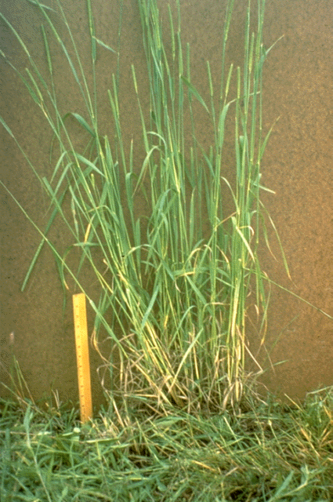
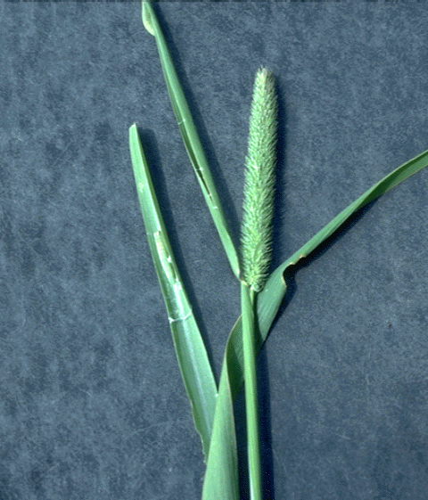

Slide 35
Grasses – Warm Season:
Bermudagrass -- grown throughout the south
Bahia
Switchgrass
Bluestem
Indiangrass
Many others

Slide 36
Grasses – Annual:
Sorghum x Sudan -- very productive in warm climate
Small cereals -- barley, wheat, rye, oats, triticale
  use with annual legume (winter or spring pea) for good silage crops; can contain about 12% CP
  May be difficult to plan harvest; want grain development but do not want mature forage; late milk-early dough stage is a good compromise
Notes:
Warm season annuals that can be grown in the PNW are sorghum, sudangrass, and sorghumx sudan hybrids as well as peralmillet, foxtail millet, teaf and corn. Many of these have potential for high nitrates accumulation in drought and some have potential for prussic acid after a frost.
Small grain cereals (triticale, wheat, oats, barley, and rye) are grown for grazing, green chop, silage, and hay over a wide range of production conditions. Digestibility of the head drops through milk stage, and then rebounds as grain fills with highly digestible starch and protein. This rebound is an important aspect of small grains that distinguishes them from those forage grasses and legumes for which seed weight never becomes a significant portion of the forage crop. Varieties of small grains that have high grain yield and grain-to-stem ratios are the most likely to have the biggest rebound in digestibility as the plant reaches maturity. Boot stage is the final stage of development prior to heading. At this stage, yield is higher than any of the preceding “vegetative” stages, yet the plant remains leafy and highly digestible. At dough stage, grain fill is virtually complete, resulting in higher yield than the preceding flower and milk stages, and digestibility that is approximately equal to or higher than those preceding stages, depending primarily on the plant’s grain-to-stem ratio. Because of their superior combination of yield and digestibility compared to other stages of development, boot and soft dough stages are desirable stages at which to harvest for silage and hay. The choice between boot and soft dough forage is a function of the end use for which the forage is going to be used, and agronomic and climatic factors that affect desired harvest time.

Slide 37
Summary on grasses:
many different species exist which are adapted to different environment -- make use of this in your environment

Slide 38
Legumes – Alfalfa, Queen of Forages
very productive – 6 to 7 tons or more of hay per year -- irrigation throughout the West
good perennial -- 5 to 6 year stands
drought resistant -- deep rooted
very nutritious
  Protein
  Ca, Mg
needs superior management and good environment
Notes:
Alfalfa hay generally contains between 25 and 30% of its dry matter as rapidly
digested non-structural carbohydrates (NSC), such as pectins, sugars and starches, that
quantitatively contribute to the level of total digestible nutrients (TDN) in the hay. In
addition, the total structural fiber in alfalfa hay, ranging between 35 and 40% of total hay
dry matter (DM) as neutral detergent fiber (NDF), is rapidly digested by microorganisms
in the rumen leading to a high proportional contribution to the hay’s TDN value. The
high protein level, generally ranging between 18 and 24% of DM,NDF of alfalfa hay ranges from 33 to 43% the low level of NDF in alfalfa hay, compared to competing forages, where values as high as 60% NDF occur for cereal or grass hays and silages, is also important in determining maximum DM intake and why it is often used in dairy rations

Slide 39
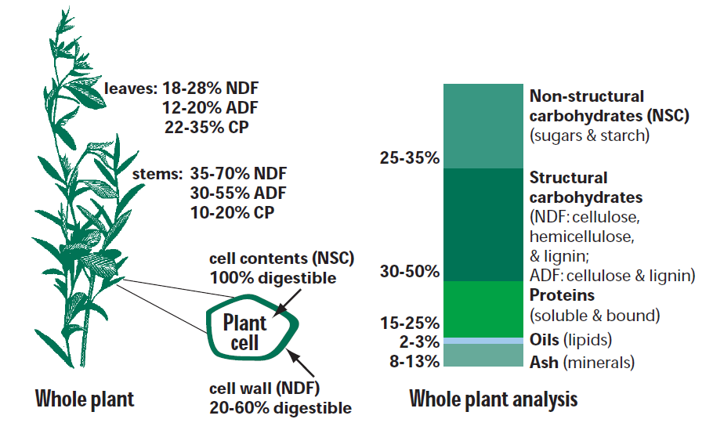
Alfalfa

Slide 40
Legumes – Alfalfa
needs well drained soils
  winter kill
  heaving
acid sensitive
extreme bloat problem
use poloxalene (“Bloat Guard”)
seed a low bloat variety; but these are lower in quality
will not withstand overgrazing; some varieties are now available which tolerate grazing
where alfalfa can be raised it will be raised; maximize the quantity of protein produced per unit of land
Notes:
has the highest yield potential and feeding value of all perennial forage legumes

Slide 41
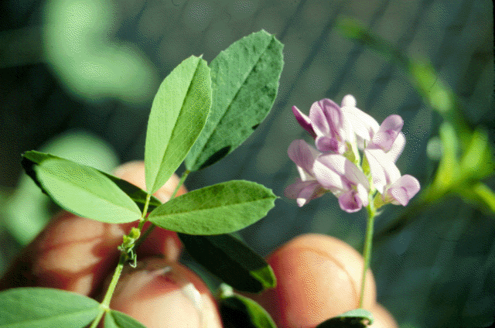
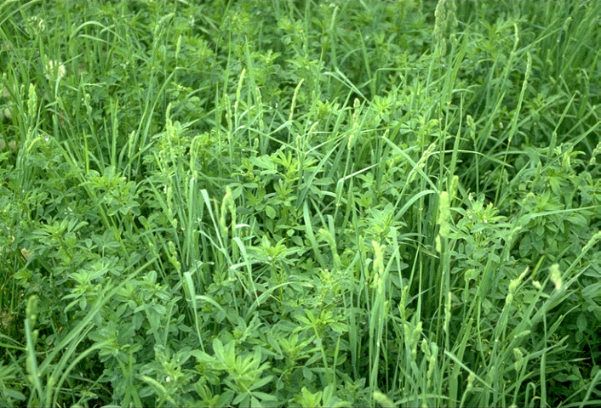

Slide 42
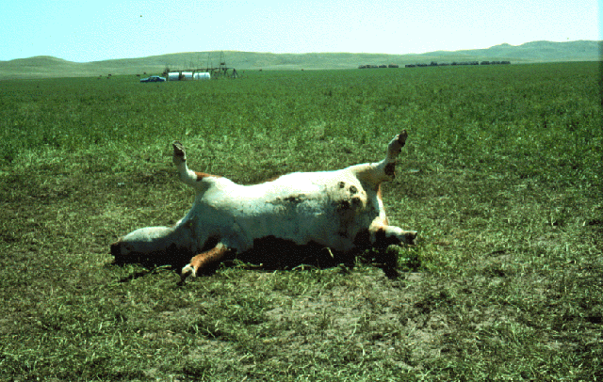
Notes:
Bloat due to initial increased rate of digestion. Immature alfalfa more likely to cause bloat as well as wet alfalfa and right after a frost
No management practice can ensure that bloat will not
occur. However, its likelihood can be greatly reduced when
grazing alfalfa. The following suggestions can reduce the risk
of cattle bloat:
• Grow grass with alfalfa.
• Provide grass hay or grain during the first week or two of
grazing alfalfa.
• Feed Rumensin®.
• Feed bloat-preventing compounds.
• Do not turn hungry cattle into an alfalfa field, especially
when plants are wet from dew.
• Do not graze immature alfalfa or alfalfa/grass.
• Provide salt and minerals.
• Observe cattle closely when turning in for the first time.
• Observe cattle closely during cool, cloudy, and rainy
weather for signs of bloat.
• Do not graze alfalfa for three days following a killing frost
(below 24°F). The harder the frost, the greater the risk for
bloat during this brief period.

Slide 43
Legumes – Birdsfoot Trefoil
long lived perennial
but difficult to establish
above average production and nutrition
exceptional pasture legume
  withstand grazing
  withstand environment -- drought and poor soil
  does not seem to induce as much bloat
  works well with grass -- competition

Slide 44
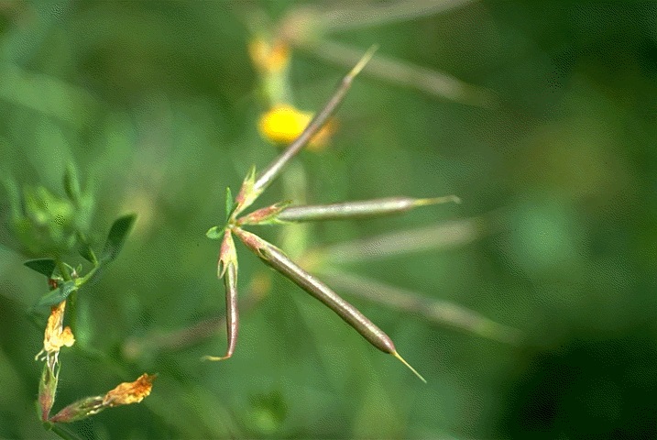

Slide 45
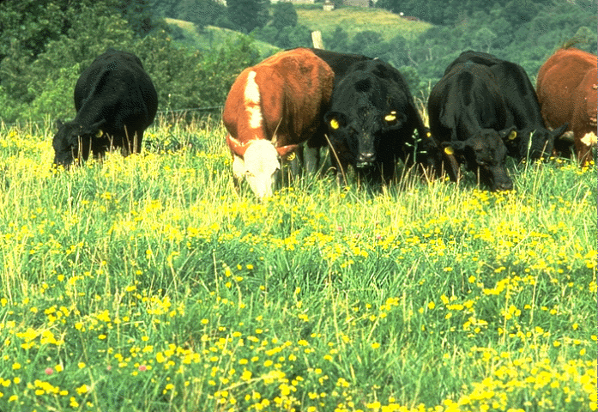

Slide 46
Legumes – Red Clover
probably second (to alfalfa) as a hay legume
  higher yield but lower protein
  more durable
both as hay or pasture legume
easy to establish – broadcast seed
biennial -- due to diseases
Estrogens – may cause repro cycle problems especially in sheep and horses

Slide 47
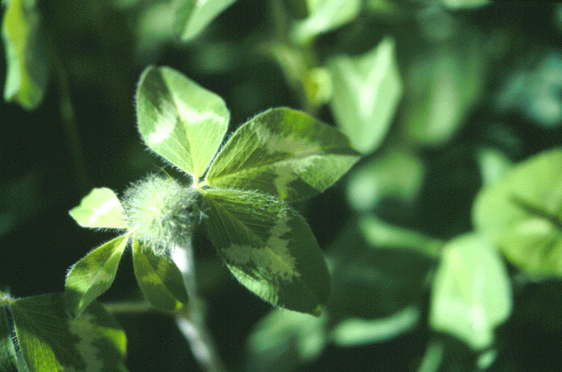
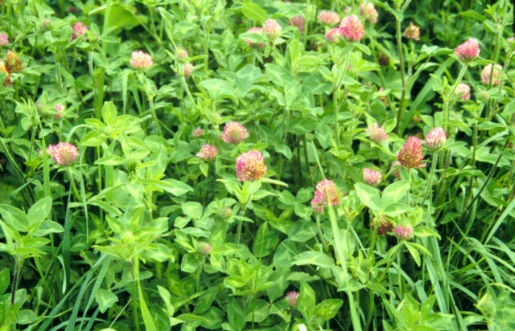

Slide 48
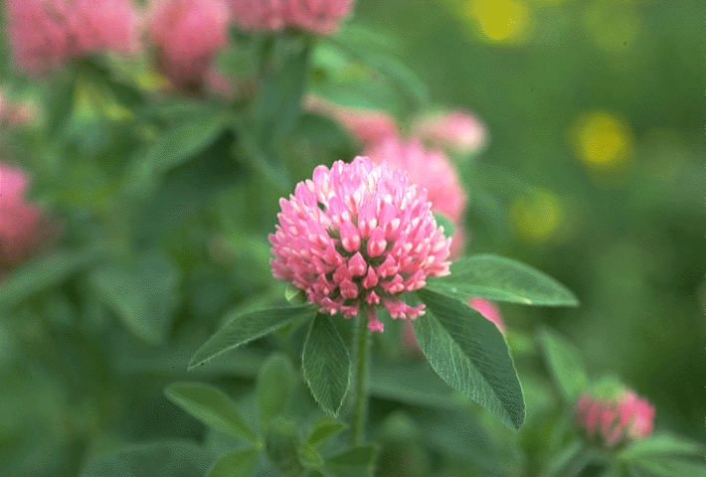
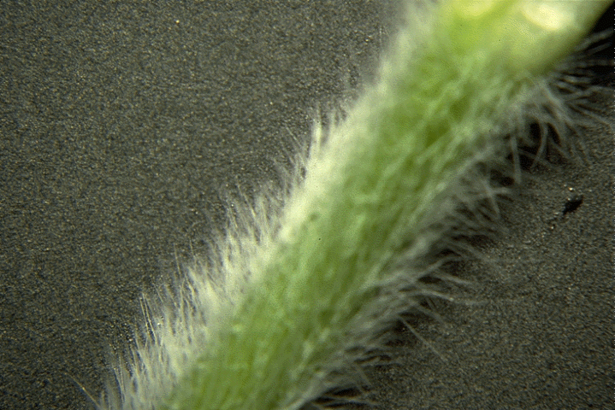

Slide 49
Legumes – White Clover
good pasture legume
  propagates by stolons -- can withstand grazing
some bloat problems (grows close to ground so animals only graze the leaves)
used in some southern Idaho irrigated pastures

Slide 50
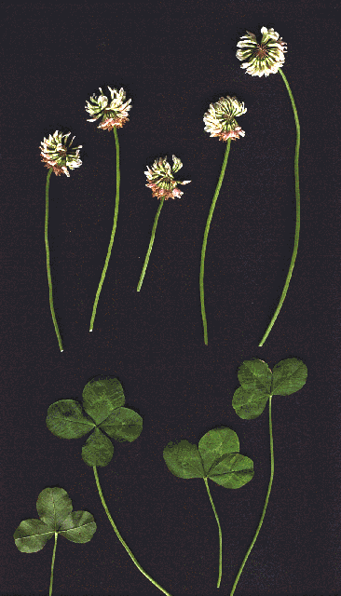
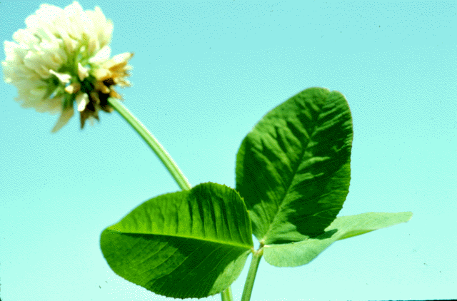

Slide 51
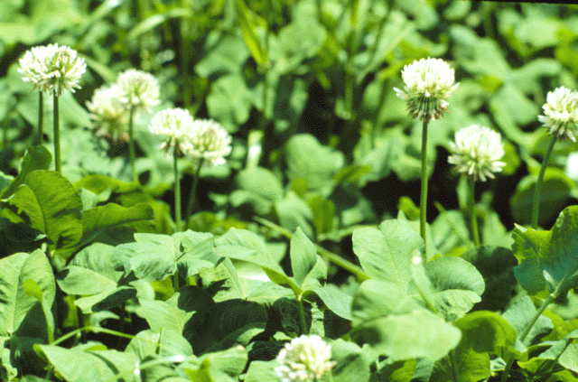
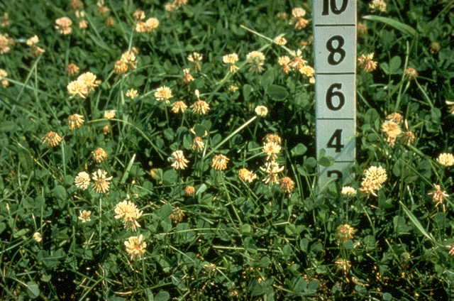

Slide 52
Legumes
Sanfoin
  drought tolerant
  hay or pasture -- no bloat
Sweet Clover
  not really used for forage any more
  lower protein – stemmy
  green manure
  Coumarin found in moldy sweet clover

Slide 53
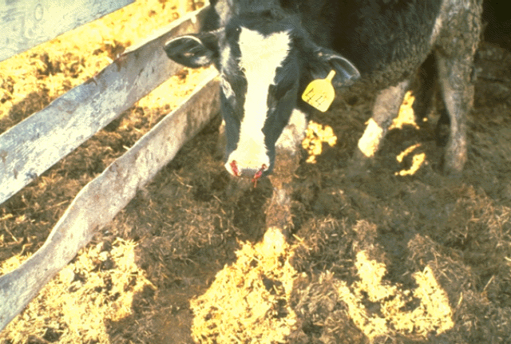

Slide 54
Annual legumes: usually are cool season, therefore are often harvested as silage or grazed
Beans (Fabas)
Peas: Austrian winter peas; work well in mixes with cereal crops (barley); high quality and quantity of silage
Summary - Legumes: legumes offer the opportunity to improve forage quality over pure stands of grass, reduce the cost of N fertilization; major problem is weed control - broad leaf weed herbicides kill legumes

Slide 55
Summary - Legumes:
legumes offer the opportunity to improve forage quality over pure stands of grass, reduce the cost of N fertilization; major problem is weed control - broad leaf weed herbicides kill legumes

Slide 56
Harvesting & Conditioning forage

Slide 57
Mechanical Harvesting
Dry forage – hay and hay making
  Must be field dried to < 16% water (84% DM)
  Requires time of harvest with good weather conditions
  Factors affecting field drying time
    Initial DM %
    Weather conditions: rain, temperature, humidity, air movement
    Conditioning:

Slide 58
Objectives in Haymaking
1. Produce a high yielding, high quality crop
2. Rapid curing
3. Minimize leaf loss
4. Minimize cell respiration (keep cell solubles)
5. Avoid leaching loss
6. Avoid molding
7. Maintain quality in storage

Slide 59
Mechanical Harvesting
Losses during field drying
  Respiration of cell contents
    Continues down to 40% water content
  Shattering – mostly with legumes
  Leaching – rain
  Sun bleaching
  Protein damage – harvest too wet, get heating
Must harvest hay at proper maturity and at the proper weather condition
Notes:
Goal fast curing to reduce losses… losses include
1. Respiration of cell contents 4% loss of DM is unavoidable. Continues down to 40% water content.
2. Leaf loss in legumes
3. Leaching loss due to rain
Hay that is stored at above 20 % moisture favors the growth of fungi.
It is the metabolic activity of these organisms that generates heat and can increase hay temperature at about 150F.
Heating can cause spontaneous combustion---- this usually occurs at 30 to 40 % moisture.

Slide 60
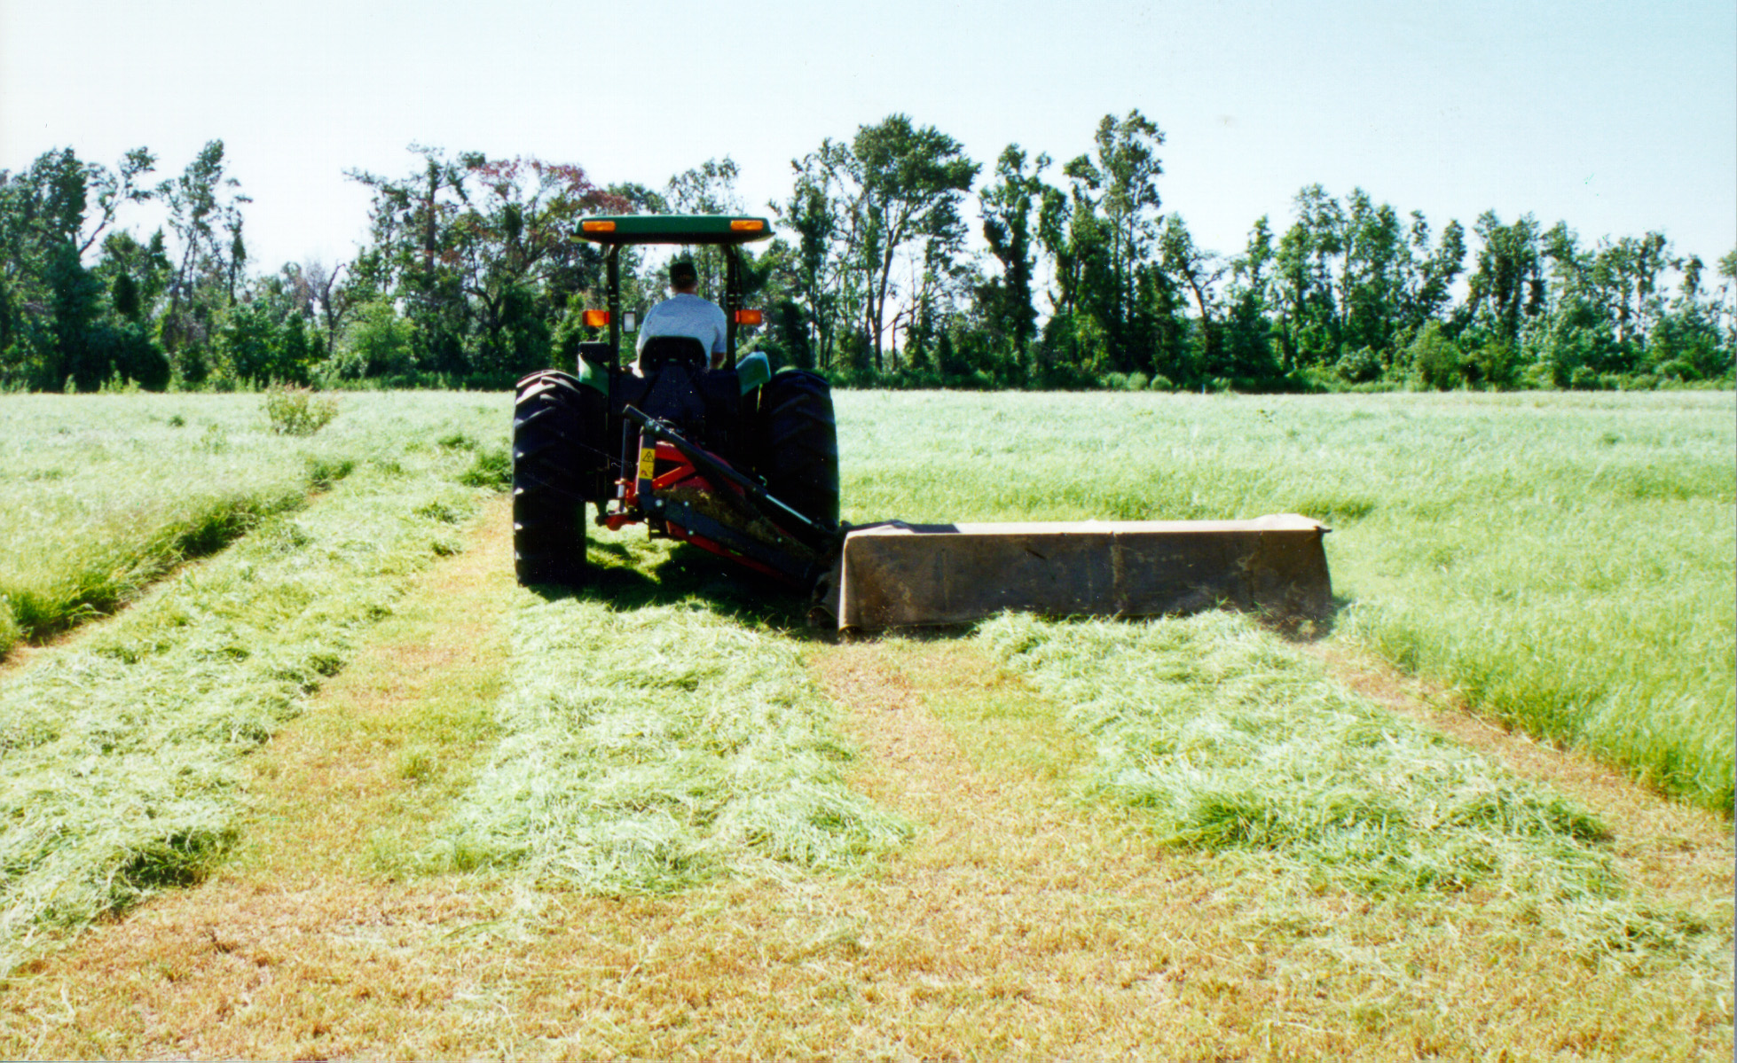

Slide 61
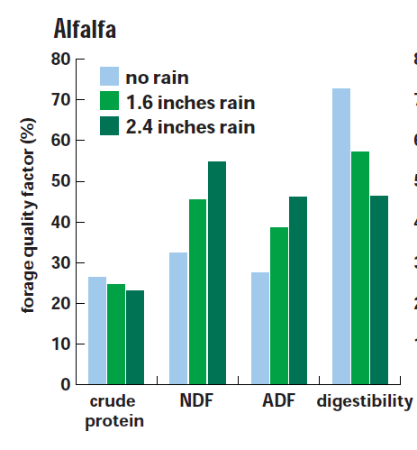
Effect of rain on nutritive components
Why does NDF and ADF increase?
Why does digestibility decrease?
Notes:
Why does NDF and ADF increase? Why does digestibility decrease?

Slide 62
Which is worse?
Having your hay rained on ? or waiting and letting it get mature?

Slide 63
Conditioning
Conditioning refers to mechanical or chemical treatment of the hay crop to accelerate drying process
Mechanical conditioners have been designed to bruise, lacerate, crush or crimp the plant to reduce the differential drying of stems and leaves
Chemical conditioning uses carbonate salts to increase field drying rate of legume hays

Slide 64
Mechanical Conditioning
Crimping: at swathing the forage is passed through rubberized rollers to crush the plant tissue which speeds drying
Masceration: much more extreme than crimping, completely crush the forage at swathing and lay it in a wafer-thin strip, less than 24 hours to baling
  Improved quality
    less field loss of nutrients
    may enhance digestibility of fiber

Slide 65
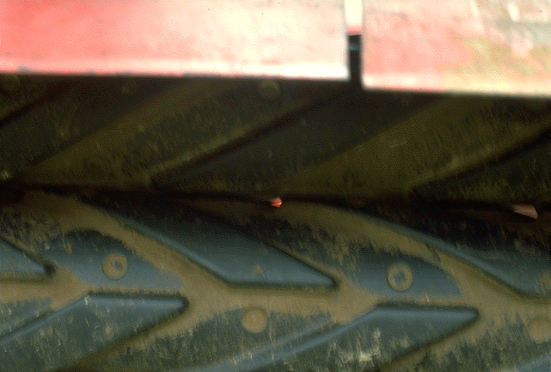
Crimping: at swathing the forage is passed
through rubberized rollers to crush the plant
tissue which speeds drying
Notes:
Conditioning refers to mechanical or chemical treatment of the hay crop to accelerate drying process
Mechanical conditioners have been designed to bruise, lacerate, crush or crimp the plant to reduce the differential drying of stems and leaves
Chemical conditioning uses K carbonate to increase field drying rate of legume hays

Slide 66
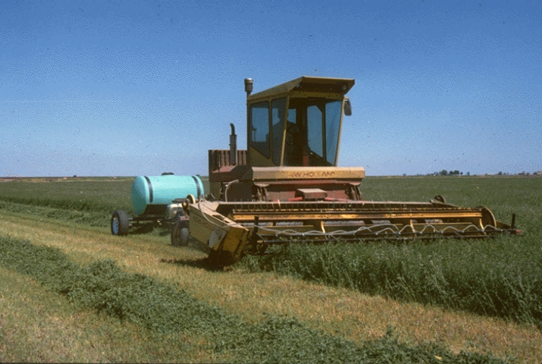
Chemical conditioning
    Desiccants – drying agents – salts that osmotically “pull” moisture out of the plant tissue
      Carbonate salts (KCO₃ or NaCO₃)
        2-3 day drying vs 3-4 days for unconditioned

Slide 67
Raking
Raking inverts the swath by rolling swathed hay over into a windrow.
The objective is to increase aeration and to transfer the swath to relatively dry ground
It can be used to reduce color loss and excessive shattering that may occur if hay is over-dry.
Drying is most rapid when the windrow is wide and thin rather than thick and narrow.

Slide 68
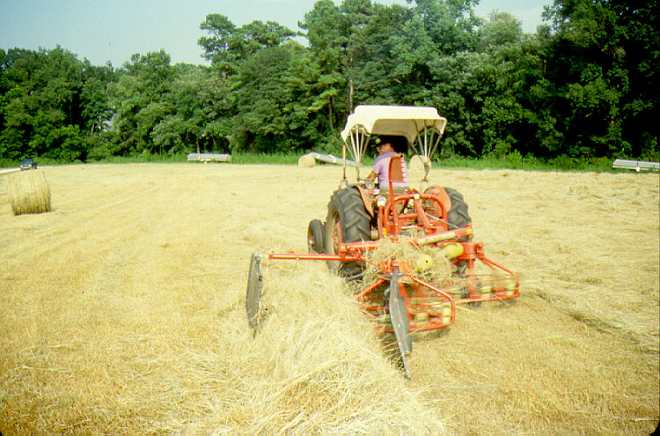

Slide 69
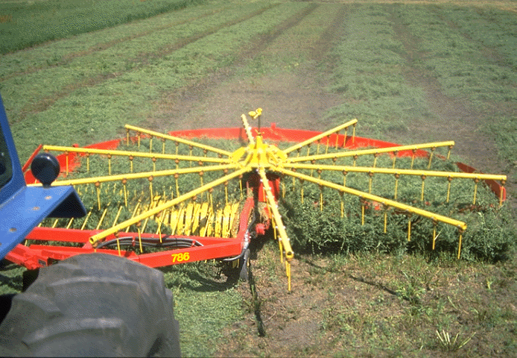
Inverter
Notes:
Raking inverts the swath by rolling swathed hay over into a windrow.
The objective is to increase aeration and to transfer the swath to relatively dry ground
It can be used to reduce color loss and excessive shattering that may occur if hay is over-dry.
Drying is most rapid when the windrow is wide and thin rather than thick and narrow.

Slide 70
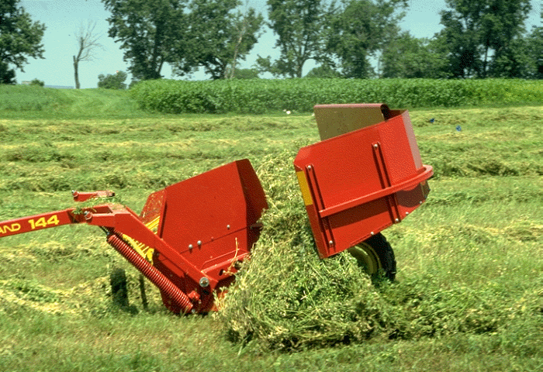
Inverter

Slide 71
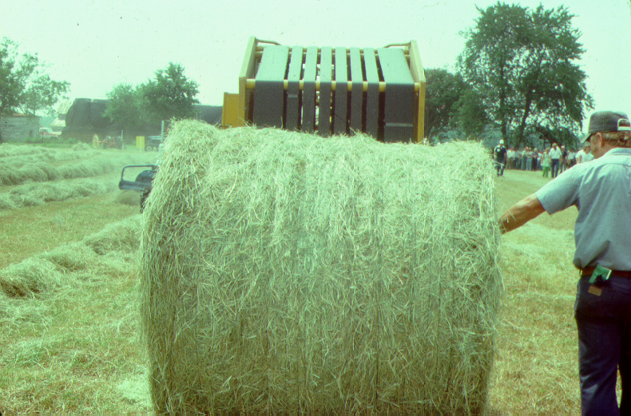

Slide 72
DM losses during haymaking
Process % DM
Respiration 2-16
Conditioning (crimper) 1-4
Raking at 40-50% H₂O 2-5
Raking at 10-15% H₂O 25-30
Baling (rectangular) 2-5
Baling (large, round) 15-40
Notes:
These are typical losses

Slide 73
Heating and Spoilage
Hay w/ 20% moisture - favors the growth of fungi.
metabolic activity of organisms = heat , 150°F.
Heating can cause spontaneous combustion---- this usually occurs at 30-40% moisture.

Slide 74
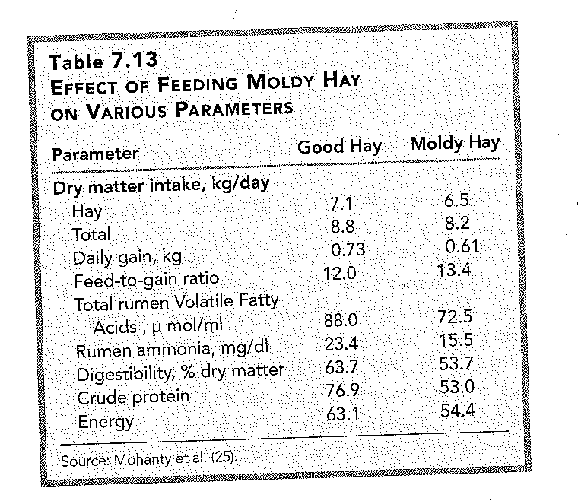
Notes:
Cattle can often tolerate moldy hay but horses can’t. Even if it is not toxic it will reduce performance

Slide 75
Preservatives
Additives for high moisture hay harvest
Rain damage is reduced and leaf retention is high.
  Organic acids – propionic or acetic
    Inhibit mold
    Harvest at 25% moisture
    Expensive
    Corrosive to harvest equipment
  Microbial inoculant – lactobacillus organisms
    Out compete the molds
    Harvest at 25% water
    Less expensive -- $1/ton
    Less consistent protection – must have live organisms
Notes:
Organic acids-When applied? To slightly wet hay (25 to 35 % moisture) during baling so that hay can be removed from the field early.
Rain damage is reduced and leaf retention is high.
Controls microorganisms that would normally cause heating and spoilage (molds) in storage.
Active on both grasses and legumes.

Slide 76
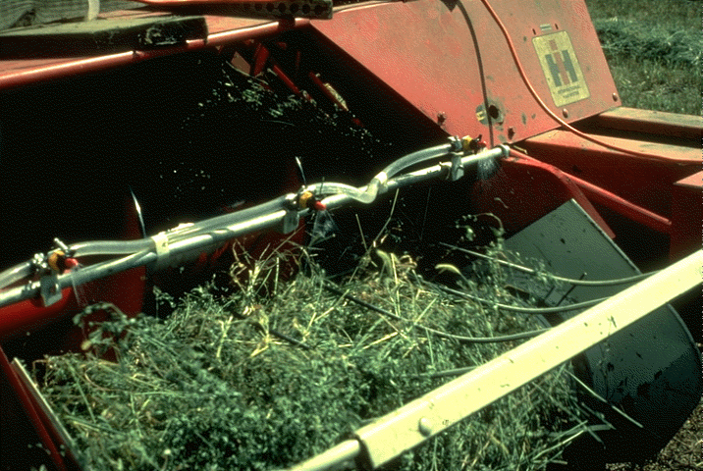

Slide 77
Storage
Hay protected from weather changes little in nutritive value
  Will loose vitamins A & E
Hay stored outside
  Will loose value
  Amount depends on weather and physical nature of hay
  More rain = more loss

Slide 78
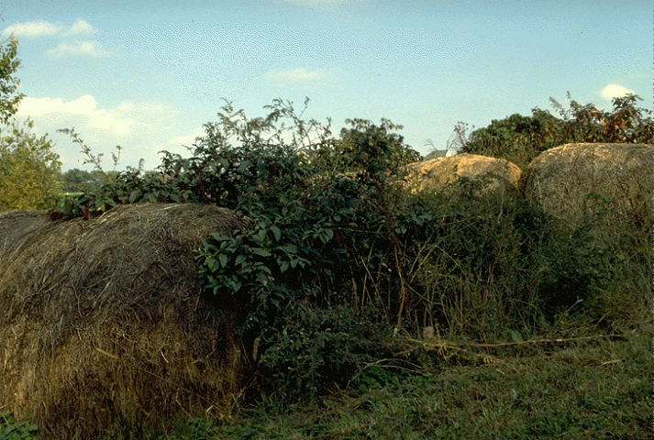

Slide 79
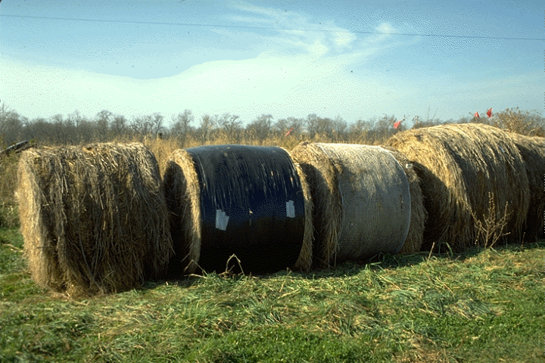

Slide 80
Relative Feed Value index for Hay
Hay is often sold using this feed value index
RFV = (digestible DM % x DM intake %)
  Digestible DM % = 88.9 - (ADF% x .779)
  DM intake % = 120 ÷ NDF%
Estimates digestible dry matter (energy) from ADF
  ADF is not as accurate at estimating energy as we would like
Calculates the DM intake potential (as a % of BW) from NDF

Slide 81
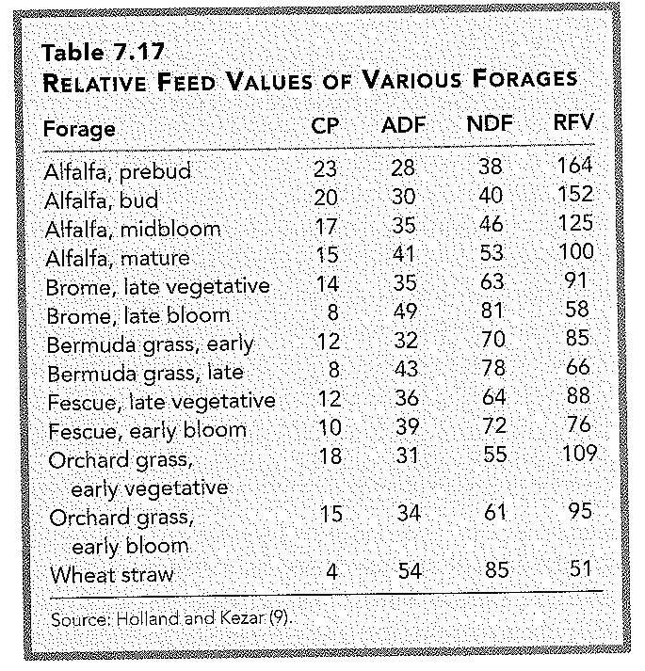
Relative feed value (RFV); based on NDF and ADF content

Slide 82
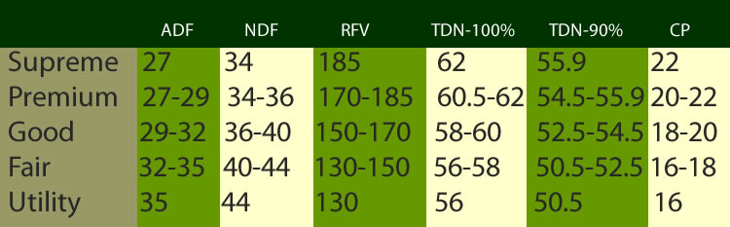
USDA alfalfa hay quality guidelines

Slide 83
RFV limitations
RFV assumes all fibers have the same digestibility
Cows may perform differently on identical RFV.
Variations in the digestibility of the NDF.
Fiber from grass and legumes naturally differs in digestibility, as it also does when grown under different ambient temperatures

Slide 84
Relative Forage Quality (RFQ)
Intake and TDN are calculated from NDF digestibility (in-vitro or in-situ digestion; 30 or 48 h)
Total digestible nutrients (TDN) substitutes for DDM
  TDN is calculated based on NFC, CP, EE and NDFD
RFQ = (DMI, % of BW) x (TDN, % of DM) / 1.23
  The value 1.23 ensures the equation has a mean and range similar to that of RFV.

Slide 85




NDF Digestibility
Costs
$22 for NDFD analysis alone
$44 for NIR plus NDFD

Slide 86
RFV vs. RFQ
The RFQ will run higher or lower than the corresponding RFV i based on the NSC, NDF, and NDF digestibility of the sample.
Grass- Legume mixes
  As a hay-crop material includes more grass with generally higher NDF digestibility, the RFQ will show an advantage to the forage over the RFV in predicting feed value

Slide 87
Take home message
RFV continues to be widely used as an index to assess quality, compare forage varieties, and price forages
With increased price of hay, RFQ may become more common
  (Especially for high quality forages)

Slide 88
Treatment methods for low quality forages

Slide 89
Treatment of low quality forage
aimed at rendering constituents of low quality forages more accessible to the digestive enzymes of the rumen's microorganisms to improve both their digestibility and intake
There are several categories of treatments: physical, chemical, microbial.

Slide 90

Physical treatment
Modification of the physical structure of the forages
mechanical treatments such as chopping, laceration or grinding, together with thermal treatment using steam
The objective of mechanical treatment:
  to reduce the size
  To increase surface area
  Also reduced volumes and increase ease handlings

Slide 91
Mechanical treatment
Chopping (by machines with knives or flails)
  cuts the blades of straw into relatively long sections (from 1 to 10 cm) = ½ to 4 inches
Laceration (achieved with a type of flail mill with no concave sieve)
  gives shorter but variable sections due to bursting the stalk along its length.
  increases the absorptive capacity of the forage and can be used to form a carrier for liquid feed supplements such as molasses and whey.
Grinding (with a hammer mill)
  produces forage particles which are less than a centimeter in length (< 0.5 inches)

Slide 92


Mechanical treatment
Amongst mechanical treatments grinding is the most common treatment in current use.
Mechanical treatment is generally costly in energy consumption

Slide 93
Chemical treatment
Alkali treatment
  Disrupts chemical linkages between lignin and hemicellulose
  Sodium hydroxide
  Calcium oxide (hydrated lime)
    Add water and becomes Calcium hydroxide
  Anhydrous ammonia
    Ammonia becomes dissolved in the water within the plant forming ammonium hydroxide
    Also adds N
Notes:
Forming a hydroxide to disrupt the linkages

Slide 94

Alkaline processing disrupts lignocellulosic structure

Slide 95
NaOH
Used at 3 to 5% of DM
Originally involved soaking forage in NaOH for 3 d
  Waste water disposal issues
  Solubilization of nutrients during washing
Currently sprayed on forage
  Less effective than soaking

Slide 96

Effect of NaOH on digestibility of barley straw

Slide 97
NaOH treatment issues
Hazardous (casuistic alkali)
Sodium accumulation in manure
Costly

Slide 98

Calcium oxide treatment of chopped corn stover using a feed wagon
Notes:
Cost of chemical is $20/ton. Can’t use limestone

Slide 99

Notes:
Advatanges $20 to 30 per ton for treatment, less caustic than NAOH, Ca has less impact than Na on soil.

Slide 100
Calcium oxide treatment

Slide 101

Ammoniation
Forage is covered with plastic and anhydrous ammonia is applied
  Should be applied at a rate equal to 3% of DM
    about 60 lbs. per dry ton of forage.
  Changes from a liquid to a gas and penetrates the forage
  Takes several weeks for the reaction to occur
  Better reaction when
    Forage has greater moisture
    higher ambient temp
  Some ammonia
  will be lost
  http://www.youtube.com/watch?v=-JtjJb-umpk
Notes:
Most widley used
Less effective than NaOH but will increse TDN by 10% and CP by 6 %

Slide 102
Ammoniation
Increase CP to 6-8 %
Increase digestibility (TDN) by 5 to 7%
Increase intake by 20%
As a result of ammoniation, the forage is no longer deficient in crude protein.
Because of improved digestibility and consumption, the animal is able to consume additional energy.

Slide 103
Ammoniation
Can partially replace “conventional” hay with treated straw
  Up to 65% in late gestation cows
  Up to 35% in cows nursing calves
  Always look at the cost
  Compare the spread between straw and conventional hay to determine if treatment will be cost effective

Slide 104
Cost of ammoniation
Estimated costs to treat 1 ton of forage are
  $26-30 for anhydrous ammonia
    based on $850-1,000/ton of ammonia
  $5-9 for plastic
    $181 for 6-millimeter black plastic than is 40 × 100 ft
  Total of $31-39/ton.
If wheat straw costs $45-50/ton, the total cost of ammoniated wheat straw in this example would be $76-89/ton
If medium quality hay is $100 or more a ton in this scenario then is it worth it?
Also can reduce the amount of anhydrous applied
  normally takes 3% anhydrous ammonia to get the full chemical reaction
  Can apply only 2-2.5% anhydrous to cut costs and still get 80-90% of the desired results on the forage

Slide 105


Slide 106


Slide 107


Slide 108


Slide 109


Slide 110


Slide 111


Slide 112


Slide 113
Wet forage: Green chop, Silage

Slide 114
Wet Forage Harvest – Green Chop or Silage
Feed is fermented with anaerobic microbes to preserve
  must be anaerobic or will get aerobic molds
  Must have substrate (simple sugars) for the anaerobes

Slide 115


Slide 116


Slide 117
Wet Forage Harvest
Anaerobic fermentation process:
  Aerobic phase: the less the initial O₂ (or fast silo filling) the shorter this phase
  Acetic acid production stage
  Lactic acid (lactate) production stage
    Eventually the pH drops to about 4 and the forage is sterilized -- preserved

Slide 118
Mechanical Harvesting - Wet forage
Conditions necessary for good silage making:
  anaerobic conditions -- press all of the air out of stored forage
  must be wet
  must be well chopped; 1/4 to 3/8” length chop; may lose “effective fiber”
  Must be proper maturity – not too high in fiber

Slide 119
Wet Forage Harvest – examples of silages
Corn silage
  Whole plant, chopped, harvested at 32-38% dry matter
  Standing crop – not allowed to wilt
  Maturity management – want to harvest grain (starch) but not indigestible fiber

Slide 120


Slide 121


Slide 122


Slide 123


Slide 124


Slide 125
What about cutting height??!!
Plant part | NDF % | NDF range | ADF% | ADF range
High cut | 41.9 | 39.0-45.8 | 20.1 | 17.9-23.7
Low cut | 45.8 | 39.5-49.7 | 22.8 | 19.9-25.6
Stubble | 63.1 | 56.7-65.8 | 36.5 | 31.4-39.7

Slide 126
Wet Forage Harvest:
  Grass silage
    Small grains: wheat, barley, triticale
      Best to harvest when the seed is in milk to early dough stage
    Cool season perennial grass; need to be sure to harvest at very early seed head emergence
  Legume silage
    *** alfalfa: harvest at pre-bloom

Slide 127
Sources of storage loss
Respiration
Gases of fermentation
Seepage – liquor contains soluble nutrients
  Some protein is converted to NPN
Spoilage on the top
  Must cover with plastic

Slide 128
Wet Forage Harvest: Types of silage storage
Upright storage-
Concrete block or
Fiberglass
(nearly) completely airtight –
minimal storage loss

Slide 129


Slide 130


Slide 131


Slide 132
Wet Forage Harvest: Types of silage storage
Bunker – floor and wall
on three sides
More loss but less cost

Slide 133


Slide 134


Slide 135


Slide 136
Wet Forage Harvest: Types of silage storage
Open pit – trench
dug out of ground
Extreme
Storage loss
Upright storage-
Concrete block or
Fiberglass

Slide 137
Wet Forage Harvest: Types of silage storage
Silo bags – horizontal
Plastic tubes
good storage
expensive plastic

Slide 138


Slide 139


Slide 140


Slide 141
Wet Forage Harvest: Types of silage storage
Balage – wet bales
contained in plastic
Allows advantages
of silage in a bale package
good storage
expensive plastic

Slide 142

Greater storage loss

Slide 143
Wet Forage Harvest
Storage loss | Average | Range
Gas tight | 5 | 1-10
Conventional upright | 6 | 2-12
Bunker | 15 | 8-25

Slide 144
Wet Forage Harvest: Ensiling aids
Energy – molasses – lactobacillus need readily available energy
Ammonia
Acids: reduce molds and reduce NPN
Microbial inoculants
Enzymes

Slide 145
Wet Forage Harvest: silage vs. hay
Silage is more palatable
Silage allows for early harvest or harvest during damp climate
  Maturity management
  Double cropping
Silage yields more energy per acre
  Less field loss
  Makes weeds more acceptable

Slide 146

Wet Forage Harvest: Comparison of silage vs hay
Silage harvest is probably more costly
  Harvest equipment
  Handle water
Silage allows for more mechanical harvesting and feeding
Silage is not for intermittent use

Slide 147


Slide 148
Effective Fiber
Important consideration in rations of ruminants that are being fed for high productivity

Slide 149
    Fiber’s role in low fiber diets of ruminants
Fiber important to maintaining optimal rumen function.
Long fiber is regurgitated and chewed (causes rumination)
  Producing large amounts of saliva
  Saliva buffers the rumen
  Prevents undesirable microorganisms
  Dilutes VFAs
  Increases liquid turnover
  Stimulates Motility

Slide 150
In Ruminant diets
Low fiber intake
  rumination decreases
  saliva production decreases
  rumen motility can be decreased
  rate of passage from the rumen slows down
Inadequate fiber can results in rumen acidosis
  decreased feed intake
  decreased dry matter digestibility
  laminitis and rumen parakeratosis
    hardening and enlargement of the papillae of the rumen

Slide 151
Effective fiber
The term “effective fiber” can be defined as the ability of a fiber source to stimulate rumination.
Measured as effective NDF (eNDF)
  effectiveness of NDF for stimulating chewing activity this has a relationship with particle size
  eNDF (% of DM) of feeds by multiplying NDF concentration by the proportion of particles retained on a 1.18-mm sieve

Slide 152
    Effective fiber
    Physical form affects chewing time
      Particularly a problem with high fiber byproduct feeds at particle size is small
      Chopping forage too fine decreases effectiveness
        eNDF
        Feed % NDF % of NDF % of DM
        Corn cobs 87 56 49
        Cracked corn 10.8 60 6.7
        Whole corn 9.0 100 9.0
        Corn gluten feed 36.0 36 12.8
        Corn silage 41.0 71 29
        Alfalfa haylage (1/4” cut) 43.0 67 29
        Alfalfa hay, late vegetative 37.0 92 34
        Oat straw 63.0 98 62
        Bromegrass hay, pre-bloom 55.0 98 54

Slide 153
low effective fiber in ruminant diets
Inadequate dietary fiber
Decreased salivary buffers
Decreased pH Decreased osmotic pressure
Decreased liquid turnover
Decreased efficiency of microbial growth
eNDF Theoretical maximum microbial synthesis, g/g CHO fermented
24 0.40
20 0.40
16 0.36
12 0.32
8 0.28
4 0.24
low effective fiber means low microbial yield

Slide 154
Inadequate fiber in ruminant diets
Results in reduced fiber digestion
  Maximum growth of cellulolytic microbes occurs ~ pH 6-7
eNDF | pH | % of max fiber digestion
24 | 6.4 | 98
20 | 6.3 | 95
16 | 6.1 | 87
12 | 5.9 | 70
8 | 5.7 | 28
4 | 5.6 | 0
Notes:
Thus, any factor that helps to maintain ruminal pH above 6.0 is generally beneficial. For example, feeding a TMR rather than “slug feeding” grain in the parlor twice a day, helps to moderate decreases in ruminal pH that occur after feeding.

Slide 155

Forage Testing
Sampling is often the weak link in forage quality evaluation
The analysis you get is for the sample you sent in....
You need to get a "representative sample“
A small sample (1/2 lb) is used to represent many tones of forage
Small sampling errors can lead to costly mistakes.
Notes:
The best time to take hay or silage samples is as near to the time of feeding or sale as possible. Many different factors affect forage quality. Some of these variables include: plant species that are in the particular hay lot (including different legumes, grasses, and weeds), stage of maturity during harvest, environmental conditions during growth and harvest, damage due to insects and plant diseases, soil fertility, and losses during harvest and storage.

Slide 156


Forage sampling
Sampling methods include mechanical coring of bales with a hay probe or pulling hand-grab samples from bales or windrows.
Notes:
Sampling methods include mechanical coring of bales with a hay probe or pulling hand-grab samples from bales or windrows. The best technique is to use a mechanical coring probe. A hay coring probe and drilling brace can be purchased for approximately $150.00, which is relatively inexpensive.

Slide 157
Why Sampling?
One handful from the outside of one bale does not represent your field, but only about 1 square foot in your field.
Soils can be highly variable across a field, so plants grown on them will be likewise.
By far, the single greatest source of error in forage test results is in the sampling technique.
Notes:
157

Slide 158
Hay sampling
Using a probe is the best method
  The inside diameter of probe should be between 3/8 and 5/8 inch.
  Sample probes should allow penetration 14 to 24 inches into the bales.
  Dull probes will push material out of the core.
Sampling video http://www.youtube.com/watch?v=MVfWWaTdB9o

Slide 159
Forage sampling
Sample different hay lots separately
  Keep track of where hay can from
  Keep track of different cuttings
Take 20 samples per lot
  Sample from multiple bales
Square bales -- Take core samples through the center of one end of the bale (between the strings)
Round bales -- Take core samples at waist height on the rounded side of the bale
To ensure accuracy of results, select a laboratory that has been certified by the National Forage Testing Association certification program.
Notes:
The hay and silage from every field and every cutting will be different. A forage lot is that hay or silage taken from the same location, field or farm, the same cutting (within a 48-hour period) at the same plant maturity, and having similar amounts of grass, weeds, rain damage, or preservative treatment.

Slide 160
Quality test of 20 single bales of alfalfa from a single cutting and field
 | DM% | CP% | ADF% | NDF% | RFV
Minimum | 84.7 | 18.2 | 28.6 | 33.7 | 103
Maximum | 89.9 | 22.4 | 36.9 | 54.1 | 184
Average | 86.9 | 20.4 | 32.4 | 40.5 | 148
Composite | 88.1 | 20.7 | 31.5 | 40.7 | 147
This is why you need to sample multiple bales
Notes:
Twenty individual bales from the same lot of hay were probed and analyzed. The table shows the variability between bales and the implications can that be drawn from analyzing only one bale. For example, if you sampled the worst bale in the lot, feeding recommendations based on this information would result in overfeeding and increased feed cost. At the end of the study, all of the individual samples were combined to form a bulk composite sample. The results of the composite are equivalent to the arithmatic average of all the samples demonstrating that compositing multiple subsamples is the best way to get an accurate picture of the forage in question.

