Slide 1
Metabolic Disorders & Nutritionally Related Diseases

Slide 2
Overview
Dairy Cattle –
  Displaced Abomasum
  Bloat
  Fatty Liver Syndrome, Ketosis
  Milk Fever

Slide 3
Percentage of cows with identified health problems
Health problem | USDA NAHMS, 1996 | Kelton et al., 1998 | USDA NAHMS, 2002 | USDA NAHMS, 2007
Mastitis | 13.4 | 14.2 | 14.7 | 16.5
Milk Fever | 5.9 | 6.5 | 5.2 | 4.9
Displaced Abomasum | 2.8 | 1.7 | 3.5 | 3.5
Retained Placenta | 7.8 | 8.6 | 7.8 | 7.8

Slide 4
Displaced Abomasum
When Abomasum becomes distended with gas, fluid or both and shifts to an abnormal position (usually to the left).
Signs include: ketosis, normal temperature, reduced milk production, listlessness, and discomfort.
  decrease milk yield; off food; pinging sound w/stethescope
Cause
  when abomasal contractions are weak or absent
Treatment
  Surgery
  Rolling and stitching
Prevention
  Feed good forage: concentrate ratio
  Have good pre-fresh program

Slide 5
Energy Balance

Slide 6
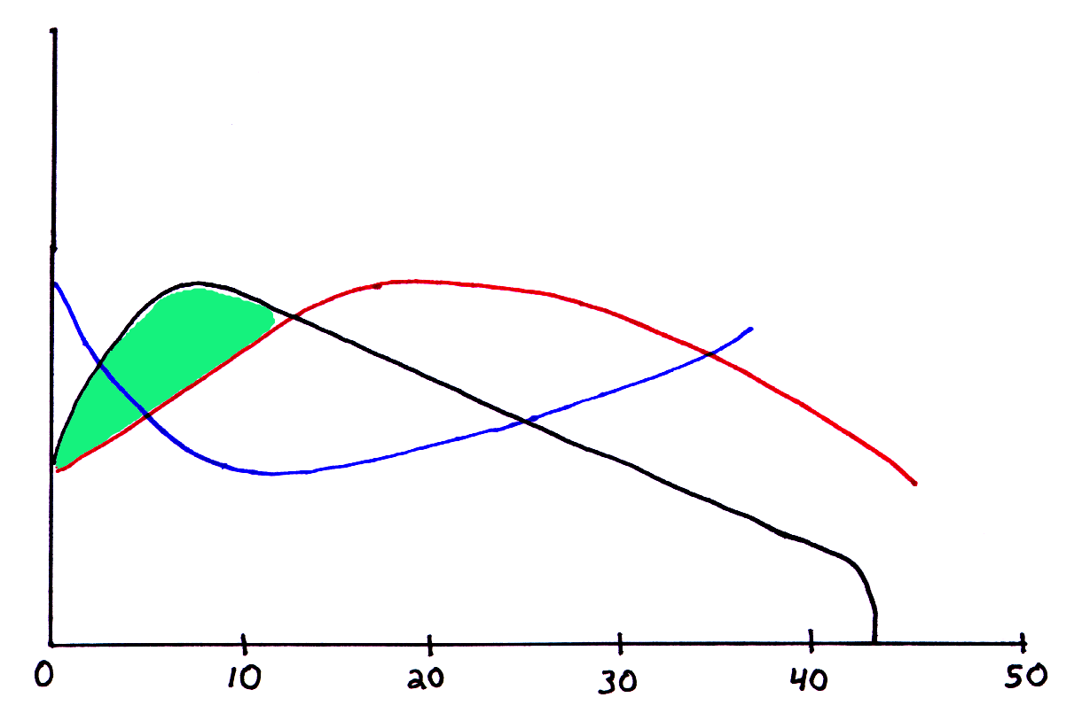
Change in Energy Status
Dry Matter
Intake
Milk Yield
Live
Weight
Week of Lactation
Garnsworthy, 1988

Slide 7
Energy Metabolism During Negative Energy Balance
G-6-Pase
Glucose-6-P Glucose
Glycolysis
Gluconeogenesis
Pyruvate
Fatty Acids
(NEFA)
Acetyl-CoA
Ketones
Oxaloacetate
Citrate
Kreb’s
Cycle
Liver
2 CO₂
12 ATP
Hrycyna, 2004

Slide 9
calving
Block et al., 2002

Slide 10
Fatty liver syndrome
Symptoms
  Liver failure
  dull, depressed, stop eating
  labored breathing
Cause
  Greater than 20% fat in liver cells
Treatment
  High forage diet and watch for other problems
Prevention
  Good pre-fresh diet, no fat cows

Slide 11
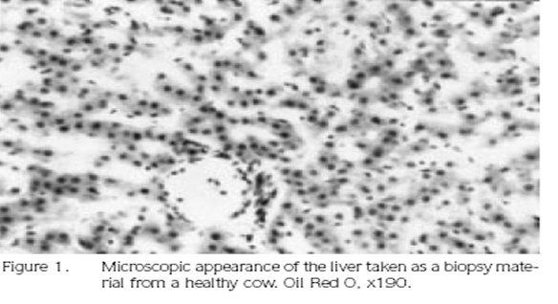
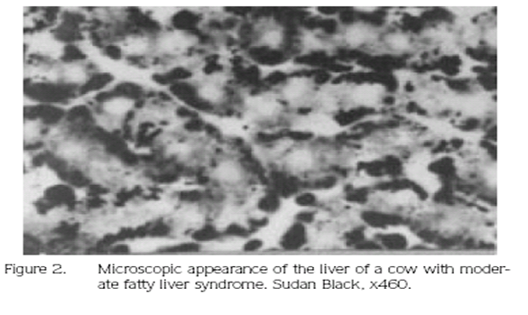
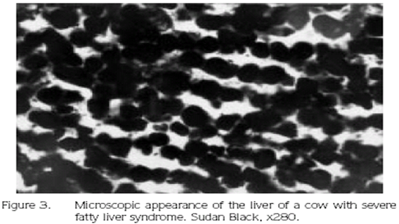

Slide 12
Ketosis
Increased plasma [AcAc, Ac, BHBA] results in ketosis
Incomplete FA oxidation & Severe NEB results in plasma ketones concentrations
Kronfeld, 1965; Schultz, 1988 Grummer, 1993;

Slide 13
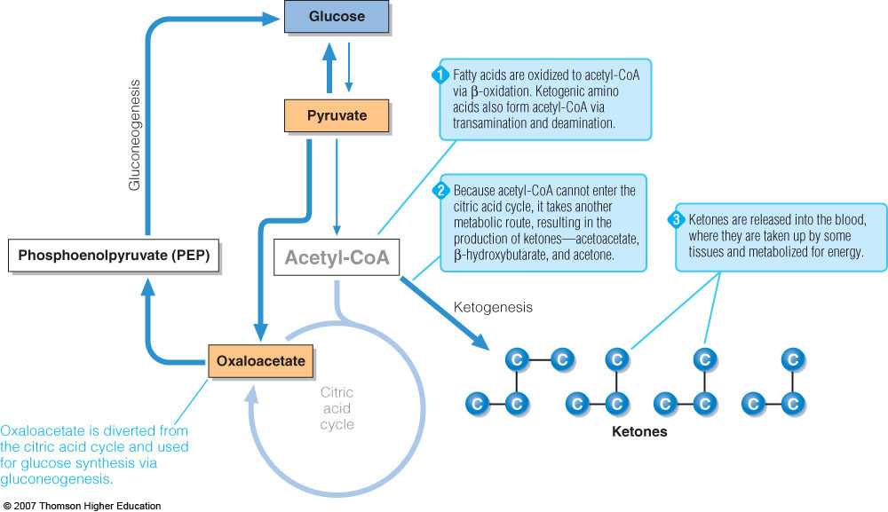
Ketogenesis

Slide 14
Adapted from Reist et al., 2000

Slide 15
Milk Fever
Symptoms
  wobbly, poor muscle coordination
  “S” curve to neck, or down cow
Cause
  Low blood calcium levels
Treatment
  Calcium I.V.
Prevention
  DCAD
  Good pre-fresh diet
  Calcium and electrolytes in warm water

Slide 16
