Slide 1
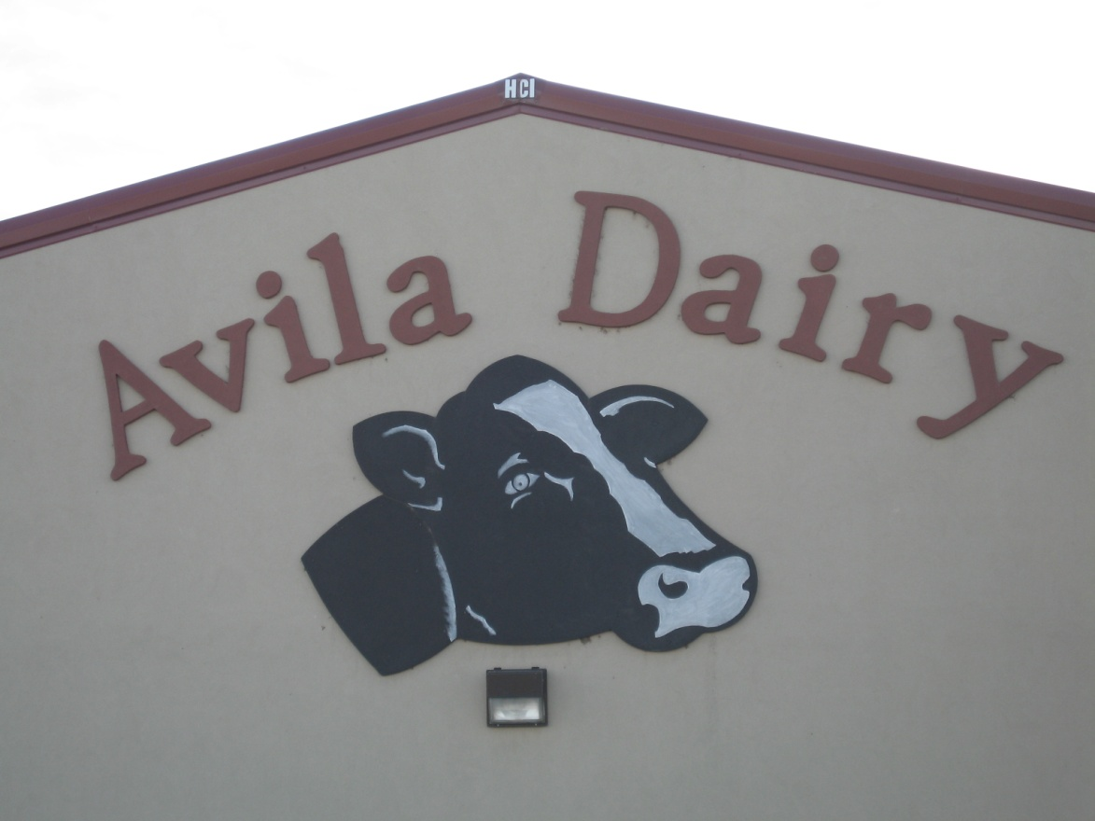
Avila Dairy Presented By: Kendrick Knehans, Jackie Owens, Jackie Wuebben, Tiffany Van Buren

Slide 2
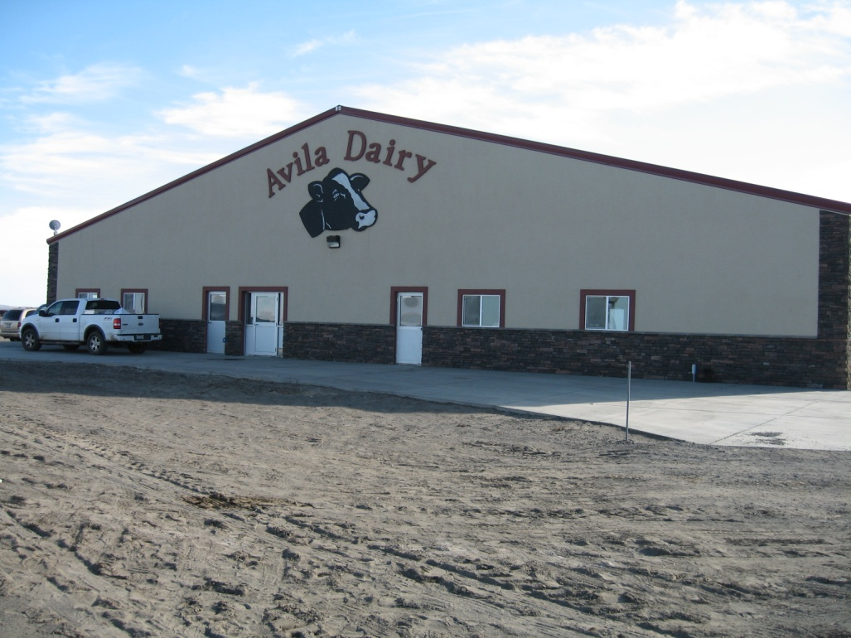
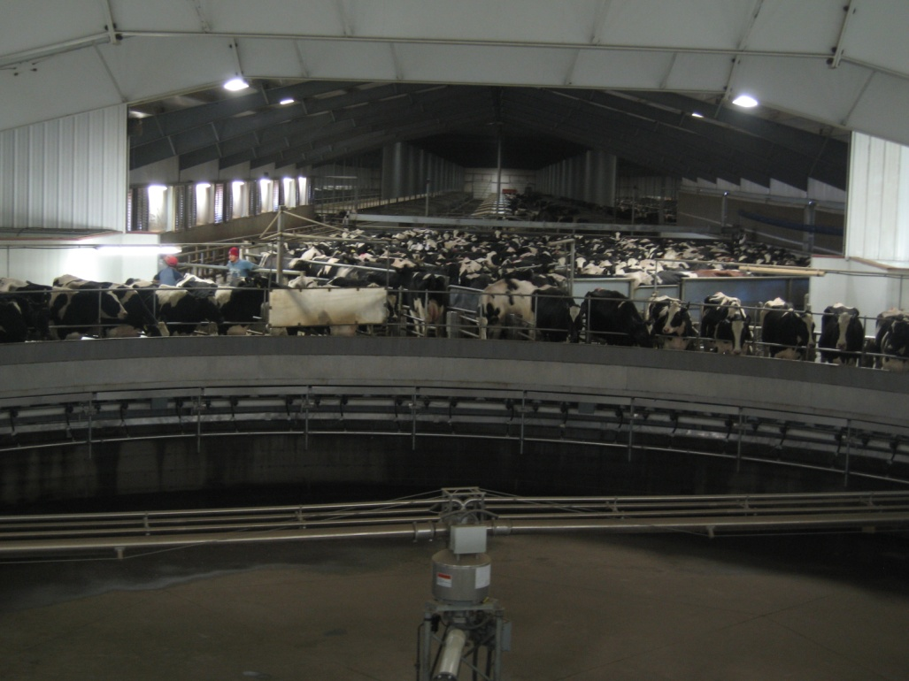
Background of Dairy

Slide 3
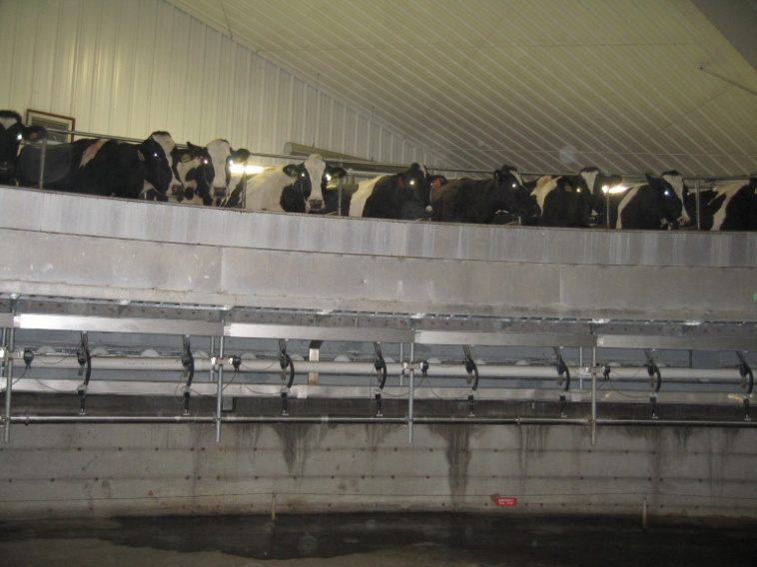
New Facility
Owners: Eddie and John Avila
Built: April 28, 2009
Capacity: 3000 head
Currently 1800 head (80 lb milk)
No cross-bred cows
100 dry cows at any given time
280 farmable acres
Fully automated 72 head rotational milking parlor
All milking equipment is located in the “pit”

Slide 4
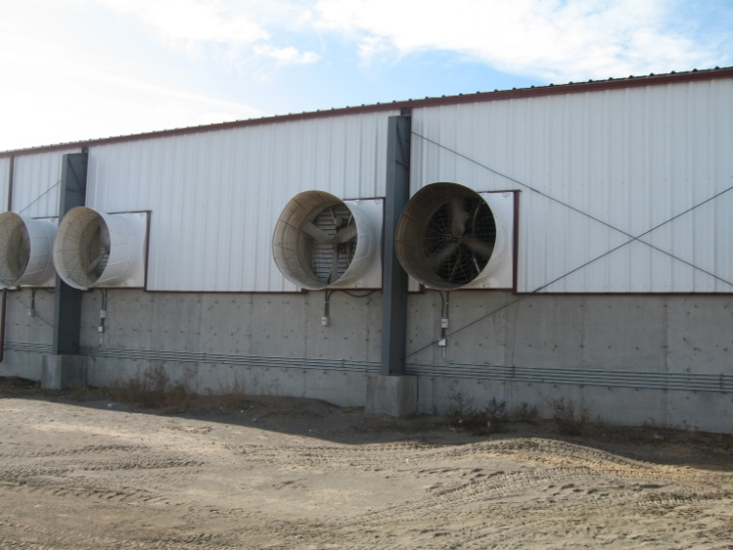
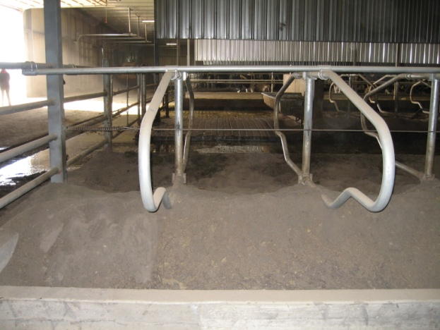
New Facility
Building utilizes cross ventilation
82 fans
Cooling pads
No curtains for winter
No shade in the dry lots
1% slope in barn; 0.5% in dry lot
Barn dimensions: 800ft long; 364ft wide
500 stalls; 400 cows/stall
6 pens w/in barn
Not all pens are being used

Slide 5
New Facility
Bedding
2980 beds in the building
Sand
Used bedding sand gets recycled
Recycled sand is not needed right now
Scraped 1X/wk
Flushed 4X/day
2 pens of breeding; 2 pens preg are in the barn
Fresh cows, heifers, and tailenders are in the drylot
No dry cow therapy

Slide 6
Old Dairy
2000 head (60 lb milk)
Calves are born here
Cows are sent here 3 wks before calving
Fed hospital milk, milk replacer, calf starter 20-20
Weaned at 2.5 months of age
Bull calves sold for about $45
Hospital pen
No hospital at the new dairy yet
Close up pens
25 miles away from the new dairy

Slide 7
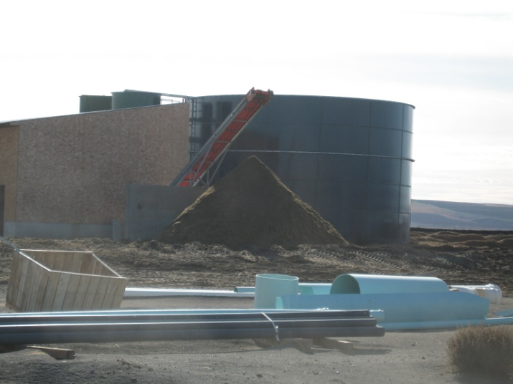
Positive Aspects
Low SCC: 160,000
Receiving bonus of $0.17/cwt of milk
Good Avg Peak Production Yield: 117.5 lbs
Decent Milk Yield/Cow: 72.5 lbs
Clean Milking Facility
Could be extremely efficient if ran at full capacity
Waste Management
Sand, Waste
Pen Maintenance
Relaxed Environment
Well-Ventilated Barn
No decrease in milk yield in summer

Slide 8
Problems and Solutions

Slide 9
Improvements Needed
Major Improvements
Minor Improvements
Operate at Full Capacity
Herd Avg Milk Yield
Days to Peak Production
Conception Rate
Days to First Breeding
Calving Interval
Dry Cow Therapy
Preparedness
Cow Comfort
Total Mixed Ration

Slide 10
Operating at Full Capacity
Herd Size: 2,137 Head
Facility Capacity: 3,000 Head
863 Head Difference
Increase PR or buy replacement heifers
Assume heifers weigh on avg 800 lbs
Costs for replacement heifers ~ $75/cwt
$0.75/lb * 800 lbs = $600/heifer (Cost of R-Heifer)
$600 * 863 = $517,800 to purchase heifers needed for full capacity

Slide 11
Solution
68.2 lbs milk * 863 = 58,856.6 lbs of milk/day
58,856.6 lbs * $0.13 = $7,651.36/DIM
$7,651.36 * 185 (Avg DIM) = $1,415,501.60 Milk Production Income
$1,415,501.60 * 60% (costs) = $849,300.96 Operating Costs
$1,415,501.60 – 849,300= $566,200.64 Gross Profit
$566,200.64 – $517,800 = $48,400.64 Total Profit at first lactation
Milk profit will increase after first lactation

Slide 12
Herd Avg Milk Yield
Herd Avg is below the State Avg
Avg/Cow = 72.5 lbs
Milk Fat%: 2.95
Goal: 3.5%
Milk Protein%: 2.99
Goal: 3.2%
Inversed Milk Fat/Milk Protein level
Could be Acidosis – The cause of low milk production yield and milk fat depression

Slide 13
Solution
Increase of 3 lbs/day in milk yield by solving acidosis problem
3 lbs/day * 2,137 head = 6,411 more lbs/day
6,411 lbs * $0.13 (current price of milk) = $833.43
20% (cost) * 833.43 = $166.69 (costs)
$833.43 – $166.69 = $666.74/cow PROFIT
If problem is Acidosis:
Increase Effective Fiber, Decrease Starch in ration
Add salts like Sodium Bicarbonates

Slide 14
Days to Peak Production
Days to Peak: 93 Days
Realistic Goal: 60 Days
Fresh Pen Management
With good peak yield, but low herd avg yield causes us to think the persistency of lactation is lacking
Nutrition is key
Metabolic Disorder
Acidosis

Slide 15
Solution
Nutrition
Nutritional Mgmt in Fresh pen would cause persistency of good peak yield to carry throughout entire lactation
1 lb milk yield increase at peak = increase of 200 lbs/cow throughout entire lactation
Goal: 2 lb increase causes 400 lb increase/cow/lactation
400 lbs * $0.13 = $52/cow Gross Profit
$52 * 20% = $10.4 (Costs/cow)
52- $10.40 = $41.60/Cow/Year Net Profit
$41.60 * 2,137 head = $88,899.20/year Profit

Slide 16
Conception Rate
Avg 1st Service CR: 33%
Avg Heat Detection Rate: 68%
Inflated
Avg Service/Conception: 2.73
Inflated
Avg Services/Cow: 3.23
Estimated Conception Rate:
Services/Cow = 3.23
[100/(3.23*100)] = 31%

Slide 17
Solution
Realistic CR Goal: 45%
Our low CR leads us to believe HD accuracy and/or semen handling may be poor
Could also be a nutrition problem
Preg Rate = HD*CR
68%*31% = 21%
Goal: 24%
Remember: HD is inflated
Increasing CR would increase PR, resulting in more calves, more milk and more money
3% PR increase would cause 63 more cows to be pregnant and produce milk
63 cows*72.5 lbs ( Avg Milk Prod/Cow/Day) = 4,567.5 more lbs/day with the extra pregnant cows

Slide 18
Other Smaller Problems
Days to First Breeding
Realistic Goal: 70-75 DIM
Avila: 80 DIM
Calving Interval
Dry Cow Therapy
There is none, as of right now
Preparedness
Cow Comfort
Dry Lots
Barn
Total Mixed Ration
Forage lengths, variation among bunks

Slide 19
Increasing Cash Flow

Slide 20
Opportunities
Days Open:
Realistic Goal: 125 days
142 – 125 = 17 extra days open
$2-3/cow/day extra cost
17 * $3 = $51/cow/day LOSS
2,137 head * $51 = $108,987 TOTAL LOSS
Solution:
Shorten Calving Interval
Earlier breeding (60 DIM instead of 80)
Accurate HD, Semen Handling
Different Sync Program

Slide 21
Opportunities
Calving Interval:
Realistic Goal: 13-13.5 months
14.2 – 13 = 1.2 months behind
30.5 * 1.2 = 36.6 extra days/cow
36.6 * $3 = $109.8/cow LOSS
$109.8 * 2,137 head = $234,642.60 TOTAL LOSS
Solution:
Could be Breeding Management
Could be Nutrition
Taking care of Days Open would also take care of Calving Interval

Slide 22
Conclusion
Overall, we were impressed with the dairy
There are many opportunities to improve in an area, that will possibly improve in other areas at the same time.
These opportunities can lead to more profit for the dairy.
The biggest dilemmas are solving the milk fat inversion and operating at full capacity.

