Slide 1
Metabolism

Slide 2
Carbohydrates
Primary component of livestock feed
Renewable resource as they are converted to CO₂ and H₂O.
Primary carbohydrate in plants is glucose
Comprise 70% of forage dry matter and 80% of concentrates
Carbohydrates are a source of energy but there is no specific requirement for them

Slide 3
Carbohydrates
Carbon, hydrogen, oxygen
Single-sugar units in ratio of 1:2:1
Exist as cyclic or ring structures
Monosaccharides are sub-classified by number of carbons
i.e., Tri-, tetr-, pent-, hex-

Slide 4
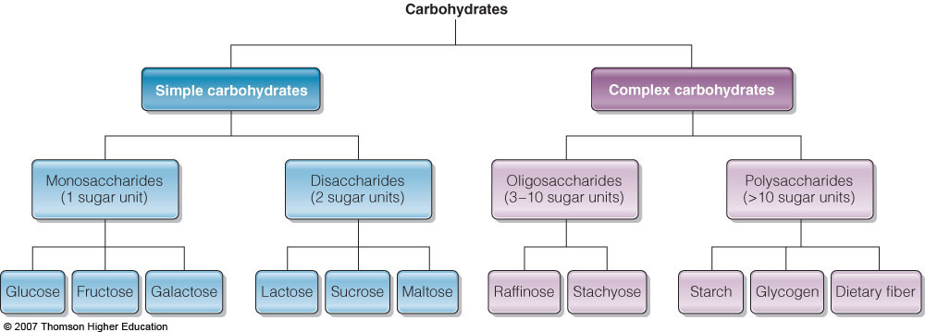
Carbohydrates

Slide 5
Carbohydrates
1.Sugars: Mono (# C) : C₃, C₄, C₅, C₆, C₇
Pentoses: Ribose; Hexoses: Glu, Gal, Man, and Fru.
Disaccharides: Sucrose, Lactose, Maltose
Tri: Raffinose, Kestose
Tetra: Stachyose

Slide 6
2. Non
Sugars
Polysaccharides
Heteroglycans
Arabinans
Xylans
Glucans
Homoglycans
Pectic Substances
Hemicellulose
Gums
Chondroitin
Starch, Dextrin,
Glycogen,
Cellulose
Complex Carbohydrates
Glycolipids
Glycoproteins

Slide 7
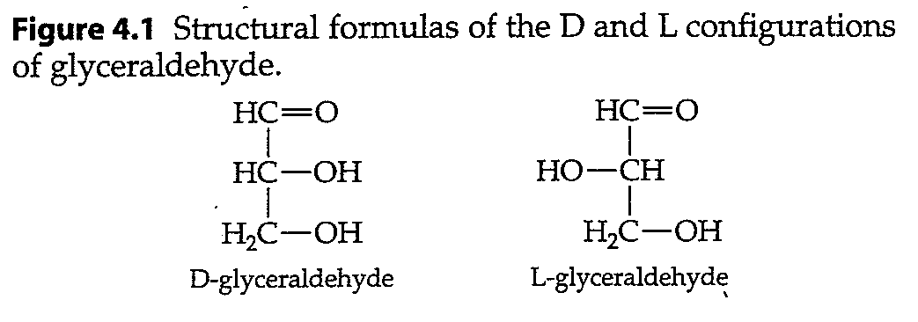
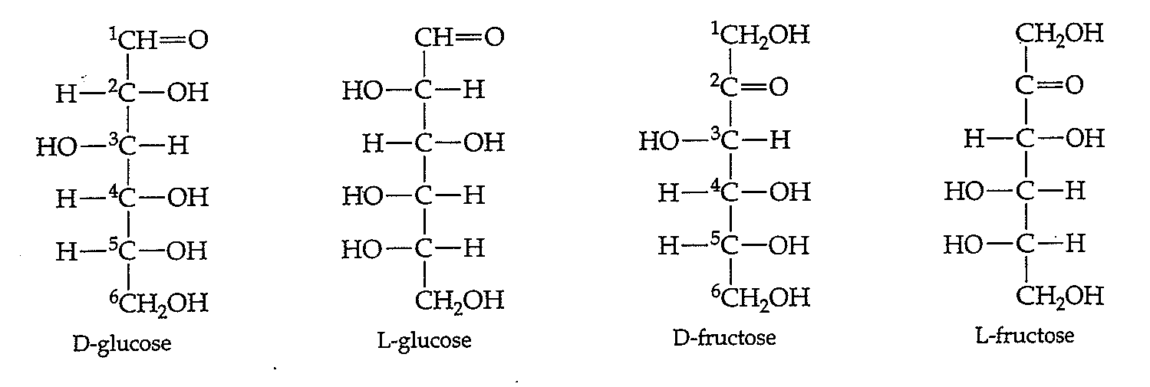

Slide 8
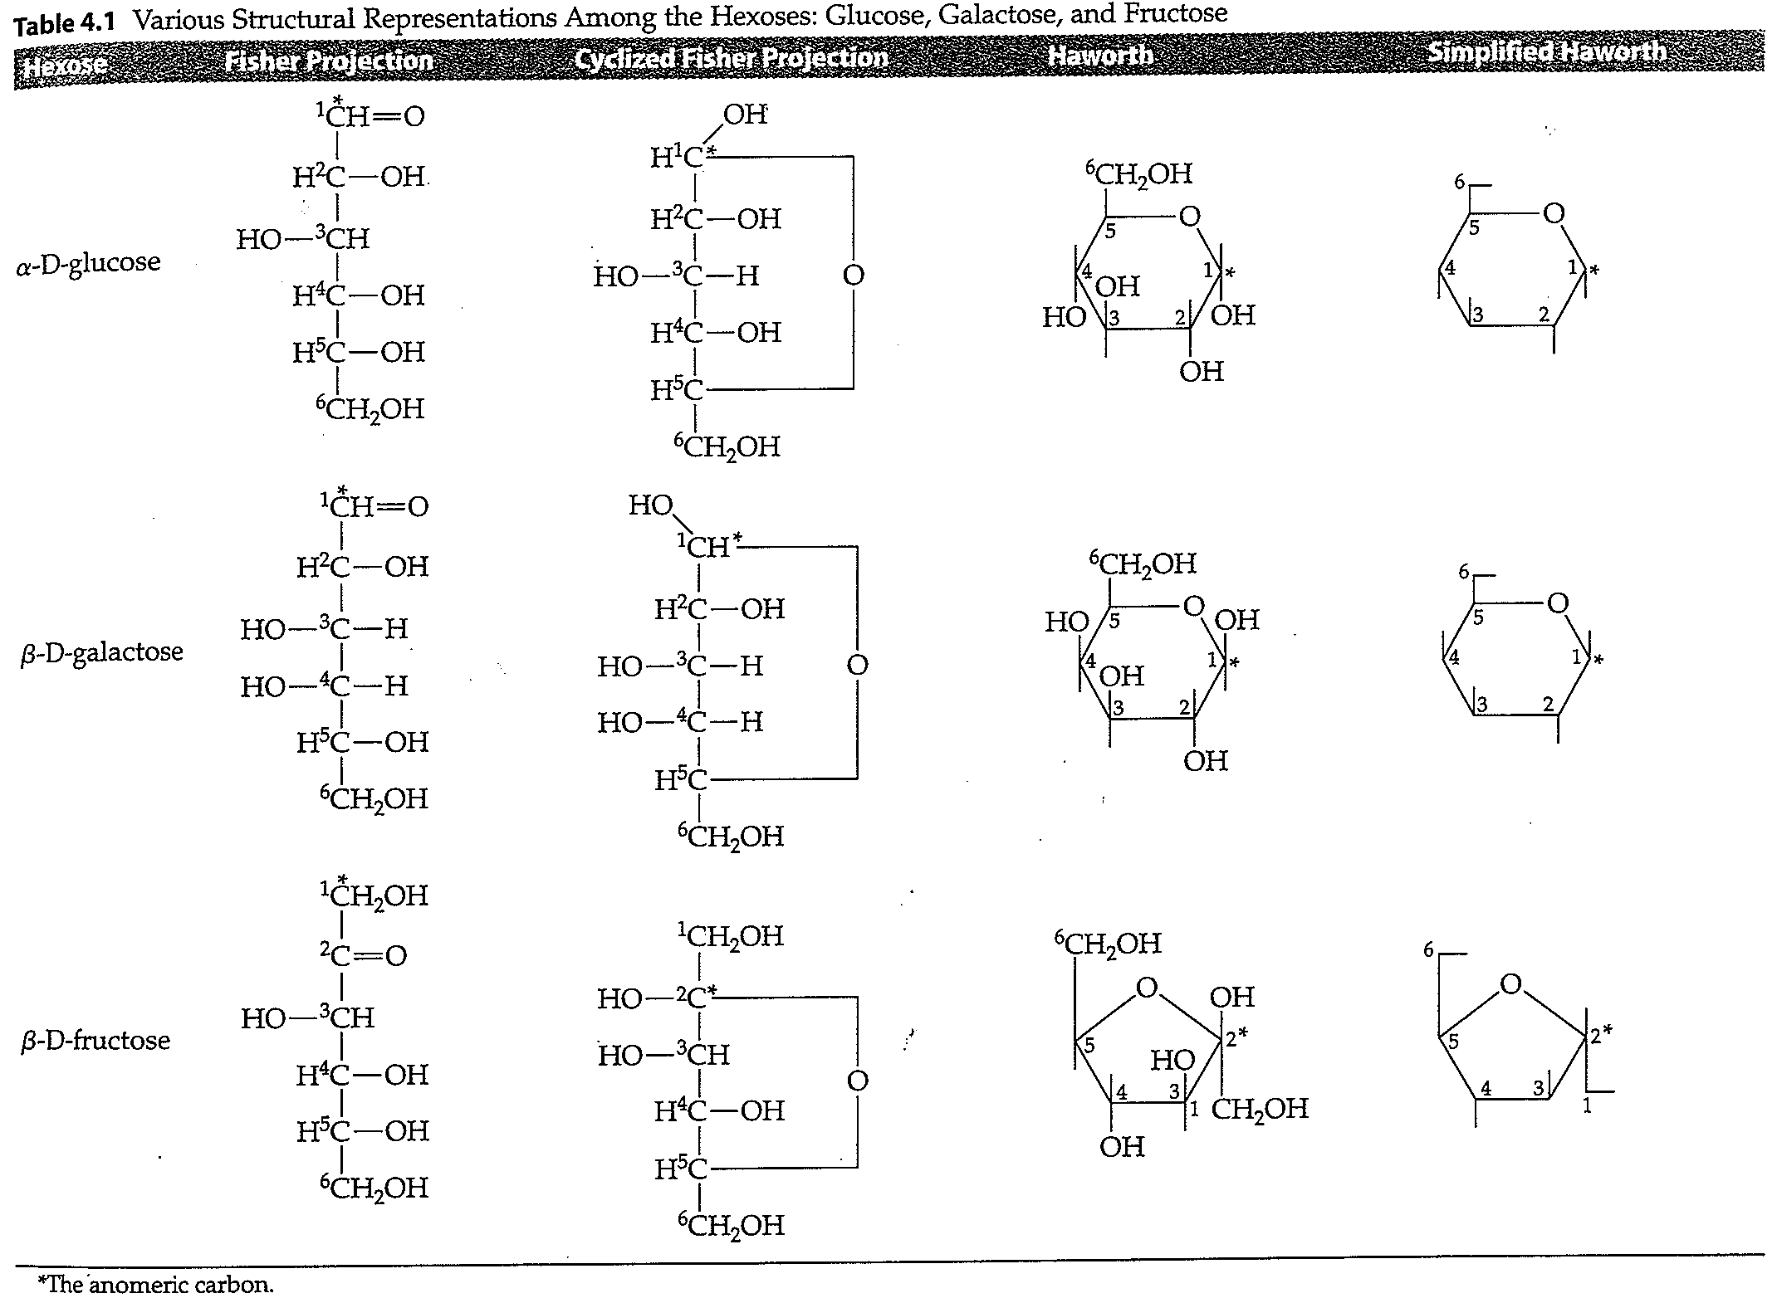

Slide 9
Structural formulas of the pentoses ribose and deoxyribose and of the alcohol ribitol (reduction of ribose)

Slide 11
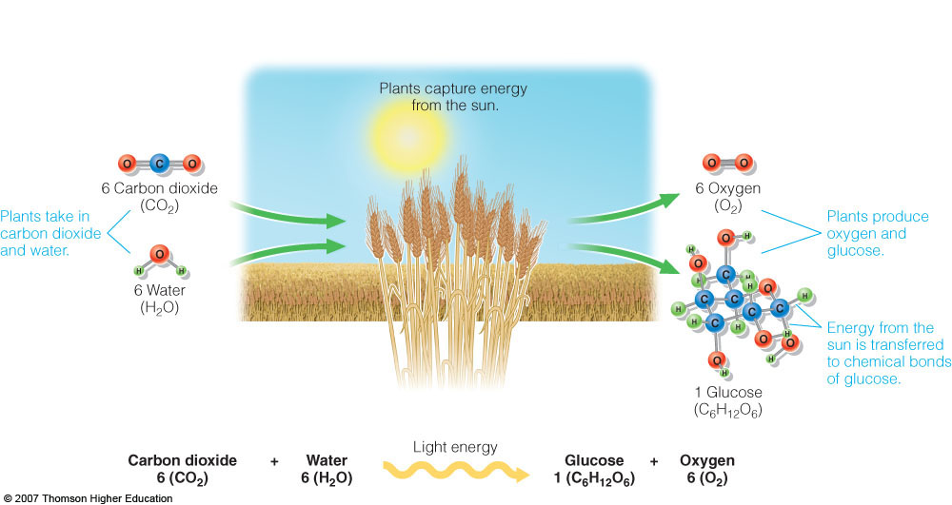
Photosynthesis

Slide 12
How does chemical structure of Monosaccharides relate to nutrition?
Mono in the D configuration are more prevalent in the diet vs. L form.
Mono are metabolized in the D configuration.
Digestive enzymes are stereospecific:
Amylase recognizes only α-1,4 linkage b/w glucose units
In cellulose, glycoside bonds are β-1,4; amylase cannot hydrolyze them

Slide 14
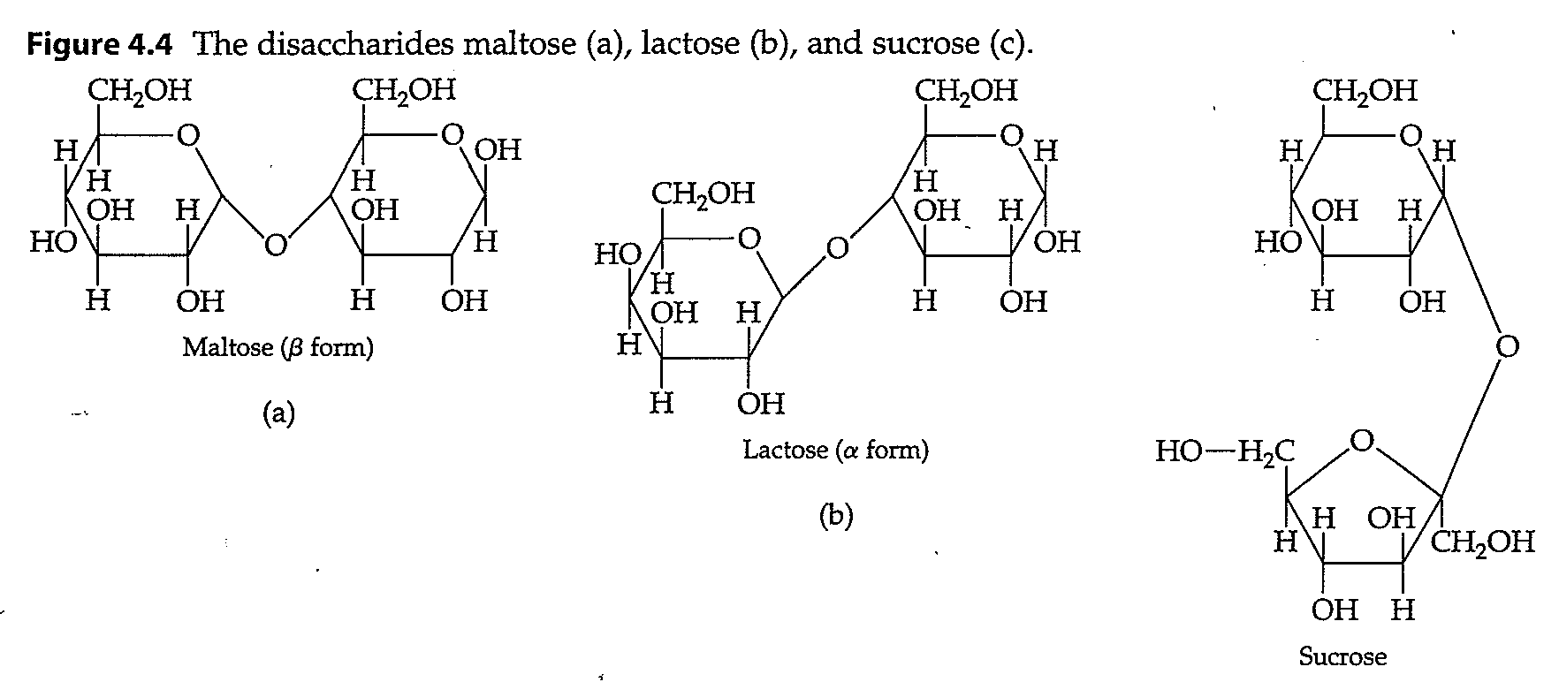

Slide 15
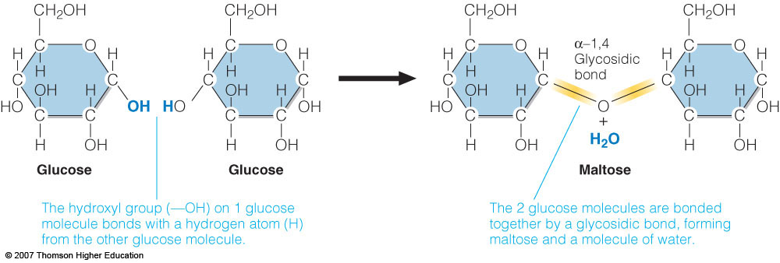
Disaccharides
Formation of glycosidic bond

Slide 16
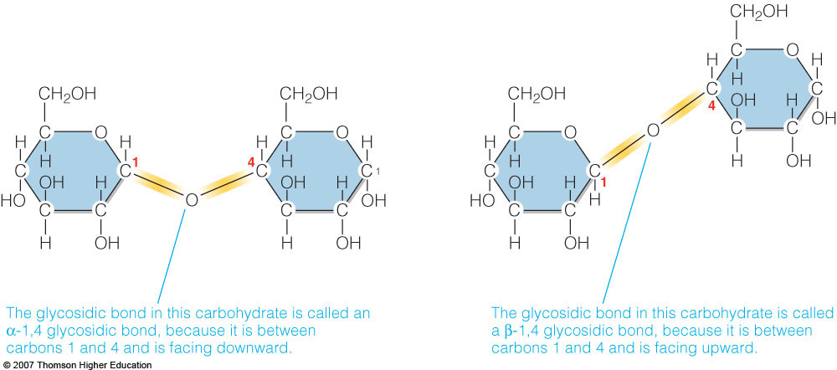

Slide 17
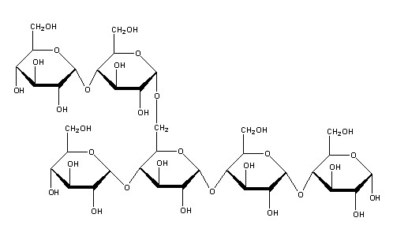
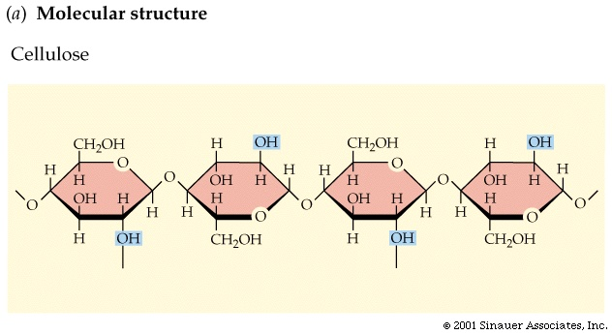
Cellulose
Starch

Slide 18
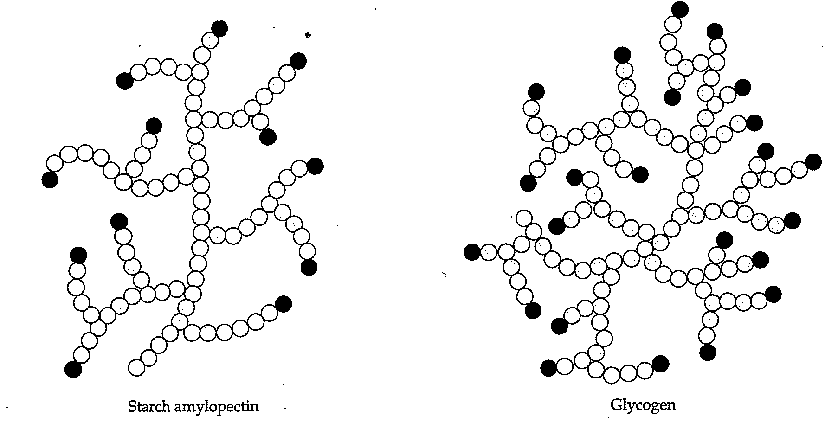
Polysaccharides

Slide 19
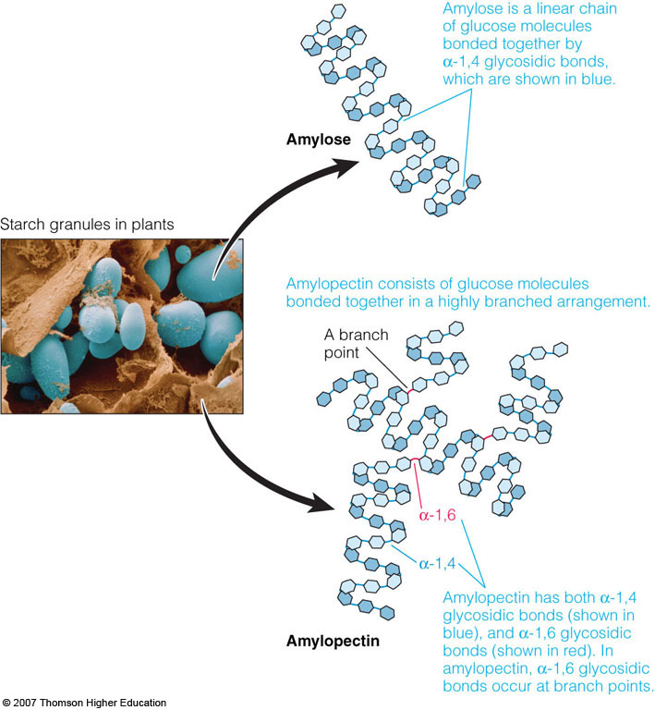

Slide 20
Polysaccharides
Starches: combination of amylose & amylopectin
Ratio is ~ 20:1 for α-1,4 linkage to α-1,6 linkage
Cellulose: glu β-1,4 glu
Not suitable for amylase

Slide 21
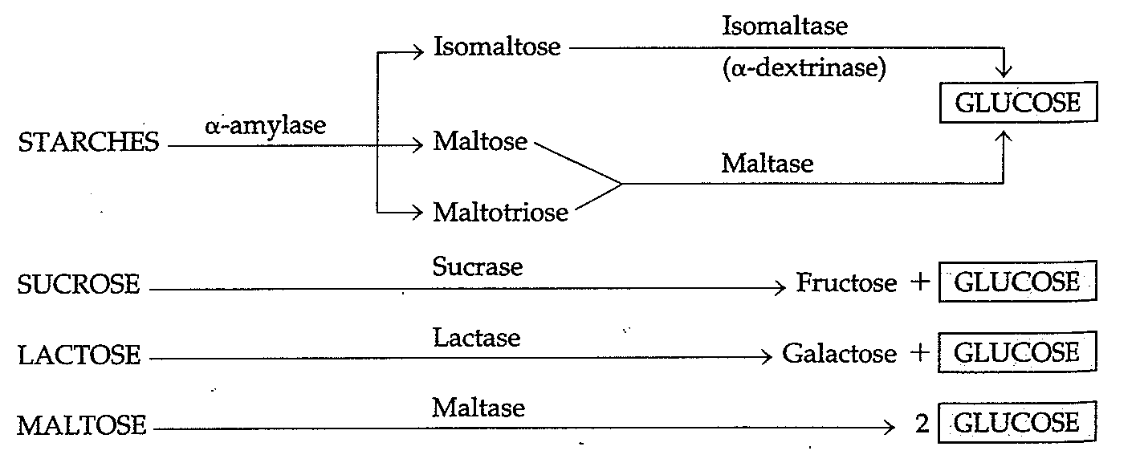
Enzymatic hydrolysis of carbohydrates (note the presence of glucose)

Slide 22
Primary Enzymes for Carbohydrates
Food Source | Enzyme | Origin | Product
Starch, glycogen, dextrin Maltose Lactose Sucrose | Amylase (α-1,4 Glu) Maltase (α-1,4 Glu) Lactase (β- Gal) Sucrase (α- Glu) | Saliva & pancreas SI SI SI | Maltose & Glucose Glucose Glucose & galactose Glucose & fructose

Slide 23
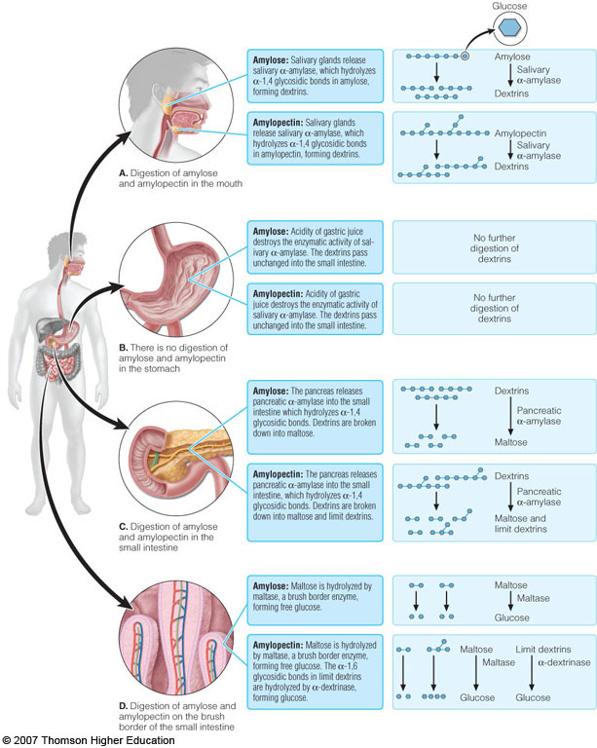
Digestion of Disaccharides cont.
0
Disaccharidases
Enzymes located on absorptive surface of small intestine cells
Types:
Sucrase hydrolzyes sucrose
Lactase hydrolyzes lactose
Maltase hydrolyzes maltose

Slide 24
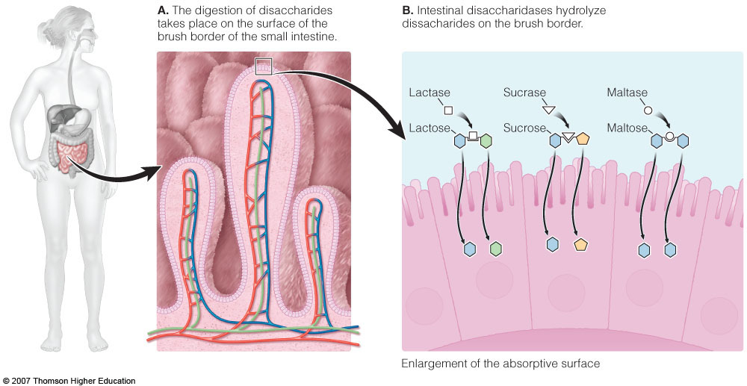
Digestion of Disaccharides

Slide 25
Carbohydrate Absorption & Circulation
Monosaccharides from digestion are absorbed by small intestine
Transport occurs by:
Active transport
Facilitated diffusion
Taken in blood to liver via hepatic portal vein

Slide 26
Digestion & Absorption
Luminal phase: on starches, none on disaccharides
Brush border (microvilli): disaccharides by α-glucosidase
Entrocyte: uptake

Slide 27
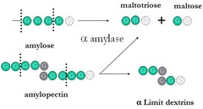
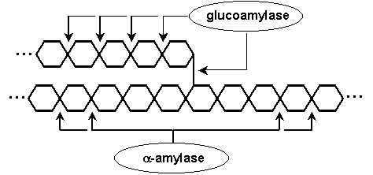

Slide 29
Brush border (microvilli) carbohydrate digestion
Final hydrolysis of disaccharides to Monosaccharides is carried out by oligosaccaridases at the brush border of the small intestine.
sucrose
Glu
lactose
Fru
Glu
maltose
Gal
Glu
Glu
BB

Slide 30
Brush border (microvilli) carbohydrate digestion
Enzyme | Specificity | Natural substrate | Product(s)
Lactase (β-galactosidase) | β-galactose | Lactose | Gal Glu
Sucrase (α-galactosidase) | α-Glu α-(1, 2) bonds | Sucrose | Glu Fru
Amylase | α-(1, 4) Glu | Amylose | Glu Amylose (n-1)
Maltase | α-(1, 4) Glu | Maltose Maltotriose | Glu
Isomaltase | α-(1, 6) Glu | α-limit dextrins isomaltose | Maltose Glu

Slide 31
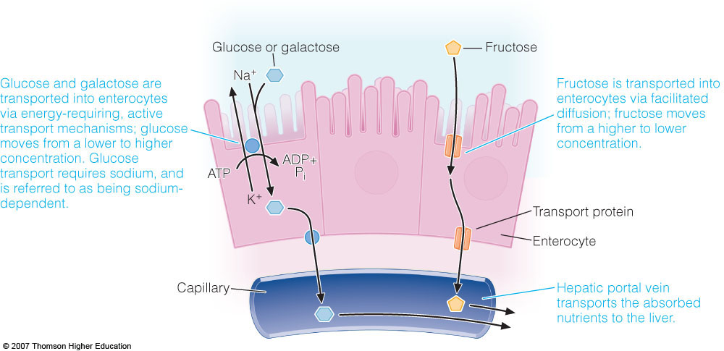
Carbohydrate transport

Slide 32
Transport of Glu from intestinal lumen to blood
Lumen
capillary
cytoplasm
Glu
Dietary Glu
Glu
Glu
K⁺
2 Na⁺
2 Na⁺
K⁺
ATP
Na⁺
K⁺
ADP + P_{i}
2 K⁺
3 Na⁺
GLUT2
K⁺ channel
SGLUT1
Na⁻ K⁺ ATPase

Slide 33
What happens?
Glu is co-transported with Na⁺ in the SI / kidney with a carrier protein SGLUT1.
SGLUT1 binds Na⁺, stimulated to bind Glu on the lumen side, Na⁺ & Glu released into cell.
Glu is extracted from SI / kidney & released into blood to go to the liver.

Slide 34
Symport integral membrane protein SGLT1, simultaneously transports 2 substrates across membrane in the same direction
The Na⁺ from diet & pancreatic secretion.
[Na⁺] is greater in lumen of SI than in cytoplasm of epithelial cells.
For transport of Na⁺ by symport, one Glu must be transported at the same time.
Intra-cellular [Na⁺] is kept low by Na/K ATPase (an active transport protein).
Na+/Glu symport occurs as long as Na/K ATPase is functioning

Slide 35
Symport
Glu transport into cell cytoplasm [Glu]
cytoplasm [Glu] is greater than that in interstitial spaces
Glu is transported down this concentration gradient via GLUT2 by facilitated diffusion
Gal goes through the same process

Slide 36
Transport of Fru from intestinal lumen to blood
Lumen
capillary
cytoplasm
Glu
Glu
Dietary Glu/Gal
Glu
K⁺
ATP
K⁺
2 Na⁺
2 Na⁺
active
K⁺
Na⁺
ADP + P_{i}
2 K⁺
3 Na⁺
Fru
Fru
Fru
Fru
facilitated
GLUT2
K⁺ channel
SGLUT1
Na⁻ K⁺ ATPase
GLUT5

Slide 37
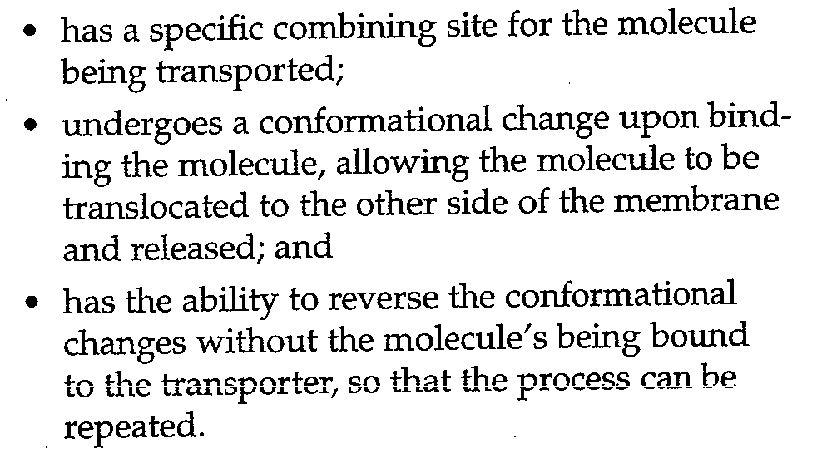
A transporter:

Slide 38
Hexose Transport
Transport hexoses down a concentration gradients (GLUT1, GLUT2, GLUT3, GLUT4, GLUT5)
Transport hexoses against a concentration gradient (SGLUT1)

Slide 39
Hexose Transport
GLUT1, 3, and 4: high affinity for Glu (Km=2-5 mM): functioning at maximal rate under physiological condition ([Glu] ~5 mM).
GLUT2: low affinity for Glu (Km=15 mM): allows it to change transport rate relative to [Glu] after consuming a carbohydrate-rich meal.
GLUT5: high affinity for Fru.

Slide 40
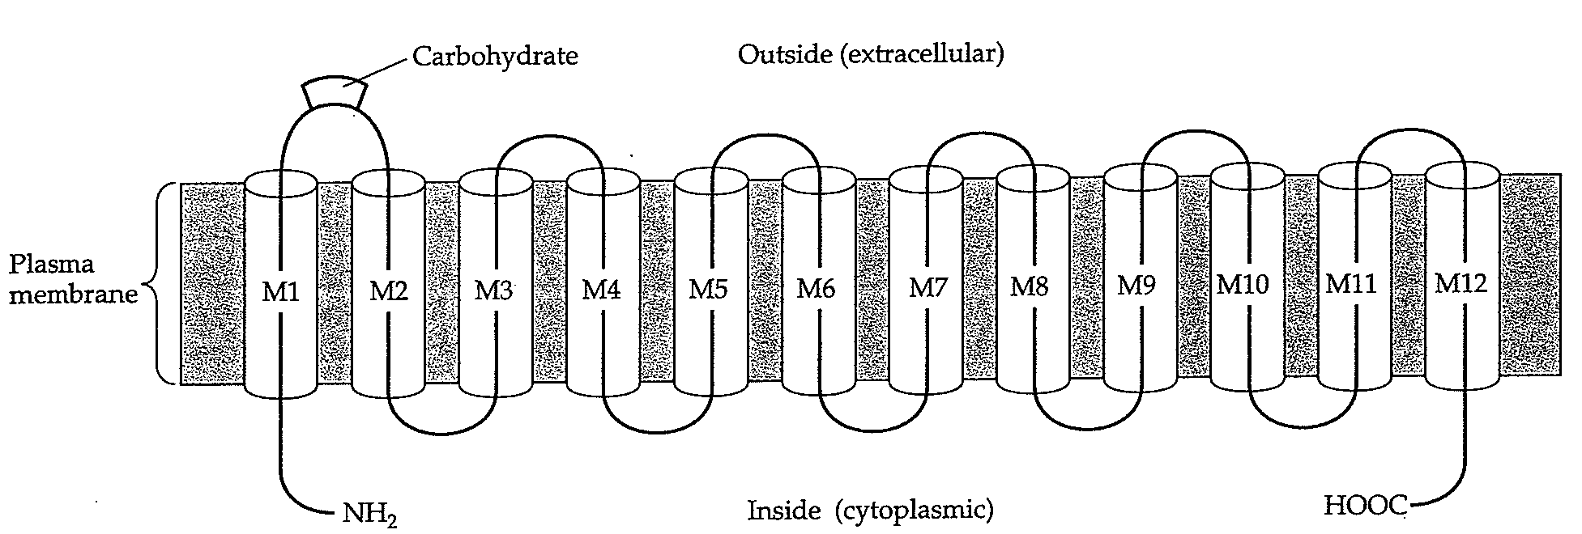

Slide 41
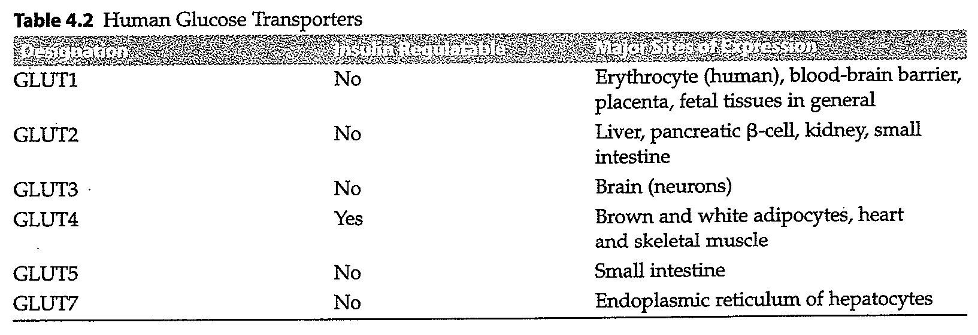

Slide 42
Glucose/Galactose Malabsorption (GGM)
A rare metabolic disorder; caused by defect in Glu/Gal transport across intestinal lining.
An autosomal recessive disorder; affected person inherits two defective copies of SGLUT1 gene (on chromosome 22).
May be related to familial intermarriage.
Sever diarrhea & dehydration in 1st d of life; lethal if not treated by completely removing dietary lactose, sucrose, glucose and galactose.

Slide 43
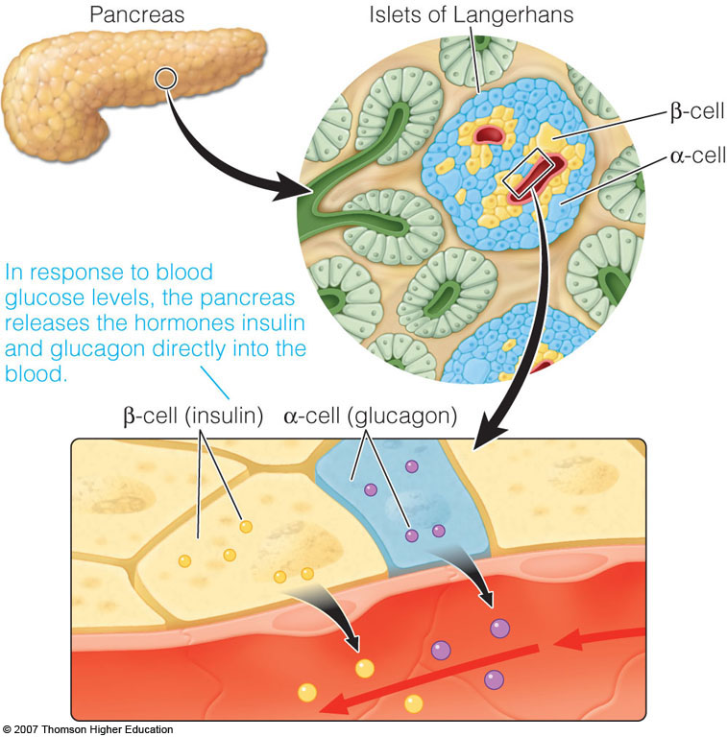
Release of Insulin & Glucagon from the Pancreas

Slide 44
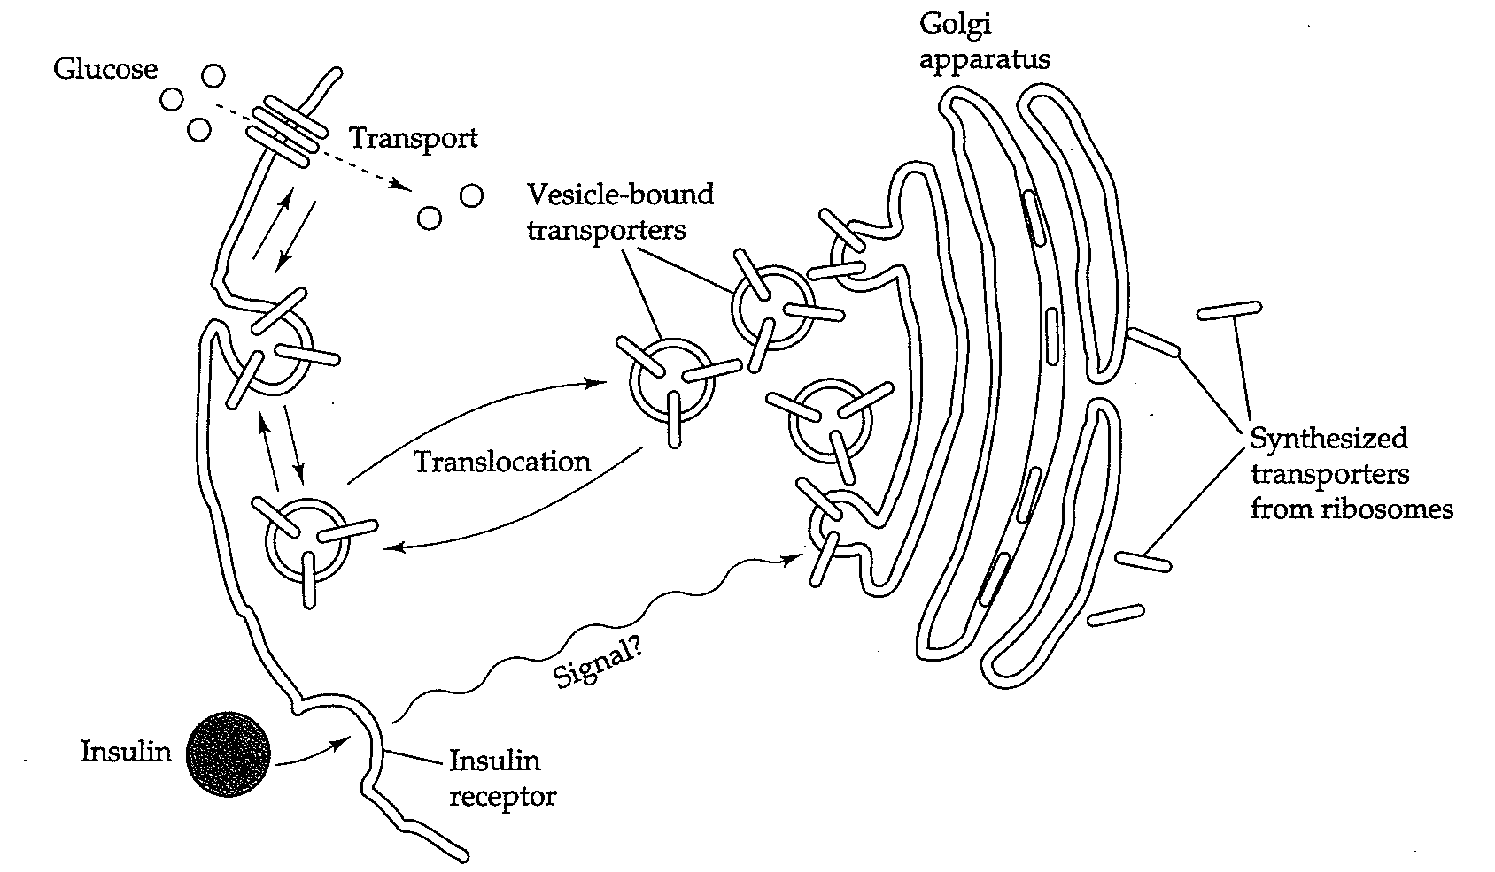

Slide 45
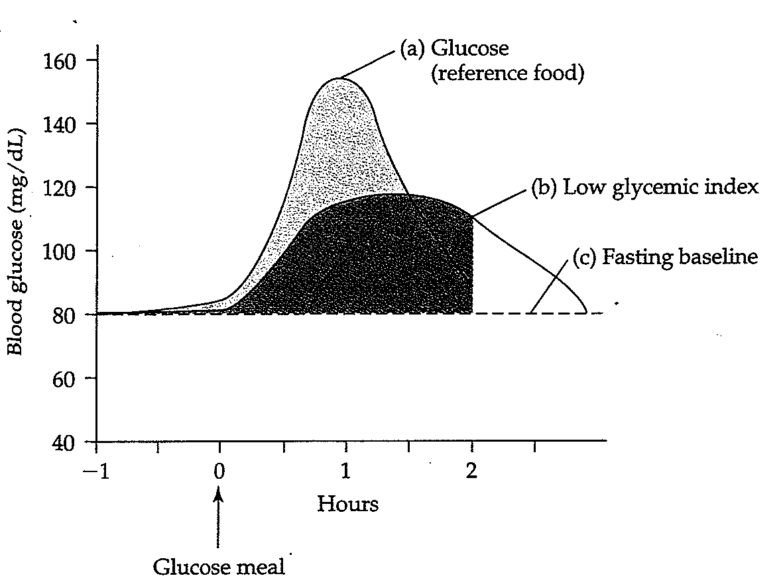
Glycemic response
Notes:
Simply stated, the glycemic response to a food is a measure of the impact of a food on blood sugar. Foods with rapidly hydrolyzed and absorbed carbohydrates generally have a fast and high impact on blood sugar, resulting in the highest glycemic indexes.”
(The glycemic index classiﬁes carbohydrate-containing foods according to their potential to raise blood sugar level.”)
“Slowly or incompletely digested carbohydrates have low glycemic indexes. In these cases, glucose is released gradually into the blood, and the blood sugar response is slow and steady.”
“Foods with a high glycemic index value tend to raise the blood sugar faster and higher than do foods with a lower value.

Slide 46
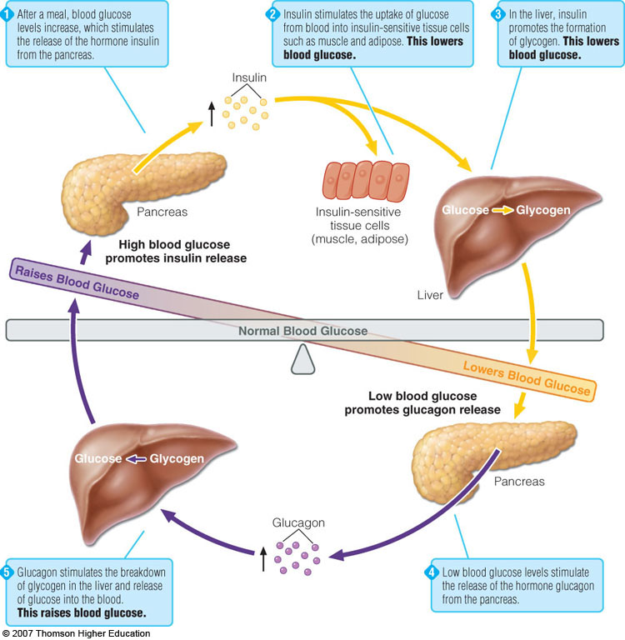
Hormonal Regulation of Blood Glucose

Slide 47
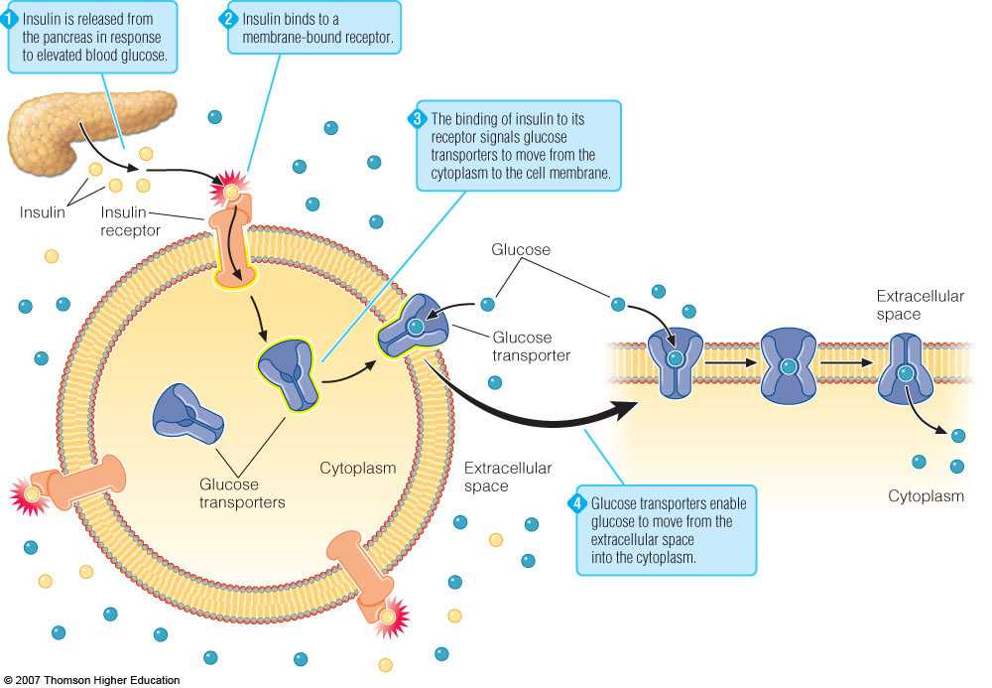

Slide 48
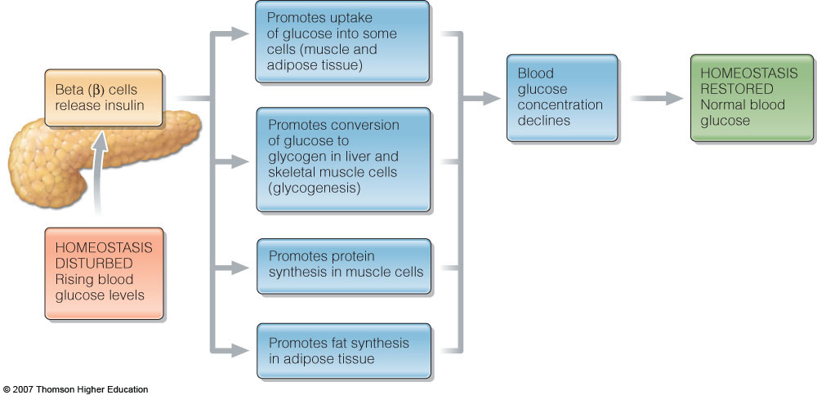
Hormonal Regulation of Blood Glucose

Slide 49
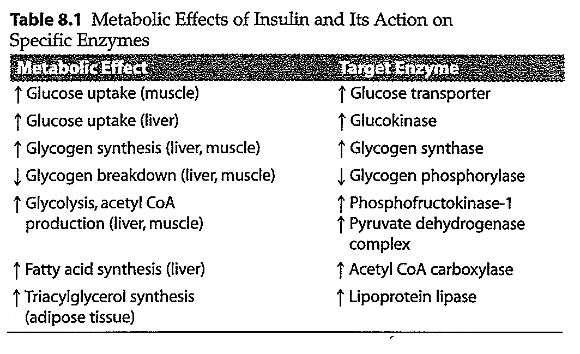

Slide 50
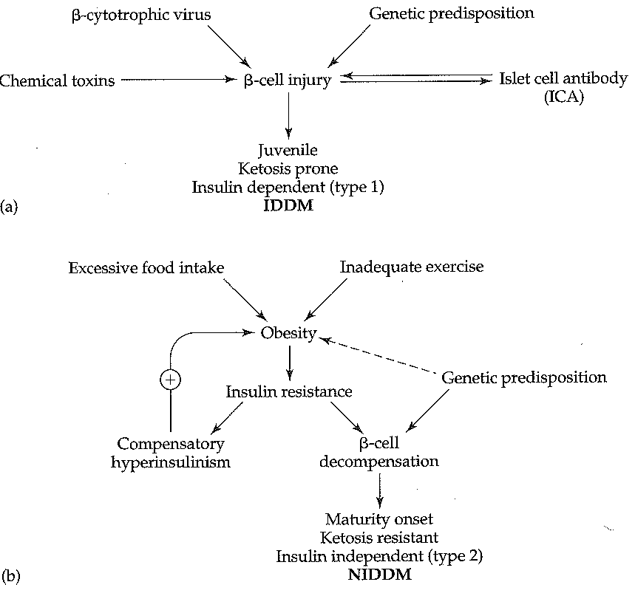
Theories of diabetes mellitus etiology

Slide 51
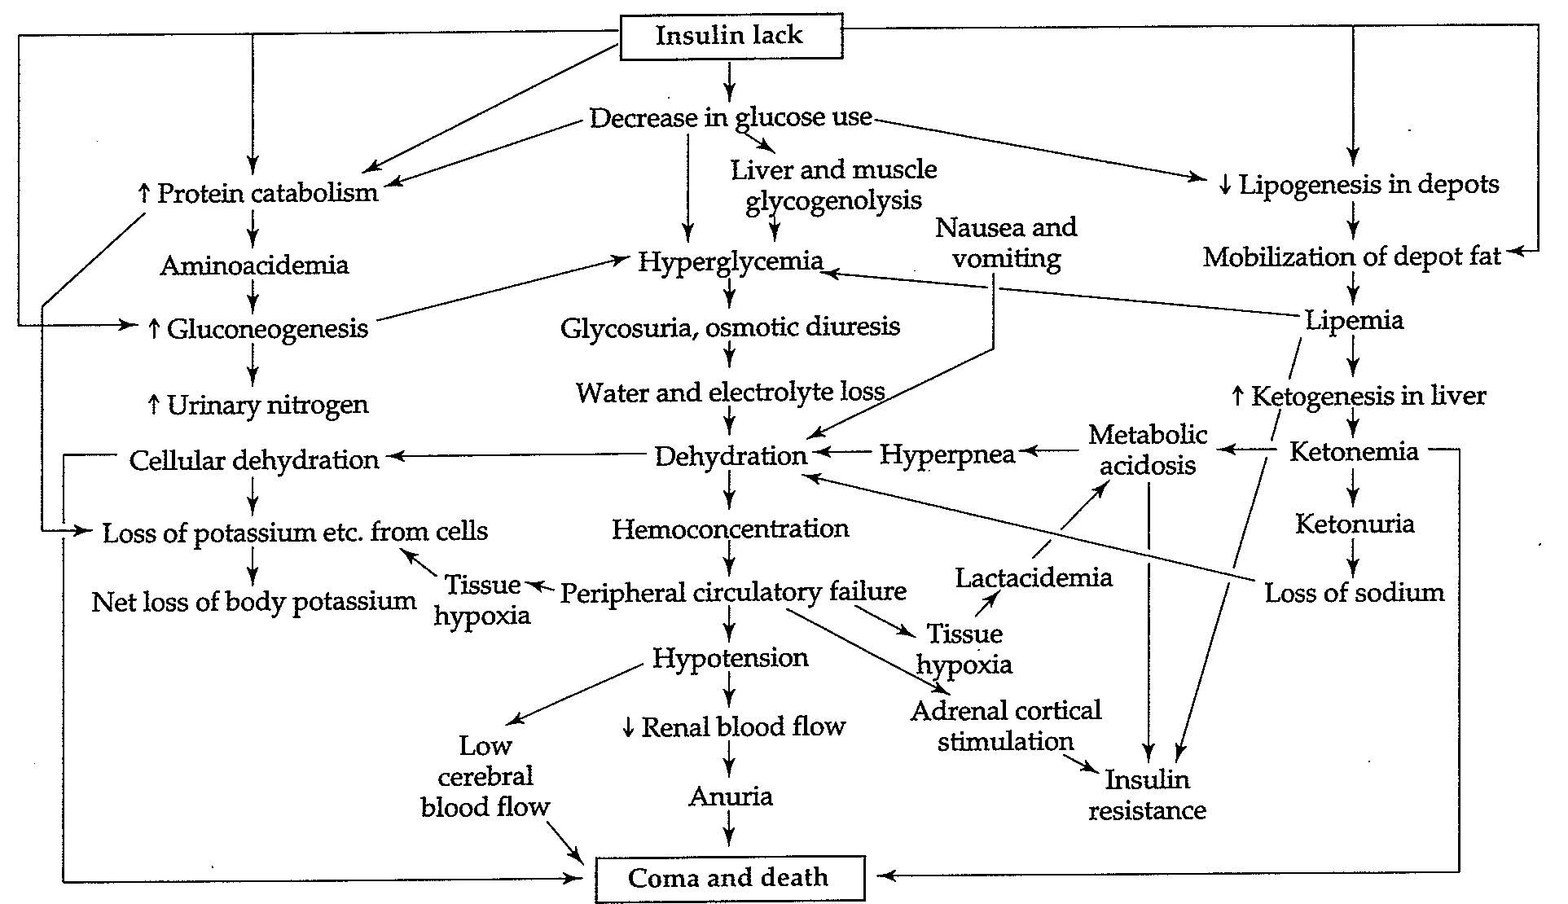
Patho-physiology of diabetic acidosis

Slide 52
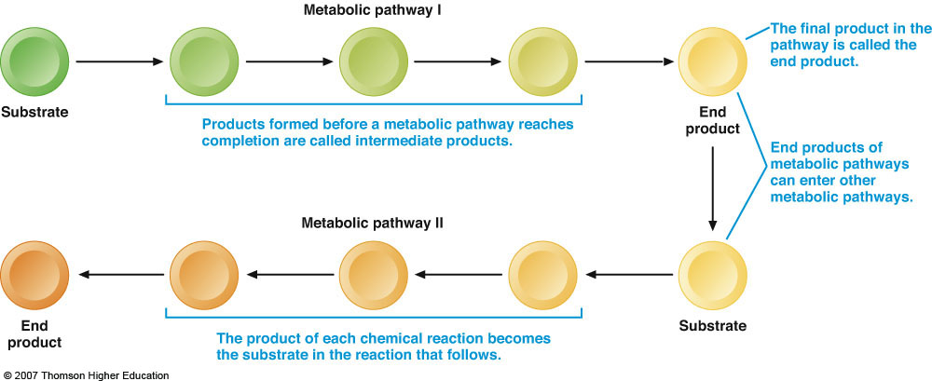
Metabolic Pathways
Fig. 8-1, p. 270
Notes:
Figure 8.1: Metabolic Pathways.
A metabolic pathway consists of a series of interrelated, enzyme-catalyzed chemical reactions.

Slide 53
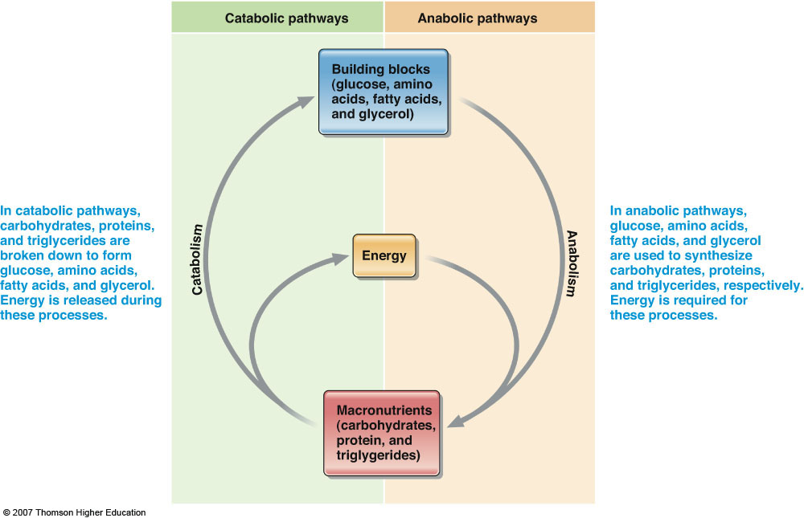
Fig. 8-2, p. 271
Notes:
Figure 8.2: Catabolic and Anabolic Metabolism.
The energy made available by catabolic pathways provides fuel needed for anabolic pathways.

Slide 54
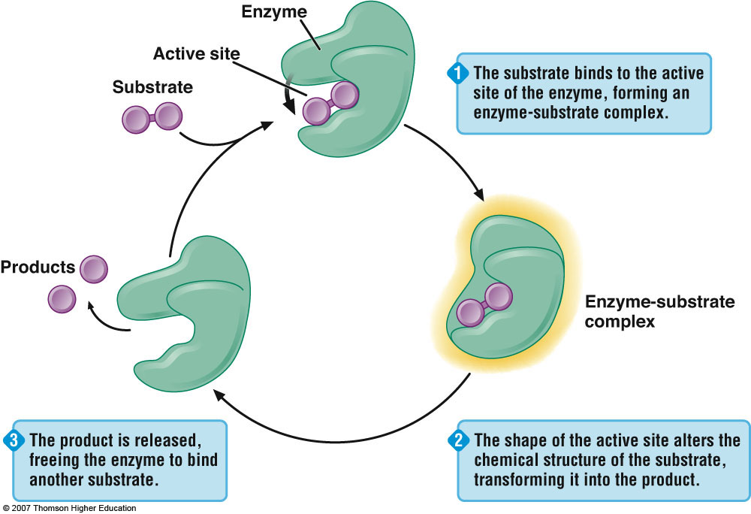
Fig. 8-3, p. 273
Notes:
Figure 8.3: Enzymes Are Biological Catalysts.
Enzymes increase the rate at which chemical reactions occur.

Slide 55
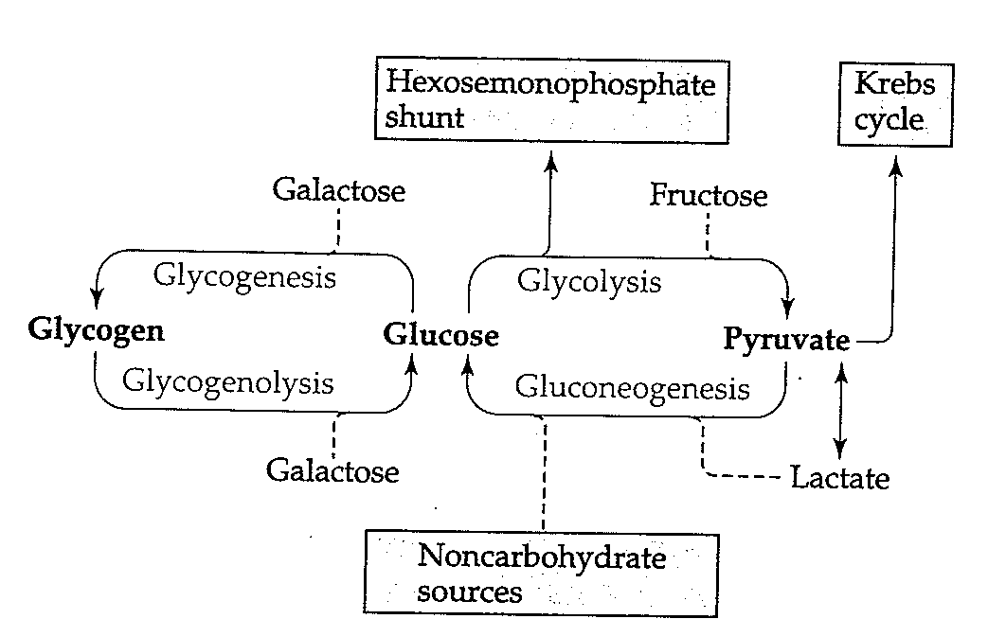
Major Pathways of Carbohydrate metabolism

Slide 56
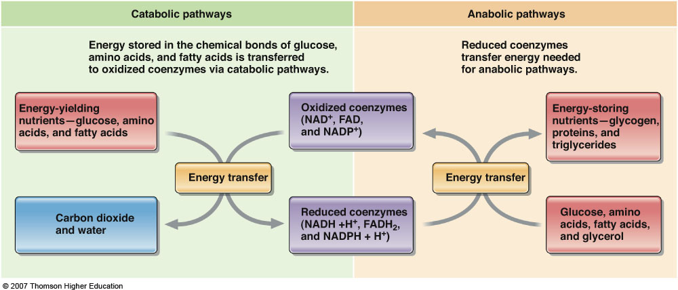
The Role of Coenzymes in Energy Metabolism
Fig. 8-4, p. 275
Notes:
Figure 8.4: The Role of Coenzymes in Energy Metabolism.
Energy is transferred to and from energy-yielding nutrients with the assistance of coenzymes.

Slide 57
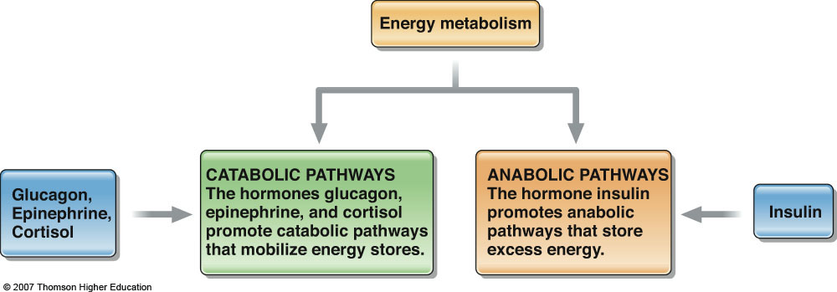
Anabolic and Catabolic Pathways Are Regulated by Hormones
Fig. 8-5, p. 276
Notes:
Figure 8.5: Anabolic and Catabolic Pathways Are Regulated by Hormones.

Slide 58
Metabolism of carbohydrates
Glycolysis
No oxygen required-anaerobic
In cytoplasm
Citric acid cycle
oxygen required-aerobic
In mitochondria
Electron transport
oxygen required-aerobic
In mitochondria
Generates energy (ATP)

Slide 59
Energy from macronutrients
Number of mitochondria
Cardiac muscle cell (high concentration of mitochondria)
Liver cells (same as above)
Skeletal muscle (less than cardiac cells)
Red blood cells (no mitochondria)
Completely dependent on glycolysis (Glu lactate + H⁺)

Slide 60
Glu
Glycogen
Glu
Glu-6-P
Glu-6-P
Glu-6-P
ATP
ATP
ATP
2 pyruvate
2 pyruvate
2 pyruvate
2 Acetyl Co-A
2 Acetyl Co-A
ATP
ATP
TCA
4 CO₂
2 lactate
4 CO₂
TCA
Red blood cells
Brain tissue cells
Skeletal or cardiac tissue cells

Slide 61
Glu
Glu
Glycogen
Glu
Glu-6-P
Glu-6-P
ATP
ATP
2 pyruvate
2 pyruvate
2 acetyl Co-A
2 acetyl Co-A
ATP
TCA
FAT
FAT
Hepatocytes
Adipose tissue cells

Slide 62
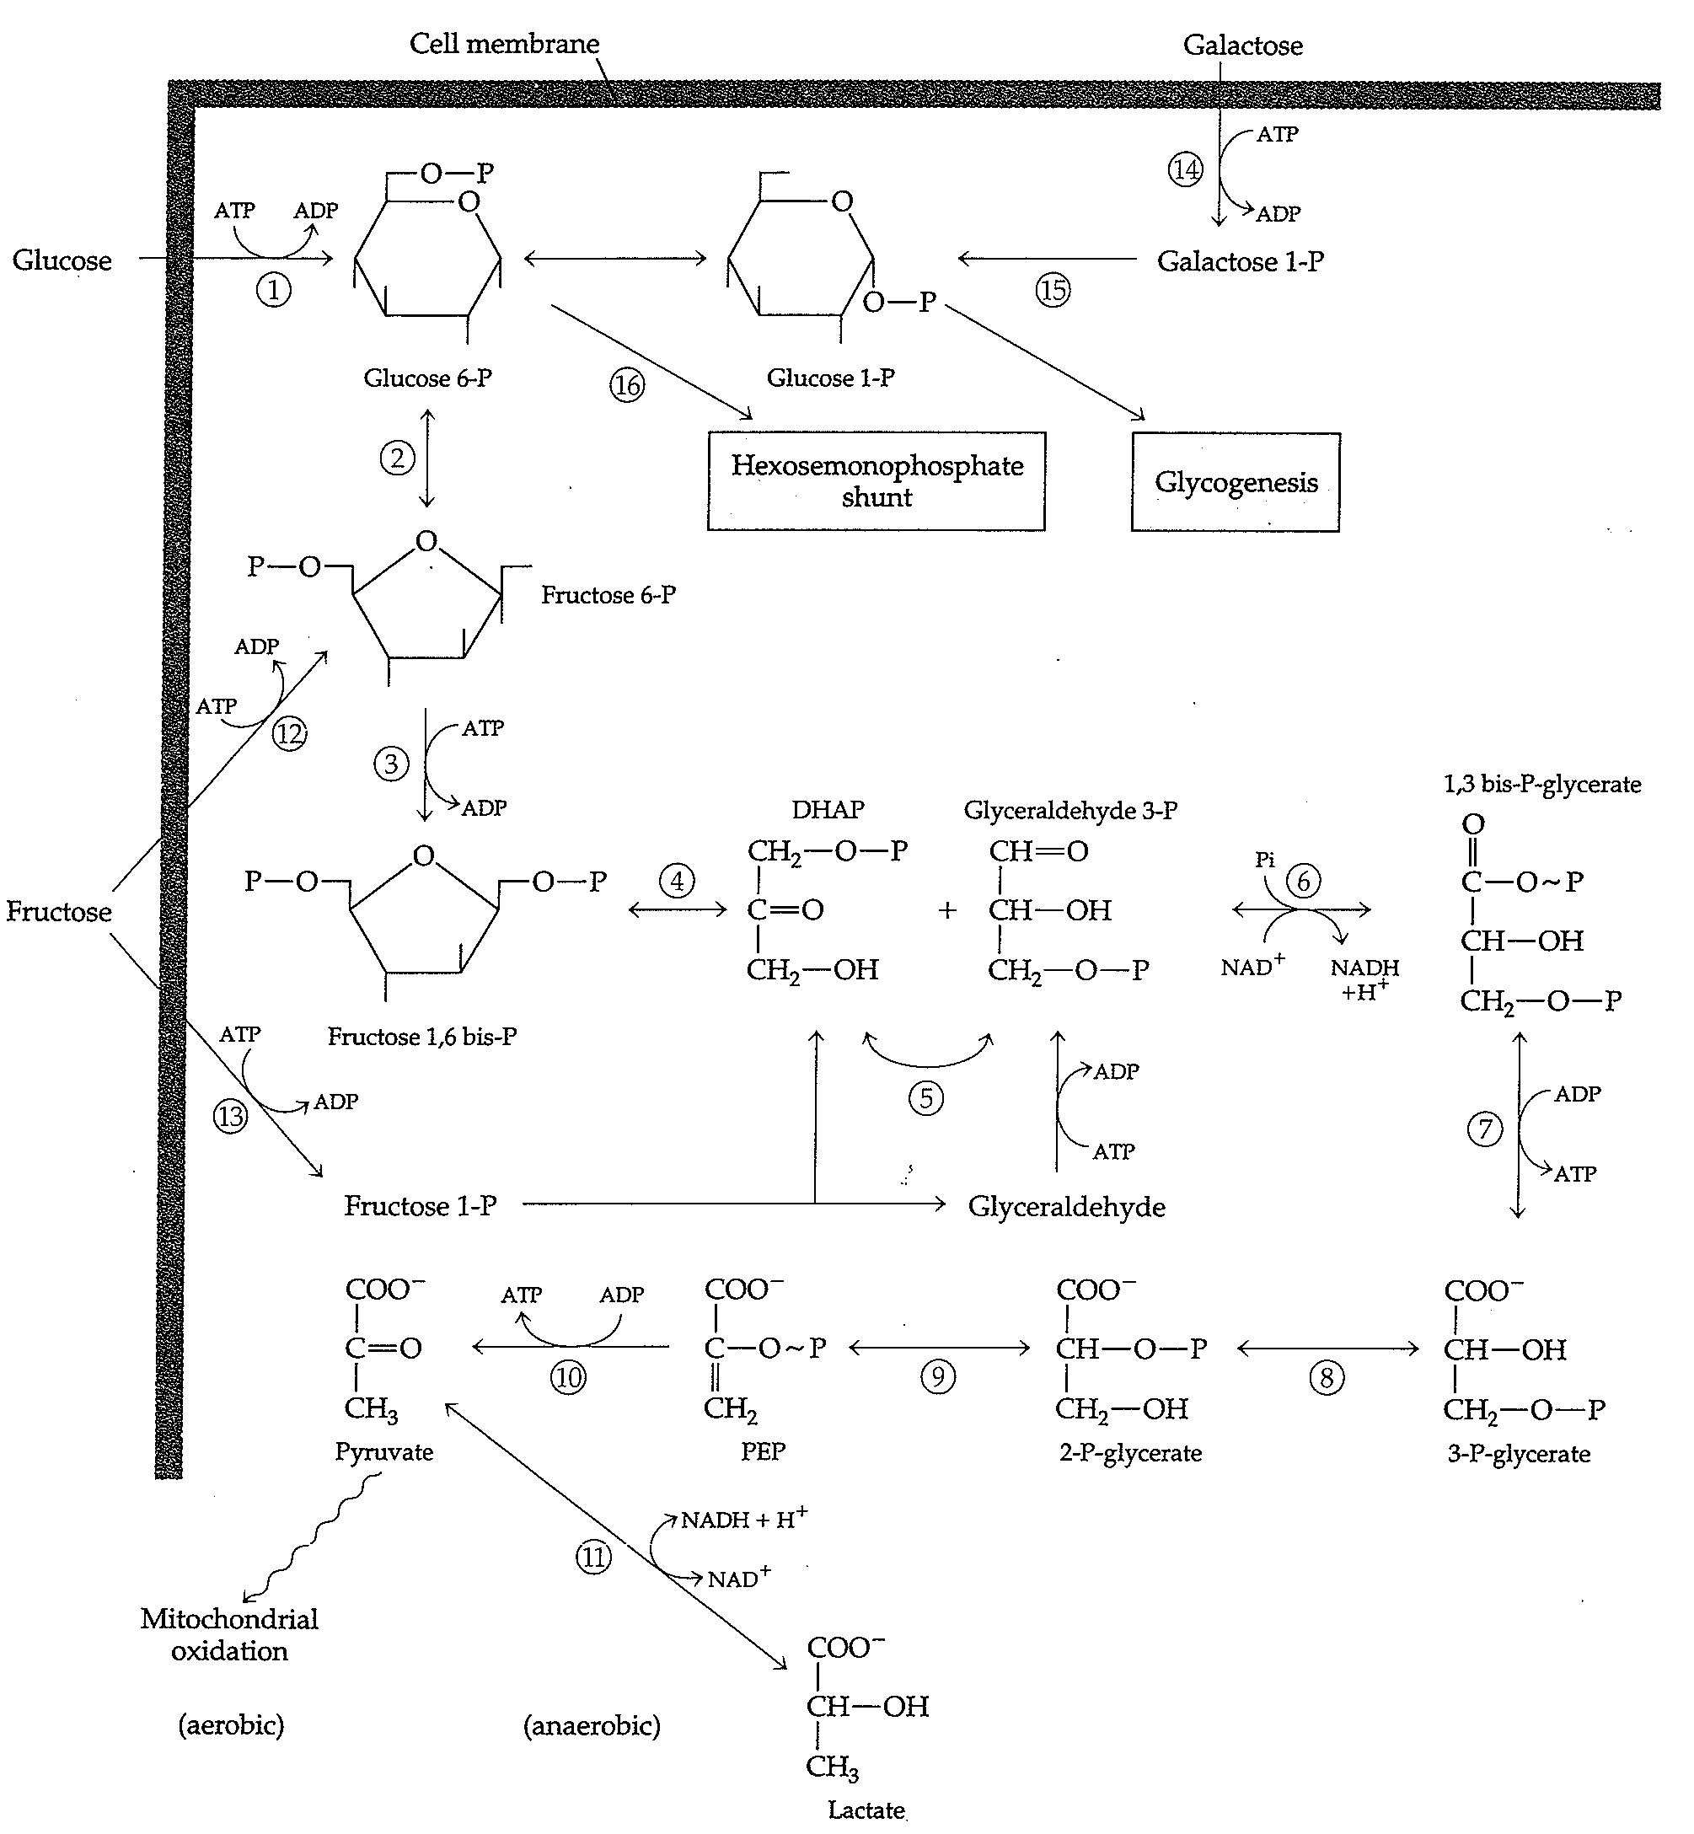
Glycolysis

Slide 63
Going into TCA cycle..!?!

Slide 64
Hexokinase reaction
The HK reaction converts nonionic Glu into an anion trapped in the cell (no transporter for P-Glu
Inert Glu becomes activated into a labile form capable of being further metabolized
Four types are known (HK I – HK IV) with HK IV known as glucokinase
Glucokinase in hepatocyte has a very high Km; enzyme is saturated only when there is very high concentration of Glu.

Slide 65
Reciprocal regulation of glycolysis and gluconeogenesis
Regulated by hormones & energy level of the cell.
Hormonal regulation:
High Fru-2,6 bis P favors glycolysis
High Fru-2,6 bis P inhibits gluconeogenesis
Energy level
High AMP & ADP, and low ATP & citrate favors glycolysis
These conditions inhibit gluconeogenesis
Glycolysis=catabolic
Gluconeogenesis=anabolic

Slide 66
Substrate (futile) Cycles
Glucose
Glycolysis
Gluconeogenesis
ATP
citrate
H⁺
Fru-6-P
F-2,6 BP
AMP
negative
negative
Phospho Fru kinase
F-1,6B Phosphaase
F-2,6 BP
AMP
positive
citrate
positive
Fru-1,6 bis P
F-2,6 BP
Phosphoenelpyruvate
ADP
positive
PEP carboxykinase
negative
Pyruvate kinase
Oxaloacetate
ATP
alanine
Pyruvate carboxylase
ADP
Pyruvate
negative
negative
positive
Acetyl Co A

Slide 67
Hormonal control of glycolysis & gluconeogenesis by Fru 2,6 Bisphosphate (F-2,6 P2)
The enzyme is structurally related to F-1,6 BP
Not an intermediate
Is an “ALOSTERIC” regulator
F-2,6 P2 activates PFK & glycolysis
F-2,6 P2 inhibits FBPase & gluconoegenesis
in glucagon (during starvation): F-2,6 P2 : glycolysis & gluconeogenesis
in glucagon (after meal): F-2,6 P2 : glycolysis
F-2,6 P2 acts as an intracellular signal indicating “glucose abundant”

Slide 68
Fru 2,6 Bisphosphate (F-2,6 P2): Central regulator
Activates PFK
Inhibits F-1,6 BisPase
It is formed by PF2Kinase & hydrolyzed by F-2,6 BisPase
“Bifunctional enzyme”
High levels of Fru-6-P: PF2Kinase: F-2,6 P2
Glycolysis

Slide 69
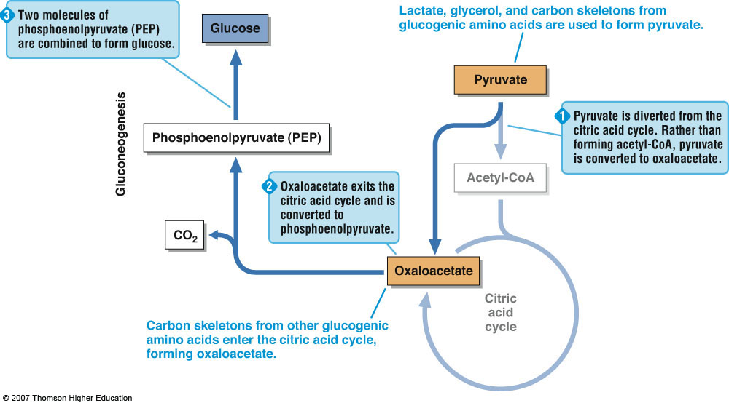
Gluconeogenesis
Fig. 8-18, p. 293
Notes:
Figure 8.18: Gluconeogenesis.
Noncarbohydrate sources used for gluconeogenesis include some amino acids, lactate, and glycerol.

Slide 70
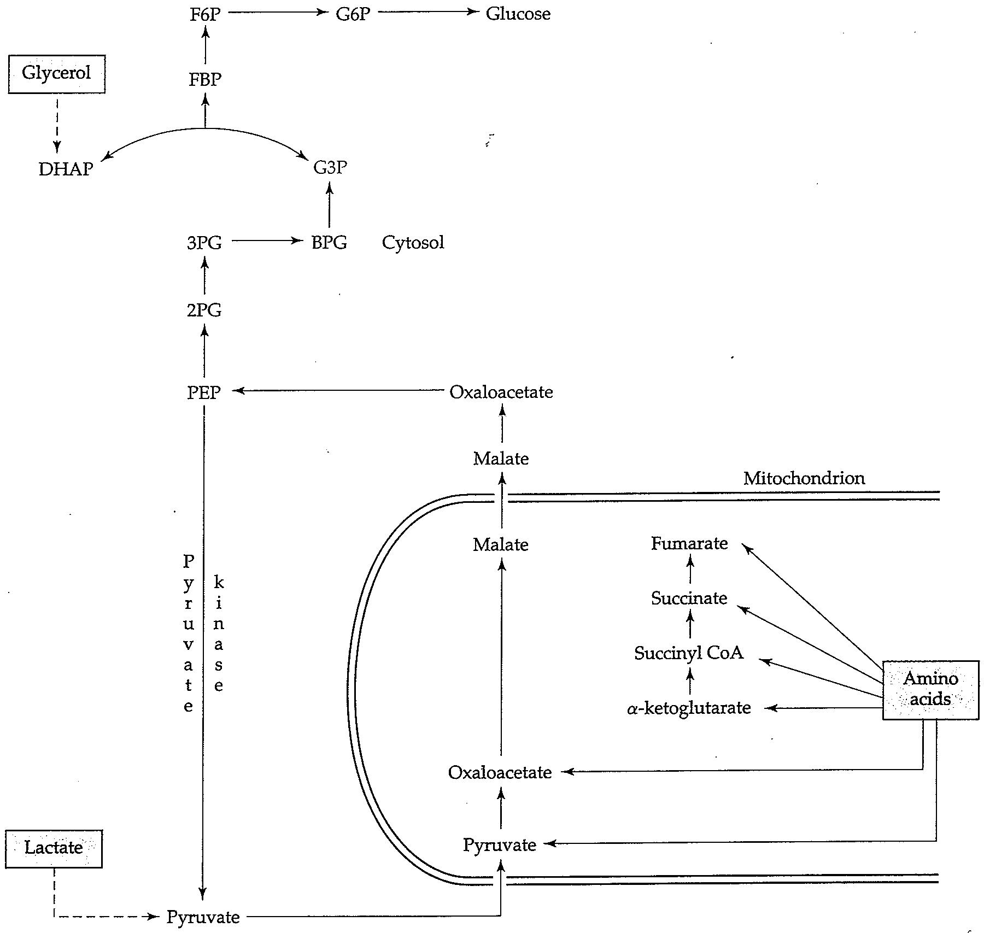

Slide 71
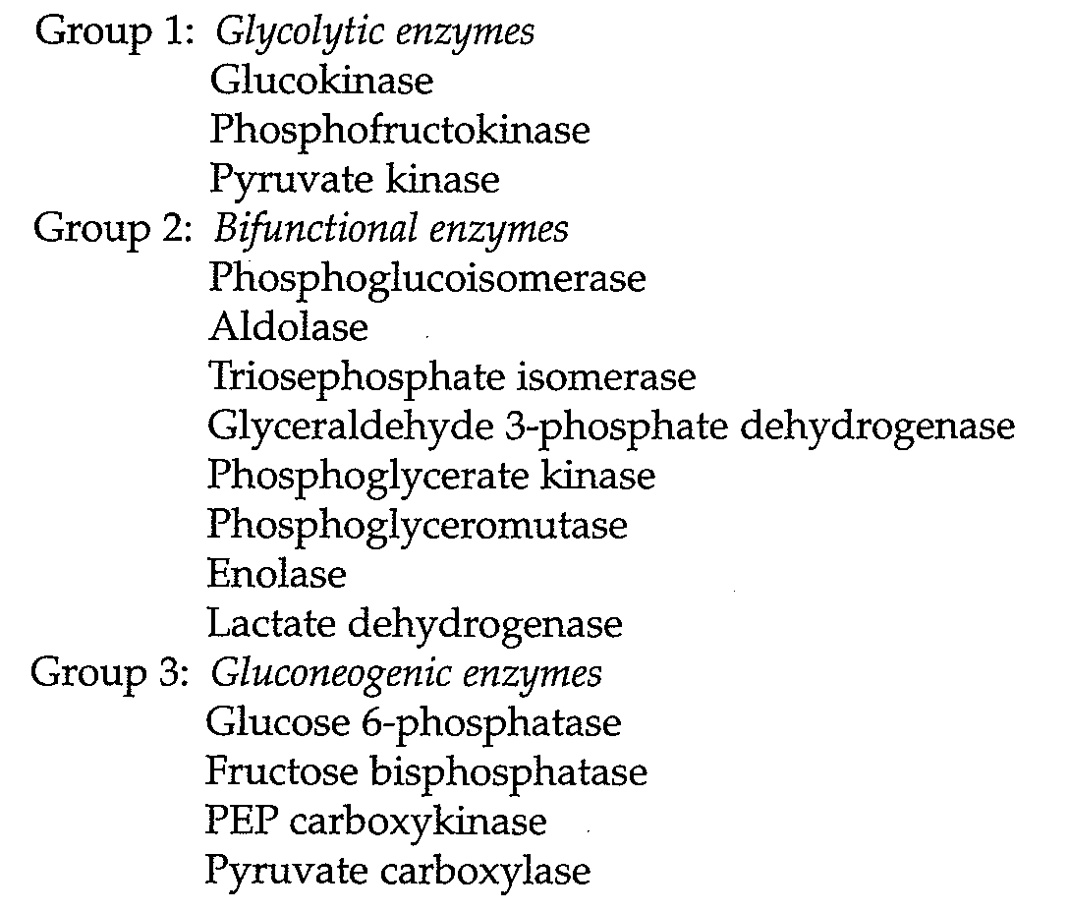
Regulation: enzymes functioning

Slide 72
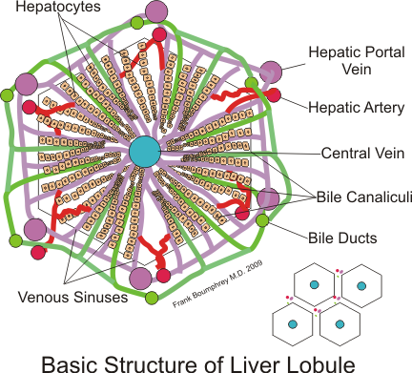
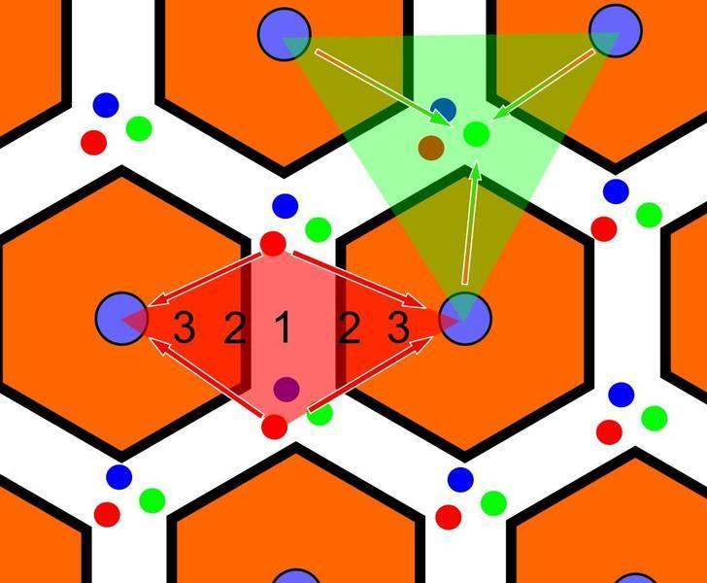
Functionally, zone I hepatocytes are specialized for oxidative liver functions such as gluconeogenesis, β-oxidation of fatty acids and cholesterol synthesis, while zone III cells are more important for glycolysis, lipogenesis.
Central vein
The functional unit is the hepatic acinus (terminal acinus), each centered on the line connecting two portal triads and extends outwards to the two adjacent central veins. The periportal zone I is nearest to the entering vascular supply and receives the most oxygenated blood. Conversely, the centrilobular zone III has the poorest oxygenation.
http://wapedia.mobi/en/Hepatic_lobule
Notes:
http://www.google.com/imgres?imgurl=http://www.siumed.edu/~dking2/bluehist/LiverAni.gif&imgrefurl=http://www.siumed.edu/~dking2/erg/liver.htm&usg=__2qL_mIOBfhJUAb7alm6fdjxCApo=&h=200&w=300&sz=240&hl=en&start=0&zoom=1&tbnid=QaEV5YnmZTa5lM:&tbnh=129&tbnw=193&ei=UAUiTvJyyeaIAtOwkZUD&prev=/search%3Fq%3Dportal%2Btriad%2Bliver%26hl%3Den%26biw%3D1280%26bih%3D923%26gbv%3D2%26tbm%3Disch&itbs=1&iact=hc&vpx=607&vpy=265&dur=3247&hovh=160&hovw=240&tx=56&ty=76&page=1&ndsp=25&ved=1t:429,r:7,s:0&biw=1280&bih=923

Slide 73
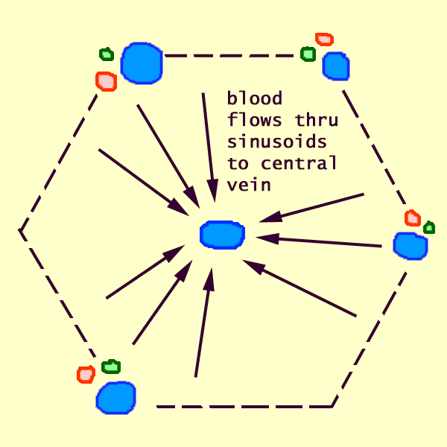
Hepatic artery
Bile duct
portal vein
http://www.siumed.edu/~dking2/erg/liver.htm

Slide 74
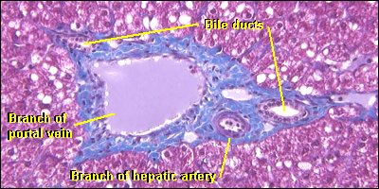
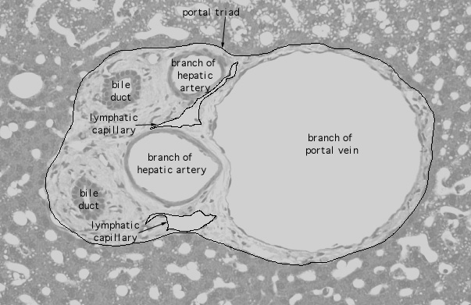
Portal Triad
Portal vein provides nutrient-rich blood (70%)
Hepatic artery provides Oxygen-rich blood (30%)

Slide 75
Metabolic pathways are compartmentalized in liver acinus
Glycolysis primarily in pericentral (perivenous) Hepatocytes (zone 3)
Low O₂ pressure
GLUT 1 (high Km) present; low affinity for Glu
GLUT 2 in all Hepatocytes
Gluconeogenesis primarily in periportal Hepatocytes (zone 1)
Glu is not taken up here
Zonation decreases with fasting: more Glu needs to be produced and released
“All cells become active in gluconeogenesis”

Slide 76
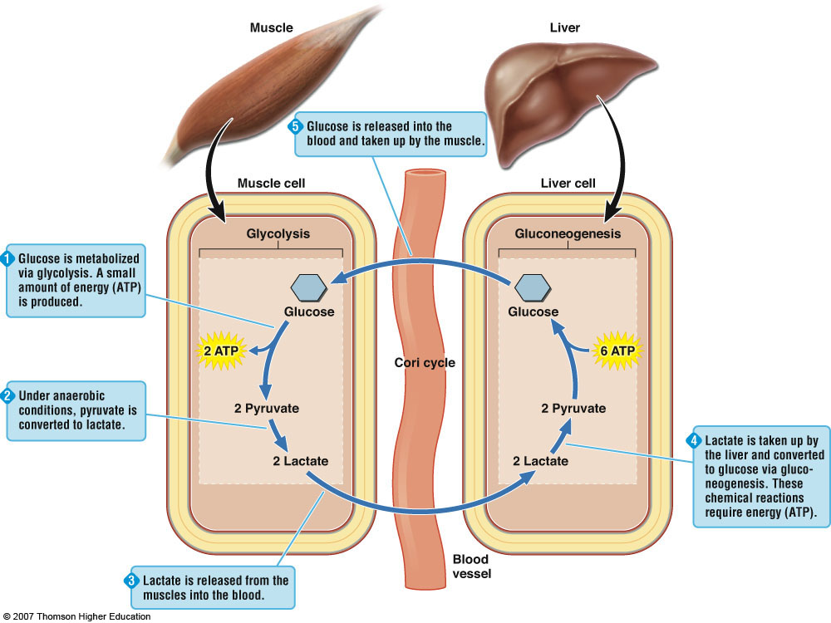
The Cori Cycle
Notes:
Figure 8.10: The Cori Cycle.
The Cori cycle is a metabolic pathway that involves both glycolysis and gluconeogenesis. Under conditions of limited oxygen availability, the Cori cycle provides a means by which small amounts of ATP can continue to be produced in the muscle.

Slide 77
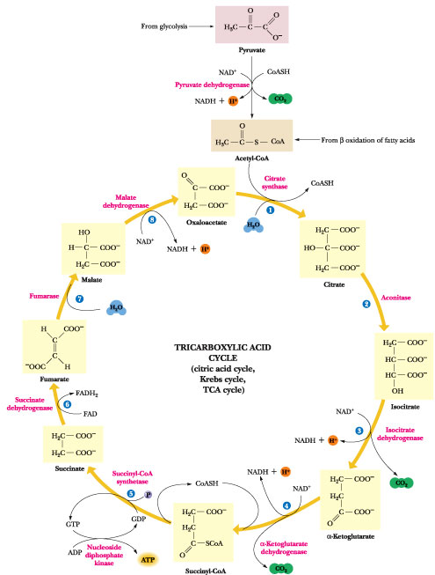
The Krebs cycle

Slide 78
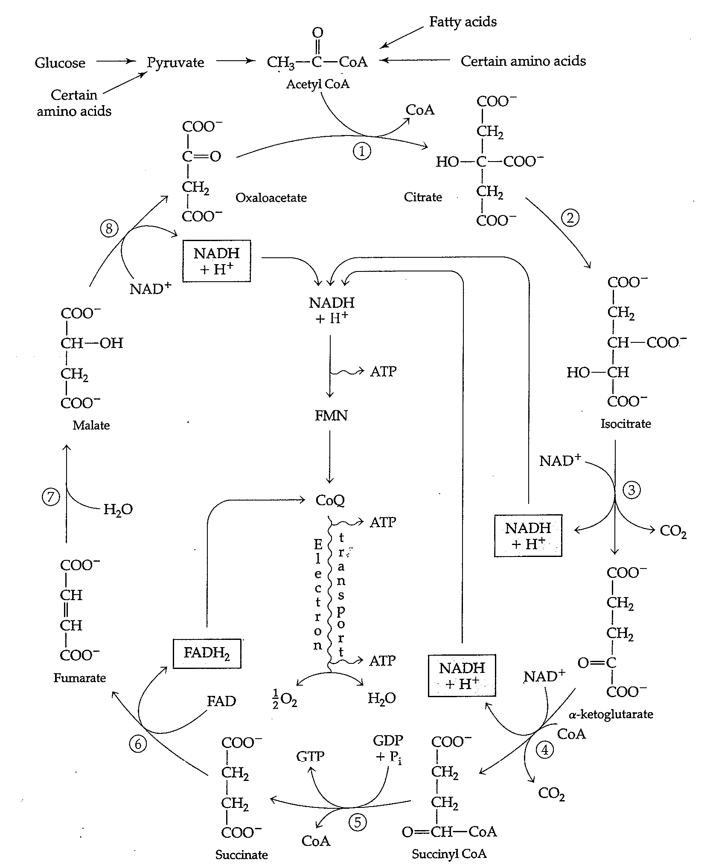
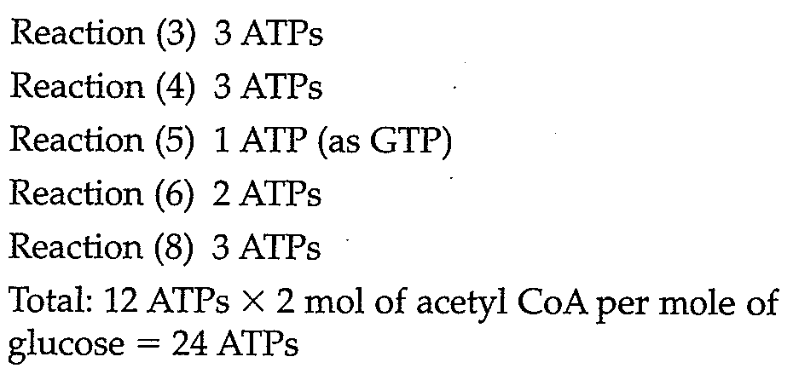
The Krebs cycle

Slide 79
The Pyruvate dehydrogenase reaction
Abr | Enzyme | Prosthetic group
E1 | Pyruvate dehydrogenase | thiamin pyrohosphate;TPP | in periphery of the complex
E2 | dihydrolipoamide acetyltransferase | Lipoamide | monomer, many copies interior
E3 | dihydrolipoamide dehydrogenase | FAD | dimer, fewer copies in periphery
Notes:
Pyruvate dehydrogenase complex deficiency is caused by a mutation in the E1-alpha polypeptide gene (PDHA1), which encodes the critical enzyme complex, the Pyruvate dehydrogenase complex (PDC) which links the metabolic pathways of glycolysis and the citric acid cycle by transforming pyruvate into Acetyl CoA. A defect in this complex causes accumulation of lactate and pyruvate in the blood; lactate and pyruvic acid in the spinal fluid; and lactate in the urine. Symptoms include lactic and metabolic acidosis, motor retardation, dystonia, growth and mental retardation, and respiratory distress

Slide 80
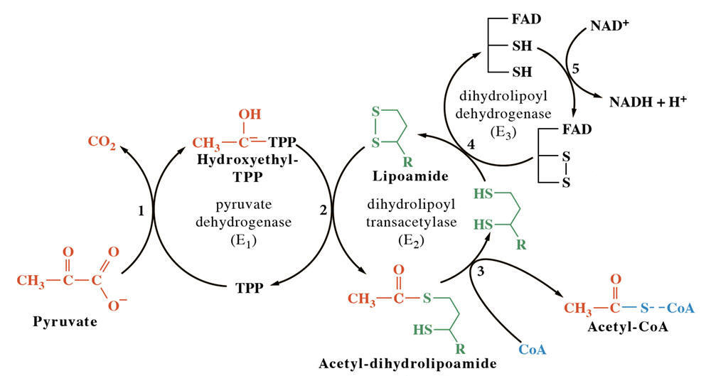
Schematic representation of the reactions conducted by E1, E2 and E3 of pyruvate dehydrogenase complex
E1 requires thiamin pyrophosphate (TPP) and Mg++ ion cofactors for decarboxylation of pyruvate followed by the reductive acetylation of the lipoic acid covalently bound to the E2 enzyme of Pyruvte DH. This enzymatic function is completed in two reactions with formation of reaction intermediate, 2-a-hydroxyethylidene-TPP

Slide 81
How does it work?
E1 catalyzes the non-reversible removal of CO₂ from pyruvate; E2 forms acetyl-CoA, E3 reduces NAD⁺ to NADH, and E3-binding protein provides E3 with binding sites to the core of the complex.
Two additional enzymes associated with the complex: a specific kinase which is capable of phosphorylating E1 at serine residues and a loosely-associated specific phosphatase which reverses the phosphorylation.
The activity of the complex may be regulated in vivo by the availability of substrates pyruvate and lipoamide themselves, as well as by the relative concentrations of NAD/NADH, CoA/acetyl-CoA, ADP/ATP, and the proportion of E1 in its active dephosphorylated state.

Slide 82
Regulation of Pyruvate Dehydrogenase Complex
Regulated by the products of the rxn they catalyze
E1 is negatively regulated by [GTP] & positively by [AMP]
E2 is negatively regulated by [acetyl Co A]
E3 negatively regulated by [NADH]/[NAD ]
E1-P is inactive:
[acetyl Co A]: increase in E1-P formation
Pyruvate decrease in E1-P formation

Slide 83
Regulation of Pyruvate Dehydrogenase Complex
P
PDC
H₂O
ADP
NADH
Acetyl Co A
ATP
Inactive
+
PDC phosphatase
PDC kinase
-
+
NAD
Pyruvate
CoASH
ADP
Ca⁺
Mg⁺
Ca⁺
PDC
ATP
P
Pyruvate + Co ASH +NAD⁺
Active
Acetyl Co A + NADH + CO₂

Slide 84
ATP Formation from Glucose Catabolism
Fig. 8-13, p. 285
Notes:
Figure 8.13: ATP Formation from Glucose Catabolism.
Although some ATP is formed directly via substrate phosphorylation, most ATP is formed via oxidative phosphorylation.

Slide 85
Direct formation of OXL from pyruvate

Slide 87
Mitochondrial compartments
Outer membrane is porous.
Inner membrane is the major permeability barrier. It has foldings (cristae) containing respiratory chain & ATP synthase (electron transport & oxidative phosphorylation).
Matrix contains PDC, enzymes for TCA cycle & FA oxidation

Slide 88
Oxidative Phosphorylation and the Electron Transport Chain
Notes:
Figure 8.7: Oxidative Phosphorylation and the Electron Transport Chain.
Oxidative phosphorylation involves a series of linked chemical reactions that comprise the electron transport chain, which is located on the surface of inner mitochondrial membrane. The energy needed to phosphorylate ADP is provided by the oxidation of NADH + H⁺ and FADH₂.

Slide 89
Oxidative Phosphorylation and the Electron Transport Chain
FMN in complex I is the 1st e⁻ acceptor.
Co-Q (complex III) not a transmembrane protein.
Complex III and Cyt C work together.
In complexes I, III & IV, enough energy to pump H⁺ out.
Complex V:
F0 opening for H⁺
F1: coupling
http://www.google.com/imgres?imgurl=http://upload.wikimedia.org/wikipedia/commons/thumb/8/89/Mitochondrial_electron_transport_chain%E2%80%94Etc4.svg/400px-Mitochondrial_electron_transport_chain%E2%80%94Etc4.svg.png&imgrefurl=http://en.wikipedia.org/wiki/Oxidative_phosphorylation&usg=__SnUjBt4yoOKNiJfKna4WVg0PAhw=&h=362&w=400&sz=108&hl=en&start=0&zoom=1&tbnid=O9H_23gAlWEoaM:&tbnh=137&tbnw=151&ei=zy0jTuixKKXliAKHivW3Aw&prev=/search%3Fq%3Dpathway%2Bof%2Belectron%2Btransport%2Band%2Boxidative%2Bphosphorylation%26hl%3Den%26biw%3D1280%26bih%3D923%26gbv%3D2%26tbm%3Disch&itbs=1&iact=hc&vpx=185&vpy=83&dur=659&hovh=214&hovw=236&tx=167&ty=124&page=1&ndsp=28&ved=1t:429,r:0,s:0&biw=1280&bih=923

Slide 90
F0: pore in inner mitochondrial membrane; opening for H+ to move
F1β is ATP synthase
http://www.google.com/imgres?imgurl=http://www.biologie.uni-hamburg.de/b-online/fo19/map03110.gif&imgrefurl=http://www.biologie.uni-hamburg.de/b-online/e19/19d.htm&usg=__RwnNZhe9YkPSxsC-4D2BkDLPeo0=&h=444&w=483&sz=13&hl=en&start=0&zoom=1&tbnid=rgnKr6IY05kUJM:&tbnh=135&tbnw=147&ei=6TAjTtifAqvWiAL61KnEAw&prev=/search%3Fq%3DATP%2Bsynthase%26hl%3Den%26biw%3D1280%26bih%3D923%26gbv%3D2%26tbm%3Disch&itbs=1&iact=hc&vpx=334&vpy=271&dur=2055&hovh=215&hovw=234&tx=133&ty=128&page=1&ndsp=31&ved=1t:429,r:7,s:0&biw=1280&bih=923

Slide 91
Chemiosmotic Coupling
Complexes I, III, IV all “pump” H⁺ into space b/w the inner and outer mitochondrial membrane.
Creating a “proton gradient” across the inner membrane.
While protons pass through complex V, osmotic energy of the gradient is converted to chemical energy (ATP).
Chemiosmotic Coupling: the use of transmembrane proton gradient (exergonic reduction rxn b/w complex I and IV, to drive energy-requiring rxn of ATP synthesis.

Slide 92
Glycogenesis

Slide 93
Glycogenin

Slide 94
Glycogenolysis

Slide 95
Release of Insulin & Glucagon from the Pancreas

Slide 97
Regulation of glycogen phosphorylase

Slide 98
Hexomonophosphate shunt

Slide 99
Amino acids Transamination and Deamination
Fig. 8-14, p. 287
Notes:
Figure 8.14: Transamination and Deamination.
To use amino acids for a source of energy, the amino group is removed in two steps: transamination and deamination.

Slide 100
Lipolysis
Fig. 8-15, p. 288
Notes:
Figure 8.15: Lipolysis.
Triglycerides are broken down to fatty acids and glycerol by the process of lipolysis.

Slide 101
Ketogenesis

Slide 102
Energy Balance
Notes:
This curve shows the general trend of energy balance in early lactation.
Cows enter a state of negative energy balance when milk energy output is greater than feed energy input.
An energy balance nadir, which is the lowest point of energy balance, is reached within the first 5 weeks, and then energy balance increases.
Once MP is established and NEI is slightly greater than energy needed for MP -> a positive energy balance will be reached, and the dairy cow will begin to replenish the body tissue that was lost in early lactation.

Slide 103
Energy Metabolism During Negative Energy Balance
G-6-Pase
Glucose-6-P Glucose
Glycolysis
Gluconeogenesis
Pyruvate
Fatty Acids
(NEFA)
Acetyl-CoA
Ketones
Oxaloacetate
Citrate
Krebs
Cycle
Liver
2 CO₂
12 ATP
Hrycyna, 2004

Slide 104
Ketosis
Increased plasma [AcAc, Ac, BHBA] results in ketosis
Incomplete FA oxidation & Severe NEB results in [blood ketones]

Slide 105
Fatty liver
Symptoms
Liver failure
dull, depressed, stop eating
labored breathing
Cause
Greater than 20% fat in liver cells
Treatment
High forage diet and watch for other problems
Prevention
Good pre-fresh diet, no fat cows

Slide 107
Insulin-independent & insulin-dependent pathways of glucose metabolism

Slide 108
The microsomal ethanol oxidizing system (mixed function oxidases)

Slide 109
Overview of Energy Metabolism
Fig. 8-20,
p. 296
Notes:
Figure 8.20: Overview of Energy Metabolism.
The relative activity of anabolic and catabolic pathways is determined by the availability of substrates, intermediate compounds, and energy needs.

Slide 110
Interconversion of macronutrients

Slide 111
Disposition of dietary glucose, AA, and fat in fed state

Slide 112
Primary post-absorption flow of substrates

Slide 113
Flow of substrates during fasting & starvation

Slide 114
Fig. 8-21, p. 297
Notes:
Figure 8.21: Fuel Availability and Hormonal Changes in Response to Feeding, Fasting, and Acute Starvation.

Slide 115
Dietary Fiber
Group of plant polysaccharides that are not digested or absorbed in the human small intestine

Slide 116
Carbohydrates digestion in the rumen

Slide 117
Carbohydrates digestion in the rumen

Slide 118
Acetate
Pyruvate + Pi + ADP →
Acetate + ATP + H₂ + CO₂
Cellulolytic bacteria
Energy source for rumen epithelium and muscle
Not utilized by liver

Slide 119
Acetate utilization
Important as a precursor to de novo fatty acid synthesis
Adipose
Lactating mammary gland
Oxidized via TCA
Activated to acetyl CoA
Used by skeletal muscle, kidneys, and heart for energy
Net gain of 10 ATP per mole of acetate

Slide 120
Acetate utilization
Dependent upon
Energy balance
Generates CO₂ and H₂O (i.e., ATP) when in low energy balance
Used for fatty acid synthesis when animal is in high energy balance
Arterial concentration
Tissue uptake is directly related to rate of rumen fermentation [blood concentration]

Slide 121
Propionate
Pyruvate + CoA + 4H⁺ → Propionate + H₂O
Amylolytic bacteria
Utilized by rumen epithelium
Converted to lactate and pyruvate
Important as a precursor for gluconeogenesis

Slide 122
Hepatic propionate metabolism
OAA
TCA
Cycle
Glucose
Succinyl CoA
Coenzyme B₁₂
Methylmalonyl CoA
ADP + Pi
Biotin, Mg⁺⁺
ATP
Propionyl CoA
AMP + 2 Pi
ATP
CoA
Propionate

Slide 123
Butyrate
Pyruvate + CoA → Acetyl-CoA + H₂ + CO₂
2 Acetyl-CoA + 4H⁺ → Butyrate + H₂O + CoA
Metabolized by rumen epithelium to ketone bodies (acetoacetate, β-hydroxybutyrate)
Later metabolized in the liver
Net ATP production is 25 per mole

Slide 124
Ruminal VFA absorption
Rumen
lumen
Rumen
wall
Portal
vein
Acetate
70
50
20
Propionate
20
10
10
Butyrate
10
1
9
Values are relative flux rates

Slide 125
Hepatic metabolism of VFA
Rumen
Portal
vein
Peripheral
blood
Liver
Acetate
70
50
Acetate
Propionate
20
10
Glucose
Glucose
CO₂
3-OH
butyrate
3-hydroxy
Butyrate
(BHBA)
Butyrate
10
1
4

