Slide 1
Lipids
AVS 517

Slide 2
Lipid Digestion, Absorption, and Transport

Slide 3
Lipids in the body
Functions
  Membrane component
  Thermal insulation and mechanical protection
  Metabolic regulator
  Energy store
    - 90% of an adipocyte is lipid
Notes:
Lipids or fats are stored in cells throughout the body principle in special kinds of connective tissue called adipose tissue. Whereas many cells contain phospholipids in the bilayer cell membranes, adipose tissue cells consist of fat globules of triglycerides which may occupy as much as 90% of the cell volume.
In addition to energy storage, depot fat provides a number of other functions. Fat serves as a protective cushion and provides structural support to help prevent injury to vital organs such as the heart, liver, kidneys, and spleen.

Slide 4
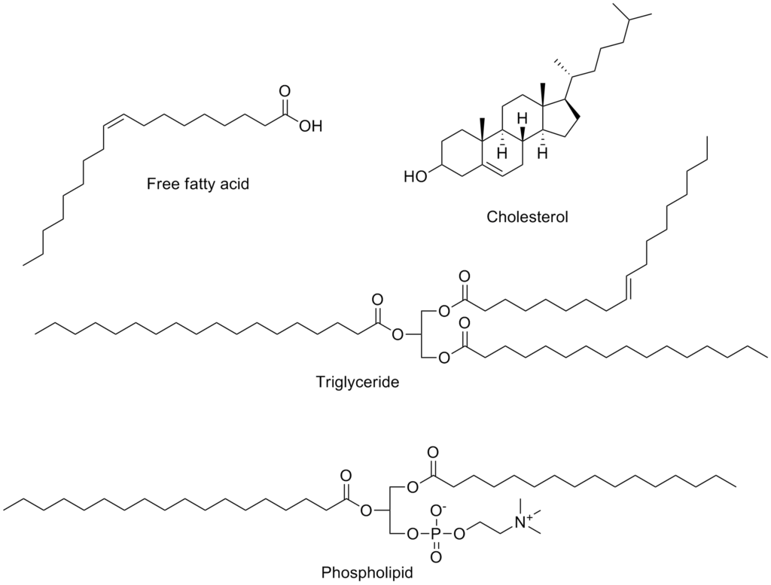
Types of Lipids
https://upload.wikimedia.org/wikipedia/commons/thumb/5/5c/Common_lipids.png/1024px-Common_lipids.png

Slide 5
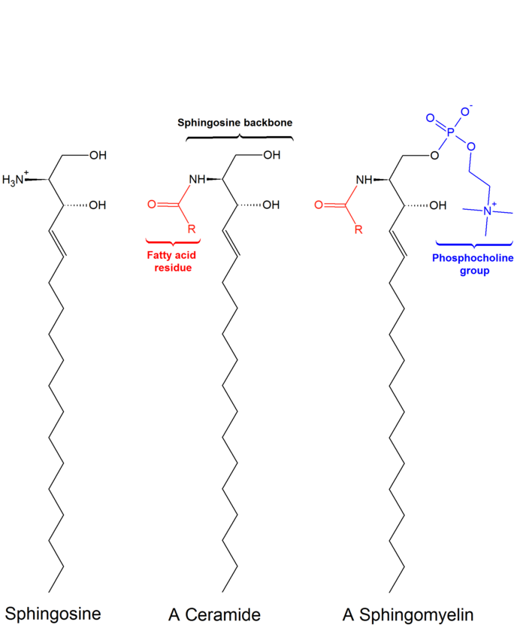
Types of Lipids
https://upload.wikimedia.org/wikipedia/commons/thumb/b/b5/Sphingolipids_general_structures.png/1920px-Sphingolipids_general_structures.png

Slide 6
In 70 kg man
10 kg fat 93,000 Kcal
glycogen 500-800 Kcal
protein ~ 18,000 Kcal
Notes:
Protein can be catabolized to provide glucose for brain and red blood cells

Slide 7
Adipose tissue is located:
In the abdominal cavity around kidneys and between the mesentery
Beneath the skin
Between skeletal muscle fibers
Notes:
Fat in the muscle is used during exercise

Slide 8
Lipid Digestion and Absorption

Slide 9
Lipid Digestion and Absorption
Triglycerides
Stomach
  Little digestion
  Gastric lipase is secreted in the stomach that hydrolyze long chain triglycerides
Small intestine
  Fat digestion and absorption occurs primarily in the duodenum and jejunum
Notes:
Triglycerides are ~95% of the fat consumed in human diets. Most dietary triglycerides are digested in the small intestine. However, two problems must be solved before digestion can occur. Triglycerides are insoluble in water, and the chyme in the intestine is an emulsion of large fat particles in water. All the lipase proteins by contrast are water-soluble. It follows that, triglycerides must be dissolved in the aqueous phase before they can be digested.

Slide 10
Lipid Digestion
Large Lipid Droplet
Action of bile salts (cholate, chenodeoxycholate)
Lipid emulsion
Small
Bile salts activate pancreatic lipase and colipase
Bile salts reabsorbed, transported back to liver
Water soluble micelles

Slide 11
A. Luminal Phase
Food entering small intestine causes the secretion of hormones such as cholecystokinin, pancreozymin and secretin
Hormones cause gallbladder to contract and secrete bile
  Stimulate the pancreas to secrete pancreatic lipase

Slide 12
1. Emulsification
Bile salts in combination with the churning action of the intestine emulsifies the fat breaking it down into small droplets
This increases the surface area of triglycerides by a factor of ~10,000
Bile salts ↑ pH of intestine which causes secretion of pancreatic lipase
Notes:
Increased surface area allows the lipase to be more effective at chopping up the triglycerides.

Slide 13
2. Partial Hydrolysis
Pancreatic lipase
  Attacks the glycerol-FA ester bonds of triglycerides at positions 1 & 3 resulting in the release of 2-monoglyceride and 2 fatty acids
Phospholipase A1 and A2
  Hydrolyzes fatty acids from phospholipids
Cholesterol esterase
  Hydrolyzes fatty acids from cholesterol esters

Slide 14
Triglyceride
+ pancreatic lipase
2-monoglyceride + 2 FA
O
H₂ – C – O – C – R₁
O
H₂ – C – O – C – R₂
O
H₂ – C – O – C – R₃
– R₁
R₁
– R₃
R₃
Notes:
Rate of hydrolysis of 2-monoglyceride
is very low so only small amounts of
glycerol are formed

Slide 15
3. Mixed micelle formation
Consist mainly of long chain FAs, monoglycerides and bile acids
Short (2-6C) and medium chain FAs (6-12 C) are soluble enough in H2O that they can be absorbed into the portal blood
Notes:
The lipolytic activity of lipase requires the emulsifying action of bile salts in order to dissolve triglycerides in water. Pancreatic lipase binds to the surface of the small emulsion ­particles.

Slide 16
Long chain FAs and monoglycerides
Micelles diffuse to the surface (brush border) of mucosal cells where they are broken down
Long chain FAs and monoglycerides are absorbed into the intestinal mucosa by passive diffusion
Bile salts remain in the lumen and move down the intestine where most are actively absorbed from the ileum

Slide 17
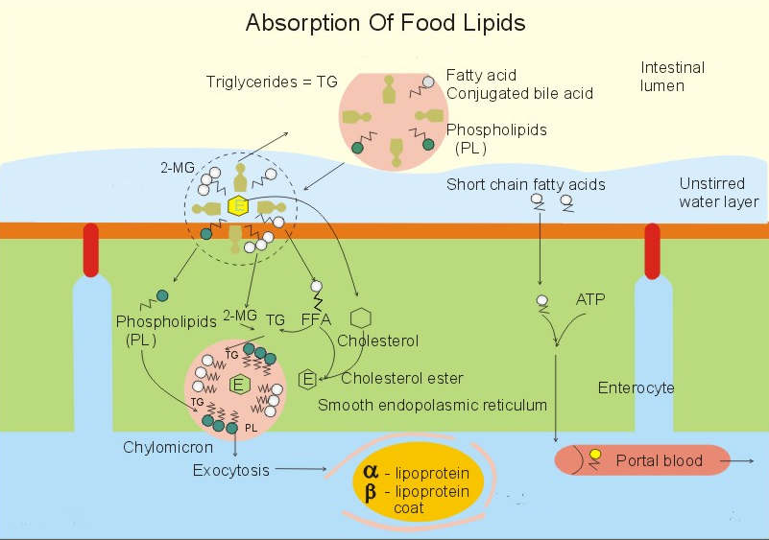
Notes:
Simple bile micelles are aggregates of bile salt monomers that form spherical structures with a diameter of 5 nm, and the micelles have a negative charge. Following a meal, bile micelles are formed above a certain concentration of bile salts, called the critical micellar concentration. The lipophilic, hydrophobic, apolar end of the bile acids faces inward creating a hydrophobic core. The hydrophilic polar end of the bile salts (hydroxyl-, carboxyl- and amino- groups) points outward, so that they are mixed with the polar water molecules. The simple lipids must pass a diffusion barrier - an unstirred water layer, which is the water layer immediately adjacent to the mucosa, where the intestinal flow rate is essentially zero. This water layer contains the water-soluble lipases and cholesterol esterases. Mixed micelles. Simple lipid molecules (cholesterol, phospholipids, fatty acids, 2-monoglycerides or 2-MG, fat-soluble vitamins and lyso-lecithin) diffuse into the lipophilic core of the simple bile micelles and form a mixed micelle (Fig. 22-13). A solution of micelles is water-clear and stable.
The mixed micelles carry the major part of all the lipids that are absorbed by the intestinal microvilli. When the lipids of the mixed micelle have diffused into the enterocyte, emulsifying more hydrolysed lipids recycles the empty bile micelle. Neither bile salt micelles nor bile salt molecules diffuse into the enterocyte

Slide 18
C. Intracellular Phase
Short and medium chain FAs (12 C or <) enter portal blood and bind to albumin without being esterified
Long chain FAs and monoglycerides are resynthesized into triglycerides in the endoplasmic reticulum of the mucosa
Notes:
The fatty acids with a short chain (up to 12 C-atoms) are more hydrophilic than the rest. They can diffuse directly to the portal blood as fatty acids. Once fatty acids enter the enterocyte, they are primarily activated to acetyl coenzyme A by a process that requires ATP and acetyl coenzyme A synthetase. Acetyl coenzyme A enters one of two pathways: the 2-MG and the a-glycerol phosphate pathways. Both bring about the resynthesis of triglycerides (TG) in the enterocyte. In the enterocyte the lipids are reformed to triglycerides, cholesterol, phospholipids etc. The reformed triglycerides, cholesterol, phospholipids, fatty acids, esters and fat-soluble vitamins reach the endoplasmic reticulum, where they are packed in another lipid-carrying particle: the chylomicron.

Slide 19
Lipid Synthesis

Slide 20
Triglyceride Synthesis
Monoglyceride (~85%)
Glycerol 3-phosphate (~15%)

Slide 21
Monoglyceride Pathway
Occurs in the smooth endoplasmic reticulum
Fatty acid + ATP Fatty Acy-CoA + AMP
+ CoA + P_{i}
Acyl-CoA synthetase is specific for fatty acids with greater than 12 carbons
Monoglyceride + Fatty Acyl CoA Diglyceride
Diglyceride + Fatty Acyl CoA Triglyceride
Acyl - CoA
Synthetase

Slide 22
Glycerol 3-Phosphate Pathway
Occurs in the rough endoplasmic reticulum
Inhibited by monoglycerides
Glycerol
Glycerol 3-P
fatty acyl CoA
Phosphatidic Acid
Fatty Acyl CoA
Pi
Phospholipid Diglyceride Triglyceride
Notes:
Glycerol 3-P is formed via glycolysis

Slide 23
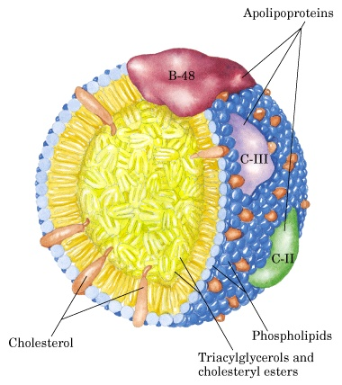
FA content of the triglycerides synthesized in the intestinal mucosa is similar but not identical to that in the diet.
http://homepage.smc.edu/wissmann_paul/anatomy2textbook/chylomicronpic.jpg
Notes:
The centrer of the chylomicron is a cholesterol ester. Chylomicrons are packed into vesicles in the Golgi-system. These vesicles reach the basolateral membrane, and their contents pass through this membrane by exocytosis. Thus the chylomicrons reach the lymphatic channel of the villus (the central lacteal). The lymph delivers the chylomicrons to the blood through the thoracic duct. Lipids are mainly absorbed through the enterocyte and transported by the lymph, which reaches the blood via the thoracic duct. Lipids thus reach the liver through the hepatic artery, with the exception of short-chain fatty acids that enter the portal blood directly. Other nutrients are absorbed directly to the blood and reach the liver through the portal vein. Using the lymph guarantees that extrahepatic tissues, principally adipose tissue and muscle, are the first to be exposed to the newly secreted chylomicrons—if chylomicrons were secreted directly into the bloodstream, they would first be delivered to the liver via the portal vein.

Slide 24
Generally fat is well absorbed 90%+
Long chain saturated FA are not absorbed as rapidly as short chain or unsaturated FA
A higher bile acid concentration is needed for micelle formation with long chain saturated FA
  Lack of bile decreases fat absorption
Notes:
All of the dietary lipid is normally absorbed in the intestine. Faecal fat derives from bacterial lipids and lipids of desquamated mucosal cells. - Disorders such as gallstones, pancreatitis, Crohn's disease, and liver disease can lead to fat malabsorption (steatorrhoea or fat-diarrhoea).

Slide 25
II. Phospholipid
Secreted in the bile and some in diet
Phospholipid Lysophosphatidyl- choline + FA
Phospholipid must be dispersed into small micelles for enzymatic hydrolysis
Phospholipases
Pancreatic
Notes:
Lysolecithin promotes micelle formation

Slide 26
LPC and FA produced become part of the mixed micelles
They are absorbed and then resynthesized into phospholipids in the mucosal cells by the glycerol 3-PO₄ pathway
Phospholipids are then utilized to form the chylomicrons or VLDL

Slide 27
III. Cholesterol
Human diet 400-700 mg/d
combination of free and esterified
Bile secretion 750-1250 mg/d free cholesterol
Cholesterol esters cholesterol + FA
Cholesterol esterase

Slide 28
Free cholesterol must be solubilized (mixed micelles) prior to absorption
More cholesterol is taken up by micelles when micelles are enlarged due to the presence of high fat
Cholesterol is taken up by the intestinal mucosa by passive diffusion then reesterified and incorporated in chylomicrons and VLDL
Cholesterol absorption is much lower than triglyceride absorption
30-60% absorption

Slide 29
Lipid Transport

Slide 30
Lipid Transport
Lipids appear in the blood in 3 forms
  Lipoproteins
  Free fatty acids – mostly bound to albumin
  Ketone bodies
Notes:
What are the two sources of FFA?

Slide 31
I. Lipoproteins
Transport form of lipid (TG, phospholipid, cholesterol) in blood
  Micromolecules of lipid and protein
Differ in terms of:
  Density
  Amount of TG
  Phospholipid
  Cholesterol
  Type & amount of protein

Slide 32
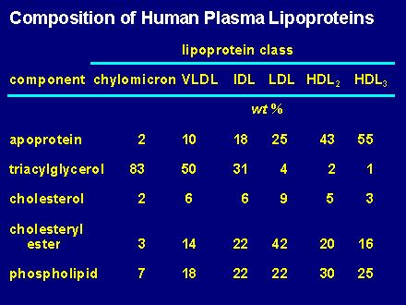
Notes:
In proceeding from LEFT to RIGHT among the six lipoproteins in this table, the trend is toward increasing protein, increasing density, and decreasing size.
Abbreviations include: VLDL, very low density lipoprotein; IDL, intermediate density lipoprotein; LDL, low density lipoprotein, HDL, high density lipoprotein
Largest lipoproteins are chylomicrons followed by VLDLs they are also least dense relatively small protein content and large lipid content
HDLs smallest particles and most dense; high amounts of protein and less lipids

Slide 33
FA
Lipoprotein
Lipase
VLDL
IDL
LDL
Intermediate
density
lipoproteins
Cholesterol esters
Excess PL and
cholesterol
LCAT
HDL cholesterol

Slide 34
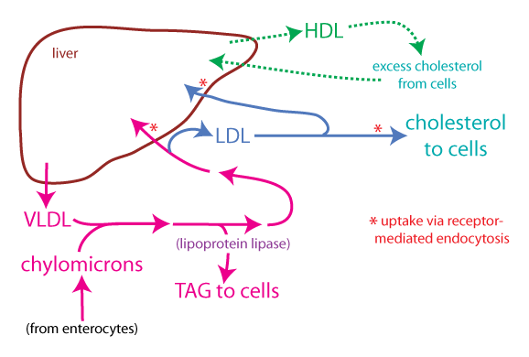
https://courses.washington.edu/conj/bess/cholesterol/liver-lipoproteins-color2.png

Slide 35
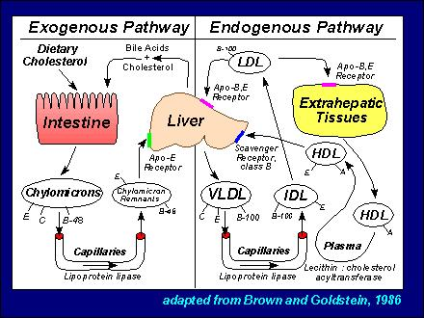

Slide 36
A. Chylomicrons
TG are primarily transported in chylomicrons and VLDL because TG are not soluble in H2O
Chylomicrons are produced only in the small intestine and they contain TG of dietary origin

Slide 37
Digestion and absorption of lipid and the formation and secretion of chylomicrons into the blood takes several hours
Turnover of chylomicrons are very rapid once they enter the blood (t ½ 4-5 min)
Triglyceride fatty acids + glycerol
Lipoprotein lipase
clearing factor lipase

Slide 38
Lipoprotein lipase is found on the outer surface of the endothelial cells lining the capillaries (adipose, heart, skeletal muscle,lung, mammary gland)
In liver lipoprotein lipase is attached to the outer surface of the hepatocytes
Following hydrolysis of TG the FAs diffuse into the tissue or they could remain in the blood and be transported to another tissue

Slide 39
Glycerol is transported in the blood to liver or kidney
Glycerol + ATP Glycerol 3-P + ADP
Oxidized
Fatty Acids Esterified TG
Glycerol kinase

Slide 40
FA
Lipoprotein
Lipase
Chylomicron Chylomicron remnant Liver
(Cholesterol ester & protein)
PL
Free cholesterol
HDL
Cholesterol esters from chylomicron remnants
are secreted into the bile or used in synthesis
of VLDL

Slide 41
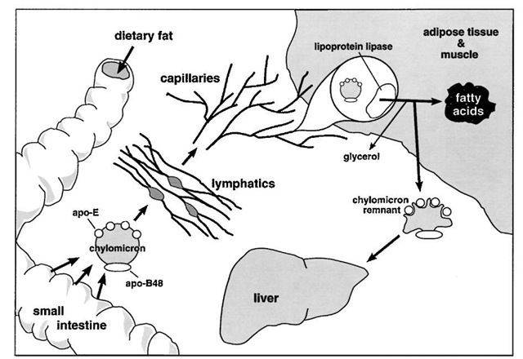
The intestine secretes chylomicron particles into the lymphatics. They gain entrance into the general circulation through the thoracic duct. Lipoprotein lipase, on the luminal surface of adipose and muscle capillary endothelial cells, hydrolyzes the triglyceride core to free fatty acids and glycerol. The free fatty acids are re-esterified and stored as triglycerides in adipose tissue or undergo b-oxidation in muscle. The lipid-depleted chylomicrons, chylomicron remnants, are cleared by the liver through a pathway that depends on apolipoprotein-E as a ligand for cellular receptors
Notes:
Lipoprotein lipase catalyzes the complete hydrolysis of triglycerides to free fatty acid and glycerol. This reaction occurs in the bloodstream, while the chylomicron particle is in proximity to the endothelial surface of the capillary wall. Cholesterol ester is not a substrate for lipoprotein lipase. Therefore, with the selective loss of triglycerides, the particle becomes more enriched in cholesterol ester. The free fatty acids are then taken up and oxidized in muscle or re-esterified and stored as triglyceride droplets in adipose tissue. The abundance of the adipose form of lipoprotein lipase is increased by insulin, thus promoting uptake of free fatty acids and storage as cytoplasmic triglyceride droplets
A chylomicron that has been depleted of its triglyc-eride core is termed a chylomicron remnant. Chylomicron remnants are cleared from the circulation, primarily by the liver.

Slide 42
B. Very low density lipoproteins (VLDL)
Lipoprotein that contains TG secreted from the liver
TG in liver are synthesized from either acetyl CoA or FAs derived from blood or chylomicrons

Slide 43
When dietary cholesterol from chylomicron remnants is not available in adequate amounts for synthesis of VLDL, the liver synthesizes cholesterol
Liver does this by increasing the activity of 3-hydroxy-3-methyl glutaryl coenzyme A reductase (HMG CoA reductase)

Slide 44
LCAT – Lecithin – cholesterol acyltransferase
LCAT esterifies excess cholesterol in HDL with FAs derived from the 2- position of lecithin (PL)
Half life of VLDL 1-3 hours

Slide 45
Lipoprotein lipase
Activity determines which tissues take up FA
Fed state – high in adipose
Fasted state-low in adipose, high in other tissues
Insulin and glucose lipoprotein lipase in adipose and also formation of α glycerol-P which stimulates esterification of FAs
Parturition - LPL in mammary gland

Slide 46
Nutritional State Lipoprotein Lipase Activity
 | Adipose | Heart | Skeletal M
Fasted | 3.3 | 19.0 | 15.4
CHO fed | 14.8 | 9.7 | 8.5
Fat fed | 7.9 | 15.1 | 14.4
J. Nutr. 105:447, 1975

Slide 47
C. Low Density Lipoproteins (LDL)
Involved in cholesterol transport
LDL is taken up by tissues metabolized and the cholesterol is released and used for cellular functions
  Specific receptor on the surface of the cell that binds LDL
Most tissues except liver depend on LDL for their cholesterol supply
  ~45% of plasma LDL pool turns over per day

Slide 48
D. High density Lipoproteins (HDL)
Functions in cholesterol and phospholipid exchange and cholesterol esterification reactions in plasma
Accepts cholesterol from tissues

Slide 49
Cholesterol bound to HDL can be esterified in plasma by LCAT and transferred to VLDL and IDL to form LDL
HDLs are synthesized in liver and small intestine
Half life of 5-6 days

Slide 50
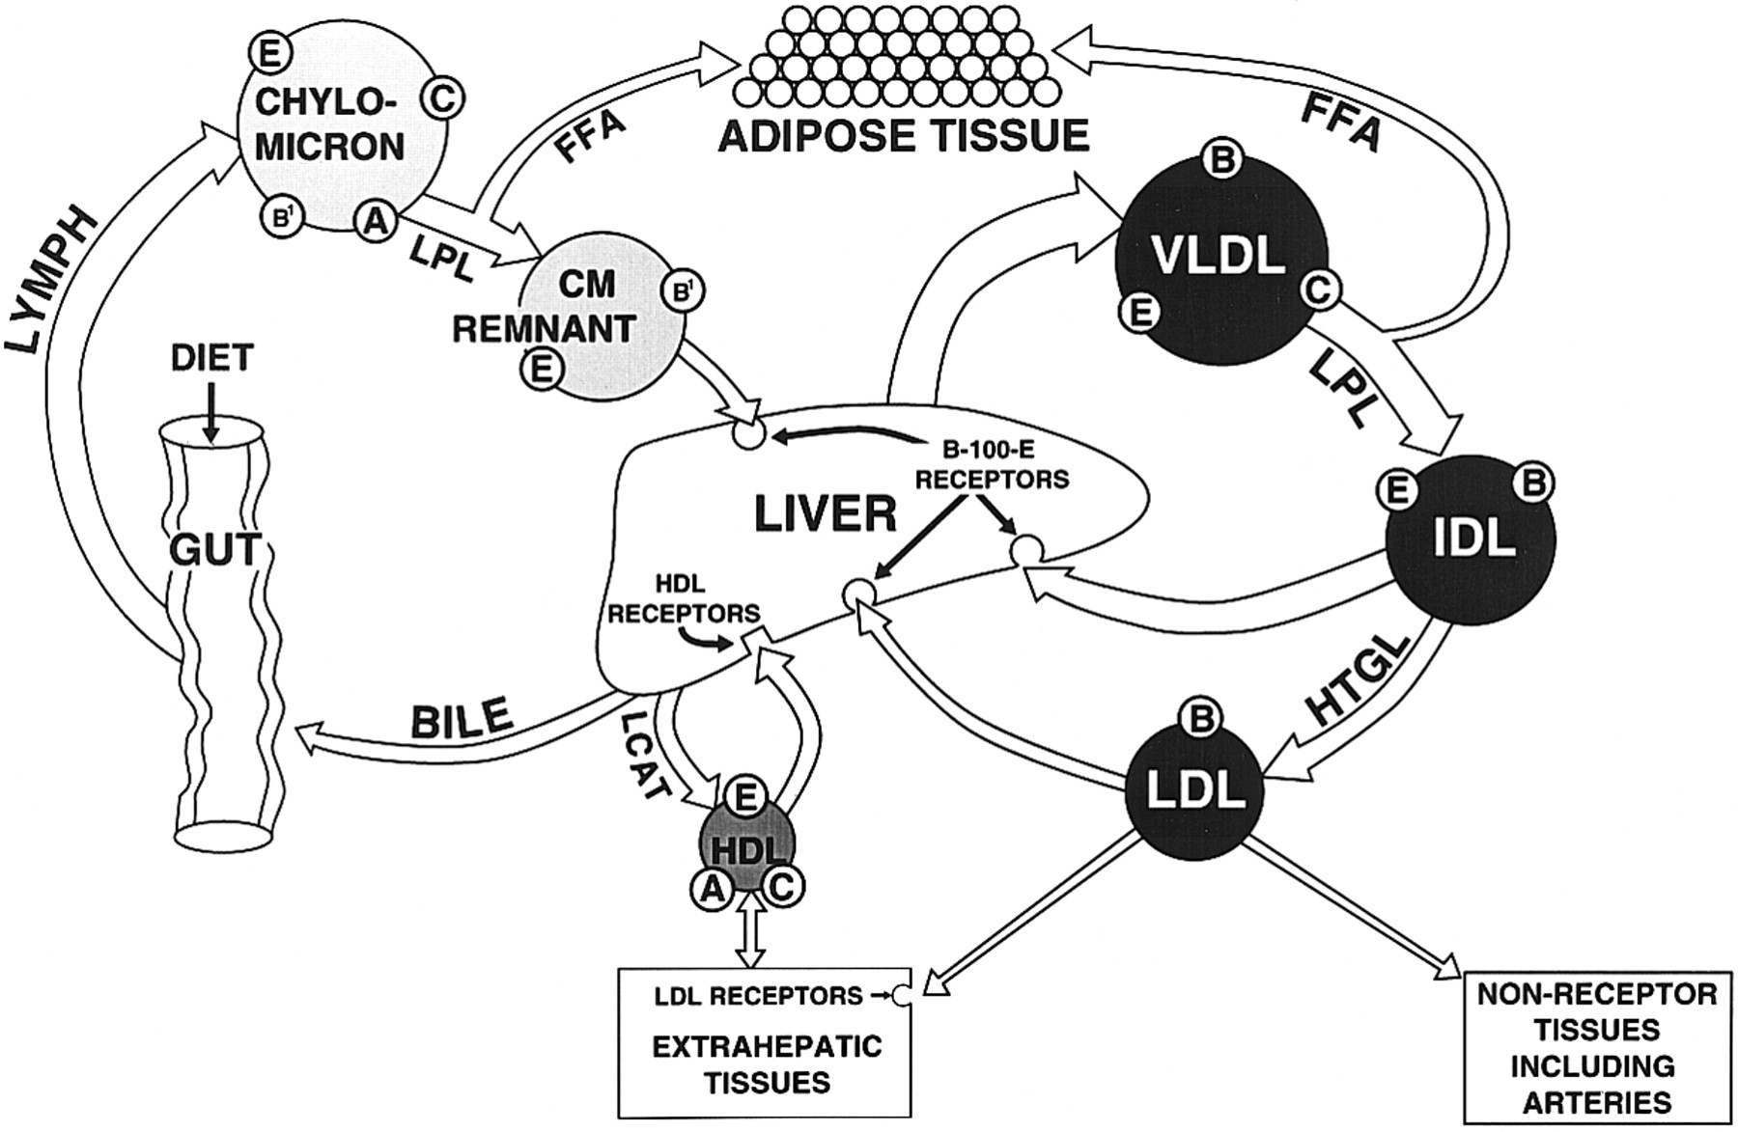
Notes:
Receptor-mediated pathways of lipoprotein metabolism. Three major pathways are involved: chylomicrons, VLDL and HDL. Intermediate density lipoprotein (IDL) is the remnant of VLDL and is cleared by the liver. LDL, which contains only apolipoprotein B-100, is the final product of the pathway; most of it is returned to the liver. Some LDL is taken up by extrahepatic LDL receptors and some by a scavenger pathway. The apopeptides contained in each lipoprotein are indicated. Three plasma enzymes essential for lipoprotein metabolism include LPL (lipoprotein lipase), LCAT (lecithin-cholesterol acyltransferase) and HTGL (hepatic triglyceride lipase.)

Slide 51
Lipid Transport
Lipids appear in the blood in 3 forms
  Lipoproteins
  Free fatty acids – mostly bound to albumin
  Ketone bodies
Notes:
What are the two sources of FFA?

Slide 52
II. Free Fatty Acids
Some from intestinal absorption
Most FFA arise from TG breakdown in adipose tissue

Slide 53
III. Ketone Bodies
Synthesis
  Gut epithelium (esp. ruminants)
  Liver
Uses (requires thioporase)
  Heart
  Brain
  Muscle

Slide 54
Lipid Metabolism

Slide 55
Lipid metabolism

Slide 56
Overview
Fatty acid oxidation
Fatty acid synthesis
Regulation of lipid metabolism
Notes:
Fatty acid oxidation in mitochondria is responsible for providing energy to cells when glucose levels are low. Triacylglycerols stored in adipose tissue of most humans can supply energy to the body for ~3 months during starvation.
Fatty acid synthesis reactions in the cytosol of liver and adipose cells convert excess acetyl CoA that builds up in the mitochondrial matrix when glucose levels are high into fatty acids that can be stored or exported as triacylglycerols.

Slide 57
Free Fatty Acids
Most FFA arise from TG breakdown in adipose tissue
Some from intestinal absorption
  Short and some medium chain FA
  Long chain will be TG
Notes:
Liver only releases FA in the form of TG in VLDL

Slide 58
Lipid Mobilization
Three major steps
  Lipolysis and release from adipose tissue
  Activation and transport into mitochondria
  β-oxidation

Slide 59
Lipid mobilization
Adipose is major tissue that releases FAs into blood stream
  Other tissues (liver, kidney, muscle) contain TG but they do not release FAs
In adipose TG are continuously being hydrolyzed to FAs and glycerol
  A net release of FAs from adipose occurs when lipolysis exceeds re-synthesis of TG

Slide 60
Fate of FFA
FFA
If too much Acetyl CoA then ketone bodies are produced by liver
Liver produces Acetyl CoA
TCA cycle
Notes:
Major source of FFA is mobilization from adipose

Slide 61
FA entry into the cell
FA primarily enter a cell via fatty acid protein transporters on the cell surface
  Fatty acid translocase (FAT/CD36),
  Tissue-specific fatty acid transport proteins (FATP),
  Plasma membrane bound fatty acid binding protein (FABPpm)

Slide 62
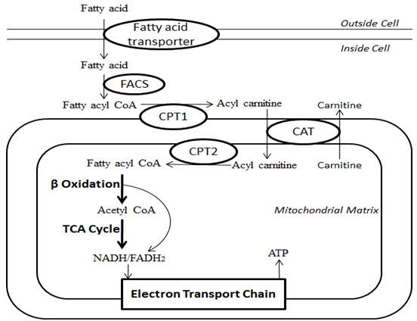

Slide 63
Fatty Acid Oxidation
Three major steps
  Lipolysis and release from adipose tissue
  Activation and transport into mitochondria
  β-oxidation

Slide 64
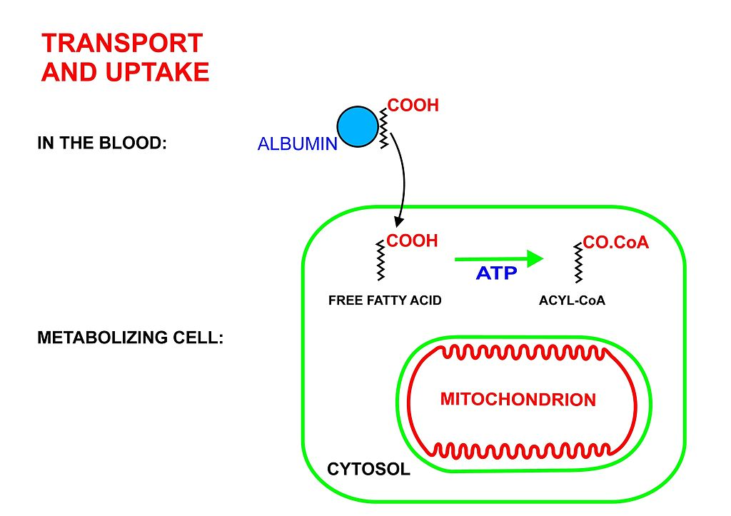
II. Activation
+ ATP
+ CoA-SH
+ AMP + PP_{i}
Modified from: https://upload.wikimedia.org/wikipedia/commons/thumb/d/d8/Metabolism2.jpg/1024px-Metabolism2.jpg
Notes:
Fatty acid plus ATP plus Coenzyme A catalyzed by CoA sythetase enzyme produces an esterified (activated) fatty acid

Slide 65
II. Activation
Acetyl-CoA Synthetase
  <4 C FA activation
  Located in mitochondrial matrix
Butyryl-CoA Synthetase/Ligase
  4-11 C FA activation
  Liver mitochondria
Acyl-CoA Synthetase
  6-20 C FA activation
  Located in microsomes, outer mitochondrial membrane

Slide 66
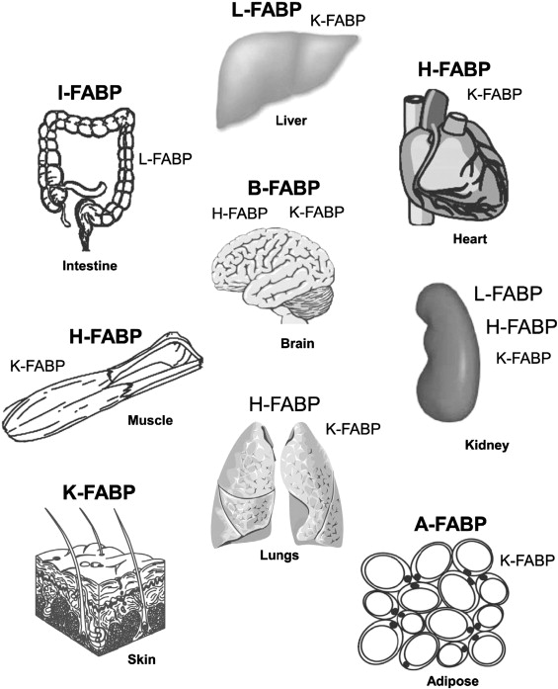
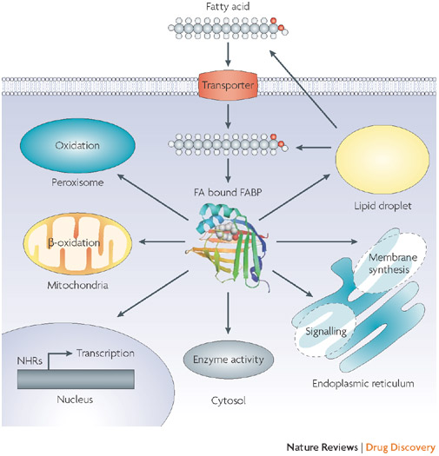
Transport to Mitochondria
Notes:
FABPs are the single most abundant proteins in the cytosol of cells most active in long chain fatty acid (LCFA) uptake and metabolism (liver, intestine), oxidation (kidney, heart, skeletal muscle) and storage (adipose). facilitate the transfer of fatty acids between extra- and intracellular membranes

Slide 67
FABP’s
Roles of FABPs
  Promote cellular uptake of FA
  Facilitate targeted transport of FA to specific metabolic pathways
  Pool for solubilized FA
  Protect enzymes against detergent effects of FA

Slide 68
Carnitine Shuttle Pathway
FA Acyl CoA synthetase (FACS)
Carnitine translocase (CAT)
Carnitine palmitoyltransferase (CPT)
Fatty acyl-CoA synthase (FACS)

Slide 69
Carnitine Shuttle Pathway
Activation via Acyl CoA synthetase
Carnitine Fatty acyl transfer (CAT I/CPT I)
Acyl carnitine crosses membrane
Acyl carnitine is converted to Acyl CoA + carnitine by CATII/CPTII

Slide 70
Fatty Acid Oxidation
Three major steps
  Lipolysis and release from adipose tissue
  Activation and transport into mitochondria
  β-oxidation

Slide 71
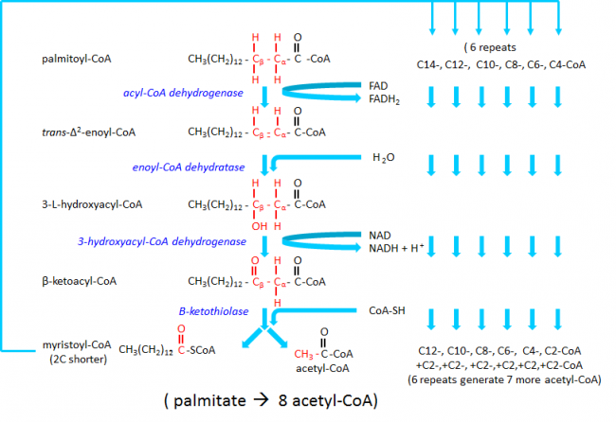
IV. β - oxidation
https://www.diapedia.org/img_cache/markdown_lightbox_5f310d22d1067b22e86bf31cd32c0c4a3d2d7b87-fe286.png

Slide 72
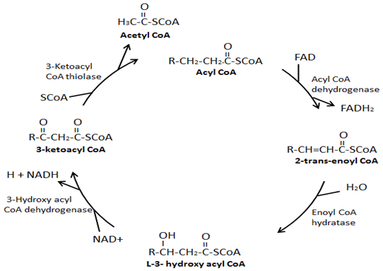
β-oxidation - Saturated FA
4. thiolysis
1. oxidation
3. oxidation
2. hydration
Products: acetyl-CoA + FADH₂ + NADH + H⁺
Notes:
B oxidation of saturated FA has 4 steps. For PUFA (poly unstarurates fatty acids) need two more enzymes enoly-CoA isomerase and 2,4 dienoyl CoA reductase.
FADH2 enters respiratory chain yielding 2 ATP and NADH results in 3 ATP so 5 ATP from each two carbon unit removed.

Slide 73
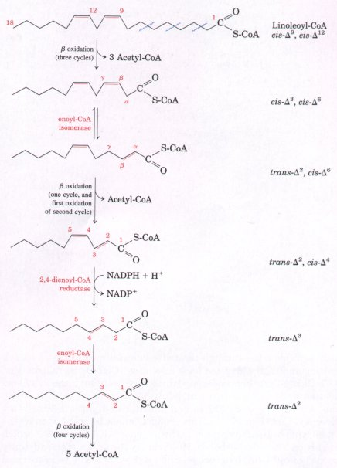
β-oxidation - PUFA
β-oxidation until cis- double bond is reached
Enoyl-CoA isomerase
  Moves double bond
2,4-dienoyl-CoA reductase
  Converts from cis to trans
β-oxidation continues
18-carbon linoleate (has a cis-Δ9,cis-Δ12 configuration).
Notes:
Linoleoyl-CoA undergoes three passes through the standard βoxidation sequence to yield three molecules of acetyl-CoA and the coenzyme A ester of a 12-carbon unsaturated fatty acid with a cis-Δ3,cis-Δ6 configuration. This intermediate cannot be used by the enzymes of the β-oxidation pathway; its double bonds are in the wrong position and have the wrong configuration (cis, not trans). However, the combined action of enoyl-CoA isomerase and 2,4-dienoyl-CoA reductase allows reentry of this intermediate into the normal β-oxidation pathway and its degradation to six acetyl-CoAs. The overall result is conversion of linoleate to nine molecules of acetyl-CoA.

Slide 74
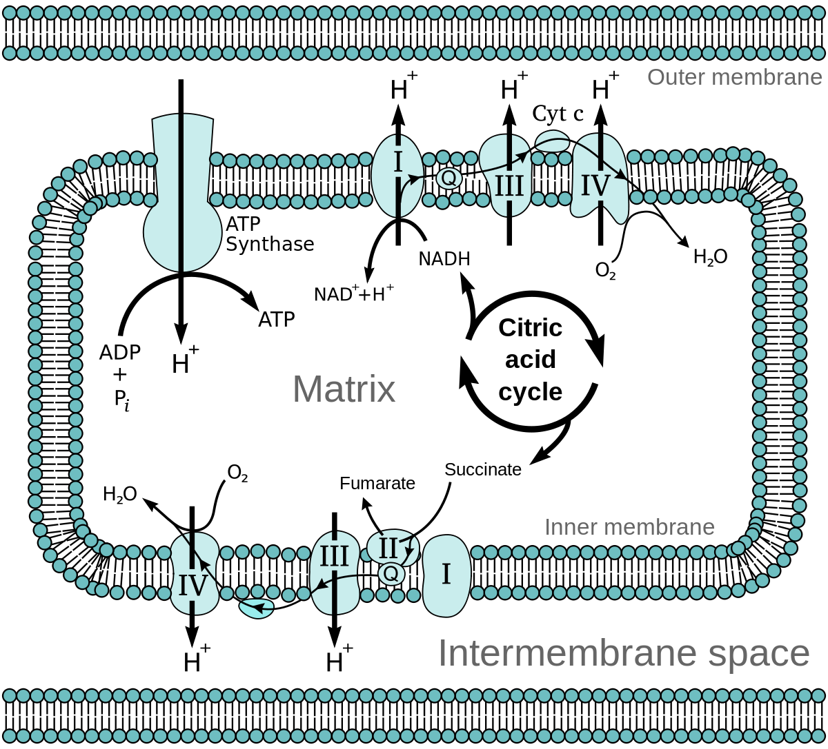
IV. β-oxidation – CAC & ETC
CAC needs oxaloacetate to accept acetyl-CoA
https://upload.wikimedia.org/wikipedia/commons/thumb/8/89/Mitochondrial_electron_transport_chain%E2%80%94Etc4.spng
Notes:
Metabolism of fat produces about 110 grams of water per 100 grams

Slide 75
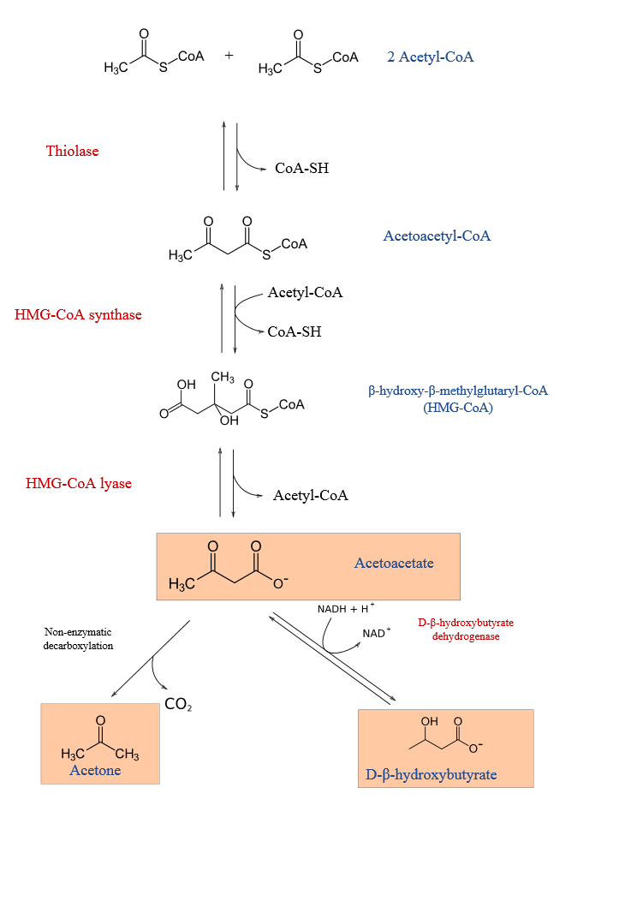
Ketogenesis
Notes:
The first enzyme in the ketone body synthesis pathway is thiolase (the same enzyme that is responsible for the cleavage step in b-oxidation)
HMG-CoA is also an intermediate in the synthesis of cholesterol

Slide 76
Ketone oxidation
The utilization of ketone bodies requires
  b-ketoacyl-CoA transferase
Lack of this enzyme in the liver prevents the futile cycle of synthesis and breakdown of acetoacetate.
Starvation causes the brain and some other tissues to increase the synthesis of b ketoacyl-CoA transferase, and therefore to increase their ability to use these compounds for energy.
Notes:
one enzyme not present in the ketone body biosynthetic pathway

Slide 77
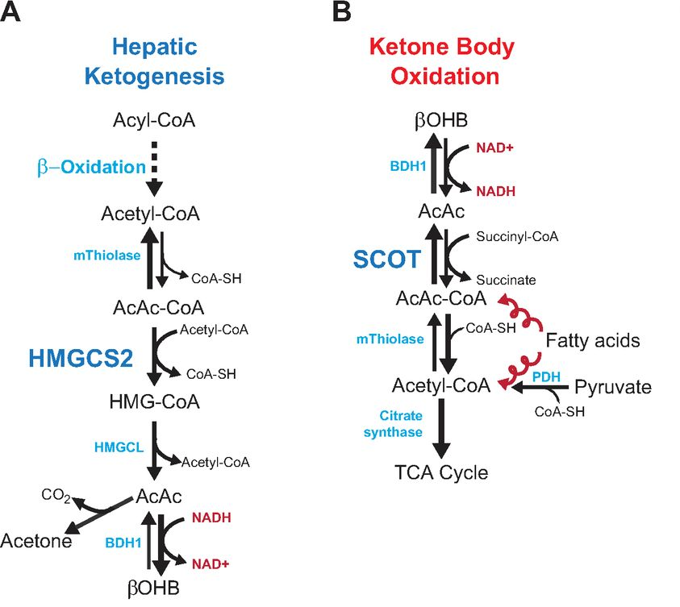
Ketone oxidation
http://ajpheart.physiology.org/content/ajpheart/304/8/H1060/F1.large.jpg

Slide 78
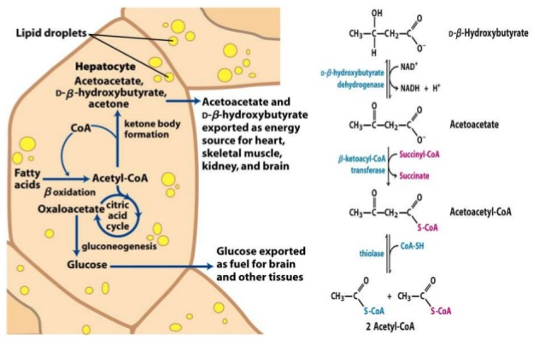
Ketone oxidation
https://image.slidesharecdn.com/betaoxidationproteincatabolism-140414150305-phpapp01/95/beta-oxidation-protein-catabolism-14-638.jpg?cb=1397487839

Slide 79
Overview
Fatty acid oxidation
Fatty acid synthesis
Regulation of lipid metabolism
Notes:
Fatty acid oxidation in mitochondria is responsible for providing energy to cells when glucose levels are low. Triacylglycerols stored in adipose tissue of most humans can supply energy to the body for ~3 months during starvation.
Fatty acid synthesis reactions in the cytosol of liver and adipose cells convert excess acetyl CoA that builds up in the mitochondrial matrix when glucose levels are high into fatty acids that can be stored or exported as triacylglycerols.

Slide 80
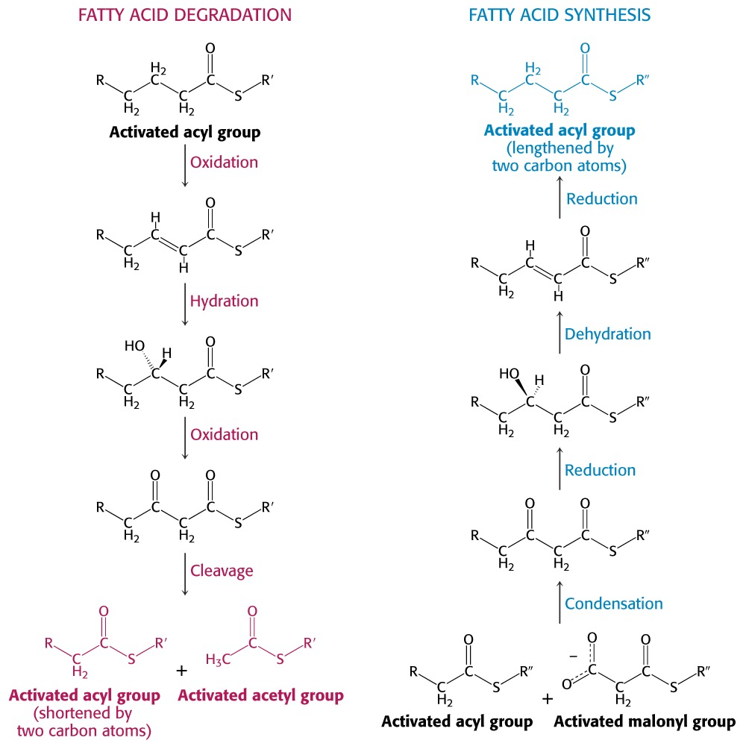
Notes:
Oxidize with double bond, hydrate, then oxidize again, then cleave. Oxidation and cleavage provides energy. The fatty acyl synthase, catalyzes the reversal of these reactions. Condenses, reduces, dehydrates, and reduces. Condensation requires activated precursors, reductions require that NADPH be converted to NADP+. The co reactants will be oxidized but the product is subsequently reversed

Slide 81
Location
Synthesised primarily in liver or adipose
  Some in intestinal mucosa and mammary gland
Tissue site of FA synthesis varies because of need for gluconeogenesis
  Fatty acid synthesis and gluconeogenesis compete for carbon, ATP and reducing equivalents

Slide 82
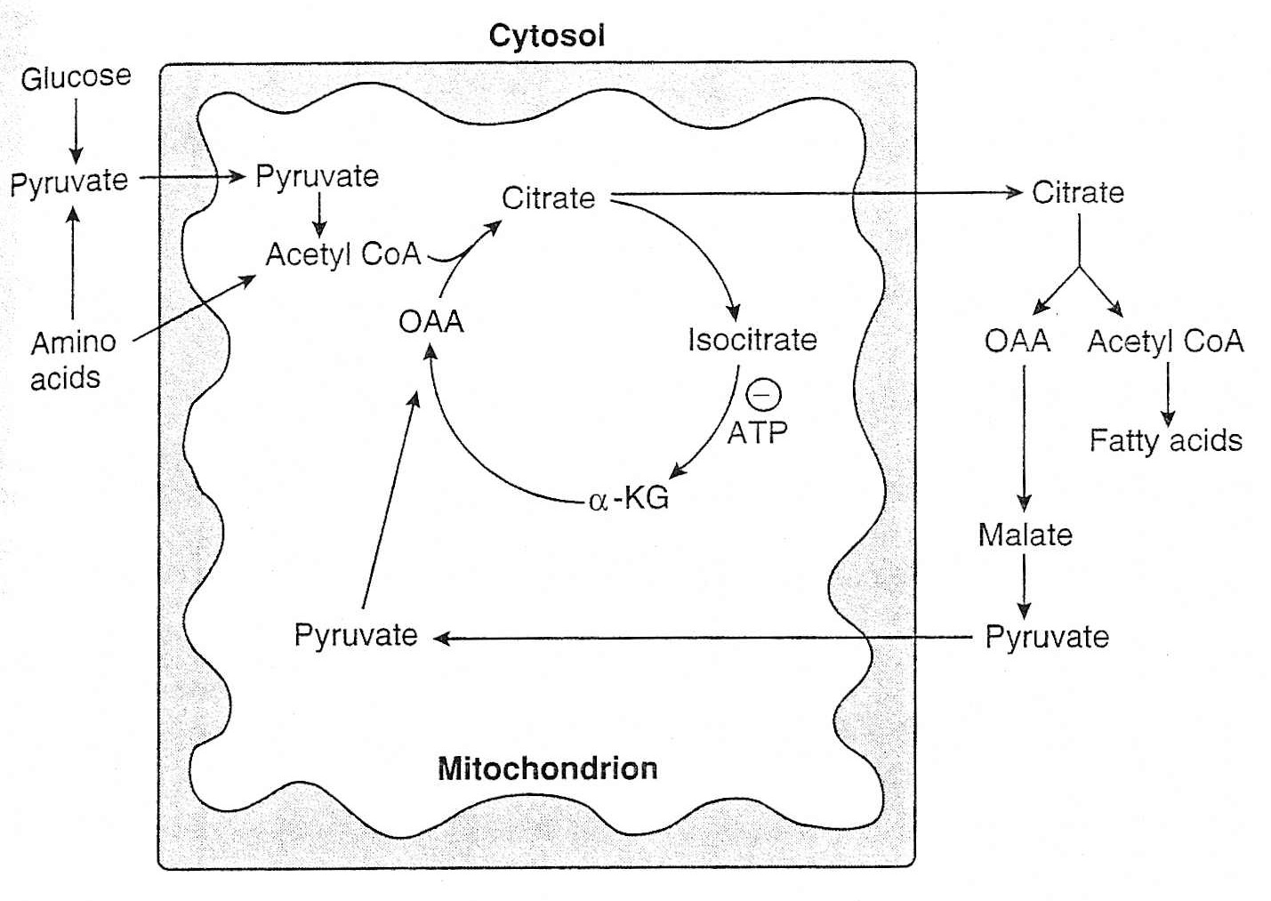
Fatty Acid Synthesis
Occurs in cytosol
Most acetyl CoA produced in mitochondria
  Mitochondria membrane is impermeable to acetyl CoA

Slide 83
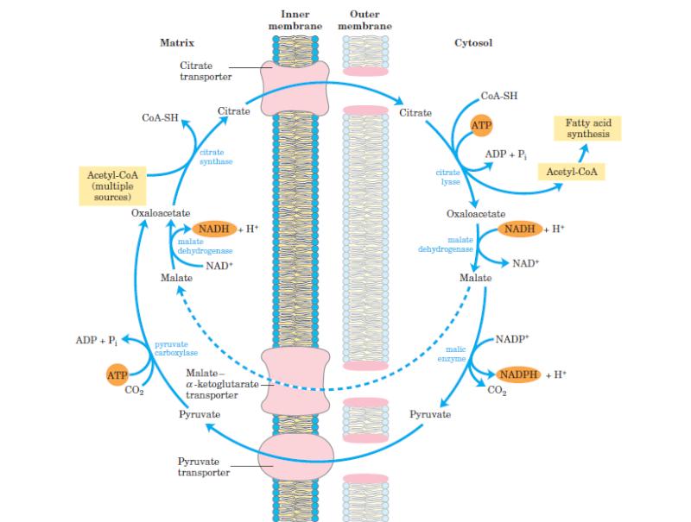
I. Citrate Shuttle –
Acetyl CoA Translocation
http://i18.servimg.com/u/f18/17/30/76/23/-09-0-10.png
Notes:
Acetyl CoA will accumulate when the ETS/oxidative phosphorylation slows. Acetyl-CoA is transported out of the mitochondrion to the cytosol where it can be used in fatty acid synthesis. This is accomplished using the tricarboxylate transport system in the inner mitochondrial membrane which pumps citrate out. Acetyl-CoA, of course is used in synthesis of citrate when combined with oxaloacetate. Citrate transferred into the cytosol is broken back to oxaloacetate and acetyl-CoA by ATP-citrate lyase (using ATP and CoA).

Slide 84
Sources of Carbon for Fatty
Acid Synthesis
 | Major Carbon Source
Chick | Glucose
Human | Glucose
Rat | Glucose
Pig | Glucose
Ruminant | Acetate
Notes:
How do we get for glucose to acetyl-CoA?

Slide 85
All carbon for FA synthesis originates from malonyl CoA except for primer carbon unit
Primer unit is either
  acetyl CoA (even chain)
  propionyl-CoA (odd chain)

Slide 86
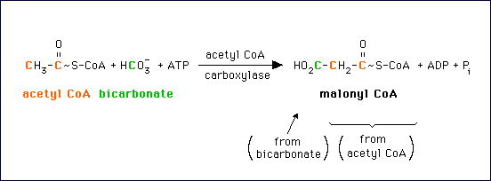
II. Carboxylation of Acetyl CoA
http://library.med.utah.edu/NetBiochem/mml/fa_carbase.gif
Notes:
The first committed step of fatty acid biosynthesis is catalyzed by Acetyl-CoA carboxylase. Malonyl-CoA serves as activated donor of acetyl groups in FA synthesis. Requires 1 ATP.

Slide 87
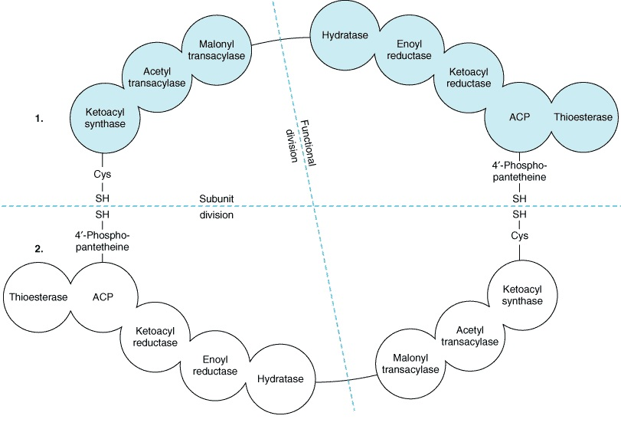
III. Fatty Acid Synthetase
As #C ↑, solubility ↓
Fatty acid synthase limits
  Max.16 C chain length
  Saturated fatty acids only
http://www.namrata.co/wp-content/uploads/2013/12/Fatty-acid-synthase-complex.jpg

Slide 88
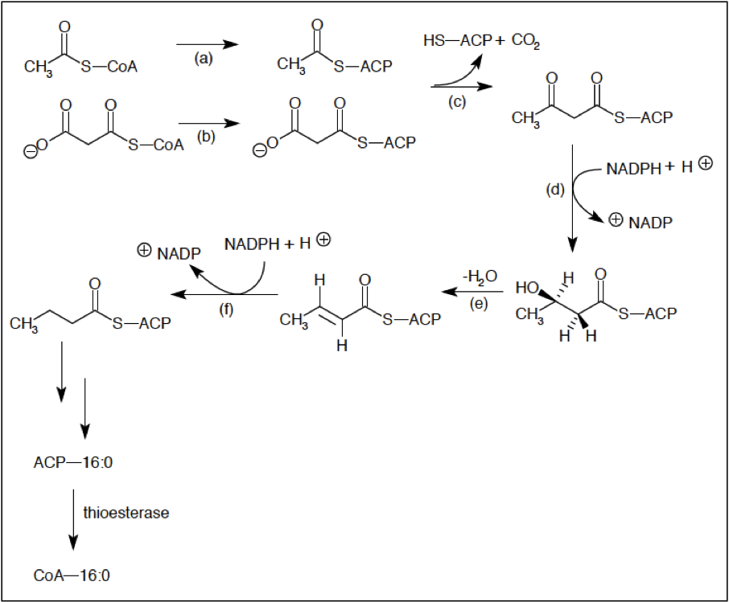
FA synthesis
Priming reaction
  acetyl-transacylase
  malonyl-transacylase
Condensation
  3-ketoacyl synthase
Reduction 1
  3-ketoacyl reductase
Dehydration
  3-Hydroxyacyl dehydrase
Reduction 2
  Enoyl reductase
Notes:
Priming is attachment of acetyl group and malonyl group (propionyl-CoA is used in priming ration instead of Acetyl CoA then get odd chain fatty acid)
condensation reaction between the acetyl group and the methylene group of malonyl residue
C-3 of the acetoacetyl moiety is reduced
double bond is created between C-2 and C-3 of the acyl residue
reduce the double bond in the acyl group in reaction 4

Slide 89
Cycle then repeats with 2 additional carbons being added from malonyl CoA
Sequence is terminated by thioesterase and the enzyme is relatively specific for FAs longer than 14 carbons
Most FAs released by FA synthetase contain 16 carbons (Palmitate)

Slide 90
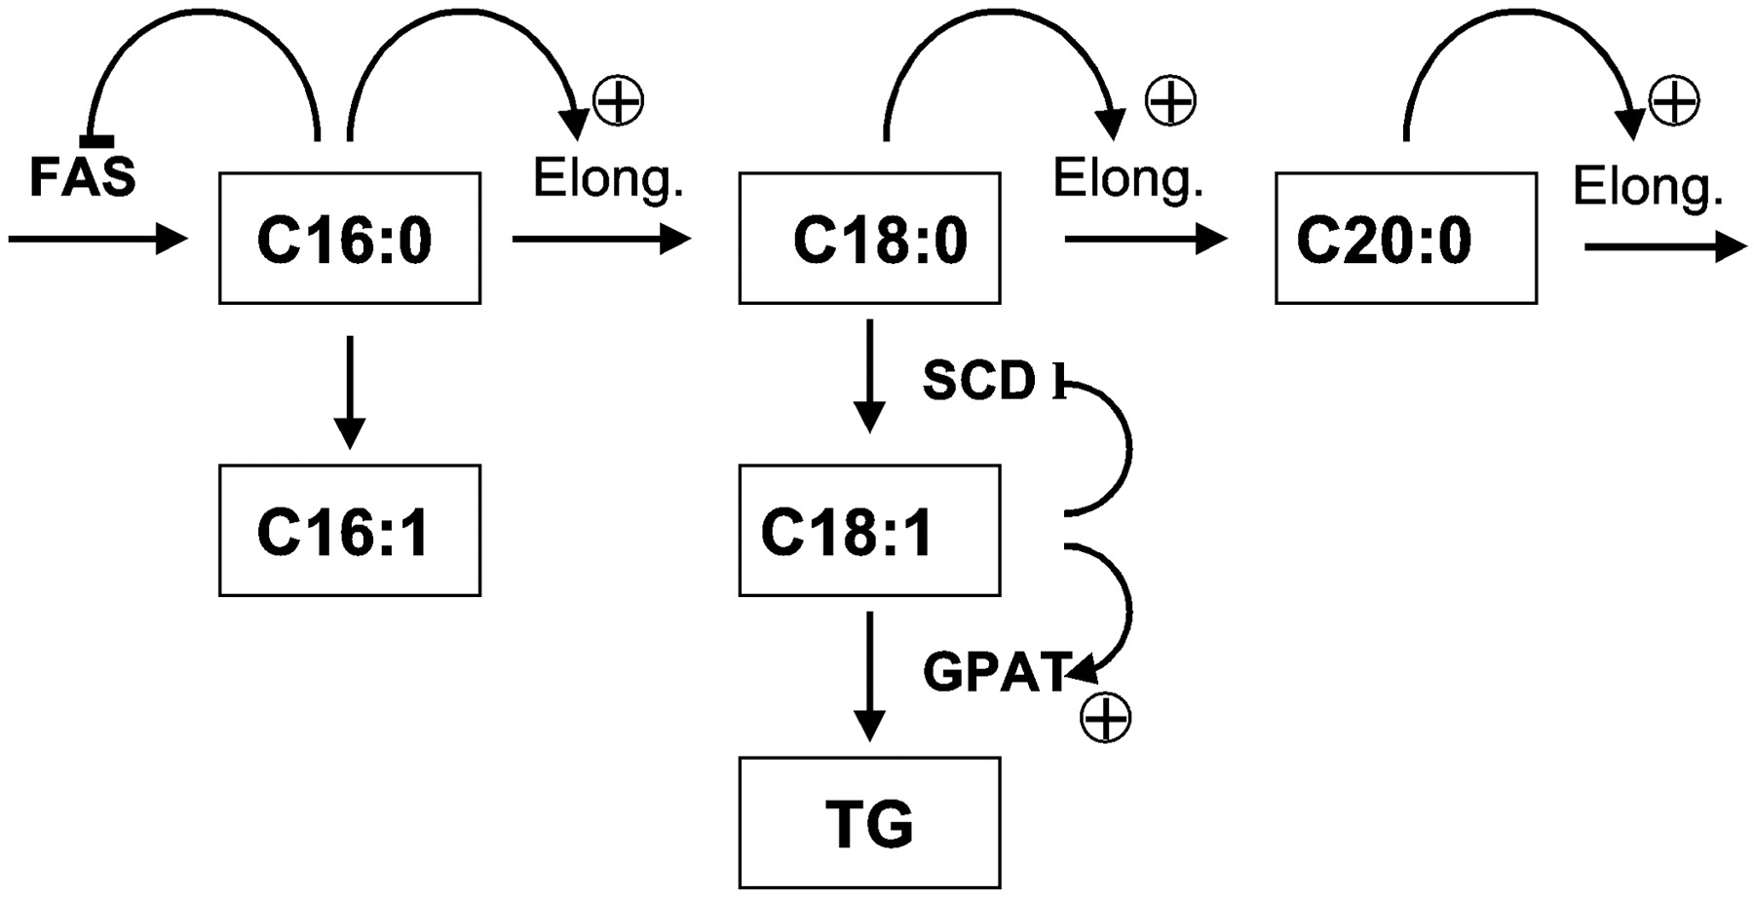
FA Synthesis – Beyond Palmitate
http://ajpendo.physiology.org/content/ajpendo/282/3/E507/F1.large.jpg

Slide 91
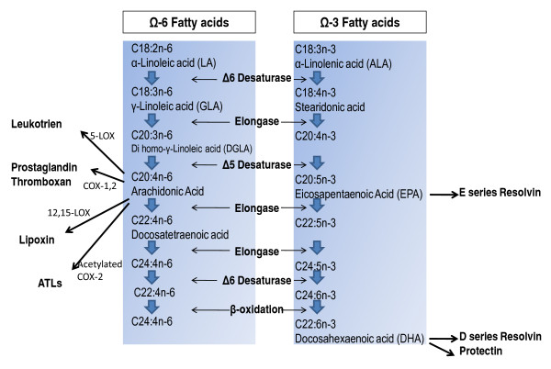
FA Synthesis - PUFA
https://www.researchgate.net/figure/224283775_fig4_Synthesis-of-unsaturated-fatty-acids-in-mammals-by-Desaturase-and-Elongase

Slide 92
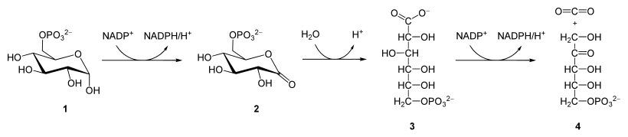
Sources of NADPH
Glucose-6-phosphate
6-phosphoglucono-δ-lactone
6-phosphogluconate
Ribulose 5-phosphate (used for DNA synth.)
https://upload.wikimedia.org/wikipedia/commons/thumb/8/8e/Ox_Pentose_phosphate_pathway.svg/820px-Ox_Pentose_phosphate_pathway.svg.png

Slide 93
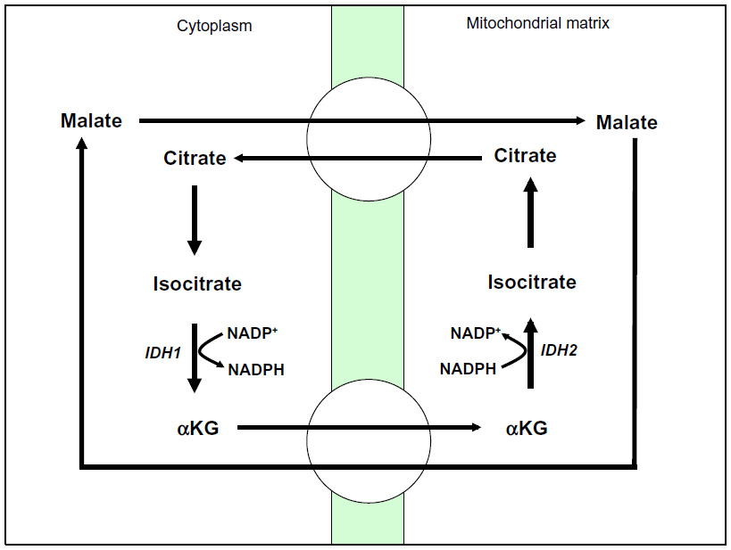
c. NADP Isocitrate Dehydrogenase (cytosol)
https://www.dovepress.com/cr_data/article_fulltext/s79000/79760/img/fig5.jpg

Slide 94
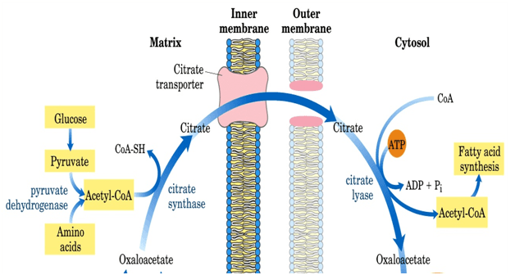
Fatty Acid Metabolism - Cells
http://www.namrata.co/de-novo-fatty-acid-synthesis-a-quick-revision-part-1/

Slide 95
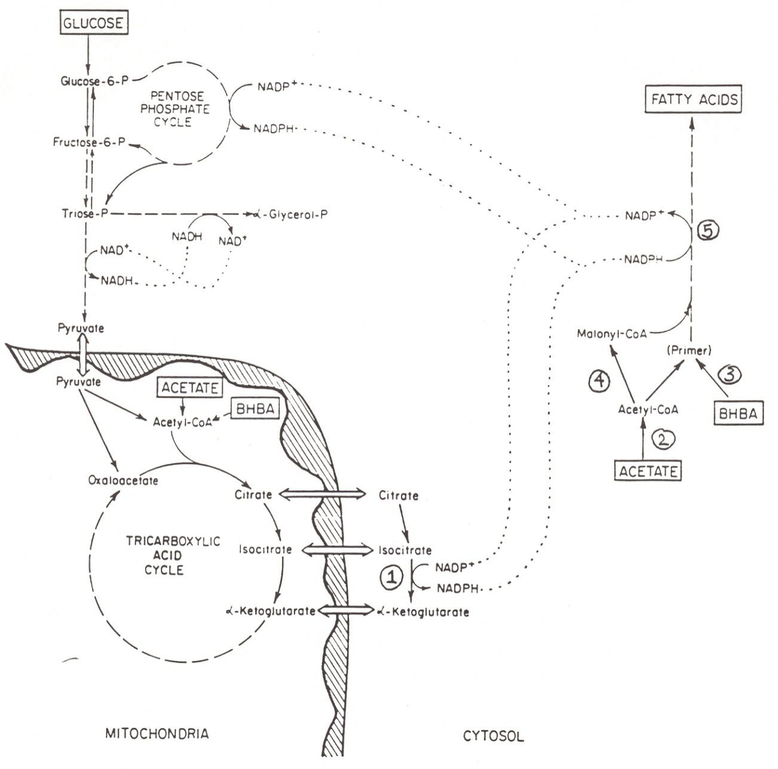
Fat Synthesis in Ruminants
NADP isocitrate dehydrogenase
Acetyl-CoA synthase
Butyryl-CoA synthase
Acetyl-CoA carboxylase
Fatty acid synthase
5
4
3
2
1

Slide 96
What is the significance of adult ruminants having:
Little ATP citrate lyase
Low amounts of NADP Malic Enzyme
Notes:
This means that glucose is not used for FA
They must rely on isocitrate dehydrogenase for NADPH

Slide 97
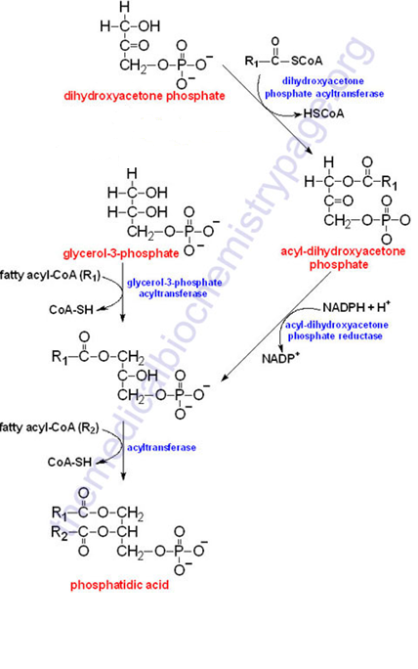
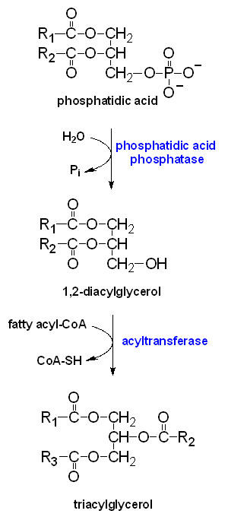
Phosphatidic acid Synthesis
Triglyceride Synthesis
Notes:
In the first part of the process, a fatty acyl-CoA is linked to carbon #1 of dihydroxyacetone phosphate (DHAP) or glycerol-3-phosphate (Gly3P) by either dihydroxyacetone phosphate acyltransferase (for DHAP) or glycerol-3-phosphate acyltransferase (for Gly3P). The product of the reaction for Gly3P is lysophosphatidic acid (LPA)The product of the DHAP reaction (acyl-dihydroxyacetone phosphate) can be converted to the product of the Gly3P reaction (lysophosphatidic acid) by NADPH and acyl-dihydroxyacetone phosphate reductase. Lysophosphatidic Acid (LPA) is acylated (with an acyl-CoA) at carbon #2 by 1-acylglycerol-3-phosphate acyltransferase to produce phosphatidic acid. The phosphate of phosphatidic acid is removed by phosphatidic acid phosphatase, forming diacylglycerol. Diacylglycerol is converted to triacylglycerol (with acyl-CoA, of course) by diacylglycerol acyltransferase. The fatty acids incorporated into TAGs are activated to acyl-CoAs through the action of acyl-CoA synthetases. Intestinal monoacylglycerols, derived from the hydrolysis of dietary fats, can also serve as substrates for the synthesis of 1,2-diacylglycerols.

Slide 98
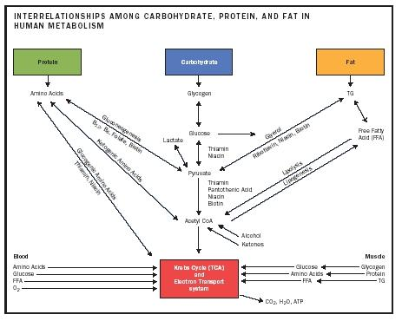

Slide 99
Overview
Fatty acid synthesis
Fatty acid oxidation
Regulation of lipid metabolism
Notes:
Fatty acid oxidation in mitochondria is responsible for providing energy to cells when glucose levels are low. Triacylglycerols stored in adipose tissue of most humans can supply energy to the body for ~3 months during starvation.
Fatty acid synthesis reactions in the cytosol of liver and adipose cells convert excess acetyl CoA that builds up in the mitochondrial matrix when glucose levels are high into fatty acids that can be stored or exported as triacylglycerols.

Slide 100
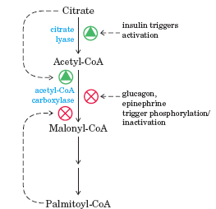
Regulation of FA synthesis:
Acetyl CoA Carboxylase
Allosteric regulation
  Stimulated by citrate
    Feed forward activation
  Inhibited by palmitoyl CoA
    High B-oxidation (fasted state)
Covalent regulation
  Induced by insulin
  Repressed by glucagon

Slide 101
Regulation of Lipolysis –
Sympathetic Nervous System
Major stimulator of FA mobilization when there is a sudden demand for energy such as in:
  Exercise
  Exposure to cold
  Frightening or stressful situations
Rapid effect but of short duration
Notes:
A = Increased Epinephrine, B = increased Norepinephrine, C = Increased Epinephrine

Slide 102
Regulation of Lipolysis –
Lipolytic Hormones
Fast-acting hormones
  Epinephrine, Norepinephrine, ACTH, Thyroid stimulating hormone (TSH), Glucagon
    Act rapidly and their effect is of short duration
Slow-acting hormones
  Growth Hormone, Glucocorticoids
  Time lag of 1-2 hours after administration
    Effects last for several hours
  Action is blocked by inhibiting RNA or protein synthesis
Notes:
ACTH = Adrenocorticotropic hormone
Glucagon, norepinephrine, and epinephrine bind to G protein-coupled receptors that activate adenylate cyclase to produce cyclic AMP. As a consequence, cAMP activates protein kinase A, which phosphorylates (and activates) hormone-sensitive lipase.

Slide 103
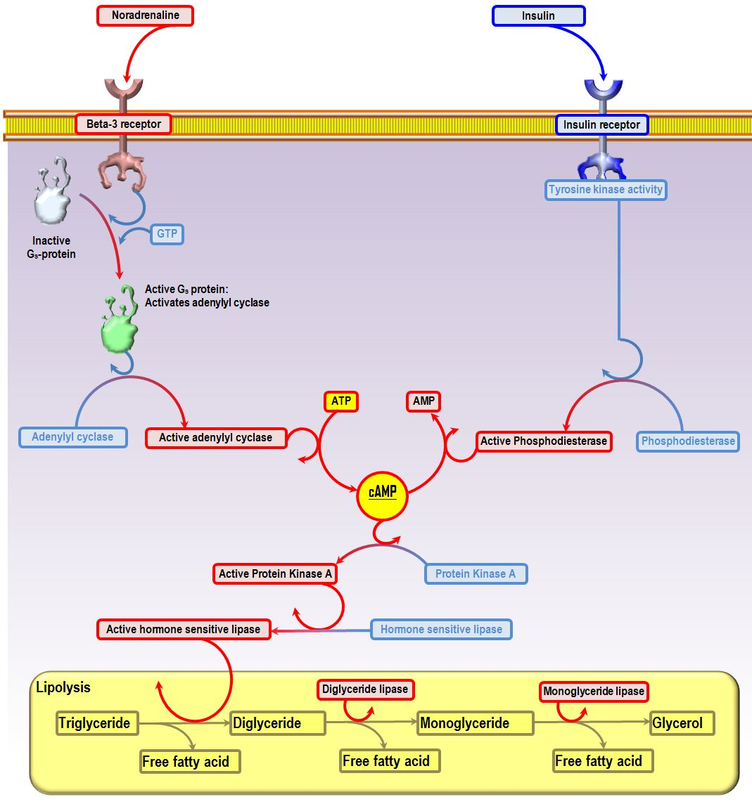
Action of these hormones is unaffected by blocking RNA or protein synthesis
http://www.derangedphysiology.com/php/
nutition-and-malnutrition/images/
second%20messenger%20systems%20i
nvolved%20in%20activation%20of%20hormone-sensitive%20lipase.JPG

Slide 104
Regulation of Lipolysis –
Lipolytic Hormones
Inhibitory hormones
  Insulin
    Acts on phosphodiesterase
  Prostaglandins E2 and E1
    Blocks effects of norepinephrine and epinephrine on cAMP

Slide 105
Regulation of Lipolysis –
Dietary Effects
Fasting increases lipolysis
    Lack of glucose for glycerol 3-P
    Shortage of ATP for activation of FA
High CHO diet decreases lipolysis
High fat diet/low CHO
    May increase release of FA due to lack of glucose
Notes:
Remember mobilization is a balance between breakdown and resynthesis so anything that inhibits resynthesis will result in mobilization

Slide 106
Regulation of Lipid Metabolism
Feeding
  CAT-1 allosterically inhibited by malonyl-CoA
  ACC allosterically activated by citrate
  net effect: FA synthesis
Starvation
  ACC inhibited by FA-CoA
  no malonyl-CoA to inhibit CAT-1
  net effect: FA oxidation
Notes:
Why is citrate imporatant?
Why is Malonyl –CoA important?
[Citrate] is high when there is adequate acetyl-CoA entering Krebs Cycle.
Excess acetyl-CoA is then converted via malonyl-CoA to fatty acids for storage.

Slide 107
Why would free fatty acids decrease in the blood after you eat?
Notes:
The reason free fatty acids in blood decreases when you eat is because a increase in glucose allows adipose tissue to uptake glucose and therefore start using FA to reform triglycerides. Also you have increased insulin which causes a decrease in HSL activity (net balance skewed toward synthesis)

