Slide 1
Challenging Students’ Ways of Knowing and Thinking
CETL HIP Workshop on Critical Thinking
February 22, 2024

Slide 2
Framework and goals
At the heart of the teaching and learning enterprise --and a liberal education itself-- is the development of independent, creative, and critical thinking and thinkers.
Indeed, the fundamental mission of the university is to preserve, extend, and promote these skills.
Further, our general education program emphasizes the cultivation of independent learners who appreciate and respect diverse identities and perspectives in multiple contexts.
In this session, we will examine strategies to build these skills, to liberate learning and thought, and to challenge intellectual deference and indifference.

Slide 3
The big picture
Critical Thinking is…
“the intellectually disciplined process of actively and skillfully conceptualizing, applying, analyzing, synthesizing, and/or evaluating information gathered from, or generated by, observation, experience, reflection, reasoning, or communication, as a guide to belief and action.” (https://www.criticalthinking.org/pages/defining-critical-thinking/766)
Critical Reflection is…
“the active, persistent and careful consideration of any belief or supposed form of knowledge in the light of the grounds that support it, and the further conclusions to which it tends”. Dewey, J. (1910). How we think.
The challenge is NOT to get students to simply accept what we say, but to question their own thoughts, assumptions, and conclusions in light of evidence, no matter how unsettling. This entails identifying and overcoming ignorance and occasionally arrogance.
The question is: How do we get students to accept this? What kind of assignments work?

Slide 4
Let’s unpack the problem
And consider strategies to overcome them

Slide 5
Imagine the student’s perspective: a quiz
When you think about incoming students, what do you think their definition of learning is?
What do you think their impression of good teaching is?
Do our students come in with high strong thinking skills?
Is it wise to inquire about the impact and sources of their knowledge?
Are students averse to challenging their knowledge and ways of knowing?
Why?
What can we do?

Slide 6
Complete this sentence:
I want/need my students to ______________________,
but they _____________________.
What are the tell-tale signs of uncritical thinking?
What are the consequences of it?

Slide 7
The basics of critical thinking and how to integrate them in non-threatening ways
Observation
Notice and predict phenomena and solutions
Analysis
Gather, understand, interpret information
Inference
Draw conclusions based on data and experience
Communication
Share findings and information
Problem Solving
Pulling it all together to create a solution
Ultimately, we want our students to think and reason with an open mind and a modicum of intellectual humility.
We want them to draw conclusions based on logic, reason, and evidence, not mere opinion. We want them to learn.
Missing from this diagram is logic and reasoning. It is implied but needs to be explicit.
This model isn’t very “human”
Is the goal always to solve a problem?
There are pros to it, though, and we should think about Bloom’s Taxonomy here as well.

Slide 8
Let’s walk through some instructional critical thinking steps. What can we do at each stage?
Steps/stages
Strategies
Content exposure/phenomena observation
Consider possibilities
Challenge assumptions
Suspend judgment
Data over beliefs
Retest ideas
Defend conclusions
Revise conclusions?
How?
How?
How?
How?
How?
How?
How?
How?

Slide 9
Additional Challenges
And Solutions

Slide 10
This is important…
Ignorance is commonly defined as the lack of knowledge, experience, information, or education: the opposite of wisdom.
“It is certain, in any case, that ignorance, allied with power, is the most ferocious enemy justice can have”
James Baldwin
Often, we define our role and our goal as battling against ignorance. There are challenges here, to be sure –with new content, students sometimes don’t know what they don’t know. Further, it is hard to get students to let go of what “feels” right even when it is wrong. But consider this:
“The greatest enemy of knowledge is not ignorance; it is the illusion of knowledge”
Stephen Hawking

Slide 11
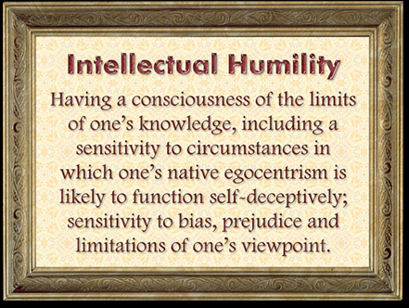
https://www.zmescience.com/science/the-dunning-kruger-effect-feature/
Why Facts Don’t Change Our Minds
Intellectual humility: the importance of knowing you might be wrong
Why it’s so hard to see our own ignorance, and what to do about it.

Slide 12
Incompetence → Competence
How do we guide the steps?
This can be imagined as moving from “oh no!” to “aha!” to “damn, this requires effort”, to “woohoo!”
What can we do at each stage?
Note the applicability to both the class and the curriculum.
Unconscious Incompetence
Conscious Incompetence
Conscious Competence
Unconscious Competence
How does critical thinking and existing knowledge come into play, here?

Slide 13
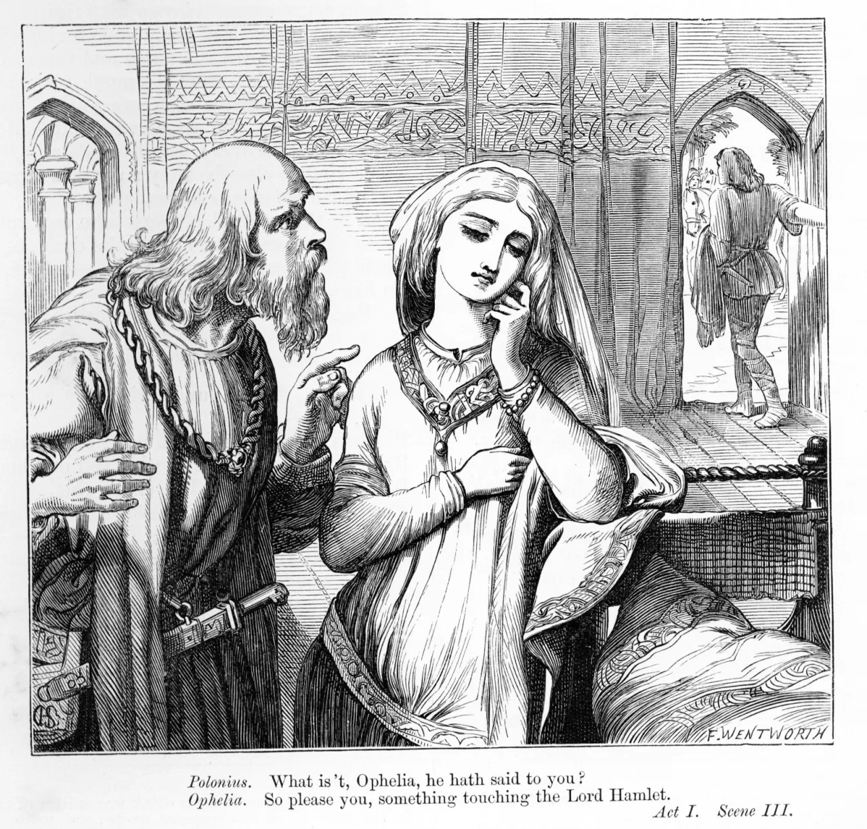
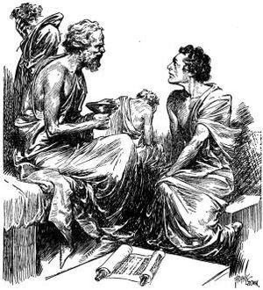
Ophelia & Meno
Act 1, Scene 3, Hamlet.
Ophelia: “I do not know, my lord, what I should think.”
Polonius: “I’ll teach you. Think yourself a baby…”
Problem: Teacher gives answers, not questions; does not allow or encourage independent thinking.
Things do not end well for Ophelia.
Don’t be a Polonius.
Plato’s Meno.
Context: An uneducated person can, with proper guidance/challenge, solve difficult problems.
Teachers don’t give answers; students discover them. This requires effort.
Teachers are patient facilitators.
Students must set a lot aside and be curious.
Students aren’t always curious.
.

Slide 14
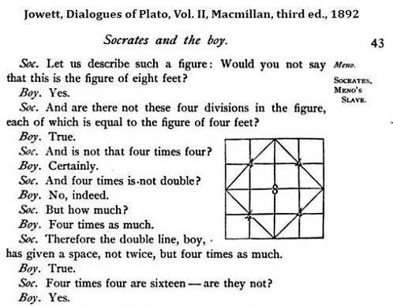
So, what do we need to succeed?
Good questions
Good examples
Good experiences/assignments
Good feedback
Timely indicators of success and failure, insight and oversight

Slide 15
Seven things to add to your to-do list
Foster the development of reasoning skills. This emphasizes the ability to think logically, identify assumptions, gather and evaluate evidence and arguments, and analyzing those data and arguments.
Avoid close-ended questions. Open-ended questions open the floor and mind to curiosity, research, “what ifs”, and “what abouts”. Questions are more “How would you?” than “Tell me the answer”.
Think about learning through research, requiring and helping students develop not only good answers based on extant literature, but good questions about topics and phenomena.
Learn through diversity. Create assignments and activities that require the examination of phenomena through and from multiple different perspectives.
Empower students to link prior learning and experiences to current actions and assignments.
Work with the library to help students understand and rely upon suitable forms of evidence and scholarship.
Provide opportunities for students to think about their thinking and learn about their learning. This is the heart of metacognition and self-regulated learning.

Slide 16
Strategies. Remember to set the rules!
Discussions
Debates
Simulations
Case-based learning
Problem-based learning
Reading, writing, research
Experiments
Experiential learning
Journals
Peer review
Cognitive (and affective) wrappers
What else?

Slide 17
DEALing with critical thinking
Critically assess
Who
What
When
Where
Why
How
Incorporate aspects of the DEAL model into your assignments:
Describe an experience
Examine it through the lens of academic concepts or strategies
Articulate Learning by explaining what was learned, how, when, and why it matters.
Give students space to discuss how, when, and why their assumptions were either validated or challenged and what they did about it.

Slide 18
What about indifference? The value and limitations of attention
The average attention span of a student?
8-15 minutes?
That’s a fair, research-based range, but do note that credible scholars of teaching and learning question some of the methods and therefore the results, and there is no uniformity of effect within and across learning environments and experiences. But we can agree, it’s pretty short. How short?
3-4 minutes? 30 seconds??
“Attention lapses” occur frequently, and in the 3-4 minute range, and even after about 30 seconds (Imagine the scenarios in which this might occur).
It gets worse the longer and larger a class is
Why?
What do we do?
How do we engage in deep learning knowing that attention wanes so rapidly?

Slide 19
Re-think Our Value and Their Motivation
“As faculty, if we are primarily concerned with transmitting content, then our value will only decrease. The Internet contains a much broader selection of lectures, demonstrations, animations, and examples on more subjects, in more languages, and with a greater variety of approaches, methods, and pedagogies than any professor, department, or even entire university can provide. If, however, we are more concerned with faculty-student interaction; the design and sequence of learning experiences; the application, analysis, and synthesis of information; the motivation of students; and, especially, the increasing complexity of students’ mental models, then the value of what we do will increase.”
“The good news is that the greatest value of a physical university will continue to be its provision of face-to-face (naked) interaction between faculty and students. The first role of technology, therefore, is to create more time for such interaction. At a very basic level, new technologies can increase student preparation and engagement between classes and create more time for the (naked) in-class dialogue that makes the campus experience worth the extra money it will always cost to deliver. The most important benefits of using technology occur outside of the classroom.”
https://www.aacu.org/liberaleducation/2014/spring/bowen

Slide 20
Bring it on home
When you think about your classes, keep the student entry point in mind.
1
Don’t shame students for what they don’t yet know, or even for being wed to a conclusion without evidence.
2
Frame and provide learning experiences as devices to build an essential skill.
3
Prioritize their learning and teach for that goal.
4
Provide the instructions and guidance necessary for discovery and change to take place.
5

Slide 21
Resources
On how to disagree: https://www.nytimes.com/2017/09/24/opinion/dying-art-of-disagreement.html?mcubz=3
On how to argue constructively: https://www.theatlantic.com/.../erisology-the.../586534/
On creativity: https://www.podbean.com/media/share/pb-rq73v-e26fab?utm_campaign=au_share_ep&utm_medium=dlink&utm_source=au_share and https://qz.com/quartzy/1381916/drawing-is-the-best-way-to-learn-even-if-youre-no-leonardo-da-vinci/?fbclid=IwAR2YOYJh3UiIbqZ2q3i2pXo5ZPw1B1N6oBQJ8BVTks9dySJDI6Rq40yJmP0
On intellectual humility: https://www.vox.com/science-and-health/2019/1/4/17989224/intellectual-humility-explained-psychology-replication?fbclid=IwAR04E0yPnR3gGcmgOVtM7hB80OM9cdeS2cFYN52TdhQtaFkxvnFTWpWFQwU
On why facts don’t change our minds: https://www.newyorker.com/magazine/2017/02/27/why-facts-dont-change-our-minds?utm_social-type=owned&mbid=social_facebook&utm_brand=tny&utm_source=facebook&utm_medium=social&fbclid=IwAR2_iH9WGpKHVrLPz4VbwyAqPQi_blEV3GyPtKlyKJCzZ1aZN1kD8Icc9Nk
On teaching students how to learn: https://www.insidehighered.com/advice/2019/02/19/advice-faculty-members-how-teach-students-how-learn-opinion#.YFomcVOQ3a8.link

