Slide 1
Aiming High: Setting and Achieving High Standards
CETL High Impact Practices Workshop Series
Session 1
September 7, 2023

Slide 2
Context

Slide 3
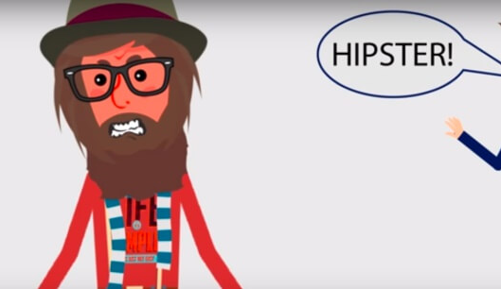
Learning can be HIP!
High Impact Practices enhance the academic success, persistence, and retention of students.
Research supports their positive effect, most notably among historically underserved populations.
They’re typically fun but can also take students out of their comfort zones.
Some Examples:
Learning through diversity
Real-world experiences
Culminating experiences
Undergraduate research
Collaborative assignments
Community-engaged learning
Simulations
Writing-intensive classes

Slide 4
This Year’s Series Focuses on the Teaching and Learning Experiences that Make HIPS Work
Aiming High: Setting and Achieving High Standards
9/7/23
Scaffolding the Learning Process
10/4/23
Meaningful Interactions: The Key to Engaged Learning
11/2/23
Challenging Students’ Ways of Thinking and Knowing
12/7/23
Timely and Meaningful Feedback: Simple yet Essential Steps to Student Success
1/18/24
Making Time for the Learning to Happen: Opportunities and Strategies for Reflection and Integrated Learning
2/1/24
Make it Matter: Real World Scenarios, Applications, and Experiences
3/7/24
Show What you Know: The Value and Practice of “Going Public” with Learning
4/4/14
STUDENT SUCCESS CONFERENCE: SEPTEMBER 21, 2023!

Slide 5
A Framework
The Ophelia Syndrome, The Pygmalion Effect, Plato’s Meno, and Mindset

Slide 6
The Ophelia Syndrome
Hamlet, Act 1, Scene 3
Laertes to Ophelia: “the best safety lies in fear”
Confused –she “does not understand [herself] so clearly”—she turns to Polonius and says: “I do not know, my lord, what I should think”.
Polonius: “I’ll teach you. Think yourself a baby…”
Things do not end well for Ophelia
What’s the problem and application to teaching and learning, here?

Slide 7
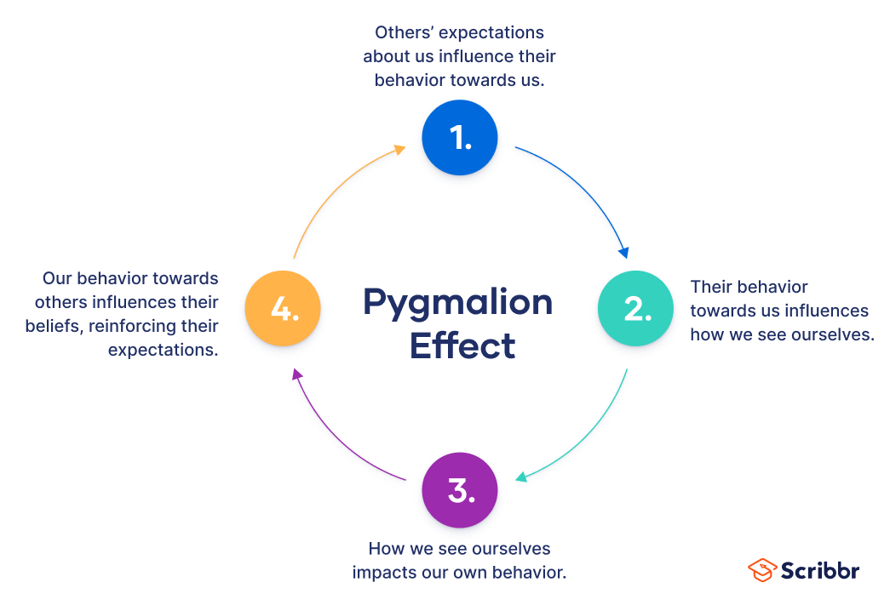
The Pygmalion Effect
Higher expectations result in increased performance:
Students do better when more is expected of them!
When we aim high, they aim high. When we aim low, they aim low.
Clearly articulated and consistently applied expectations create an atmosphere conducive to learning.
It’s all about the effects of expectations and this requires:
A positive climate and tone –we need to set it!
Appropriate and equitable learning opportunities
Consistent engagement
Meaningful feedback
An awareness of the learning process, not just the product
The standards must be both high and appropriate
Do we make time for this and consider how our behaviors and expectations influence student engagement and performance? Examples?

Slide 8
From Meno to Mindset
Plato, Socrates, and Meno
Mindset
Virtue –can it be taught, is it acquired by practice, or is it a natural trait?
Geometry –the foundation of “the Socratic Method”: it can be taught, and it can be learned. We can facilitate the learning.
This requires good questions, consistent engagement, persistence, quality feedback, validation…and patience.
How/do you do this?
“The view you adopt of yourself profoundly affects the way you lead your life”

Slide 9
Why Mindset Matters
At this stage of their development, many students haven’t (yet) had the opportunity to think about their thinking and learn about their learning.
Further: “…research on younger undergraduate students reveals [that] students take little or no responsibility for their own learning, blaming their shortcomings in achievement on their ‘ineffective’ instruction and the ‘too advanced’ or irrelevant course… Reinforcing their avoidance of responsibility for their learning is their widespread belief that learning should not require effort” --Linda Nilson, Creating Self-Regulated Learners.
What are the implications of/solutions to this?

Slide 10
Pulling it all Together
Exploring the Intersections and
Strategies to Set, Maintain, and Attain High Standards

Slide 11
Setting, Maintaining, and Attaining High Standards
Set
How do we set high yet appropriate expectations?
Where do we communicate them?
When do we communicate them?
Maintain
How do we demonstrate consistency of application?
Where in our courses (documents and discussions) do we show this?
When, in the narrative arc of the class, are we tempted to yield or stay true?
Attain
How do we help students attain these goals?
Where do we express and share support?
When do we take and relinquish the lead?

Slide 12
Exercise 1: Set, Maintain, Attain
How do you set, maintain, and attain standards in your professional work?
How do you set, maintain, and attain standards for your students?
Are they high?
Are there intervals by which you measure your success?
Is there accountability?
What are your motivations?
Intrinsic and extrinsic forces?
Go back to the how, when, and where prompts for setting, maintaining, and attaining high standards and further consider this: how do you know if your standards are high or low? What pathways to success are you providing?

Slide 13
The Easy Stuff and the Hard Stuff
It’s fairly easy to develop, articulate, and communicate high course-appropriate standards.
It’s a little more difficult to stick to them, but we should --with a positive and supportive tone.
It’s a lot more difficult to help students to attain them.
Why?
Students have aversions
Students may not want to succeed at the level we desire or expect
Students can become demoralized
So can we
So, what do we do?

Slide 14
Positive Framing –and Exercises-- to Support a Growth Mindset

Slide 15
Help Students DEAL with Learning
D | E | AL
DESCRIBE the learning experience. Think: What? Where? Who? When? Why | EXAMINE the experience through the lens of academic concepts, theories, or strategies EG: Culturally Responsive Pedagogy, UDL, Course Learning Goals | ARTICULATE LEARNING by discussing and explaining what you learned, when you learned it, how you learned it and why it is important –to you and the field!-- and what you can/will do differently because of it.

Slide 16
Deploy Simple Engagement Strategies to Discover what Students Know, Don’t Know, & Need to Know
Strategy | Description
CATs and LATS, like “quick quizzes” | Set aside a few minutes of class time for low-stakes quizzes and exercises to help students practice retrieving and processing newly learned information.
Distributed Practice | Allow students to work on skills and knowledge acquisition over time. Scaffold learning!
The Productive Struggle | The one who does the work does the learning, so offer challenging tasks that require creative and/or critical thinking.
3-2-1 | Let students write down 3 things they learned (potentially from the previous class session), 2 things they found interesting, and 1 thing they have questions about.
Ticket In-and-Out the Door | Have students present a question or finding from previous session to current session, and at the end, share one thing they learned or didn’t quite grasp today.
Learning Journals | Parallel to assignments, learning journals provide a place for students to write, share, and reflect on their progress. They can note, and you can discuss, problem areas and solutions.
Problem/Project-Based Learning | Teamwork is often better than groupwork, and this reinforces accountability, problem-solving, and mutual growth and development.
How I Learned, not What I Learned | Retrieval is critical to new learning, but don’t let the students rely on you as the source of all knowledge and information! Learning is about discovery. Get them to think about how they learn, not just what they learn.

Slide 17
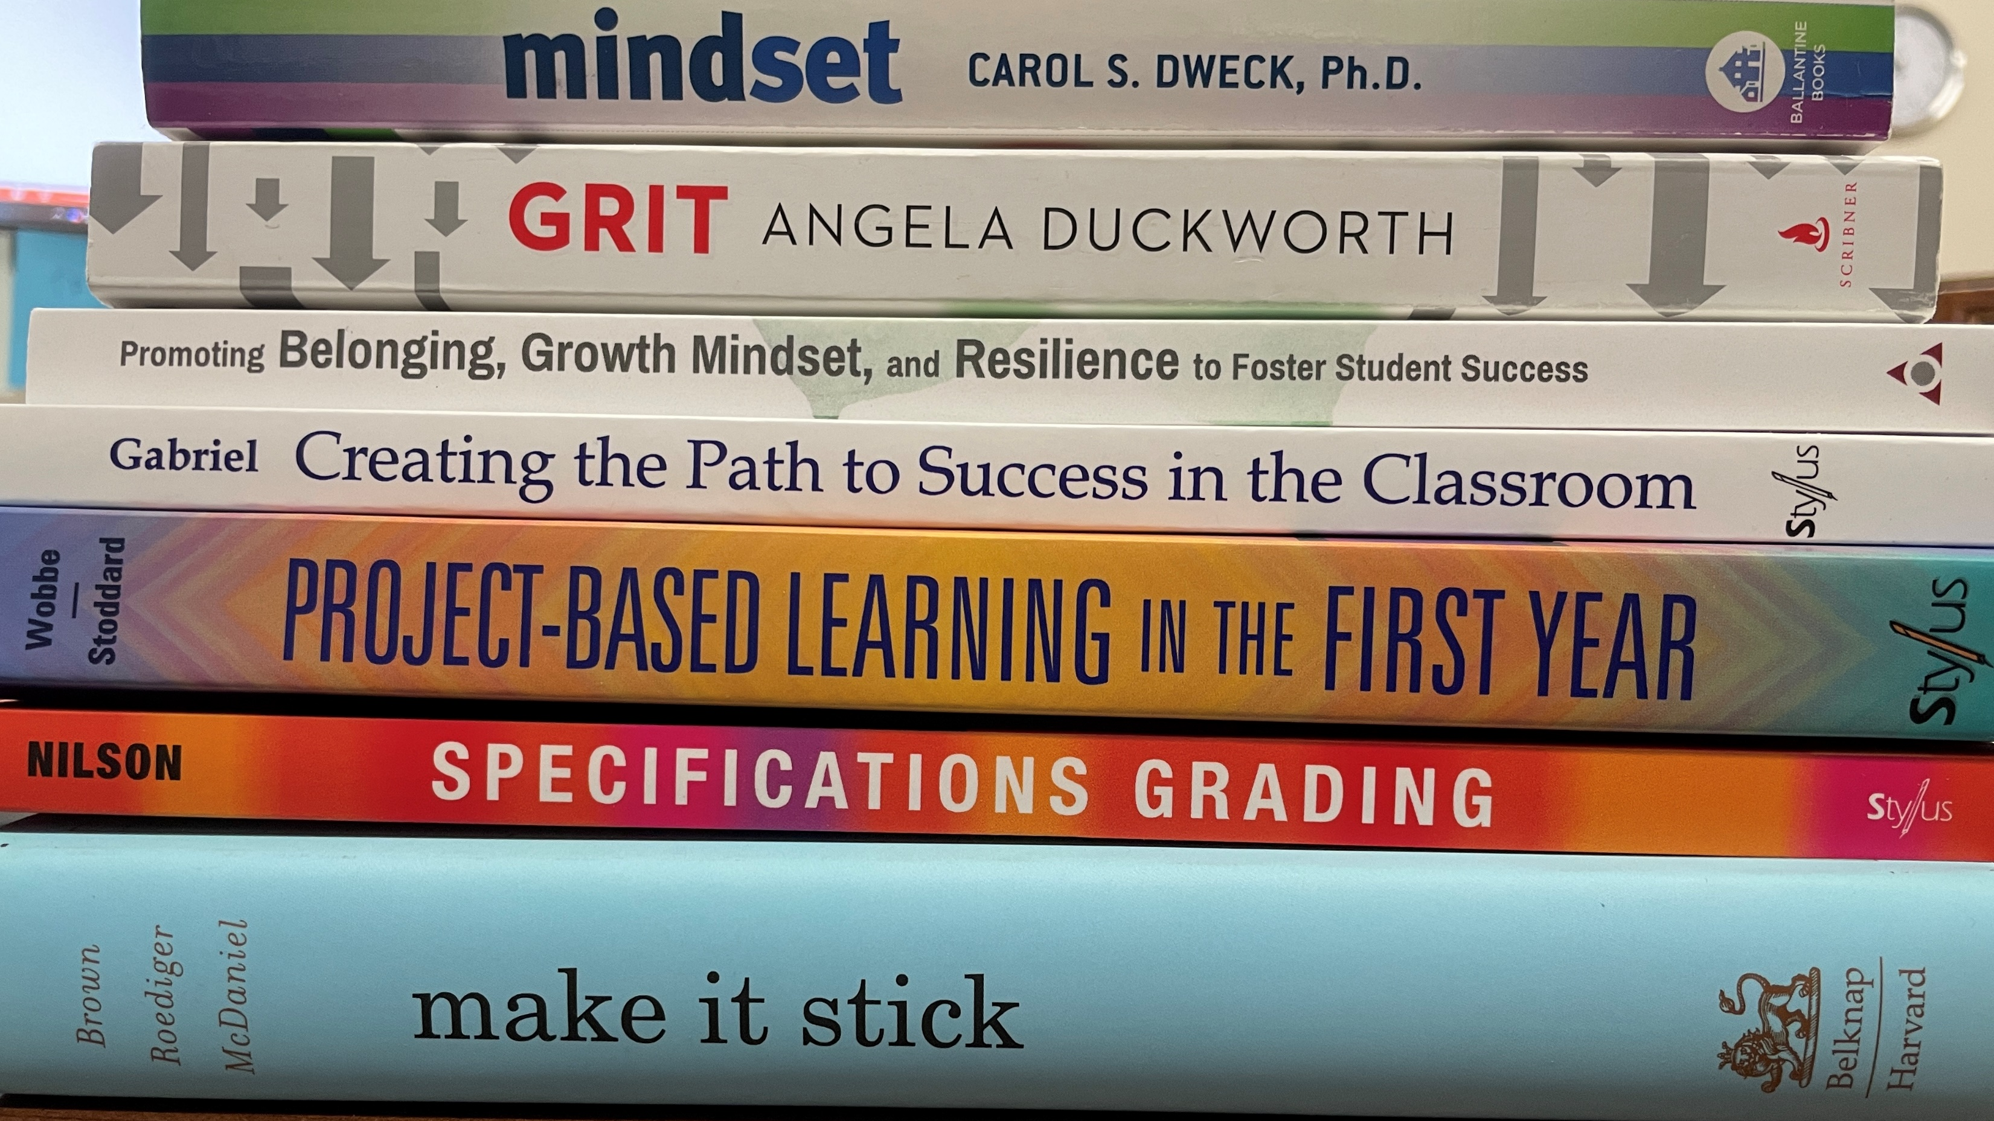

Slide 18
Additional Ideas, Resources, and Supports
Your investment in their learning is critical. Be available. Be supportive.
Be mindful of diversity and consider Universal Design for Learning.
Keep your assignments and activities central to the class, not busy work they do on the side or in isolation until a high-stakes due-date arrives.
Focus on the process, not just the product.
Consider segmented writing, mixed media formats, and a revise and resubmit policy –it works for us, why not for them?
Stimulate and sustain curiosity and value to the students, not just from your perspective, but their own.
Consider tutors, peer mentors, the writing center, the counseling center…

Slide 19
Top Ten Tips for HIPs
At the core of HIP programs are HIP pedagogies and practices that make the learning experience valuable. You can become a High Impact Professor. Just…
Engage students in the learning experience and their awareness of it.
Use a variety of active and collaborative learning techniques in your classes.
Set and maintain high expectations of student performance.
Clarify what students need to do to succeed in class, in college, and potentially beyond.
Employ pedagogies appropriate for course objectives and students’ abilities (inclusion, UDL).
Build on/tie into students’ knowledge, experience, interests, and abilities.
Provide meaningful feedback.
Weave diversity into the curriculum.
Make time for students.
Help them become accountable for their own learning.

