Slide 1
Welcome New Faculty!
University of Idaho
New Faculty Orientation
August 14-16, 2023

Slide 2
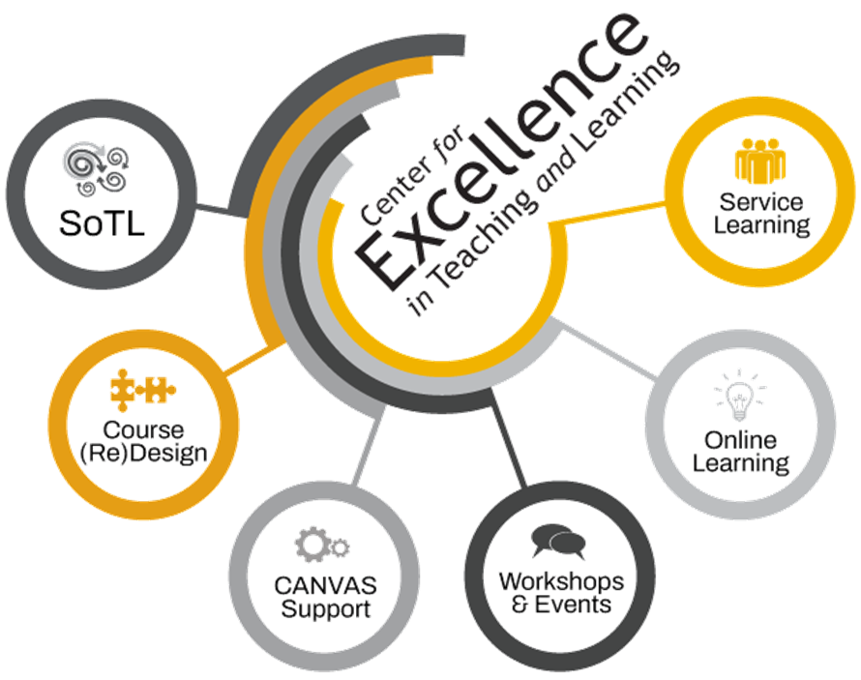

Slide 5
Getting Started with Teaching and Learning
What do you teach?
How long have you been teaching?
What formats? (Circle all that apply)
In-class/online/In a lab/In the community
HOW do you teach? What’s your teaching “style”?
Why?
Any challenges?
What’s your Secret Skill?

Slide 6
Shifting Gears
Let’s talk about teaching

Slide 7
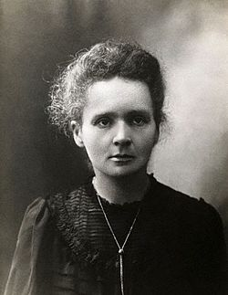

Slide 9
Foundations
It’s not just about teaching, it’s about Teaching for Learning

Slide 10
Teaching & Learning: A Shared Responsibility
Successful students grasp content, reveal knowledge, work through difficult challenges, and are aware of their own learning and how to enhance it.
Impactful faculty guide, challenge, and inspire students. They know their stuff and foster curiosity, creativity, and even risk to get at the learning.
Success happens when we move beyond assumptions that because we teach, they learn. We need to connect the two. We need to teach for learning.
But how?

Slide 11
Defining What Matters & Defining our Roles
As faculty, if we are primarily concerned with transmitting content, then our value will only decrease. The Internet contains a much broader selection of lectures, demonstrations, animations, and examples on more subjects, in more languages, and with a greater variety of approaches, methods, and pedagogies than any professor, department, or even entire university can provide. If, however, we are more concerned with faculty-student interaction; the design and sequence of learning experiences; the application, analysis, and synthesis of information; the motivation of students; and, especially, the increasing complexity of students’ mental models, then the value of what we do will increase.
https://www.aacu.org/liberaleducation/2014/spring/bowen

Slide 12
So, let’s think about engaging our students while still keeping it simple
A quick glimpse at learning & memory
Some simple & effective strategies
This is when the learning happens!

Slide 13
A Closer Look at Low-Risk/High-Yield Active Learning Strategies
Interactive Lecture
Think-Pair-Share
One Minute Papers
Discussions –large & small
Muddiest/Clearest Points
Concept Tests
Debates and Simulations
Peer Review
Info Lit Races
Case Studies, CBL, PBL

Slide 14
Exercise 2: Skills and Strategies
Returning to our first exercise, please jot down, discuss, and further develop together…
A skill you have or
A strategy you use to
Engage learning and learners, and
What learning looks like in your classes.

Slide 15
Shifting Gears
Getting at the Learning

Slide 16
We can help students learn and thrive by focusing on…

Slide 17
And by…
Read: Make it Stick!
Most teaching focuses here…
…but consider the other side

Slide 18
Exercise 3: What Do We Focus On?
Think first day and every day
Where do you spend most of your time and energy as a teacher?
What do you do to help students gain and apply foundational knowledge?
Do you help students learn about their own learning?

Slide 19
The Relevance of Critical Thinking and Critical Reflection
Critical Reflection is the “active, persistent and careful consideration of any belief or supposed form of knowledge in the light of the grounds that support it, and the further conclusions to which it tends.”
It involves “thinking about our thinking” (Dewey, How we Think).
Getting students to do this can be tough!

Slide 20
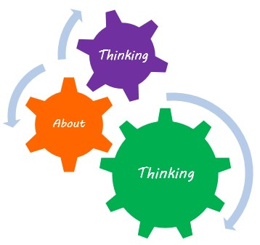
What We’re Ultimately Getting at is Linking Critical Reflection→Metacognition→Self-Regulated Learning
The monitoring and managing of one’s cognitive processes as well as the awareness of and control over one’s emotions, motivations, behaviors, and environment as related to learning
Conscious control over one’s cognitive processes

Slide 21
Consider the Cognitive Wrapper Template

Slide 22
Shifting Gears
HIPs, Mindset, and Inclusion by Design

Slide 23
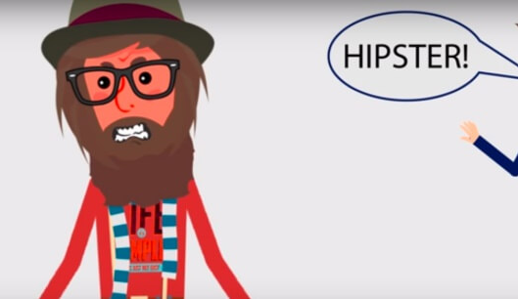
Learning can be HIP!
High Impact Practices (and Pedagogies) enhance the academic success, persistence, and retention of students. Research supports their positive effect among historically underserved populations.
They’re typically fun but can also take students out of their comfort zones.
Some Examples:
Learning through diversity
Real-world experiences
Culminating experiences
Undergraduate research
Collaborative assignments
Community-engaged learning
Simulations
Writing-intensive classes

Slide 24
Top Ten Tips for HIPs
At the core of HIP programs are HIP pedagogies and practices that make the learning experience valuable. You can become a High Impact Professor. Just…
Engage students in the learning experience and their awareness of it.
Use a variety of active and collaborative learning techniques in your classes.
Set and maintain high expectations of student performance.
Clarify what students need to do to succeed in class, in college, and potentially beyond.
Employ pedagogies appropriate for course objectives and students’ abilities (inclusion, UDL).
Build on/tie into students’ knowledge, experience, interests, and abilities.
Provide meaningful feedback.
Weave diversity into the curriculum.
Make time for students.
Help them become accountable for their own learning.

Slide 25
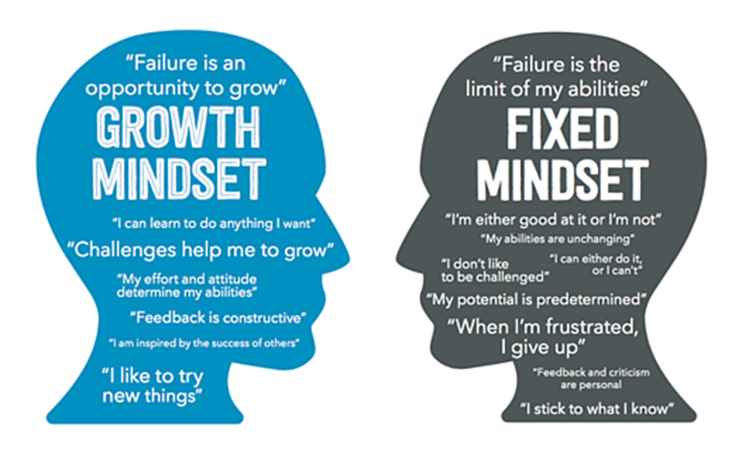
Mindset Also Matters
“The view you adopt of yourself profoundly affects the way you lead your life”

Slide 26
Why It Matters
At this stage of their development, many students haven’t (yet) had the opportunity to think about their thinking and learn about their learning.
Further: “…research on younger undergraduate students reveals [that] students take little or no responsibility for their own learning, blaming their shortcomings in achievement on their ‘ineffective’ instruction and the ‘too advanced’ or irrelevant course… Reinforcing their avoidance of responsibility for their learning is their widespread belief that learning should not require effort”
Linda Nilson, Creating Self-Regulated Learners.

Slide 27
Helping Students Shift from a Fixed Mindset to Growth Mindset

Slide 28
DEAL with Learning
D | E | AL
DESCRIBE the learning experience. Think: What? Where? Who? When? Why | EXAMINE the experience through the lens of academic concepts, theories, or strategies EG: Culturally Responsive Pedagogy, UDL, Course Learning Goals | ARTICULATE LEARNING by discussing and explaining what you learned, when you learned it, how you learned it and why it is important –to you and the field!-- and what you can/will do differently because of it.

Slide 30
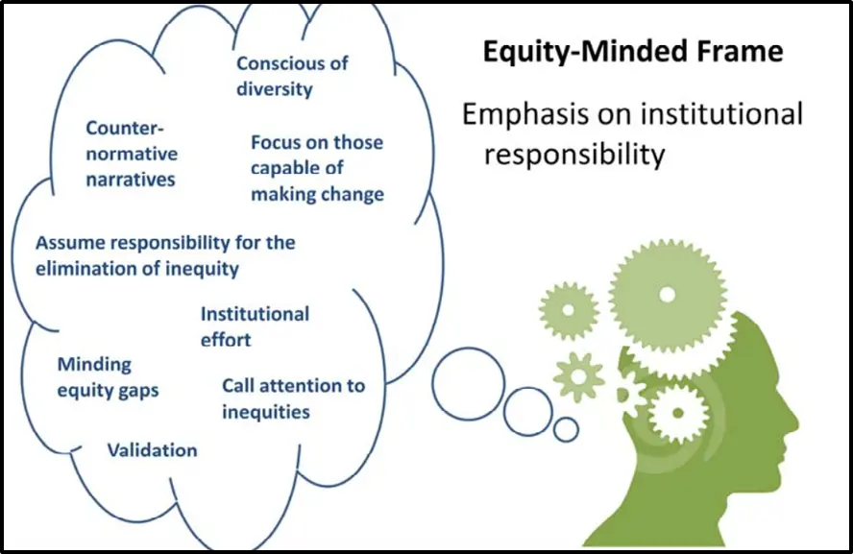
Diversity Equity Inclusion Accessibility
CETL’s Repository for DEIA for Teaching and Learning
The Leading Faculty Development Network’s Key Resources
CDAR Resources
Tips on Designing Inclusive Learning Experiences
Universal Design for Learning (UDL) Resources
https://www.webpages.uidaho.edu/cetl/deia.asp
Resources!

Slide 31
Concluding Thoughts and Tips
Make a connection –the first day and every day, including your syllabus.
Be present –autopilot is an easy system default; try to avoid it.
Be engaged –show you care and that you’re interested in the class and your students.
Be engaging –mix it up! Think about ways to bring your content and classes to life. WE’RE HERE TO HELP!
Be there for your students –believe it or not, you are probably the reason many of your students will chose to continue their education and go on to accomplish great things.
Build community –look at each class as a learning community. What brings and holds you together? Provide that. Nurture it.
Set and communicate clear and relevant expectations –ask me about the Pygmalion Effect! Students can achieve high standards!
Make learning –and your class– meaningful to your students –from your syllabus to your activities to your assignments and feedback: make it matter.
Discuss, model, and engage in meaningful conversations –RSI is a thing in online education, and its also foundational to a successful class.
Be inclusive –you will encounter a wonderfully diverse array of students at the U of I and every one of them deserves an opportunity to thrive. We can help!
Talk to us about how to handle hot topics –they will occur, and we can help. Stay tuned for more.
We’re here to help you every step of the way, every day!

Slide 32
Exercise 4: Your Ticket Out the Door
When you think about helping all students learn (inclusively), what’s:
One area where you really shine
One thing you would like to learn more about
One thing –an idea, a teaching strategy, a hypothesis-- you’re going to try this year

Slide 33
Remember: We’re here to help!
https://www.webpages.uidaho.edu/cetl/ ←The website the New York Times has (not yet) proclaimed to be the single greatest contribution to teaching and learning in higher education since the dawn of time.

Slide 34
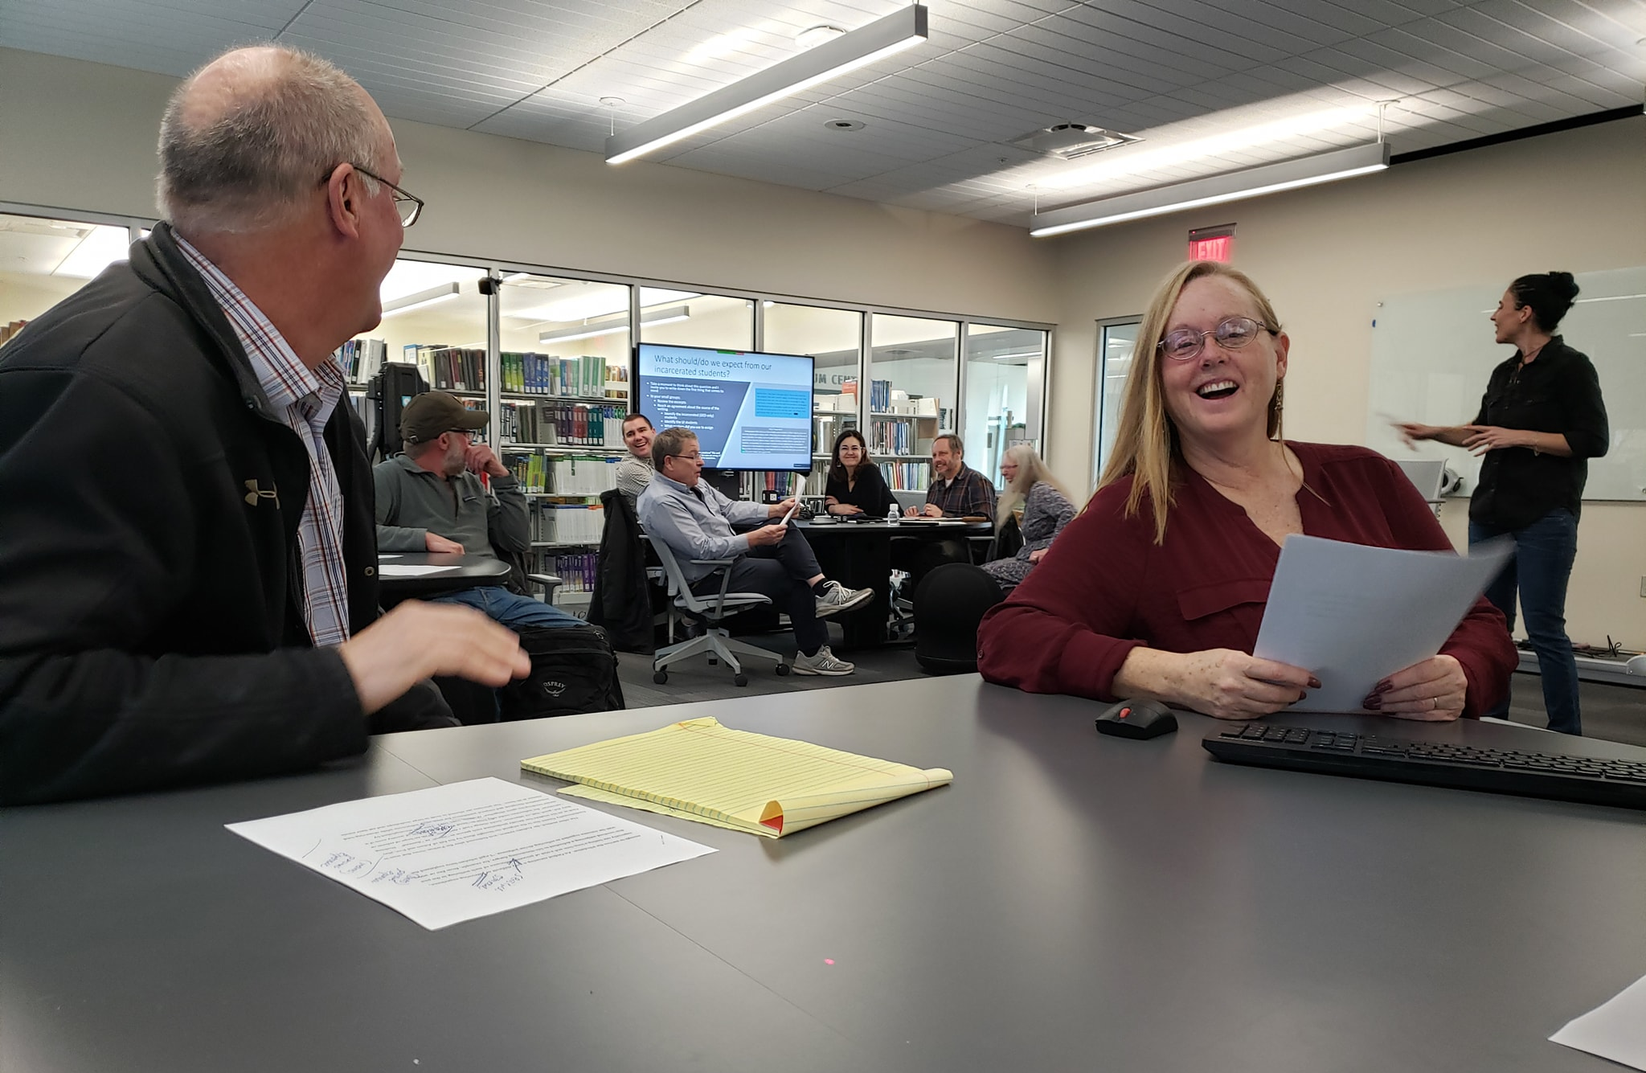
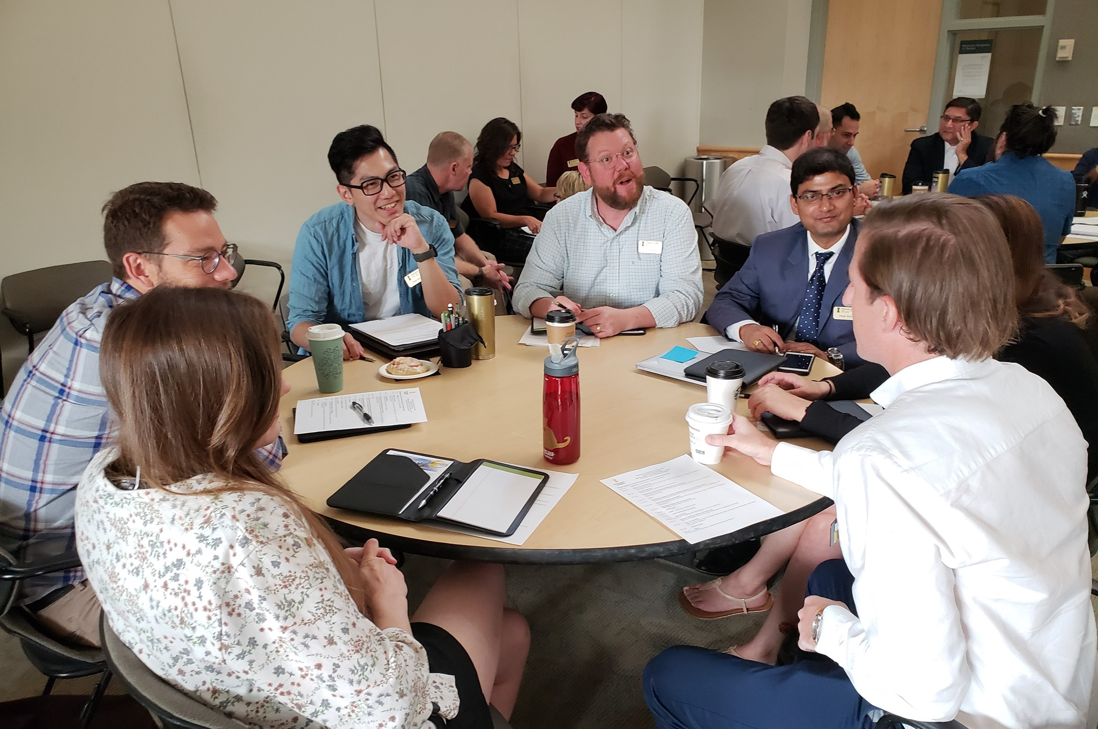
OUR MISSION
The Center for Excellence in Teaching and Learning is a comprehensive faculty and academic development center dedicated to the success of all faculty, graduate students, and academic programs. With expertise in higher education pedagogy, we provide course and instructional design support for all faculty, across all instructional modalities: in-class, online, and everything in-between. We are also active scholars and not only support and promote Teaching as Research and the Scholarship of Teaching and Learning; we help faculty at all levels develop strong and sustainable research programs while maintaining a healthy work-life balance.

Slide 35
We’re Here to Support Your Success…
A Successful Career
As scholars
As teachers
As scholarly teachers
As thriving colleagues
With balance and well-being in mind
Scho
l
ar
sh
I
p
Teach
I
ng
Serv
I
ce

Slide 36
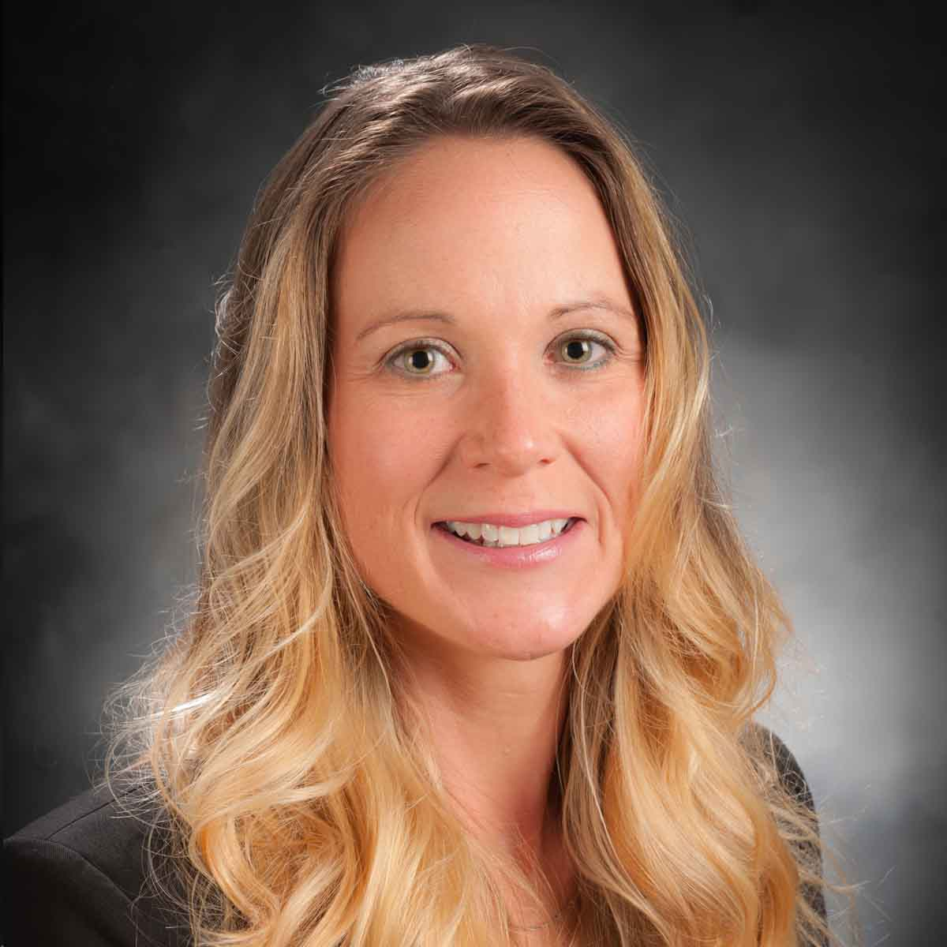
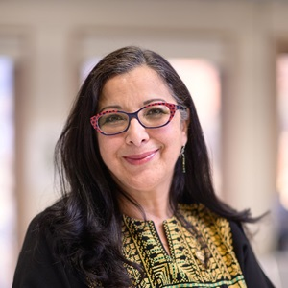
We are:
Faculty Developers, Academic Consultants,
Instructional Designers, and Online Learning Specialists.
Our team members hold doctoral degrees and have teaching and research experience in STEM, Education, the Social Sciences, and Humanities.
Erin Chapman
Rula Awwad-Rafferty
Faculty Associate, DEIA in T&L
Service-Learning Faculty Associate

Slide 37
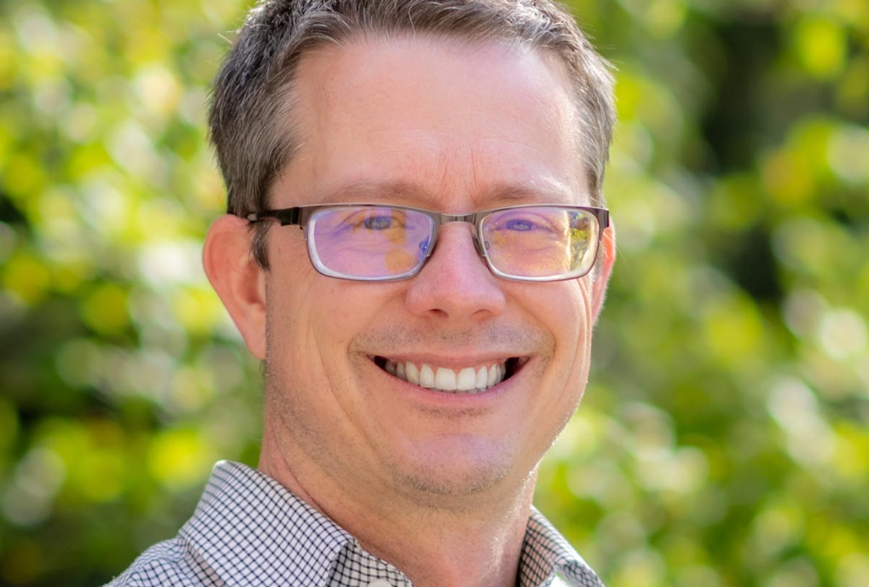
Teaching Online?
Here’s a One minute read
Here’s a Two minute read.
Visit out Online Learning Team –Jen Elbek and Sean Quallen

Slide 38
Jump Start Your Classes!
Make a Connection!
https://www.facultyfocus.com/articles/teaching-professor-blog/the-first-day-of-class-a-once-a-semester-opportunity/
Check out for our Workshop and Events Series!
Follow us on Facebook!
Come to CETL’s “Getting Started” open house!
11am-12pm, Wednesday, August 16, CETL Office Suite, Education Building 220;
Every day in the CETL and online; and
Take advantage of our Syllabus and Class Tune-Up Special: Design or redesign a learning-centered syllabus and class. Contact:
Doug Habib at dhabib@uidaho.edu
Jendra Elbek at jelbek@uidaho.edu
Sean Quallen at squallen@uidaho.edu
Use our template and drop us a line any time!

Slide 39
Appendix A: Ready to Use Teaching-Learning Strategies

Slide 40
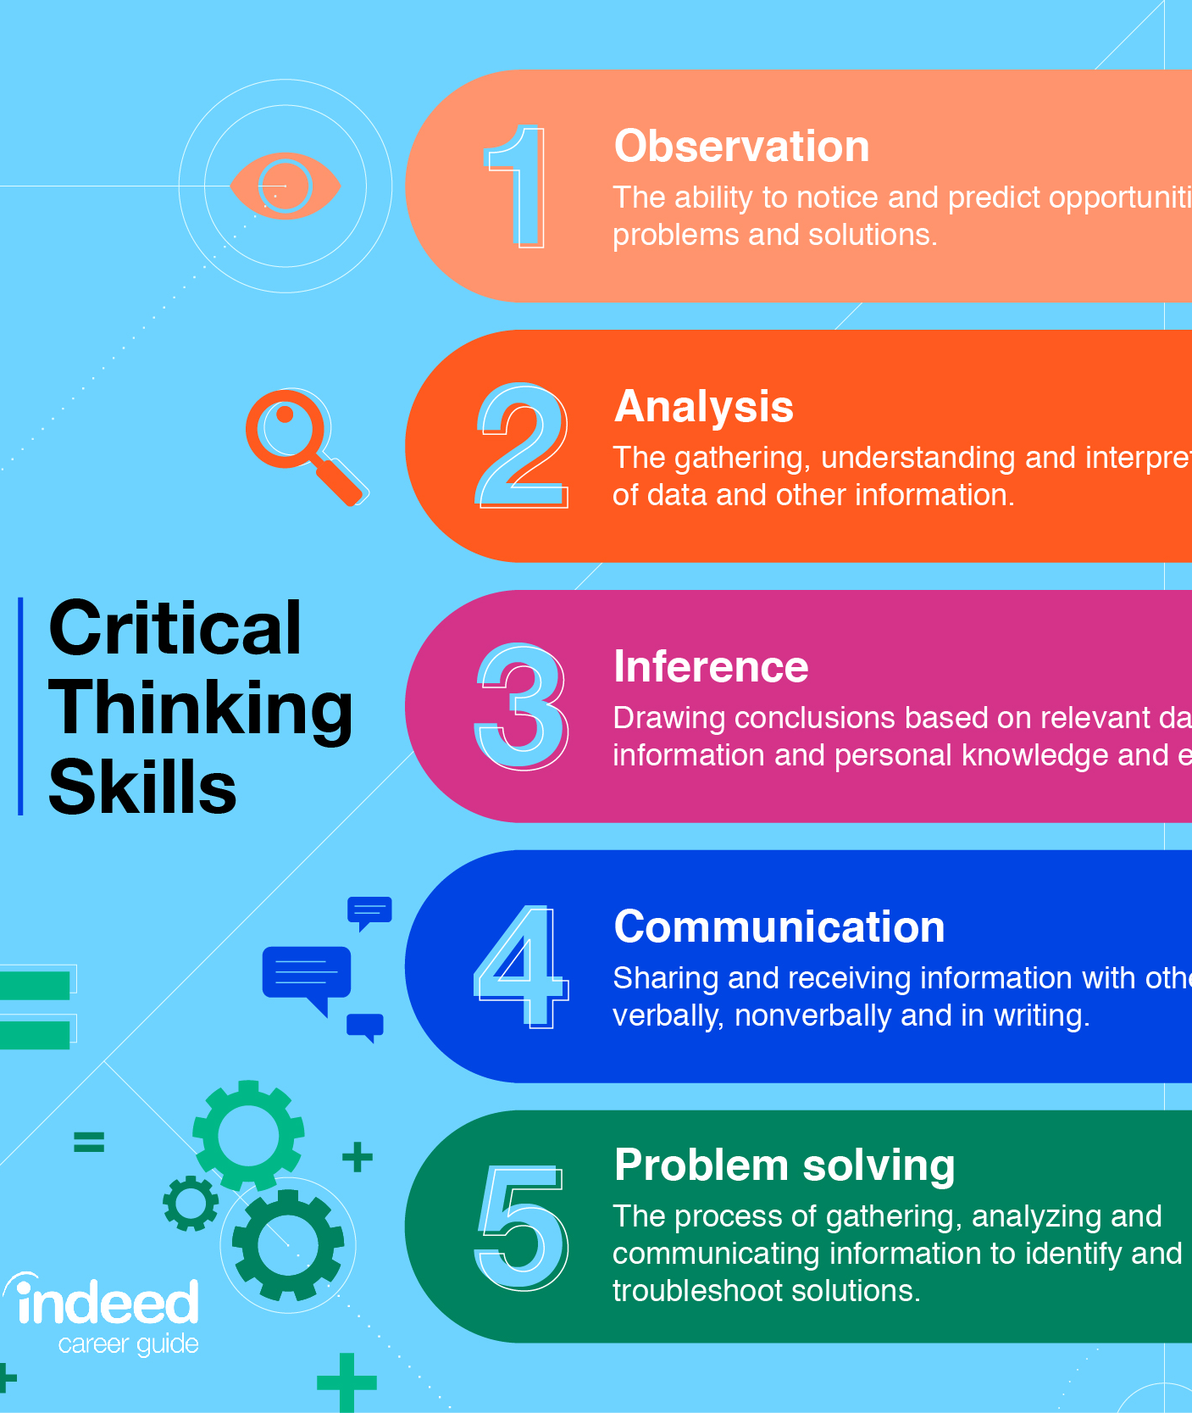
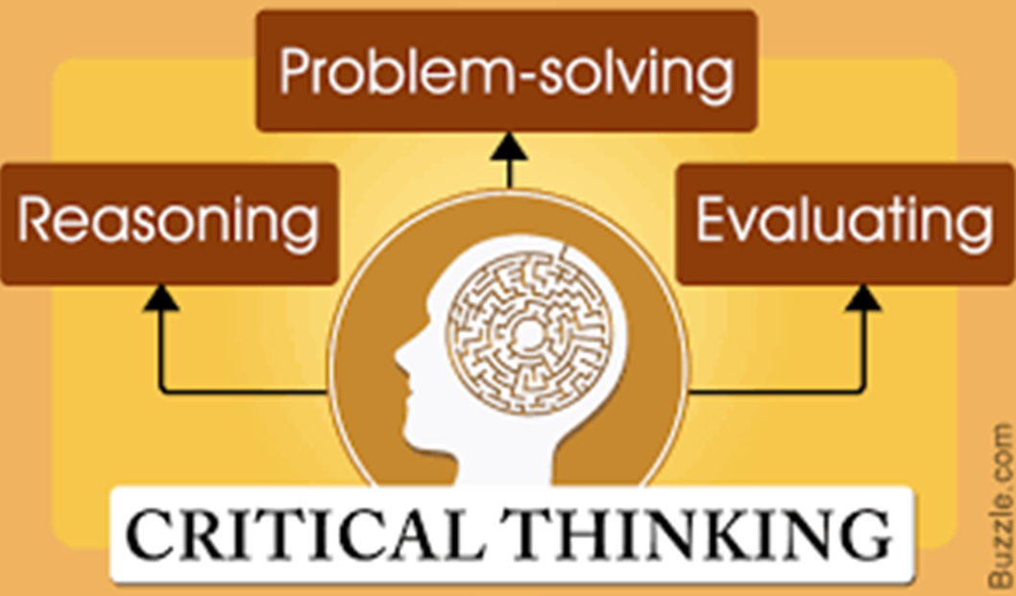
Critical Thinking Frameworks
Ultimately, we want our students to think and reason with an open mind and a modicum of intellectual humility. We want them to draw conclusions based on logic, reason, and evidence, not mere opinion. We want them to learn.

Slide 41
Critical thinking requires some work from us as well as our students. What can we do at each stage?
Steps/stages
Strategies
Content exposure/phenomena observation
Consider possibilities
Challenge assumptions
Suspend judgment
Data over beliefs
Retest ideas
Defend conclusions
Revise conclusions?
How?
How?
How?
How?
How?
How?
How?
How?

Slide 42
Simple Engagement Strategies to Discover what Students Know, Don’t Know, and Need to Know
Strategy | Description
CATs and LATS, like “quick quizzes” | Set aside a few minutes of class time for low-stakes quizzes and exercises to help students practice retrieving and processing newly learned information.
Distributed Practice | Allow students to work on skills and knowledge acquisition over time. Scaffold learning!
The Productive Struggle | Offer challenging tasks that require creative and/or critical thinking skills. Remember: the one who does the work does the learning!
3-2-1 | Let students write down 3 things they learned (potentially from the previous class session), 2 things they found interesting, and 1 thing they have questions about.
Ticket In-and-Out the Door | Have students present a question or finding from previous session to current session, and at the end, share one thing they learned or didn’t quite grasp today.
Technology | Use technology APPROPRIATELY and as part of the authentic learning experience.
How I Learned, not What I Learned | Retrieval is critical to new learning, but don’t let the students rely on you as the source of all knowledge and information! Learning is about discovery. Get them to think about how they learn, not just what they learn.

Slide 43
As you design your classes, think about creating a roadmap to success and consider alternate routes. Backwards design your classes around your learning goals and student learning outcomes. We can help!
Goal/outcome | What I usually do | Alternatives? | Methods & Instruments
https://www.webpages.uidaho.edu/cetl/learning-assessments.asp

Slide 44
Timely Tips and Lessons Learned from Covid What’s works and what’s doesn’t
What’s working: Three Cs
Communication
Predictable patterns
Common technological foundations
Mutually agreeable expectations
Community
Using technology to create a visible presence –us and them
Building and sustaining engagement
Fostering relationships among class members
Clarity
What’s expected, when, and how
On shifting instructional modalities
On how and why different technologies and pedagogies are used.
What’s not:
Too rigid or too flexible
“More of me”, the instructor, lecturing
Poor use of class time
Poor use of/aversion to technology
Lack of variety
Poor LMS presence/usage
Unpredictable communication
Never asking for student input
Never doing anything with it
Ditto for faculty feedback
Inside-the-box thinking
What we did in a crisis isn’t sustainable for quality

