Slide 1
New Faculty Orientation
…how to succeed at research and creative activity and have a little fun along the way
Holly Wichman
Department of Biological Sciences
Institute for Modeling Collaboration and Innovation

Slide 2
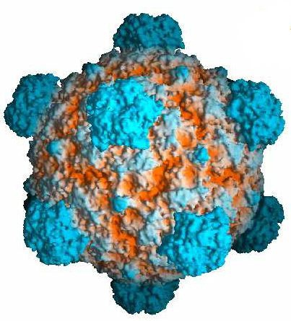
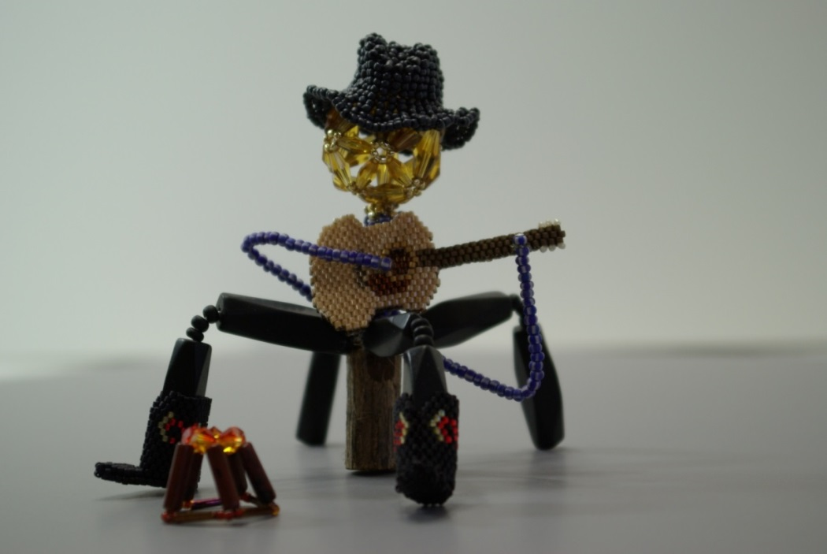
A little bit about me

Slide 3
You are already a success

Slide 4
Time
The great dividing line between success and failure can be expressed in five words; “I did not have time”.
Franklin Field

Slide 5
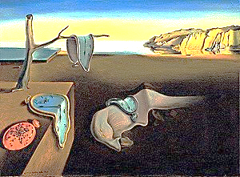
Make good use of your time Poor use of time is the biggest impediment to tenure and to successful research
IMAGE: https://en.wikipedia.org/wiki/The_Persistence_of_Memory

Slide 6
Importance
IMPORTANT and URGENT
IMPORTANT and NOT URGENT
Urgency
NOT IMPORTANT and URGENT
NOT IMPORTANT and NOT URGENT
redrawn from Seven Habits of Highly Effective People

Slide 7
IMPORTANT and URGENT
Crisis
Stress
IMPORTANT and NOT URGENT
Focus
Productivity
NOT IMPORTANT and URGENT
Illusion
Distraction
NOT IMPORTANT and NOT URGENT
Escape
from Seven Habits of Highly Effective People

Slide 8
IMPORTANT and NOT URGENT
Try so spend most
of your time here.

Slide 9
If you don’t do it when it is here, it moves here

Slide 10
Have a plan
Put it in writing
Break it down into bite-sized chunks
Annual plan / weekly goals
Say it out loud to someone else
Use the buddy system to set goals

Slide 11
Have a plan
Have a plan
Include life in your plan
Partners
Family and friends
Self
Schedule your research and writing time

Slide 12
You need to know the rules if you are going to win the game
Communicate with your chair and the senior members of your department
Find mentors and role models
Reciprocal peer mentoring
Pay attention to your annual and 3rd year reviews
Make sure your job description accurately reflects your job and your use of time

Slide 13
You need to know the rules…
What is expected of you in terms of grant funding and publications / exhibitions?
Do you need to demonstrate independence from you graduate / postdoc mentors?
How is collaborative research credited in your unit?

Slide 14
Keep track of what you accomplish
Keep running lists: grants submitted / funded projected and actual expenditures publications (funding cited, student authors) anything you will need to report

Slide 15
Celebrate what you accomplish
1st graduate student
Submitted a paper
Published a paper
Submitted a proposal
Major exhibition
Grant funded

Slide 16
Don’t create emergencies for yourself or others
If it only takes a minute and you will need to do it eventually, just do it now
If it takes more than a minute and you will need to do it eventually, put it on your to-do list or calendar
Respond to requests from staff

Slide 17
A few other pointers
Take care of the people who take care of you
Learn the rules and take responsibility: compliance budgets / purchases hiring / personnel

Slide 18
I Interdisciplinary
Collaboration

Slide 19
Create synergistic collaborations
You make your own research community

Slide 20
This is a Goldilocks University Not too big, not too small, just right
IMAGE: https://review.firstround.com/the-goldilocks-effect-and-how-to-harness-social-influence

Slide 21
This is a Goldilocks University
Not so big you get lost in the crowd,
Not so small that there is no one to interact with.
It’s just right.
A place where you can make things happen.

Slide 22
Get to Know Your Community
Engage in events where you will meet faculty from outside your own department and college
Sit with someone you don’t know
Watch the University Events calendar
https://www.uidaho.edu/events
Sit on University committees (sparingly at first)

Slide 23
Explore the Institutes
Institute for Modeling Collaboration and Innovation (IMCI)
https://imci.uidaho.edu/
Institute for Interdisciplinary Data Sciences (IIDS)
https://www.iids.uidaho.edu/
Institute for Health in the Human Ecosystem (IHHE)
https://www.uidaho.edu/research/entities/ihhe
Aquaculture Research Institute (ARI)
https://www.uidaho.edu/research/entities/aquaculture
Institute for Innovative Climate Solutions
https://ics.uidaho.edu/

Slide 24
Ride for the brand

Slide 25
My goal is to be the collegue I want to have

Slide 26
I try not to be a Henny Penny
IMAGE: https://medium.com/@bptaylor52/chicken-little-syndrome-b8641836da78

Slide 27
I am The Little Engine that Could
https://www.penguinrandomhouseretail.com

Slide 28
IMAGE: http://mariahcasey.typepad.com/leadermom/

