Slide 1
Toward Inclusive Teaching, Research, Outreach/Extension and Service
Day 2
New Faculty Orientation
August 15, 2023

Slide 2
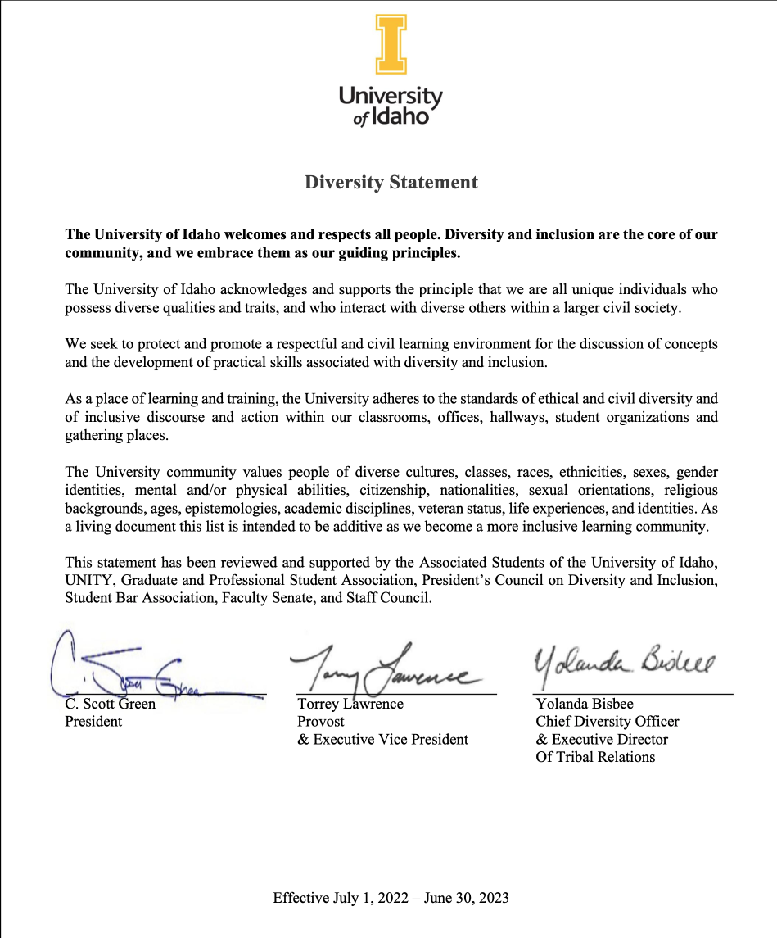
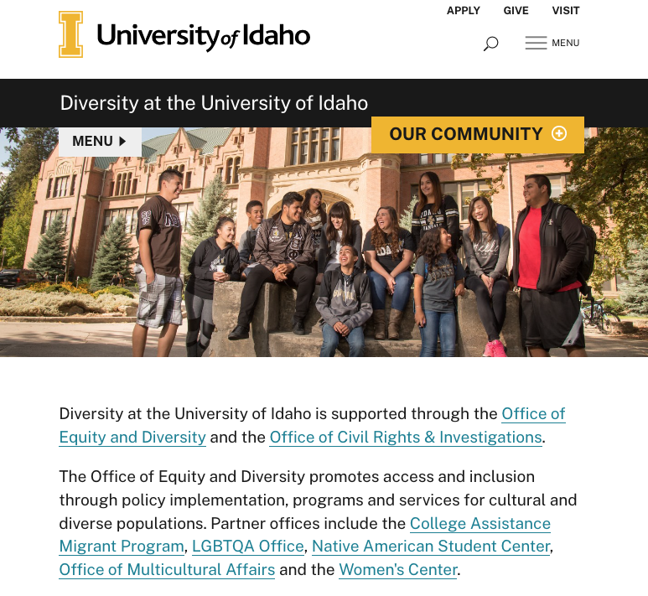
WHAT DOES IT MEAN TO BE INCLUSIVE in your work as a faculty member?
uidaho.edu/diversity

Slide 3
Focused Topics
Each session will last 20 minutes. Each presenter will facilitate a discussion on a focused topic related to inclusive practices embedded within teaching, research, outreach, and/or service.
We’ll run two sessions.
Dr. Katrina Eichner, Assistant Professor, Culture, Society and Justice
Jesse Martinez, Director, Office of Multicultural Affairs
Kirsten Pomerantz, Senior Instructor, Elementary Education
Dr. Rebecca Scofield, Chair, Associate Professor, History
Dr. Philip Stevens, Associate Professor, Anthropology, Director of American Indian Studies
Cory Voss, Director, Center for Disability Access and Resources

Slide 4
Before you Leave:
Write down three things you learned in this session
In your own words, tell me what you understand about inclusive work as a faculty member
What is still confusing about inclusive practices?

