Slide 1
Learning-through-Diversity: A Pathway to Advancing Equitable Educational Experiences
UI PFF CIRTL Workshop, Session 1
October 5, 2023
Brian Smentkowski, PhD
Founding Director, University of Idaho Center for Excellence in Teaching and Learning

Slide 2
About this series
Session 1 focuses on what LTD is and why it matters
This session will introduce key concepts relating to:
Inclusive teaching practices,
Our role in providing equitable educational opportunities, and
The CIRTL framework
Session 2 more fully integrates the CIRTL framework and links two core aspects of it:
Learning through Diversity and Teaching as Research
Session 3 provides a deeper dive into:
The development of an equity-mindset, and
Applied strategies for creating accessible, inclusive, and equitable learning experiences for diverse learners
Session 4 focuses exclusively on Universal Design for Learning
This expert-led session provides a rich context and evidence-based practices for supporting multiple means of engagement, representation, and expression of knowledge
Session 5 focuses exclusively on Culturally Responsive Pedagogy
This expert-led session provides insights and strategies for identifying and navigating the barriers and opportunities cultural differences provide
Session 6 focuses exclusively on Inclusion by Design
By this time, you will have the tools to think and act with intentionality to advance equitable learning opportunities
This session will focus on how you can embed what you have learned in every-day practice
Session 7 is reserved for sharing how you have pulled it all together. It is a conversational session where you share a reflection and an action.

Slide 3
Acknowledgments
First, I would like to acknowledge that U of I Moscow is located on the homelands of the Nimiipuu (Nez Perce), Palus (Palouse) and Schitsu’umsh (Coeur d’Alene) tribes. We extend gratitude to the indigenous people that call this place home, since time immemorial. U of I recognizes that it is our academic responsibility to build relationships with the indigenous people to ensure integrity of tribal voices.
Second, I would like to thank the CIRTL Network and, in particular, the Cross Network Operations Group, the TAR Leaders FLC, TAR Summer Course participants, Robin Greenler, Colleen McLinn, and Kate Diamond for their support, help, and perspective on the design of this series; Erin Chapman, CETL Faculty Associate for Diversity, Equity, and Inclusion in Teaching and Learning; and Jerry McMurtry and Michael Decker in the College of Graduate Studies for providing the platform for this discussion at the U of I.
Third, I would like to acknowledge and express my gratitude to all of you for your commitment to this important topic.

Slide 4
What brings you here today?
Exercise 1

Slide 5
Exercise 1: Answers and Concepts
What brings you here today? Why does this subject matter?
What comes to mind when you hear—or how do you define-- the following words:
Diversity
Equity/Equity Frame
Inclusion
Accessibility
Cultural Humility/ Responsive Pedagogy
Bias/Implicit Bias

Slide 6
A Framework
Introduced in this Session and integrated more fully into Session 2

Slide 7
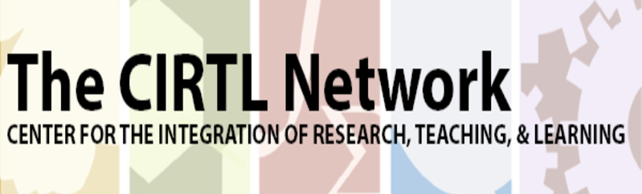
CIRTL is…
The Center for the Integration of Research, Teaching, and Learning.
CIRTL seeks to enhance excellence in STEM undergraduate education through development of a national faculty committed to implementing and advancing evidence-based teaching practices for diverse learners.
CIRTL was founded in 2003 as a National Science Foundation Center for Learning and Teaching in higher education.
CIRTL uses graduate education as the leverage point to develop a national STEM faculty committed to implementing and advancing effective teaching practices for diverse student audiences as part of successful professional careers.
The goal of CIRTL is to improve the STEM learning of all students at every college and university, and thereby to increase the diversity in STEM fields and the STEM literacy of the nation.

Slide 8
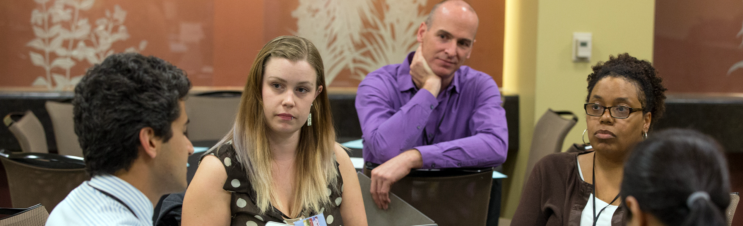
Core Ideas
*Learning-through-Diversity*
Learning-through-diversity capitalizes on the rich array of experiences, backgrounds, and skills among STEM undergraduates and graduates-through-faculty to enhance the learning of all. It recognizes that excellence and diversity are necessarily intertwined
*Teaching-as-Research*
Teaching-as-research is the deliberate, systematic, and reflective use of research methods by science, technology, engineering, and mathematics (STEM) instructors to develop and implement teaching practices that advance the learning experiences and outcomes of both students and teachers
Learning Communities
Learning communities bring together groups of people for shared learning, discovery, and generation of knowledge. To achieve common learning goals, a learning community nurtures functional relationship among its members.

Slide 9
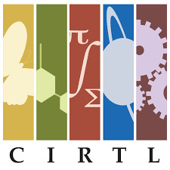
Core Values
Learner-Centered Education: Learning is shaped by the needs, identities, experiences, communities, and goals of our learners. We develop educators who place learners at the center of their work.
Equity and Inclusion: In equitable and open environments, everyone is respected, valued, and encouraged, so that they are able to contribute to their fullest potential. We work to develop and sustain inclusive working spaces and learning communities that achieve equitable outcomes.
Diversity and Representation: Diversity of people brings forth diversity of ideas and learning. We cultivate and engage participation as a network, including leadership, that is representative of the demographics and lived experiences of the broader population.
Collaboration: Working together allows us to better achieve our co-created goals. We engage constituencies at all levels within and across institutions as colleagues in our work.
Inclusive Excellence and Innovation: Critical examination of data, scholarly reflection, and collective review are our standards of excellence. We innovate for mutual improvement of inclusive educational practices.
Reflective Decision-Making: Reflective decision-making is responsive to the evolving landscape of the CIRTL Network. We gather, share and analyze evidence to make data-informed decisions to collectively guide the CIRTL Network.
Intellectual Generosity: Mutual openness to ideas of each other advances understanding and discovery of knowledge. Acknowledging that there are
multiple ways of knowing, we respectfully listen and share our ideas,
perspectives, practices, and expertise.

Slide 10
Salience and Relevance
The articles, below –each from a leading publication’s most recent issue-- demonstrate the salience and relevance of Learning-through-Diversity in the scholarship of teaching and learning.
Attas, R. & Anstey, L. & Brant, L. & McRae, K., (2023) “Infusion rather than isolation: Integrating principles of equity, diversity, inclusion, decolonization, and Indigenization in toolkits for remote instruction during the COVID-19 pandemic”, To Improve the Academy: A Journal of Educational Development 42(1): 4. doi: https://doi.org/10.3998/tia.1841
Schrum, Kelly, and Katarina Mårtensson. 2023. “Growing SoTL—Embracing Diversity, Messiness, and Complexity”. Teaching and Learning Inquiry 11 (January). https://doi.org/10.20343/teachlearninqu.11.1.
McSweeney, Jill and Schnurr, Matthew A. (2023) "Can SoTL Generate High Quality Research while Maintaining its Commitment to Inclusivity?," International Journal for the Scholarship of Teaching and Learning: Vol. 17: No. 1, Article 4. Available at: https://doi.org/10.20429/ijsotl.2023.17104
Potter, Michael K. and Raffoul, Jessica (2023) "Engaged Alienation: SoTL, Inclusivity, and the Problem of Integrity," International Journal for the Scholarship of Teaching and Learning: Vol. 17: No. 1, Article 2. Available at: https://doi.org/10.20429/ijsotl.2023.17102

Slide 11
Our Broad Goal
To become mindful and inclusive faculty who improve learning through teaching. {Note the causality, here}
This requires us to:
Appreciate the diverse backgrounds of students and their implications for learning.
Identify curricular, teaching, and assessment practices that promote inclusive learning.
Draw upon the diversity of students to enhance and enrich engaged and inclusive learning.
Recognize existing inequities, and promote an equitable, inclusive and respectful climate for learning.

Slide 12
Our Targeted Goal
To adopt Learning-through-Diversity as a pedagogical prism for designing, developing, and delivering inclusive, equitable, and accessible learning experiences;
To apply TAR strategies to develop, integrate, and assess inclusive, equitable, and accessible teaching practices*;
To develop a solid foundation for engaging in meaningful DEIA-informed teaching.
{*Introduced here, integrated in Session 2}

Slide 13
The Intersection of LTD and TAR and Why it Matters*
TAR
LTD
PFF
Transformational and Equitable
Teaching and Learning
Can we move from this:
To this?
LTD
TAR
Mindful Evidence-Based Teaching
What’s happening
–and possible– here?
LTD
TAR
{*This intersection will be integral to Session 2 and beyond}

Slide 14
Making the LTD ←→TAR Connection
When we say that Learning-through-Diversity capitalizes on the experiences, backgrounds, identities, and skills of students to enhance learning for all, we are engaging in a representational form of scholarly teaching –bringing who we are and who our students are into the equation.
It is more than that, though: through a TAR prism, we can hypothesize and predict the impact of equitable, inclusive, and accessible teaching practices on learning. LTD then becomes a TAR topic.
Teaching-as-Research transforms curiosity about learning into a research question that can promote improved learning for diverse learners.
Here, an LTD<->TAR framework is used to advance equitable educational experiences.

Slide 15
Bringing LTD into the Classroom
An Introduction to Inclusive Teaching Strategies

Slide 16
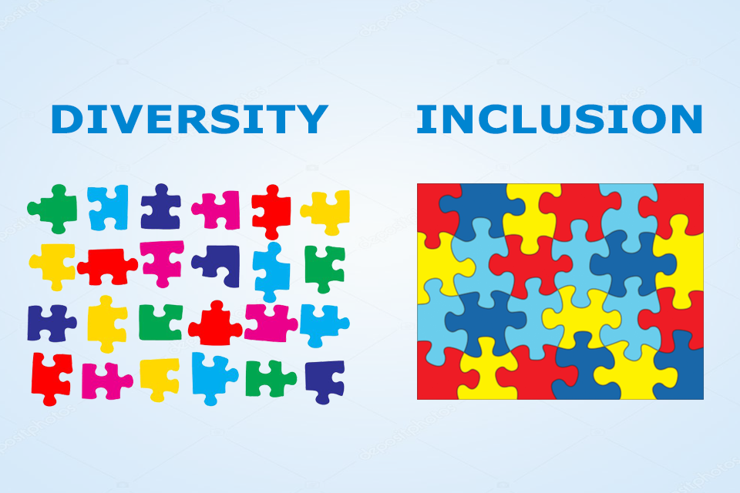
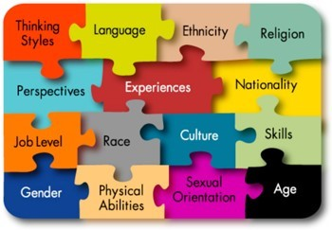
Premise: Inclusive Teaching Practices→ Inclusive Learning Experiences
Faculty and students bring an array of experiences, backgrounds, and skills to the teaching and learning process.
Effective teaching capitalizes on these rich resources to the benefit of all. This is "Learning-through-Diversity".
At the same time, existing social and educational practices do not always promote equal success for all learners.
Creating equitable learning experiences and environments requires intentional and deliberate efforts on the part of present and future faculty alike.
This series is designed to stimulate, frame, and support these efforts.
https://www.cirtl.net/about/core_ideas/learning_through_diversity.

Slide 17
So, how do we teach inclusively?

Slide 18
Let’s revisit some our concepts and a question, then think about a mindset
What is “an authentic statement of a commitment to DEIA?”

Slide 19
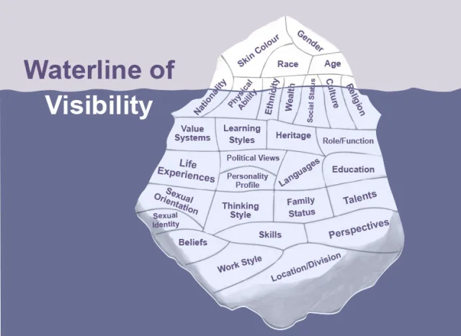
Exercise 2: A Deeper Dive: Visible and Invisible Barriers

Slide 20
Inclusive Practices and Pedagogies: A Primer
Inclusive teaching strategies can be separated into three categories:
Incorporating diverse perspectives into course content by expanding reading lists beyond dominant/narrow narratives and their sources; offering various ethnic, racial, and other perspectives in case studies; ensuring PowerPoints and lecture examples offer a variety of human examples; and avoiding tokenizing particular individuals, students, or representations.
Creating an inclusive classroom climate where all students are encouraged to participate, by learning about students’ backgrounds and tailoring approaches accordingly, establishing ground rules for discussing controversial issues, and developing (and helping students develop) deeper awareness of difference.
Incorporating Universal Design for Learning principles in class, by providing/facilitating multiple means of engagement, representation, and expression.
--Yale Poorvu Center for Teaching and Learning
Implicit Bias and critical self-reflection tools:
https://poorvucenter.yale.edu/ImplicitBiasAwareness and https://implicit.harvard.edu/implicit/selectatest.html
https://projects.iq.harvard.edu/files/eijc/files/inclusive_teaching_strategies_reflecting_on_your_practice.pdf?m=1525282190
See pp. 24-26, below, to learn more about course, curriculum, instructional, and faculty development in DEIA and LTD.

Slide 22
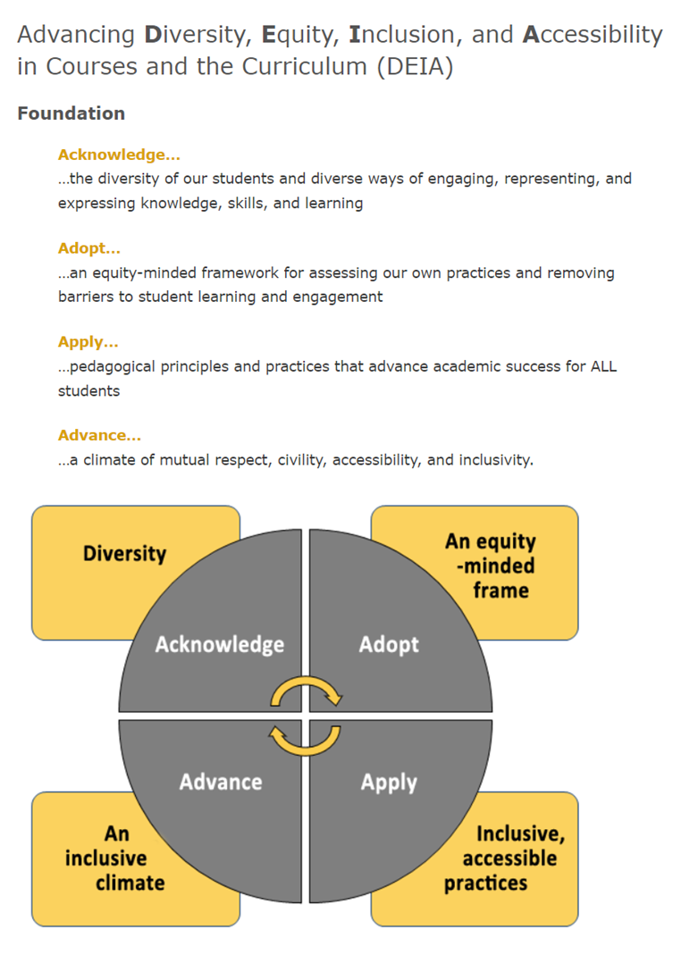
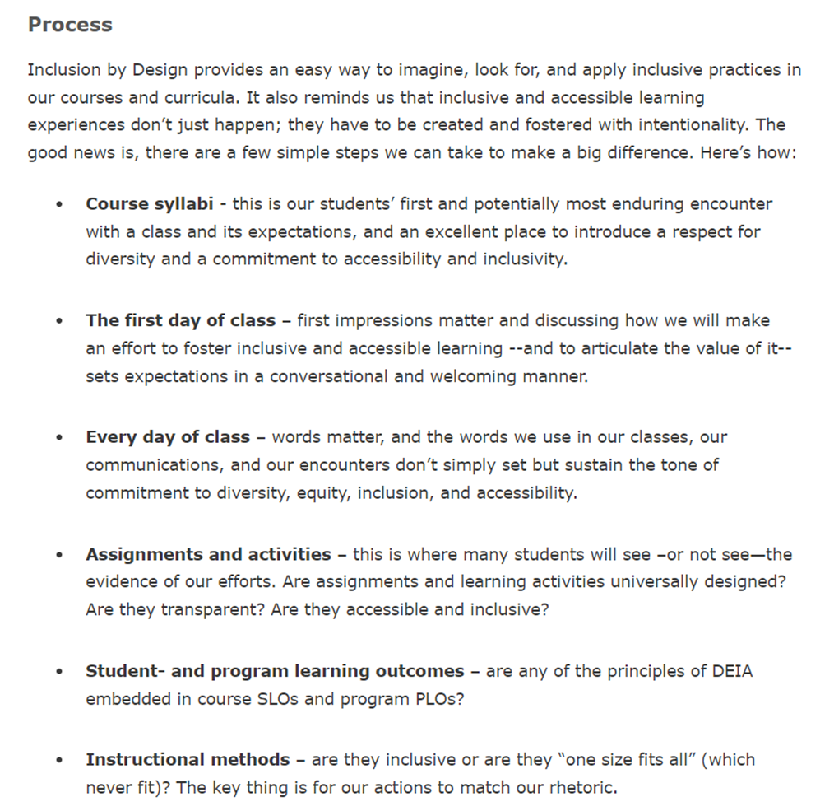

Slide 23
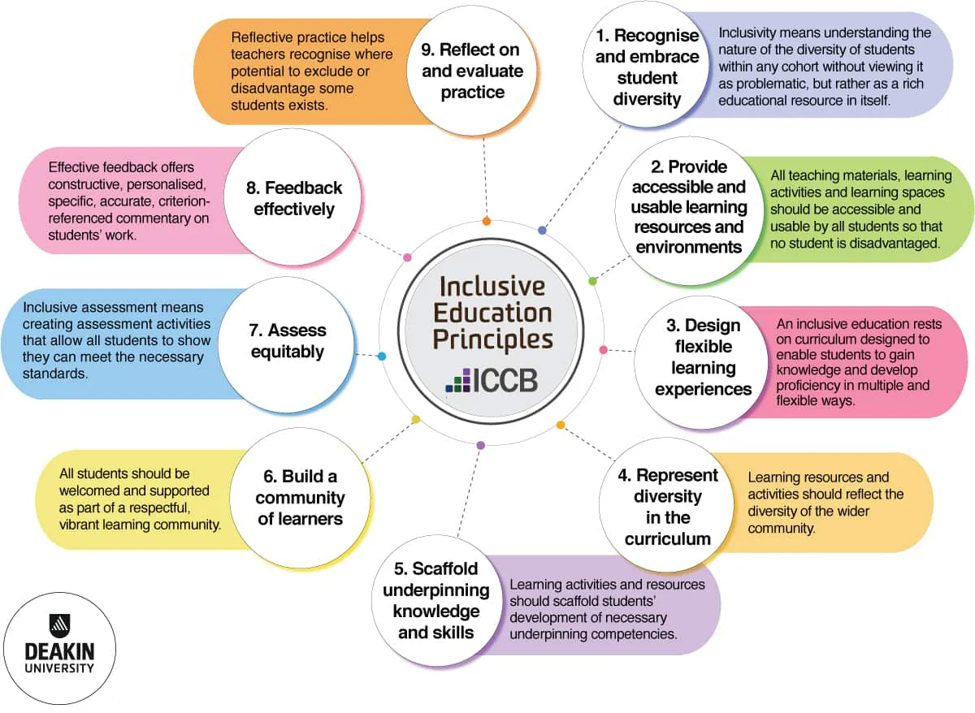

Slide 24
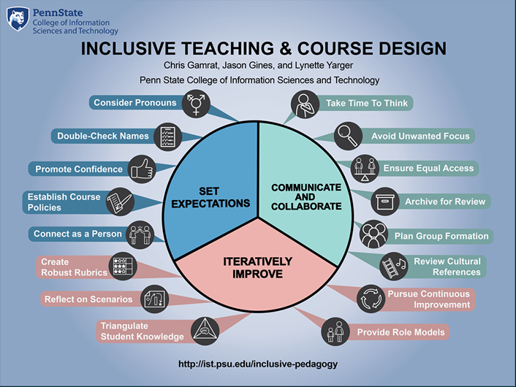

Slide 25
Exercise 3: Ticket out the Door
What’s one or two things you can now do in your class, or in your approach to teaching and learning, to make a difference?
Session 2 will build on this using the CIRTL Framework, and
Session 3 will provide a deeper dive into inclusive and equitable teaching strategies, with an emphasis on how to meaningfully integrate them into your classes.

Slide 26
Guides and Resources for Inclusive Teaching

Slide 27
Select CETL Inclusive Teaching and Learning Resources
The Value of Diversity (pdf)
Inclusive Pedagogy Slides (pdf)
Keeping My Class Inclusive: Diversity, Inclusion, and Universal Design Online (pdf)
Universal Inclusive Design Checklist (pdf)
A Quick Guide to Using Inclusive Language (pdf)
Microaggressions in the Classroom (pdf)
Inclusion By Design Syllabus Survey
CETL Repository for DEIA's Inclusion by Design
POD Network’s Key Resources
Tips on Designing Inclusive Learning Experiences
Universal Design for Learning (UDL) Resources
Inclusive Learning Experiences don’t just happen; they are made…carefully and with intentionality

Slide 28
Guides for Growth and Development
Becoming an anti-racist educator, Wheaton College
Center for Urban Education (CUE) Racial Equity Tools, University of Southern California
Diversity Toolkit: A Guide to Discussing Identity, Power and Privilege, Master of Social Work Program, University of Southern California
Faculty Toolkit on Digital Inclusion, Office of Global Inclusion, New York University
Inclusive Pedagogy, University of Chicago
Inclusive Teaching Practices, Office of Teaching & Learning, University of Denver
Inclusive Teaching Resources and Strategies, CRLT, University of Michigan
Teaching Race: Pedagogy and Practice, Center for Teaching, Vanderbilt University
Incorporating Diversity, Center for Teaching Innovation, Cornell University

