Slide 1
Learning through Diversity: A Pathway to Advancing Equitable Educational Experiences
UI PFF CIRTL Workshop, Session 6: Inclusion by Design
March 21, 2024
Brian Smentkowski, PhD
Founding Director, University of Idaho Center for Excellence in Teaching and Learning

Slide 2
Where we’ve been and where we’re going: The light at the end of the tunnel
5 Oct.
Learning-through-Diversity: What it is and why it Matters
The goal of this session is to establish the value of inclusive teaching and learning practices in higher education and to introduce key principles and practices that advance equitable learning experiences for all students.
26 Oct.
How the CIRTL Framework Advances Equitable Learning Experiences
This session integrates two Core Ideas of the CIRTL Network into a unified Framework for successfully integrating inclusive teaching and learning practices in higher education. This Framework encourages consideration of the kinds of evidence we can generate to see if our practices are working.
30 Nov.
Applied Strategies for Inclusive and Accessible Teaching and Learning
Developing an equity mindset & applied strategies for creating accessible, inclusive, and equitable learning experiences for diverse learners. Goals: making inclusive teaching second nature and exploring teaching strategies that work for you and your curriculum.
25 Jan.
Universal Design for Learning
This expert-led session focuses exclusively on UDL. Participants in this session will learn evidence-based practices for adapting, adopting, and integrating techniques that support multiple means of engagement, representation, and expression of knowledge.
15 Feb.
Culturally Responsive Pedagogy
Expert-led session focused exclusively on Culturally Responsive Pedagogy. Participants will develop insight into the role that culture plays in framing student presence, participation, and success, and strategies for identifying and navigating both multiple barriers to, and opportunities for, inclusive learning mindful of the impact cultural differences play in engaged learning.
21 Mar.
Inclusion by Design
By this stage, participants will have the tools necessary to think and act with intentionality. The goal of this session is to pull it all together and develop a blueprint for change. Participants will apply a simple but effective methodology for embedding inclusive teaching and learning principles and practices in all aspects of a class.
18 Apr.
Sharing
This conversational session is reserved for participants to share what they have learned, to answer any remaining questions, to seek input, and to share inspiration and tactics for making a difference in the learning and lives of their students.

Slide 3
Today’s goals
We are at that wonderful moment when we begin to see how all our work comes together.
We explored the depths, and now it is time to rise to the surface and think broadly about how we make learning through diversity an integral part of our every-day practice.
Recalling that:
LTD “…capitalizes on the rich array of experiences, backgrounds, and skills among…undergraduates and graduates-through-faculty to enhance the learning of all”;
Our goals are to:
Think about all aspects and artifacts associated with our teaching responsibilities.
This includes our mindset, presence, practices, policies, artifacts, and activities through a DEIA frame.
Before it becomes second nature, it has to be intentional; ergo, inclusion by design.

Slide 4
Inclusion by Design
Inclusion by Design provides an easy way to imagine, look for, and apply inclusive practices in our courses and curricula.
It also reminds us that inclusive and accessible learning experiences don’t just happen; they have to be created and fostered with intentionality.
The good news is, there are a few simple steps we can take to make a big difference.

Slide 5
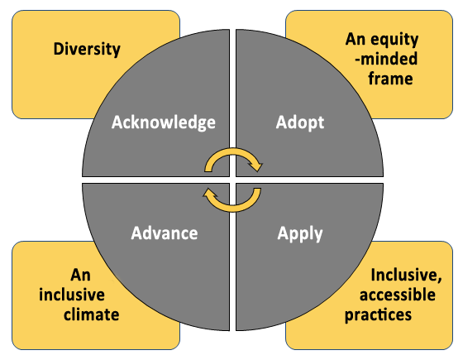
Building DEIA into our Practices, Courses, and Curriculum in Four Easy Steps
Acknowledge… …the diversity of our students and diverse ways of engaging, representing, and expressing knowledge, skills, and learning
Adopt… …an equity-minded framework for assessing our own practices and removing barriers to student learning and engagement
Apply… …pedagogical principles and practices that advance academic success for ALL students
Advance… …a climate of mutual respect, civility, accessibility, and inclusivity.

Slide 6
When, Where, and How?
Course syllabi - this is our students’ first and potentially most enduring encounter with a class and its expectations, and an excellent place to introduce a respect for diversity and a commitment to accessibility and inclusivity.
The first day of class – first impressions matter and discussing how we will make an effort to foster inclusive and accessible learning --and to articulate the value of it-- sets expectations in a conversational and welcoming manner.
Every day of class – words matter, and the words we use in our classes, our communications, and our encounters don’t simply set but sustain the tone of commitment to diversity, equity, inclusion, and accessibility.
Assignments and activities – this is where many students will see –or not see—the evidence of our efforts. Are assignments and learning activities universally designed? Are they transparent? Are they accessible and inclusive?
Student- and program learning outcomes – are any of the principles of DEIA embedded in SLOs and PLOs?
Instructional methods – are they inclusive or are they “one size fits all” (which never fit)?
The key thing is for our actions to match our rhetoric.

Slide 7
Revisiting what matters
Part 1: Pause, think, reflect, and write:
What LTD topic interests you the most?
Why?
How can it be addressed in your class or lab?
Can you frame it as a TAR question?
What kind of question is it?*
What is?
What might work?
A vision of the possible?
What is the problem it is intended to solve?
Why does it matter?
Part 2: Report out
My name is ________ and I am interested in ________, because ________.
In my ________ class, I want to ________ to see if ________.
This is important because it addresses and potentially solves the problem of _________________.
*Consider Pat Hutching’s taxonomy of questions, viewable here:
https://www.centerforengagedlearning.org/studying-engaged-learning/asking-inquiry-questions/.
Notes:
Part 1: 3 minutes. Part 2: 10 minutes.

Slide 8
Mapping it Out
Part 1: Developing your blueprint
Part 2: Refining it –prompt for final session
Aside from every-day practices –mindfulness, awareness, presence, appreciation, actions– and artifacts –the syllabus, assignments, feedback, interactions…
What is ONE BIG THING you will do in your classes to make them more accessible, equitable, and inclusive?
How will you monitor it and see if it works?
Write, draw, map –whatever helps– here.

Slide 9
Reference Points
Reminders

Slide 10
Additional Resources
CETL has an abundance of resources, guides, and materials to help you develop, adopt, or adapt syllabi statements, teaching practices, and communication strategies that can make a big difference in the learning and lives of our students.
Visit our website, or contact me or our UDL Instructional Designer, Jen Elbek to learn more!
Inclusion By Design Syllabus Survey
CETL Repository for DEIA's Inclusion by Design
Leading Faculty Development Network’s Key Resources
UofI CDAR’s Resources
Tips on Designing Inclusive Learning Experiences
Universal Design for Learning (UDL) Resources

Slide 11
Concluding thoughts and words of encouragement
Remember that LTD “…capitalizes on the rich array of experiences, backgrounds, and skills among…undergraduates and graduates-through-faculty to enhance the learning of all”.
It empowers us to engage in mindful, reflective pedagogical practices that enhance inclusive, equitable, and accessible learning experiences.
It helps us become reflective scholarly teachers, which gives joy and meaning to our work throughout our lifetime.

Slide 12
Thank You!

