Slide 1

Notes from a Basically Applied Scientist
24 Jan 2012
Sanford Eigenbrode
Professor of Entomology

Slide 2
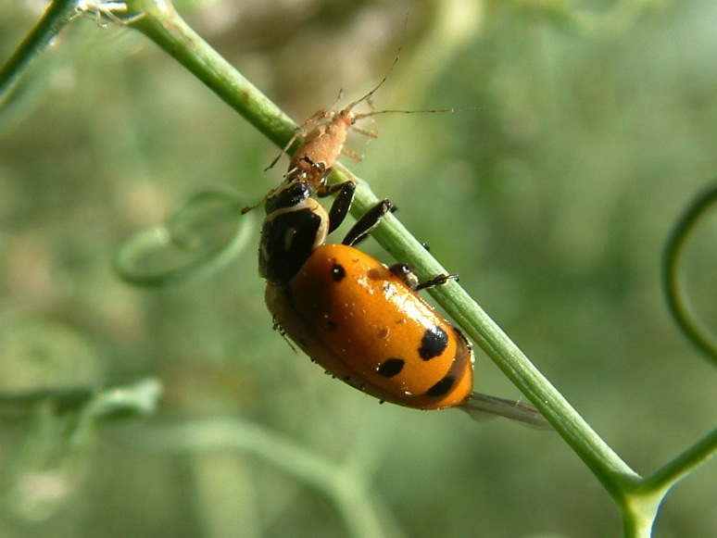
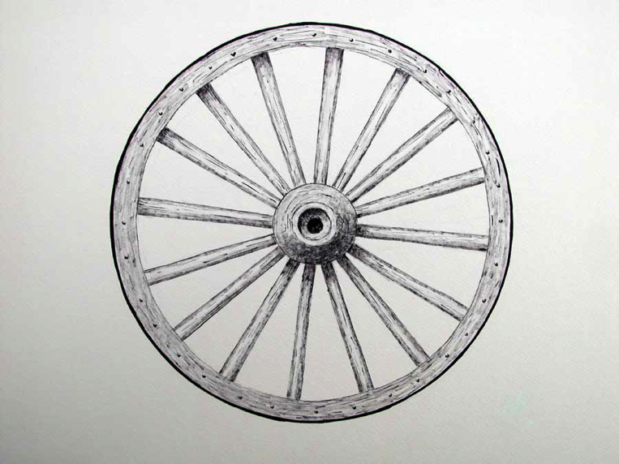
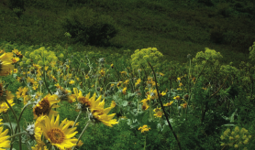
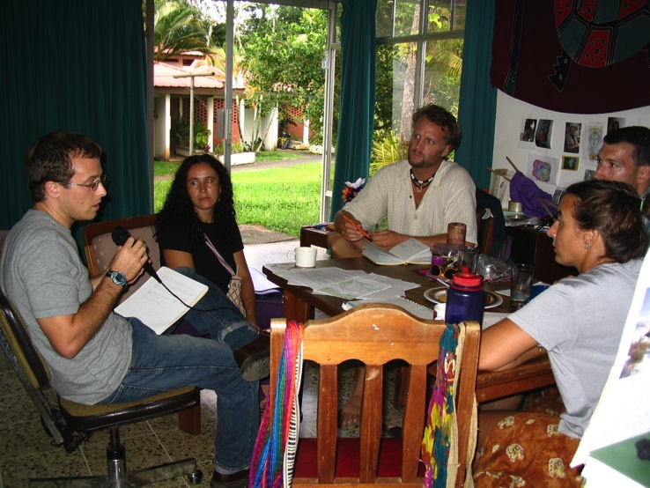
Basic
Applied
Basic
Applied
Applied
Basic
Applied
Basic
Basic
Applied
Basic
Applied
Applied
Basic
Applied
Basic
Basic
Applied
Basic
Applied
Head
Heart
Head
Heart
Heart
Head
Heart
Head
Head
Heart
Head
Heart
Heart
Head
Heart
Head
Head
Heart
Head
Heart

Slide 3
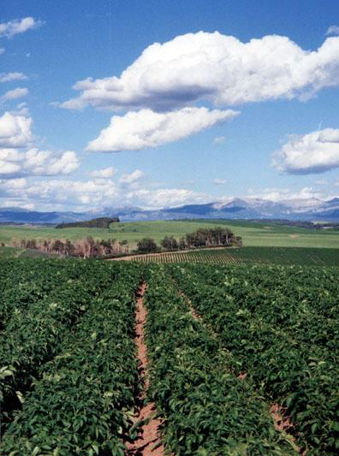
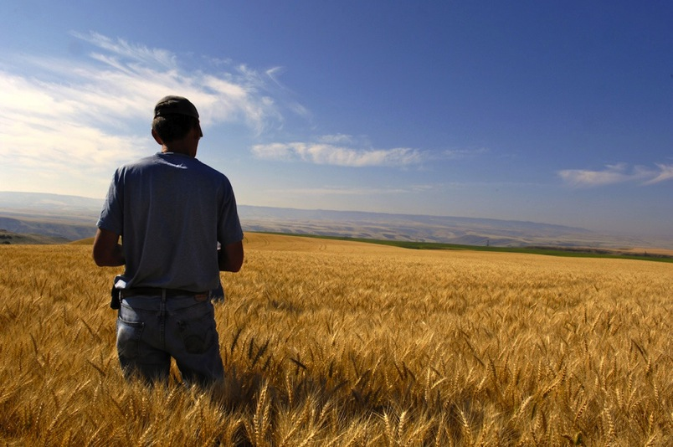
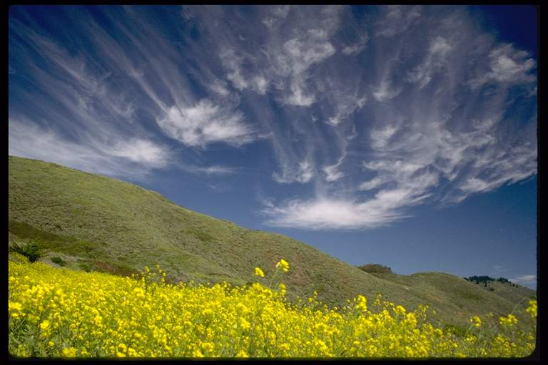
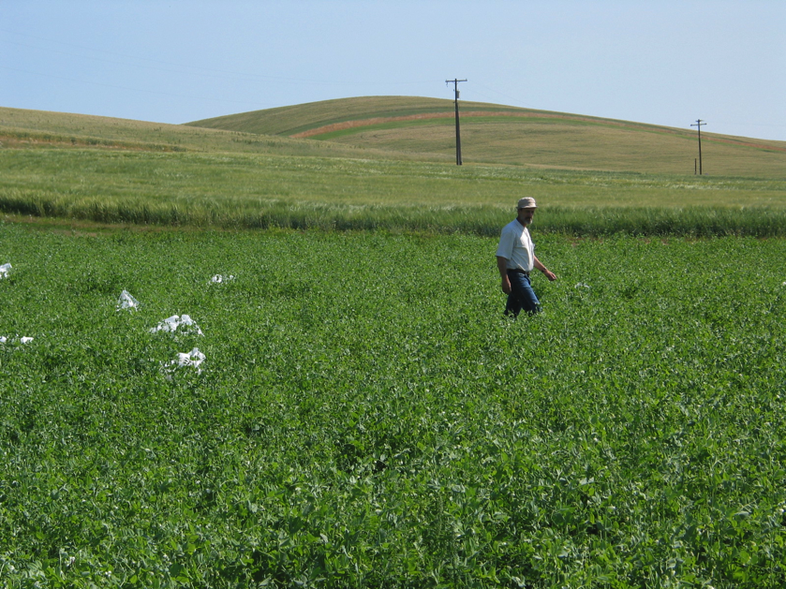

Slide 4
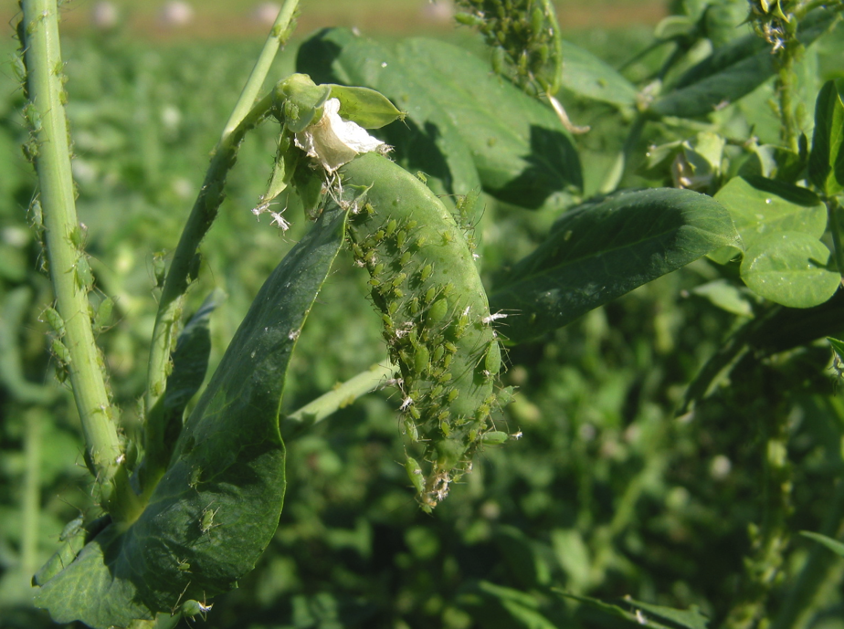
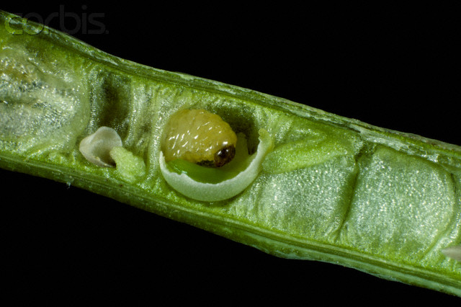
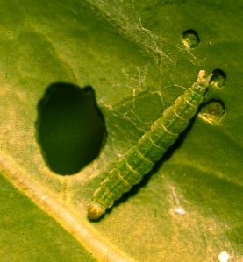
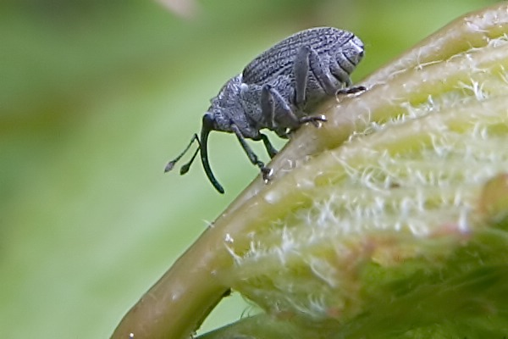

Slide 5
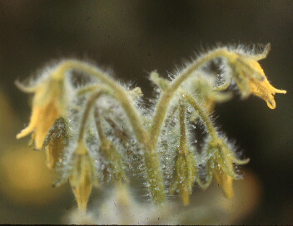
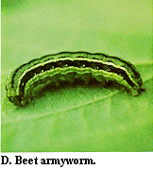
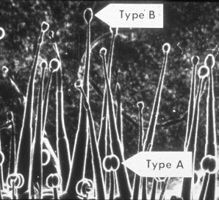
Host Plant Resistance to Insect Pests
Glandular trichomes on wild tomato spp.

Slide 6
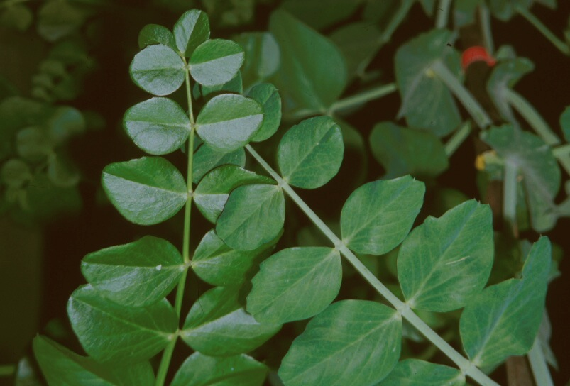
Biological Control and Host Plant Breeding

Slide 7
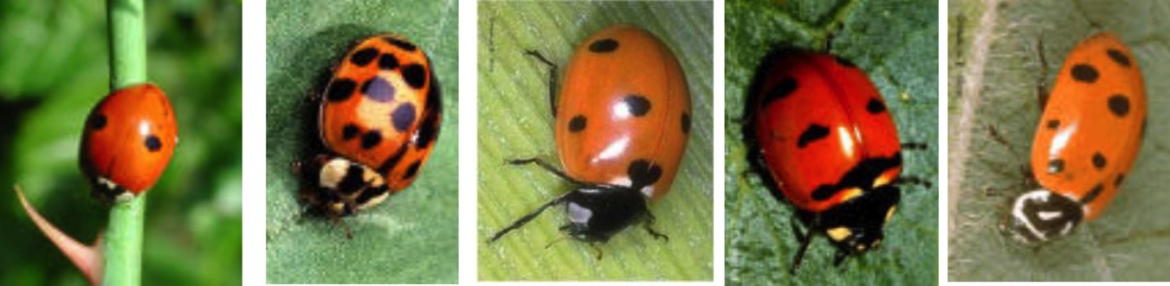
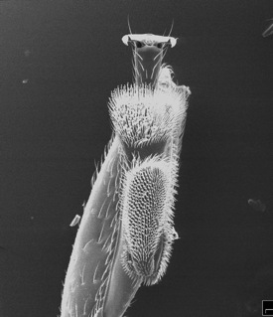
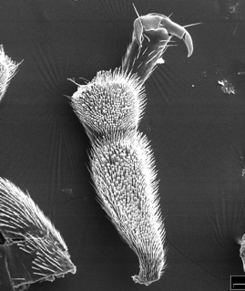
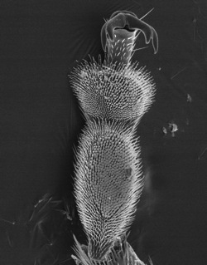
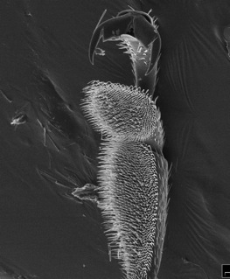
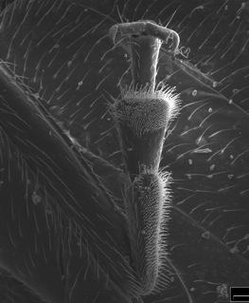
A. bipnct. | H. axyr. | C. sept. | C. trans. | H. conv
Eigenbrode et al. 2009

Slide 8
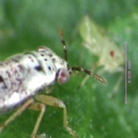
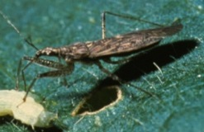
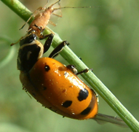
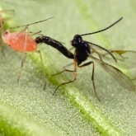
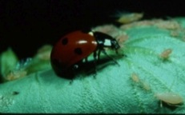
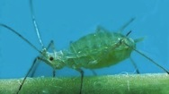
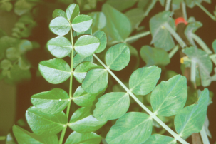
Plant Phenotype and the Insect Community
Geocoris
pallens
Nabis
alternatus
Hippodamia
convergens
Coccinella
septempuncata
Aphidius ervi
Acyrthosiphon pisum
Northfield, Eigenbrode, Snyder 2012 (Ecology)
Pisum sativum
Notes:
List general potential niche differences:

Slide 9
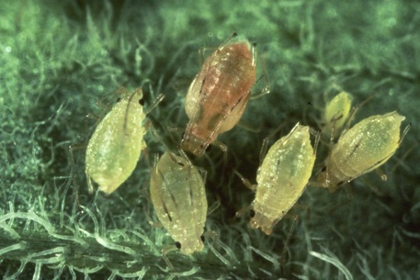
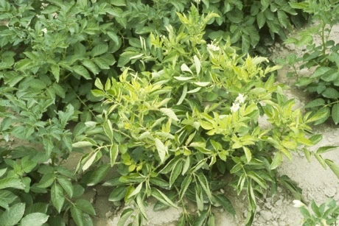
Plant Virus Infection and Vector Behavior
Illustration: Kerry Mauck

Slide 10
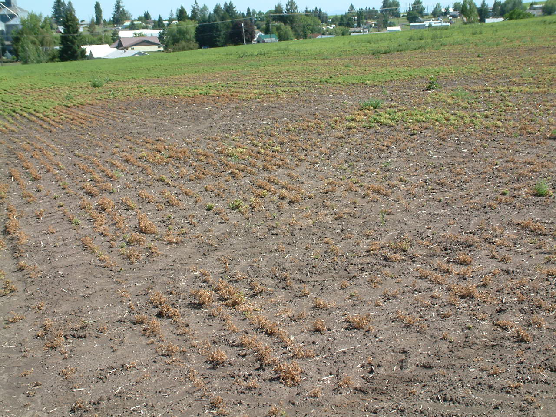

Slide 11
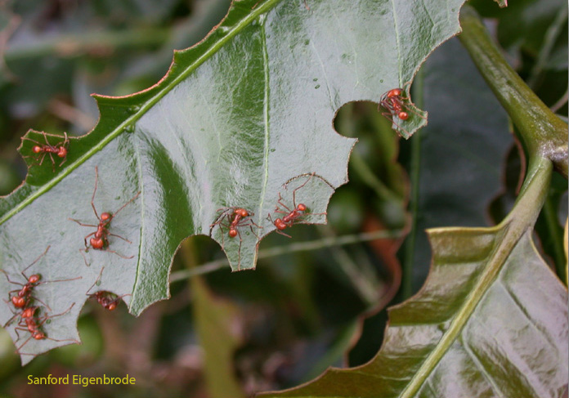

Slide 12
Basic and Applied
Basic science (fundamental, pure) - motivated by curiosity
Applied science - designed to answer specific questions (solve problems)
Notes:
The reason why this can be examined in light of the wheel, is that the distinction highlights the different promises and motivations of science, one class of which is deeper understanding of nature and the cosmos. An intellectual pursuit but one rooted in wonder.

Slide 13
Basic and Applied
Socrates: Shall we set down astronomy among the subjects of study?
Glaucon: I think so, to know something about the seasons, the months and the years is of use for military purposes, as well as for agriculture and for navigation.
Socrates: It amuses me to see how afraid you are, lest the people should accuse you of recommending useless studies.
  Plato’s Republic

Slide 14
Applied
Basic
FEEDSTOCK MODEL

Slide 15
Applied
Basic

Slide 16
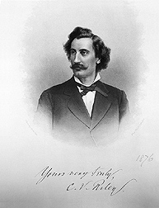
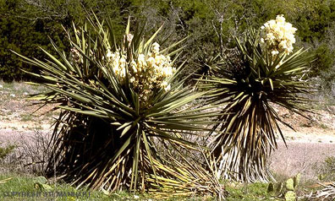
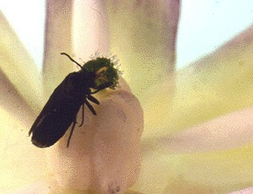
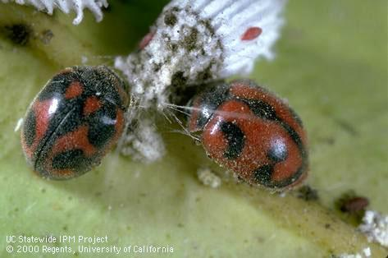

Slide 17
Applied
Basic

Slide 18




Collaboration and Integration
UI NSF-IGERT Projects

Slide 19

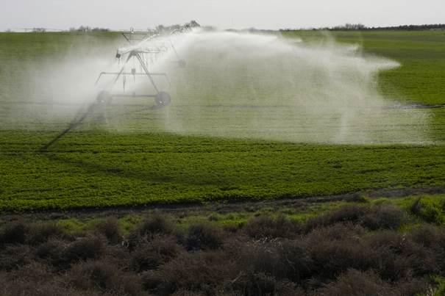
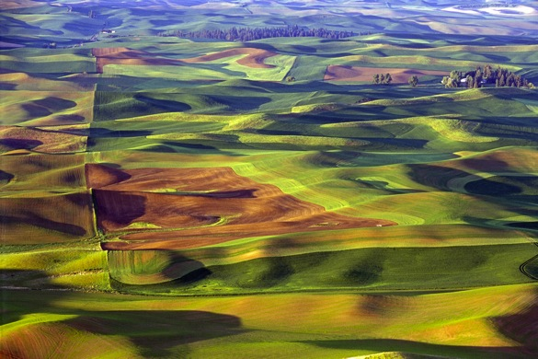
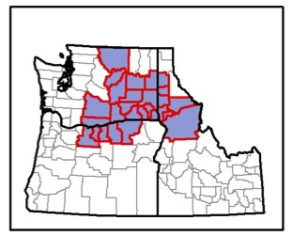
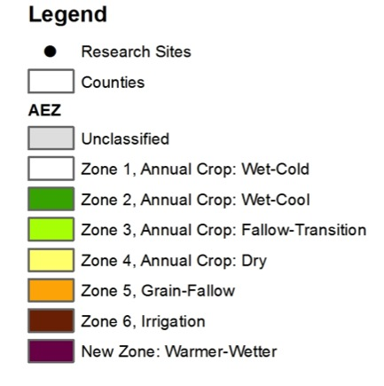
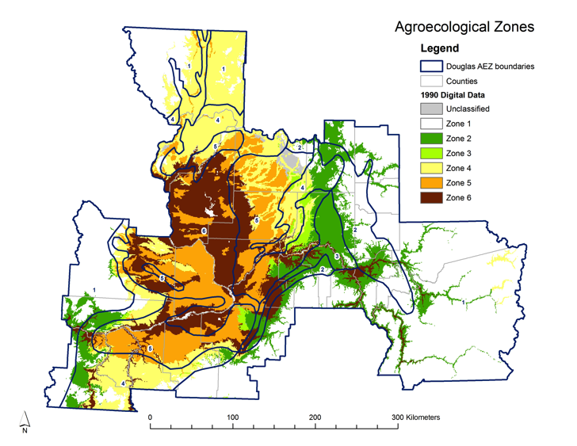
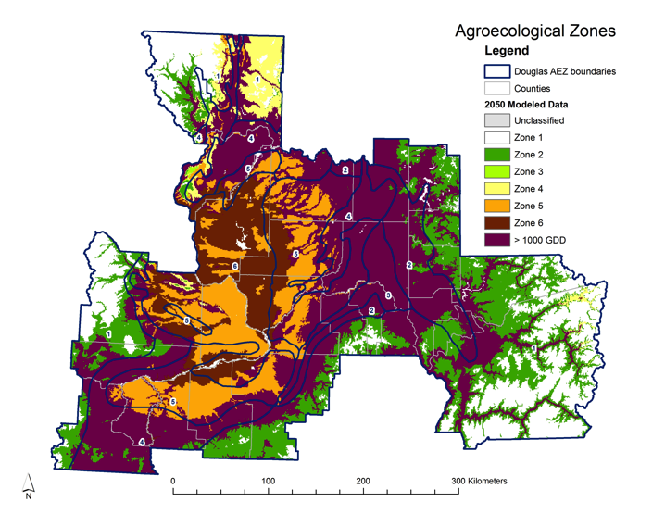
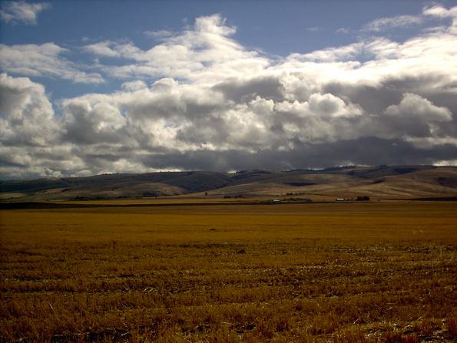

Notes:
Agroecological Zones (AEZ) of the inland Pacific Northwest Region are the focus of the ACCPNA. Zonation is based on data from WorldClim Global Climate Data (http://worldclim.org) with criteria for delineation after Douglas et al. (1990). Predominant cropping systems are based on production records and observation. Projection for 2050 was generated from the Canadian Centre for Climate Modeling and Analysis global climate model with the A2 emission scenario for CO₂ and climate surface interpolation (Hijmans et al. 2005). Locations of experiment stations for long-term ACCPNA trials are indicated.

Slide 20
Project Integration
Extension
Education
Stakeholder Committee
Geospatial
Framework
K-12 Teacher Engagement
Diverse Delivery Platforms
Team-Based Graduate Ed.
Cross-Project Specialist
Stakeholder Data Collection
Minority Involvement
Research
Integrated Theoretical Framework
Economic
Cropping Systems
Climate
Monitoring and Experiments
Baselines and Monitoring
Alternative Cropping Systems
Social and Economic
Pests, Weeds, Diseases

Slide 21
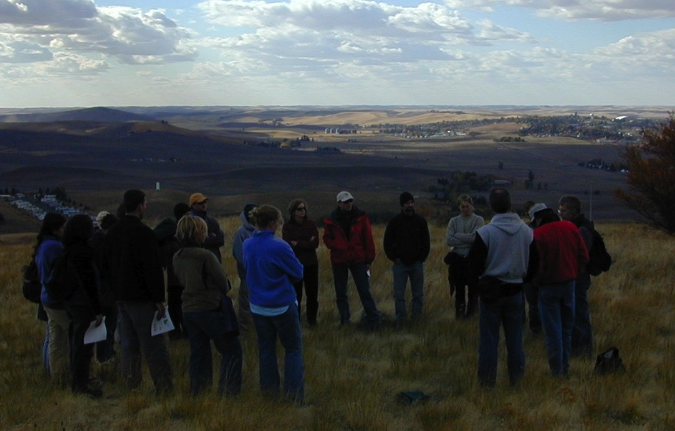
UI IGERT project 2001-2008, 2009-2015
Sociologist
Mammalian ecologist
Bird ecologist
Entomologist
Botanist/geneticist
Social scientist
Forest ecologist
Fish Ecologist
Entomologist
Forester
Tree physiologist

Slide 22
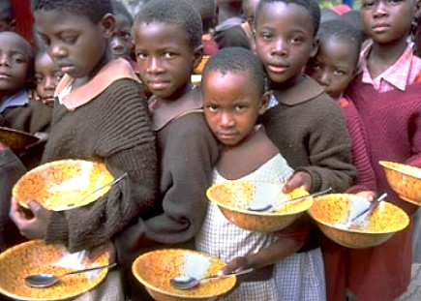
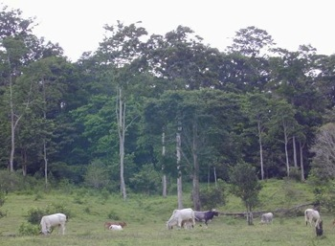
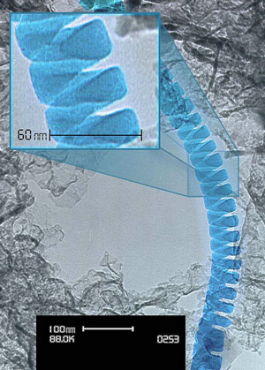
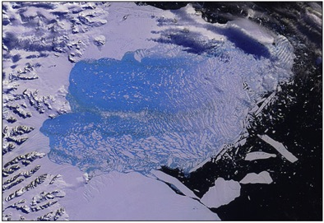
Calls for Interdisciplinary Work
The need to solve societal problems
The inherent complexity of nature and society
The power of new technologies
The desire to explore new sythesis
– Facilitating Interdisciplinary Research, NAS, p. 40

Slide 23
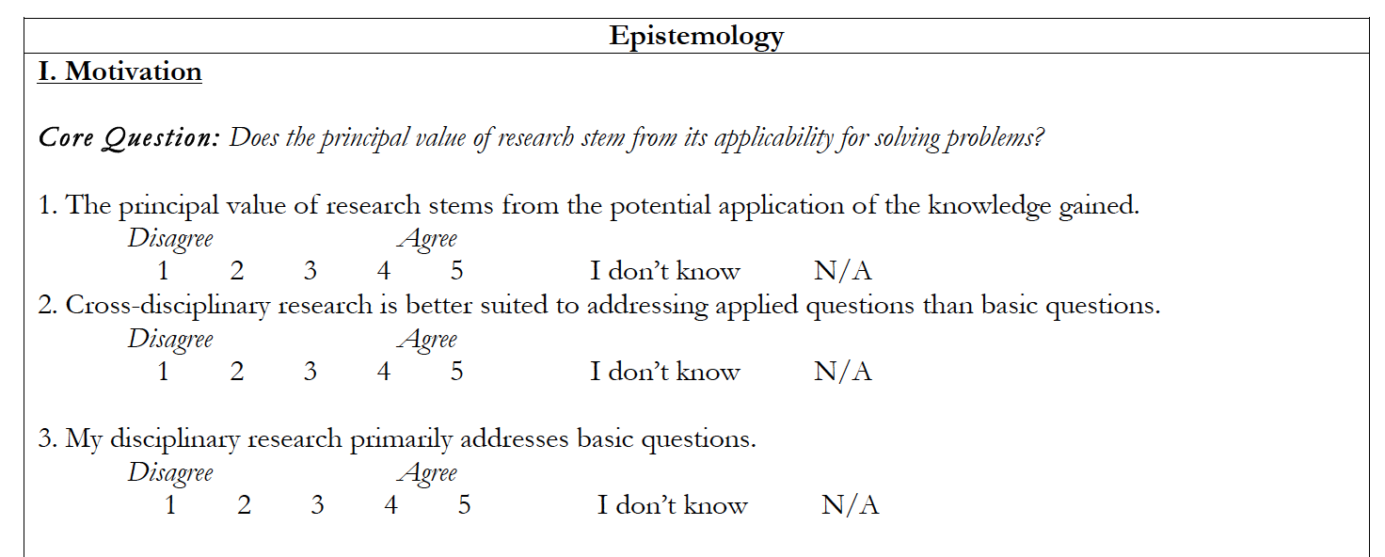
The Toolbox Workshop

Slide 26
Cross-disciplinary work is better suited to addressing applied questions (n = 120)

Slide 27


“…the network of relationships linking the human race to itself and to the rest of the biosphere is so complex that all aspects affect all others to an extraordinary degree.
…no gluing together of partial studies of a complex nonlinear system can give a good idea of the behavior of the whole. ”
“The world of the quark has everything to do with a jaguar circling in the night.”

Slide 28
The Potential for Broader Integration
“Skepticism and wonder [are the]…the two uneasily cohabiting modes of thought that are central to the scientific method” –Carl Sagan
“Science is as much an inner path … as it is a discipline aimed at accumulating knowledge of the physical world.” - J. W. von Goethe
Anschauung – wonder through looking
Notes:
The arousal of the feeling of wonder through contemplative looking (Anschauung)
EVEN CROSS-DISCIPLINARY SCIENCE, OFTEN VIEWED AS THE PRAGMATIC REQUESITE FOR ADDRESSING COMPLEX APPLIED PROBLEMS WILL BE (MAX NEEF, OTHERS) A MEANS FOR DISCOVERY, PERHAPS A NEW KIND OF DISCOVERY CONCERNING THE HUMAN CONDITION, ACROSS THE BOUNDARIES OF THE THREE WORLDS OF BIOPHYSICAL REALITY, SUBJECTIVE EXPERIENCE AND SOCIAL CONVENTION AND IDEA (POPPER, ECCLES, HEISENBERG)
ic is a manifestation of the Head and Heart balance. The pure delight in understanding the mysterious or even in knowing enough to be awestruck by nature again and again and again. Is our basic science devotion? It is of course about the “head”, but the heart as well.
Werner Heisenberg, one of the fathers of quantum physics, suggested that there is actually no conflict between accepting Goethe’s way of contemplating nature, and the contributions and findings of modern physics. For him both ways are complementary instead of opposites (Heisenberg, 1952)

Slide 29

Phaedole humida

Slide 30
The Potential for Broader and Deeper Integration?
Are we at a stage where “we know very much, but understand very little”? (Manfred Max Neef 2005)
And can we address that through broader, more innovative collaborations?

Slide 31


The Potential for Broader and Deeper Integration?
Closer collaborations between sciences, humanities and the arts
Notes:
EVEN CROSS-DISCIPLINARY SCIENCE, OFTEN VIEWED AS THE PRAGMATIC REQUESITE FOR ADDRESSING COMPLEX APPLIED PROBLEMS WILL BE (MAX NEEF, OTHERS) A MEANS FOR DISCOVERY, PERHAPS A NEW KIND OF DISCOVERY CONCERNING THE HUMAN CONDITION, ACROSS THE BOUNDARIES OF THE THREE WORLDS OF BIOPHYSICAL REALITY, SUBJECTIVE EXPERIENCE AND SOCIAL CONVENTION AND IDEA (POPPER, ECCLES, HEISENBERG)
Werner Heisenberg, one of the fathers of quantum physics, suggested that there is actually no conflict between accepting Goethe’s way of contemplating nature, and the contributions and findings of modern physics. For him both ways are complementary instead of opposites (Heisenberg, 1952)

Slide 32

The Potential for Broader and Deeper Integration?

Slide 33



“All the spokes are needed.”
Notes:
“All the spokes are needed”

