Slide 1
Social Justice and Feminist Leadership:
Sharing the Unique Perspectives and Universal Concepts
Heather Shea Gasser, Director, Women’s Center

Slide 2
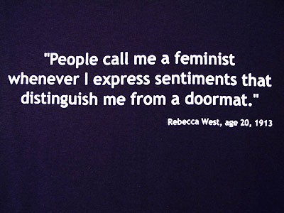

Slide 3
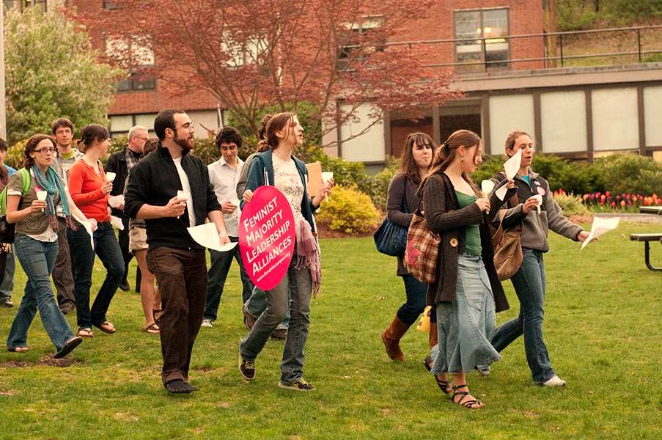
“Am I a feminist?”
“It’s a question I’ve dodged many times. This avoidance only adds to the reasons I should become more aware. I know the stereotype that goes along with the ‘feminist’ label. I’m not an extreme person, but I realize that gender seems to play an unnecessary role in too many facets of my life. It angers and then confuses me when I think of this and all the cues that are so ingrained into our culture for me to notice.”
College Student quoted in Gmelch (1998) “Gender on Campus”

Slide 4
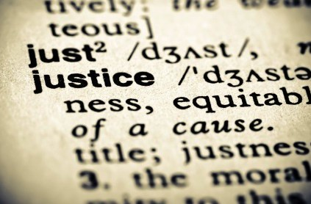

Slide 5
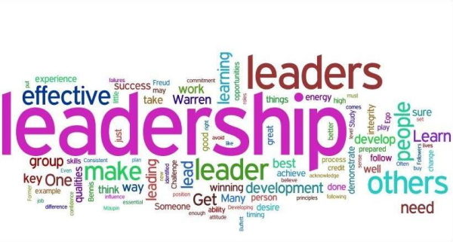

Slide 7
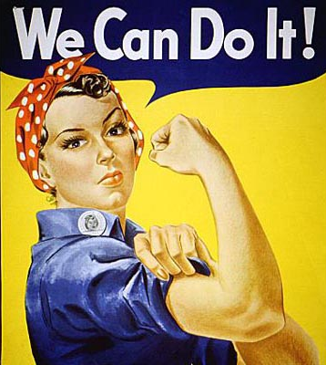

Slide 8
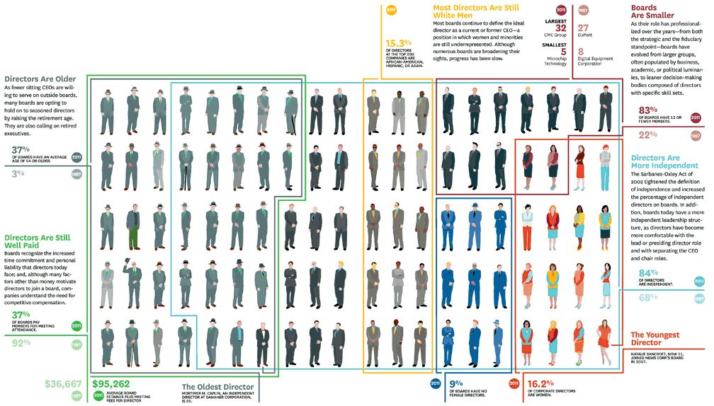

Slide 10
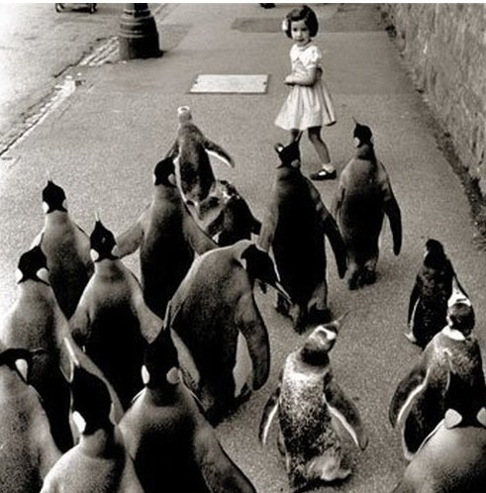

Slide 11
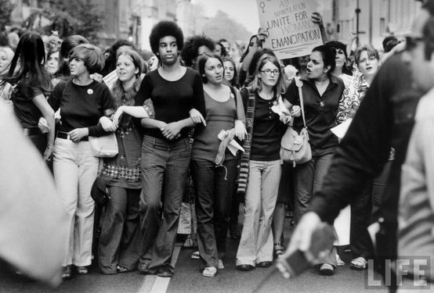

Slide 12
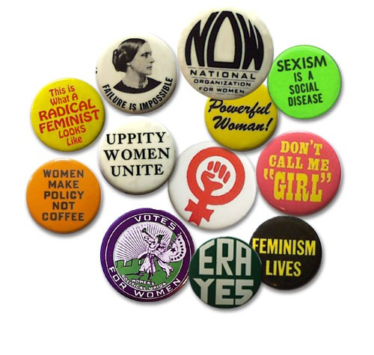

Slide 13
“Everyone’s
presence
and participation
must be valued.”
~ bell hooks

Slide 15
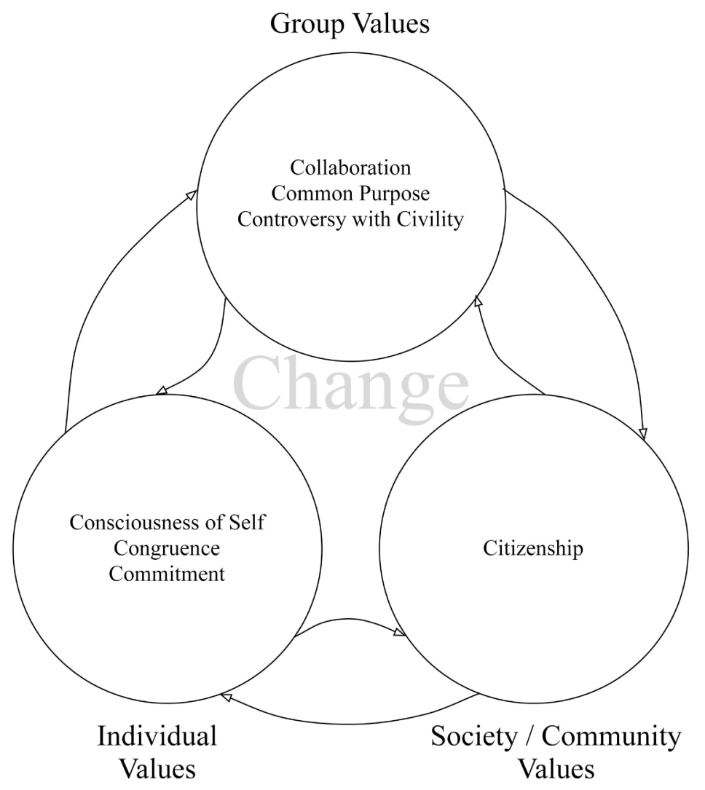
Social Change Model of Leadership Development
Komives S. R. & Wagner, W. (2009). “Leadership for a Better World: Understanding the Social Change Model of Leadership Development”

Slide 16
Relational Leadership Model
Komives S. R., Lucas, N., & McMahon, T. (2006) “Exploring Leadership : For College Students Who Want to Make a Difference”

Slide 17
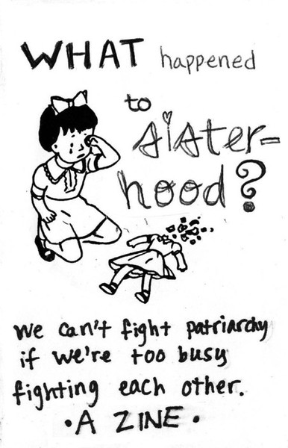

Slide 18
Relational Leadership Model
Komives S. R., Lucas, N., & McMahon, T. (2006) “Exploring Leadership : For College Students Who Want to Make a Difference”

Slide 20
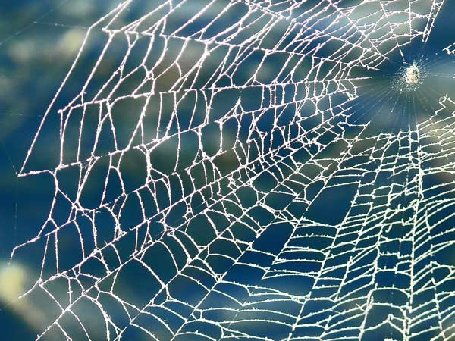

Slide 22
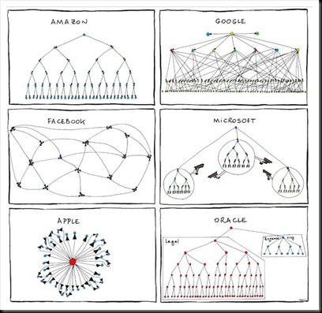

Slide 26
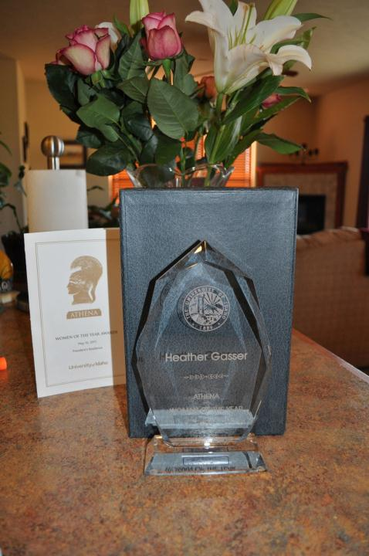
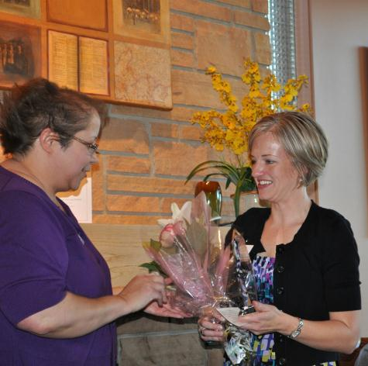

Slide 27
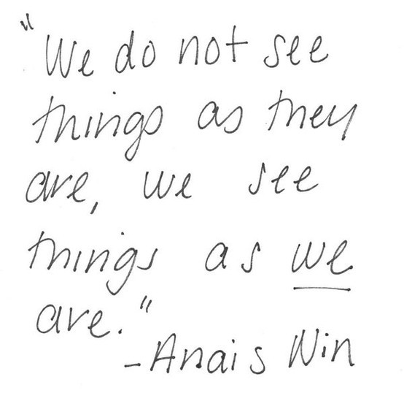

Slide 28
