Slide 1
The International Community Looks for . . . Community?
Bill L. Smith, Ph.D.
Director, Martin Institute
Renfrew Interdisciplinary Colloquium, 6 March 2012

Slide 2
Origins at the University of Idaho
Boyd and Grace Martin, 1979

Slide 3
The “Unique” in the Int’l Comm.

Slide 4
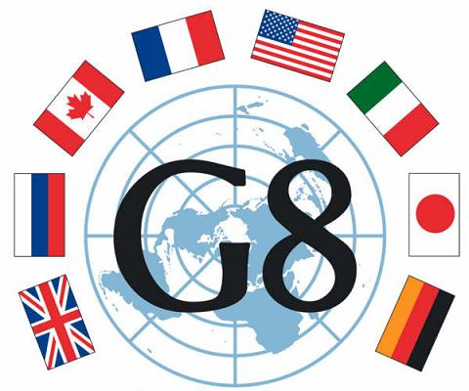
Idea 1: It Depends . . .
A Global construct?
The Powerful west?
“The” United Nations
The US and Its Allies
The Security Council? The General Assembly?
The G20? The Group of 77? The EU?

Slide 5
Idea 2: It’s Complicated . . .
Peacekeeping (1948)
The Responsibility to Protect (2005)
Libya -> check, and a pat on the back
Syria -> well . . .
Also: Nuclear Technology, Genetically Modified Crops, Intellectual Property Rights, Migratory Fish Stocks, Disaster Preparedness and Relief, International Criminal Court, Laws of the Sea, Free/Fair Trade, Corporate Social Responsibility, Rights for Migrant Workers, Rights of the Child, Piracy, Religious Intolerance, Refugees, Etc.

Slide 6
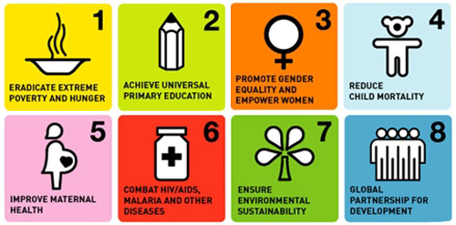
Idea 3: It’s Optimistic . . .

Slide 7
The International Community Is, or Isn’t, Depending Upon the Issue
Questions?

